Slide 1
George Mason
District Roundtable
April 8, 2021

Slide 2


Slide 3
Council Update

Slide 4


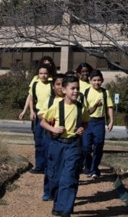

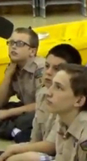

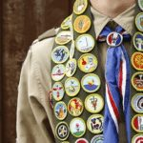
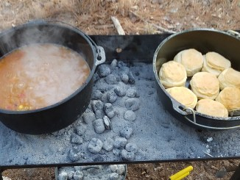
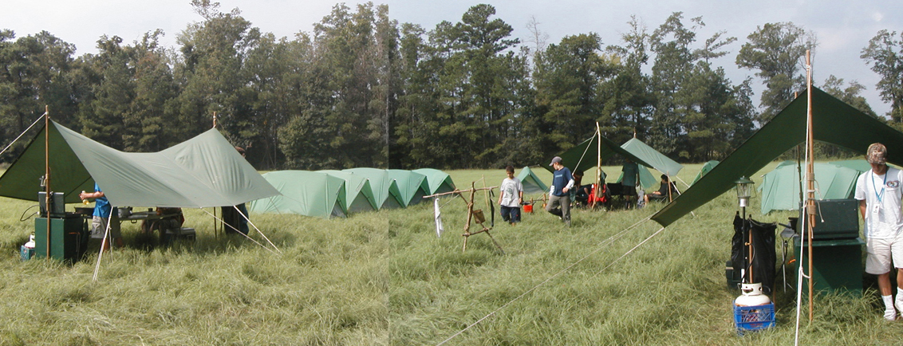
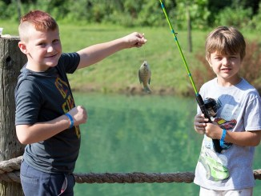
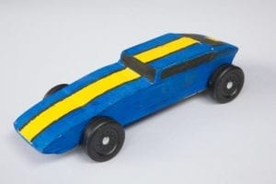
George Mason Program
Matt Burns, Vice Chair Program
Teralyn Carlson, Deputy Vice Chair
George Mason District

Slide 5

Current 2020-2021 GM Calendar
April 11-24, 2021 – District Merit Badge Event
April 30 to May 9, 2021 – District Hike-O-Ree
May 8, 2021 – Jamboree on the Trail
May 31, 2021 - Memorial Day Flags In

Slide 6
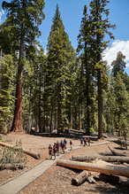
George Mason Hike-O-Ree 2021
Challenge – See if George Mason District Scouts/Scouters, family & friends can, collectively, total 2,021 miles. Participating units earn a ribbon.
Why – Good socially-distanced exercise one of any age can do while enjoying our wonderful outdoors. Keep youth engaged.
Who – Units (Packs, Troops, Crews) organize own activity, total unit hike, den/patrol hikes or family hikes. Your choice. Follow all Scout safety requirements.
When – Any hikes between 4/30 and 5/9/21 qualify. Hikes on May 8 also qualify for Jamboree on the Trail.
Where – Hike anywhere and keep track of mileage. Neighborhood, school track, park (local, state, national) or other, safe place.
How – Recruit a unit POC to collect mileage of unit members. After 5/9, e-mail unit number and mileage totals to Matt Burns (burnsmj509@gmail.com). Matt will publish total and distribute unit ribbons.

Slide 7
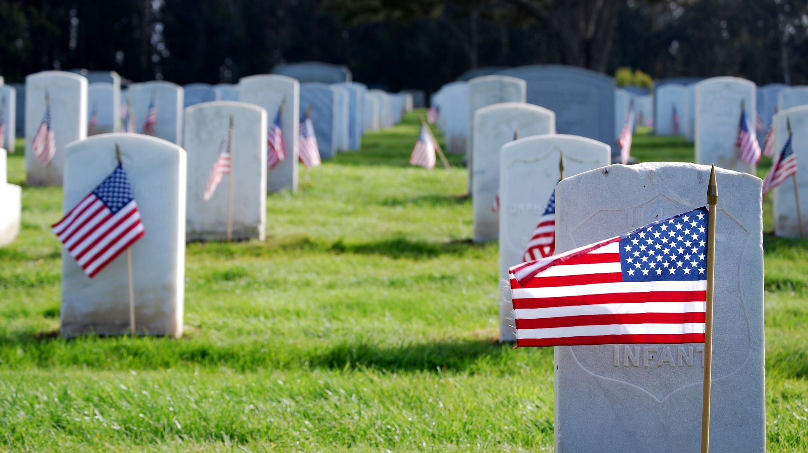
Flags In
May 31, 2021
Flag placement will start at 10:00 am
Social distancing – bring a mask.
National Memorial Park, 7482 Lee Highway, Falls Church
All Scouts, including Girl Scouts, are welcome.
Class A Uniforms
For more info, contact Russell Pittman at ruspittman@gmail.com.

Slide 8
Civic and Related Activities of Interest to Scouts
Dyke Marsh Sunday Morning Bird Walks – 8:00 a.m. on Sundays. Hikes led by experienced birders. See website.
Fairfax City Fitness Challenge (3 April to 29 May). Register any time.
Great Falls Park – FREE Admission (April 17) Kick-Off to National Park Week/National Junior Ranger Day. See website.
Lakeside Explorers (April 22) – Burke Lake hosts newest nature club for youth (7 to 11 years old). Cost is $32 per child for four weeks. See website.
Huntley Meadows Monday Morning Birdwalks (start May 3) 7:00 a.m. on Mondays, rain or shine. Good activity for the summer vacation that could count for Cub Outdoor Activity Award.
Viva Vienna (May 29-31) – Rotary Club will be updating Vienna Town Council next week regarding plans for possible event. If it happens, it will be smaller and socially-distanced.
Fairfax City Fido Fest (June 12) activities and demonstrations. See website.
Fairfax City Independence Day (July 3) – Daytime parade popular with Cubs. Other daytime events and evening fireworks.

Slide 9
SCOUTS BSA Roundtable

Slide 10
2021 District Merit Badge Event
April 11 to the 24th using Zoom. Classes meet twice a week for two weeks (four sessions).
Each class will consist of MB Counselor, second registered adult and 15 Scouts. Corsizio registration will be close on April 9, 2021.
Merit badges offered will include:
  Public speaking
  Electricity
  Emergency Preparation
  Citizenship in the World
  Family Life
Feedback to John Drisco at gmasonmeritbadgeday@gmail.com

Slide 11
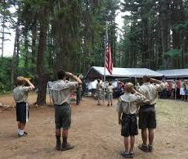
Future Camporees
Save the Dates!!!
George Mason Spring 2022 Camporee – April 29 – May 1, 2022
  Theme and Site TBD
George Mason Fall 2022 Camporee – October 21 – 23, 2022
  Theme and Site TBD
Please factor this into unit calendars/planning.
Scouts are loyal – including loyalty to District activities.

Slide 12
GM High Adventure
(March 2021)
NCAC High Adventure Committee (HAC) updates and announcements: https://www.ncacbsa.org/high-adventure/
  2021 NCAC High Adventure vacancy information: email ragollhofer@acm.org
  Local day hikes, overnight, and multi-day treks: https://3.basecamp.com/3958009/buckets/16000091/uploads/3272427444
  Wilderness First Aid vendors: https://public.3.basecamp.com/p/6cocPGgDnFSAy5nWMnTfPMzu
For those units planning summer 2021 HA trips:
Keep up the day hikes; schedule mandatory training as soon as it becomes available; schedule mandatory physicals; keep ahead of training checklists.
Be prepared to conduct full-crew, full-weight overnight shakedown trips as COVID guidance evolves in coming weeks.
Contact Joe Knecht at knechtjoe@yahoo.com if there are any issues accessing documents or you have questions regarding high adventure planning.

Slide 13
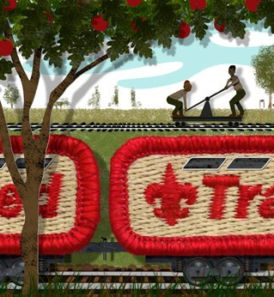
Training
Unit Training – For position-specific training at your unit, contact Roy De Lauder at EagleScout.Roy@cox.net or go to Training Opportunities page on GM Web Site.

Slide 14
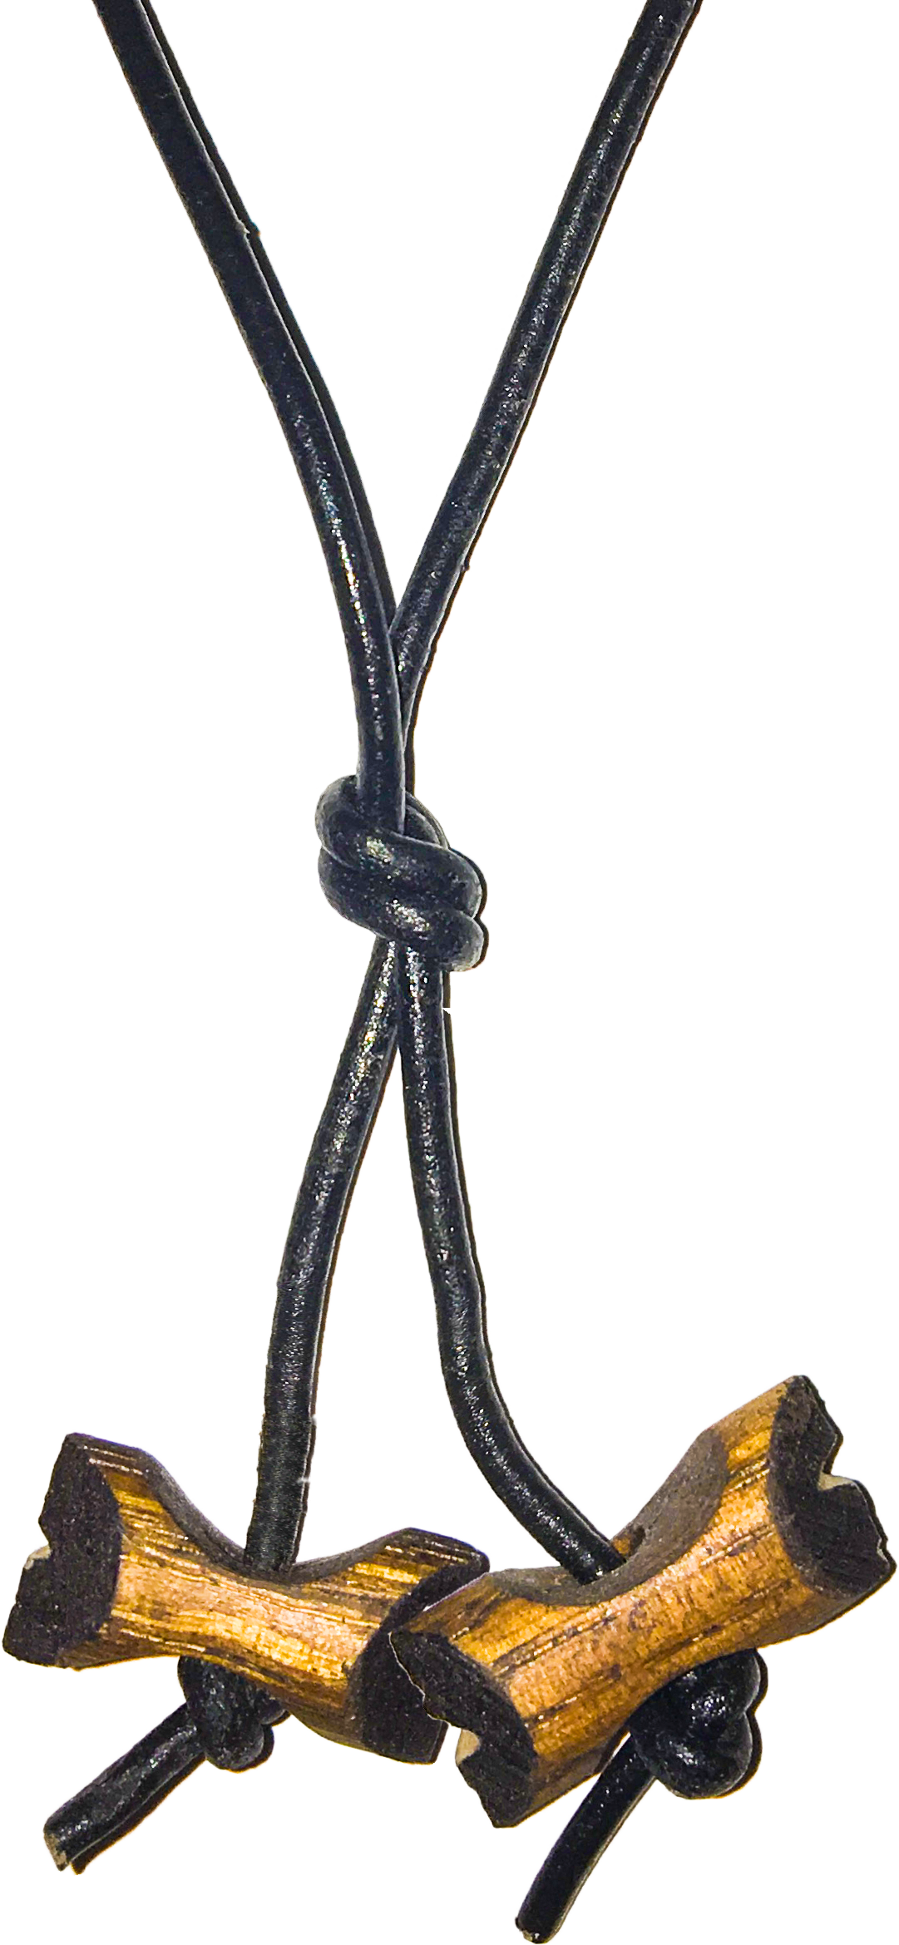
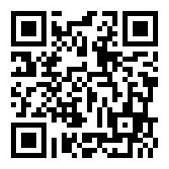
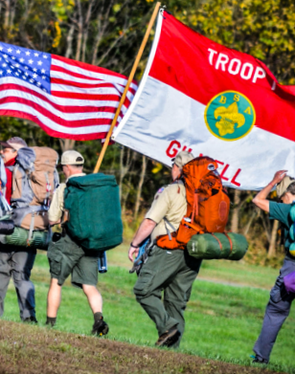
Wood Badge Registration NOW Open
Spring Course
Register at: https://scoutingevent.com/082-42945
Weekend #1: 30 April - 2 May
Weekend #2: 5 - 6 June
Course Director: Mr. Chris Geiger
geigercj@gmail.com
Fall Course
Registration Open 1 May, 2021
Weekend #1: 10 - 12 September
Weekend #2: 9 - 10 October
Course Director: Mrs. Alexandria Keenan
ADLKeenan@gmail.com
Wood Badge could be postponed or delayed based on covid restrictions
Wood Badge is the Boy Scouts of America’s ultimate leadership training designed to meet the advanced leadership needs of Scouters in all aspects of the BSA, whether unit, district, or council level – from assistant den leaders to Scoutmasters, from Cubmasters to Venturing Advisors, from committee members to commissioners. It is a fun, energetic and inspiring course guaranteed to infuse your unit with fun and meaning – all designed to fulfill the mission of the BSA, and ensure our youth is getting everything they are promised from the program.
QUESTIONS?
For information about specific courses, contact the Course Director listed above.

Slide 15
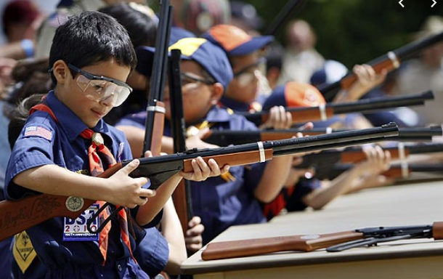
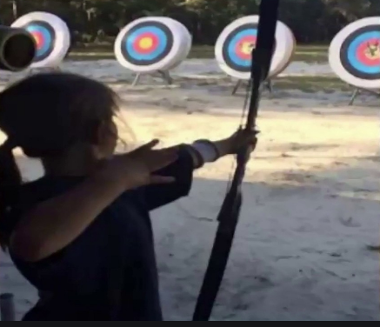
Shooting Sports
Requests for Shooting Events – Lead Time!
  50+ scouts - 6mos
  Less than 50 scouts - 3mos
Shooting on private land:
  Requirements
  Permissions/protocols
Shooting Sports web page
Shooting Sports Instructor Classes:
  Rifle/Shotgun
  Archery (Virtual classes available)

Slide 16


Merit Badges
Every merit badge counselor needs to be on the District Charter. The time for action is NOW!
The online Merit Badge Counselor registration works for all Scouters who do not already hold another District position.
Be sure the counselor uses his/her legal name – no nicknames.
Merit Badge Counselors, or the unit Dean/Leader, also need to scan and send Margee the Merit Badge application form listing the badges the counselor is applying to teach and providing a justification of his/her qualifications.
Youth Protection Training is the essential first step. Don’t hit “send” on the application without it!
Contact Margee if you have questions at GM.MB.Dean@hotmail.com.
Online Merit Badge Courses – Watch video, fill out workbook, contact Counselor
Virtual Merit Badge Opportunities (Nation-wide)
Parktakes (select “Scouts” from the Category of Activity)
MeritBadge.Info – Various MB Days throughout the country
Fly Fishing Merit Badge Program, Northern Virginia
Merit Badges Scouts can complete at Home

Slide 17
Other Topics
Order of the Arrow
General Announcements
District Executive Minute
District Commissioner Minute
District Chair Minute
Minutes and slides available on the GMD Website (District Resources, Roundtable)
Next meeting – May 13, 2021 @ 7:30pm

