Slide 1
George Mason
District Roundtable
May 13, 2021

Slide 2


Slide 3
Council Update

Slide 4
Cub Scout Summer

Slide 5
Camp Snyder/Service Projects

Slide 6
High Adventure Brief
Joe Knecht
GM District High Adventure Committee

Slide 7
Overview:
BSA High Adventure Mission
End State
Opportunities
Recognition
Resources/Planning Considerations
May NCAC High Adventure Announcements

Slide 8
Why have a High Adventure (HA) program?
Mission: The mission of Scouts BSA is to prepare young people to make ethical and moral choices over their lifetimes by instilling in them the values of the Scout Oath and Law.
…the BSA High Adventure Program provides opportunities for challenging outdoor experiential education that supplements the BSA mission.
Scouts learn more skills, self-reliance, and life lessons in the HA setting.
Provides opportunities for Scouts (and Adults) to train for, look forward to, and rise to the challenge.
In addition to the standard Scouting program, HA increases backcountry skills, confidence, and provides a logical path for advancement.
Increases retention; provides visible goals for younger Scouts and Cub Scouts.

Slide 9




BSA High Adventure Bases:
National: Philmont; Northern Tier; Florida Sea Base; Summit Bechtel Reserve
Council: Maine HA Base; Adirondack HA Base; Lenhok’sin; Louisiana Swamp Base; Rocky Mtn HA Base; Teton HA Base; Chilkoot HA Base; etc.
Pros: iconic experiences; professional support; treks can be tailored to crew; accredited camps; provisional opportunities
Cons: expensive; often travel and time intensive

Slide 10

Unit-based High Adventure (local treks):
Backpacking: Appalachian Trail; Tuscarora Trail, etc.
Canoeing: Potomac; Shenandoah; James; etc.
Kayaking/Sailing: Chesapeake Bay
Cycling: C&O Canal; Great Allegheny Passage, etc.
Pros: inexpensive; local; allows maximum participation; can be great preparation for other HA treks; provides true scout-led high adventure
Cons: training intensive; significant planning requirements; increased risk management requirements

Slide 11
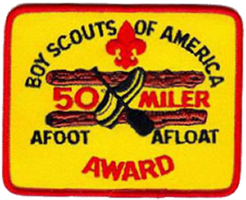


Recognition:
BSA 50-Miler Award https://www.scouting.org/awards/awards-central/50-miler/
Triple Crown Award; Grand Slam Award (National High Adventure Bases) https://www.nationalhighadventureawards.org/about
Unit-specific recognition Troop recognition for multiple 50-Milers; one each backpacking, canoeing, and cycling. (e.g., Troop 681 Ironman Program)

Slide 12
-- There are limitless HA opportunities for Scouts across the spectrum of age and capabilities.
-- HA treks require significant planning and coordination, but will create lifelong memories for Scouts and Adult Leaders.
-- Units with active HA programs are best able to recruit and retain Scouts.
Conclusion:
Questions?

Slide 13
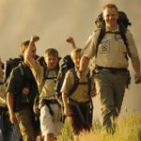
GM High Adventure
(May 2021)
NCAC High Adventure Committee (HAC) updates and announcements: https://www.ncacbsa.org/high-adventure/
  NCAC High Adventure Sourcebook (v. April 2021) https://3.basecamp.com/3958009/buckets/16000091/uploads/3714603646#__recording_3743770604
  Local day hikes, overnight, and multi-day treks: https://3.basecamp.com/3958009/buckets/16000091/uploads/3272427444
  Wilderness First Aid vendors: https://public.3.basecamp.com/p/6cocPGgDnFSAy5nWMnTfPMzu
For those units planning summer 2021 HA trips:
Check with HA bases for COVID requirements (proof of vaccination or negative COVID test)
Contact Joe Knecht at knechtjoe@yahoo.com if there are any issues accessing documents or you have questions regarding high adventure planning.

Slide 14

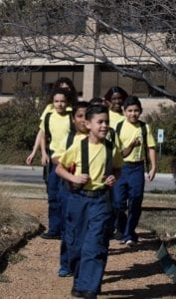

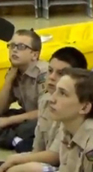


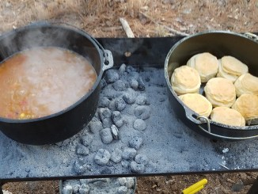
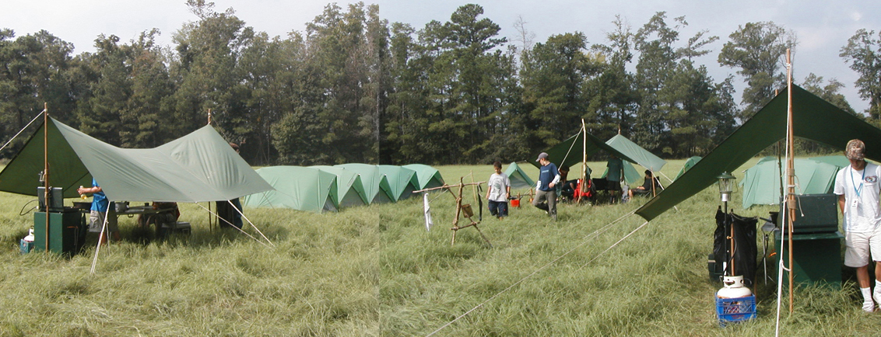
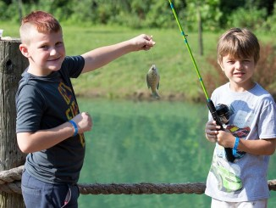
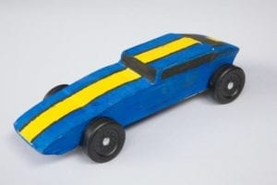
George Mason Program
Matt Burns, Vice Chair Program
Teralyn Carlson, Deputy Vice Chair
George Mason District

Slide 15

Current 2021 GM Calendar
May 31, 2021 - Memorial Day Flags In (10am)
October 15-17, 2021 – GM District STEM Camporee
November 10, 2021 – Veterans Day Flags In

Slide 16
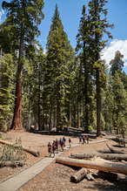
George Mason Hike-O-Ree 2021
Challenge – See if George Mason District Scouts/Scouters, family & friends can, collectively, total 2,021 miles. Participating units earn a ribbon.
Have heard from the following units:
  Pack 152
  Pack 882
  Troop 1978G
  Troop 140
  Troop 187
  Troop 1887
  Troop 918
Looking for more unit reports. Please e-mail unit number and mileage totals to Matt Burns (burnsmj509@gmail.com). Matt will publish total and distribute unit ribbons.

Slide 17
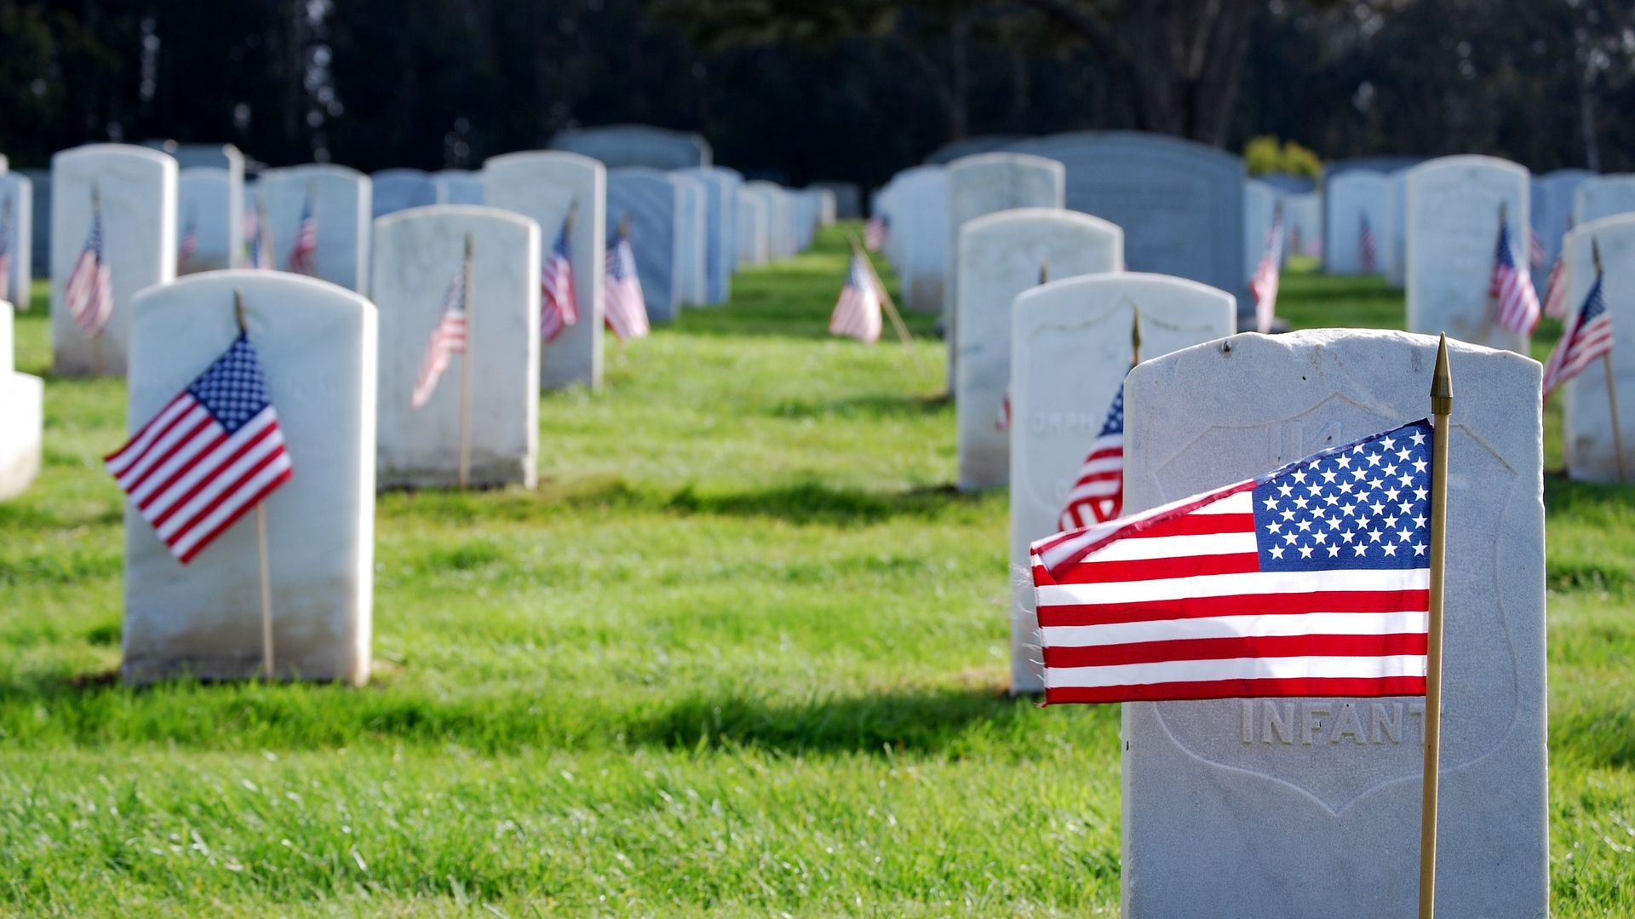
Flags In
Memorial Day (May 31, 2021)
Flag placement will start at 10:00 am
Social distancing – bring a mask.
National Memorial Park, 7482 Lee Highway, Falls Church
All Scouts, including Girl Scouts, are welcome.
Class A Uniforms
For more info, contact Russell Pittman at ruspittman@gmail.com.

Slide 18
Civic and Related Activities of Interest to Scouts
Dyke Marsh Sunday Morning Bird Walks – 8:00 a.m. on Sundays. Hikes led by experienced birders. See website.
Fairfax City Fitness Challenge (3 April to 29 May). Register any time.
Huntley Meadows Monday Morning Birdwalks (start May 3) 7:00 a.m. on Mondays, rain or shine. Good activity for the summer vacation that could count for Cub Outdoor Activity Award.
Viva Vienna (May 29-31) – Rotary Club will be updating Vienna Town Council next week regarding plans for possible event. If it happens, it will be smaller and socially-distanced.
Fairfax City Fido Fest (June 12) activities and demonstrations. See website.
Fairfax City Independence Day (July 3) – Daytime parade popular with Cubs. Other daytime events and evening fireworks.

Slide 19
SCOUTS BSA Roundtable

Slide 20

Fall 2021 District Camporee
District will hold its next Camporee on October 15-17, 2021.
Location – 4H in Front Royal
Theme - STEM
Patches – Will be provided as part of Camporee.
Plan to open registration in late July.

Slide 21
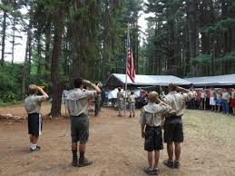
Future Camporees
Save the Dates!!!
George Mason Spring 2022 Camporee – April 29 – May 1, 2022
  Theme and Site TBD
George Mason Fall 2022 Camporee – October 21 – 23, 2022
  Theme and Site TBD
Please factor this into unit calendars/planning.
Scouts are loyal – including loyalty to District activities.

Slide 22
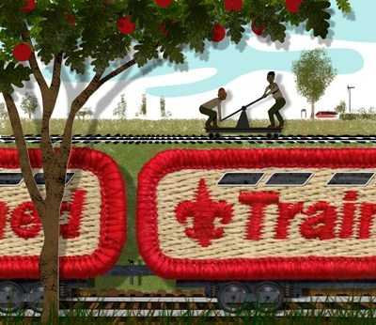
Training
Unit Training – For position-specific training at your unit, contact Roy De Lauder at EagleScout.Roy@cox.net or go to Training Opportunities page on GM Web Site.
Basic Adult Leader Outdoor Orientation (BALOO):
  05/20/21 & 05/23/21 – Camp Snyder
  05/24/21, 05/27/21 & 05/29/21 – Gaithersburg, MD
  06/19/21 – 06/20/21 – Huntingtown, MD
Introduction to Outdoor Leadership Skills (IOLS):
  05/21/21 – 05/22/21 – Camp Snyder
  06/19/21 – 06/20/21 – Huntingtown, MD
Red Cross Remote and Wilderness First Aid ("WRFA") - May 22-23, 2021

Slide 23
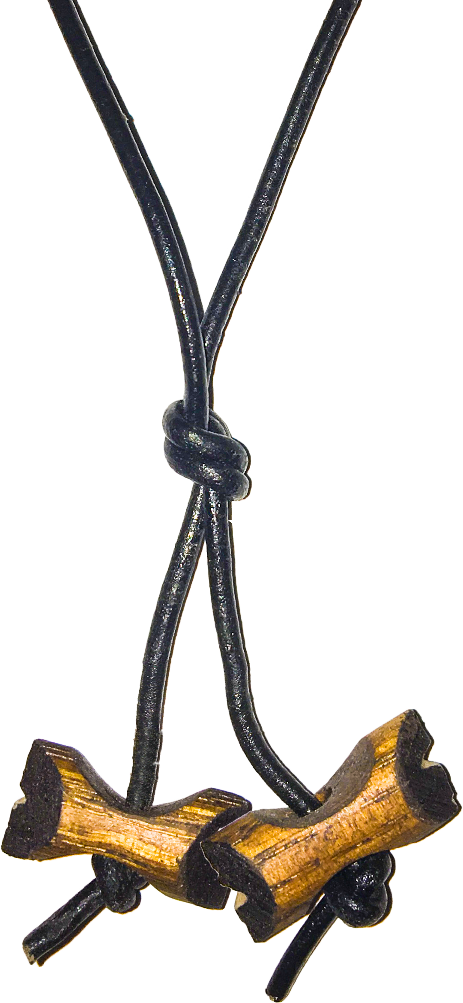
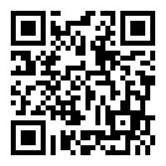
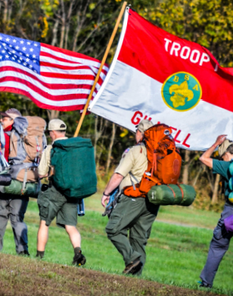
Wood Badge Registration NOW Open
Fall Course
Registration Open 1 May, 2021
Weekend #1: 10 - 12 September
Weekend #2: 9 - 10 October
Course Director: Mrs. Alexandria Keenan
ADLKeenan@gmail.com
Wood Badge could be postponed or delayed based on covid restrictions
Wood Badge is the Boy Scouts of America’s ultimate leadership training designed to meet the advanced leadership needs of Scouters in all aspects of the BSA, whether unit, district, or council level – from assistant den leaders to Scoutmasters, from Cubmasters to Venturing Advisors, from committee members to commissioners. It is a fun, energetic and inspiring course guaranteed to infuse your unit with fun and meaning – all designed to fulfill the mission of the BSA, and ensure our youth is getting everything they are promised from the program.
QUESTIONS?
For information about specific courses, contact the Course Director listed above.

Slide 24
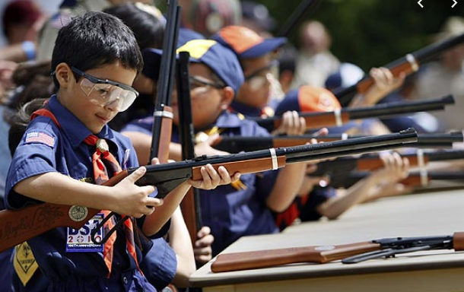
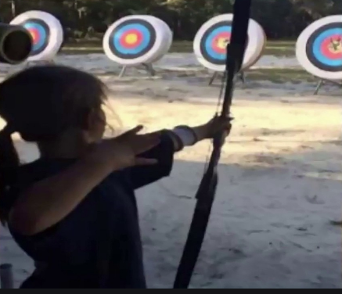
Shooting Sports
Requests for Shooting Events – Lead Time!
  50+ scouts - 6mos
  Less than 50 scouts - 3mos
Shooting on private land:
  Requirements
  Permissions/protocols
Shooting Sports web page
Shooting Sports Instructor Classes:
  Rifle/Shotgun
  Archery (Virtual classes available)

Slide 25


Merit Badges
Every merit badge counselor needs to be on the District Charter. The time for action is NOW!
The online Merit Badge Counselor registration works for all Scouters who do not already hold another District position.
Be sure the counselor uses his/her legal name – no nicknames.
Merit Badge Counselors, or the unit Dean/Leader, also need to scan and send Margee the Merit Badge application form listing the badges the counselor is applying to teach and providing a justification of his/her qualifications.
Youth Protection Training is the essential first step. Don’t hit “send” on the application without it!
Contact Margee if you have questions at GM.MB.Dean@hotmail.com.
Online Merit Badge Courses – Watch video, fill out workbook, contact Counselor
Virtual Merit Badge Opportunities (Nation-wide)
Parktakes (select “Scouts” from the Category of Activity)
MeritBadge.Info – Various MB Days throughout the country
Fly Fishing Merit Badge Program, Northern Virginia
Merit Badges Scouts can complete at Home

Slide 26
George Mason Program
Matt Burns, Vice Chair Program
Teralyn Carlson, Deputy Vice Chair
George Mason District

Slide 27
Current 2020-2021 GM Calendar
May 31, 2021 - Memorial Day Flags In
October 15-17, 2021 – GM District STEM Camporee
November 10, 2021 – Veterans Day Flags In

Slide 28
George Mason Hike-O-Ree 2021
Challenge – See if George Mason District Scouts/Scouters, family & friends can, collectively, total 2,021 miles. Participating units earn a ribbon.
Have heard from the following units as of 5-12-21:
  Pack 152
  Pack 675
  Pack 882
  Troop 140
  Troop 187
  Troop 918
  Troop 1887
  Troop 1978G
  District Committee
So far, total of 649 miles hiked.
Will order unit streamers next week – delivery early June.
Looking for more unit reports. Please e-mail unit number and mileage totals to Matt Burns (burnsmj509@gmail.com). Matt will publish total and distribute unit ribbons.

Slide 29
Flags In
May 31, 2021
Flag placement will start at 10:00 am
Social distancing – bring a mask.
National Memorial Park, 7482 Lee Highway, Falls Church
All Scouts, including Girl Scouts, are welcome.
Class A Uniforms
For more info, contact Russell Pittman at ruspittman@gmail.com.

Slide 30
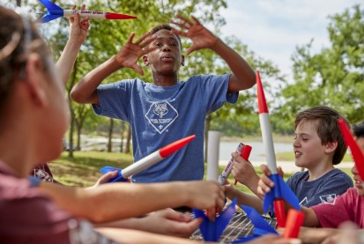
STEM
Check out the new GM District STEM page!
  https://www.ncacbsa.org/george-mason/stem-program/
World of Weird (WOW) Science Week – 12-16 July
  STEM day camp for youth in grades K-5
  Registration deadline is 31 May
  https://scoutingevent.com/082-WOWscience

Slide 31
Civic and Related Activities of Interest to Scouts
Dyke Marsh Sunday Morning Bird Walks – 8:00 a.m. on Sundays. Hikes led by experienced birders. See website.
Fairfax City Fitness Challenge (3 April to 29 May). Register any time.
Huntley Meadows Monday Morning Birdwalks (start May 3) 7:00 a.m. on Mondays, rain or shine. Good activity for the summer vacation that could count for Cub Outdoor Activity Award.
Viva Vienna (May 29-31) – Rotary Club will be updating Vienna Town Council next week regarding plans for possible event. If it happens, it will be smaller and socially-distanced.
Fairfax City Fido Fest (June 12) activities and demonstrations. See website.
Fairfax City Independence Day (July 3) – Daytime parade popular with Cubs. Other daytime events and evening fireworks.

Slide 32
SCOUTS BSA Roundtable

Slide 33
Fall 2021 District Camporee
District will hold its next Camporee on October 15-17, 2021.
Location – 4H in Front Royal
Theme - STEM
Patches – Will be provided as part of Camporee.
Plan to open registration in late July.

Slide 34
Future Camporees
Save the Dates!!!
George Mason Spring 2022 Camporee – April 29 – May 1, 2022
  Theme and Site TBD
George Mason Fall 2022 Camporee – October 21 – 23, 2022
  Theme and Site TBD
Please factor this into unit calendars/planning.
Scouts are loyal – including loyalty to District activities.

Slide 35
Training
Unit Training – For position-specific training at your unit, contact Roy De Lauder at EagleScout.Roy@cox.net or go to Training Opportunities page on GM Web Site.
Leadership Training:
Basic Adult Leader Outdoor Orientation (BALOO):
  05/20/21 & 05/23/21 - Camp Snyder
  05/24/21, 05/27/21 & 05/29/21 - Gaithersburg, MD
  06/19/21 - 06/20/21 - Huntingtown, MD
Scoutmaster Position Specific Training
  05/15/21 – Virtual
  05/22/21 – Virtual
  06/05/21 – Alexandria, VA
  09/18/21 – Virtual
Introduction to Outdoor Leadership Skills (IOLS):
  05/21/21 - 05/22/21 - Camp Snyder
  06/19/21 - 06/20/21 - Huntingtown, MD
  06/26/21 - 06/27/21 – Lorton, VA

Slide 36
Wood Badge Registration NOW Open
Fall Course
Registration Open 1 May, 2021
Weekend #1: 10 - 12 September
Weekend #2: 9 - 10 October
Course Director: Mrs. Alexandria Keenan
ADLKeenan@gmail.com
Wood Badge could be postponed or delayed based on covid restrictions
Wood Badge is the Boy Scouts of America’s ultimate leadership training designed to meet the advanced leadership needs of Scouters in all aspects of the BSA, whether unit, district, or council level – from assistant den leaders to Scoutmasters, from Cubmasters to Venturing Advisors, from committee members to commissioners. It is a fun, energetic and inspiring course guaranteed to infuse your unit with fun and meaning – all designed to fulfill the mission of the BSA, and ensure our youth is getting everything they are promised from the program.
QUESTIONS?
For information about specific courses, contact the Course Director listed above.

Slide 37
Shooting Sports
Requests for Shooting Events – Lead Time!
  50+ scouts - 6mos
  Less than 50 scouts - 3mos
Shooting on private land:
  Requirements
  Permissions/protocols
Shooting Sports web page
Shooting Sports Instructor Classes:
  Rifle/Shotgun
  Archery (Virtual classes available)

Slide 38
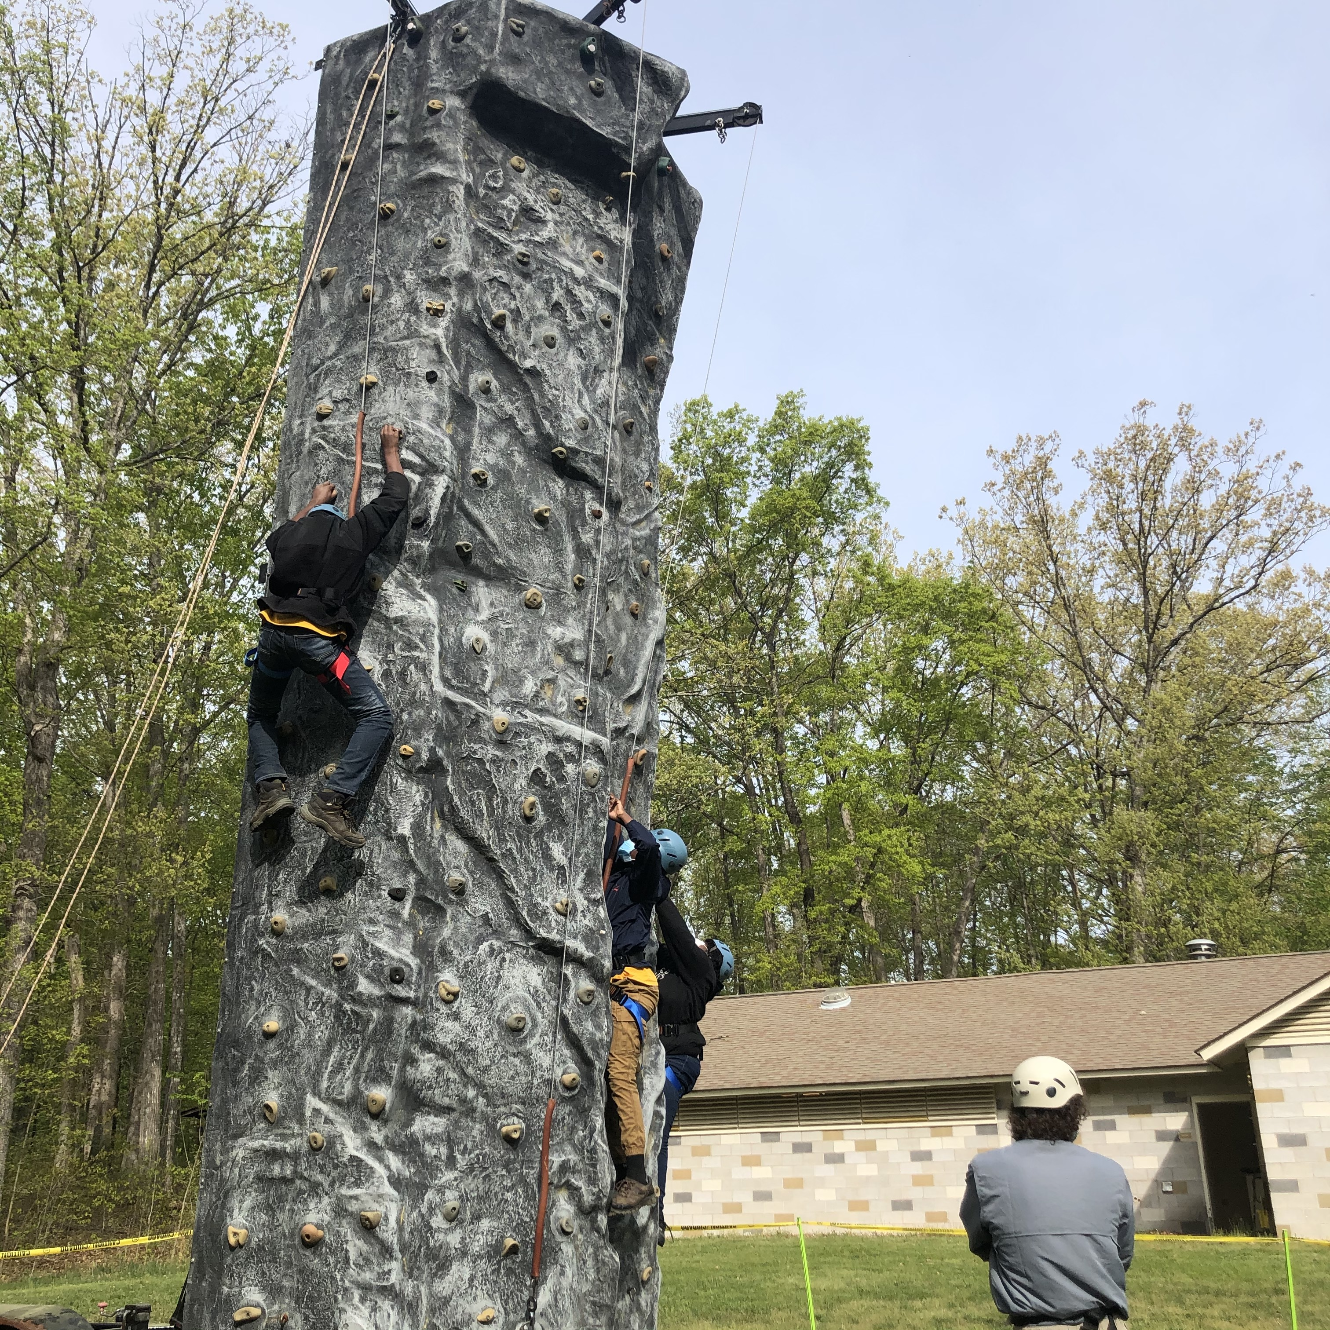
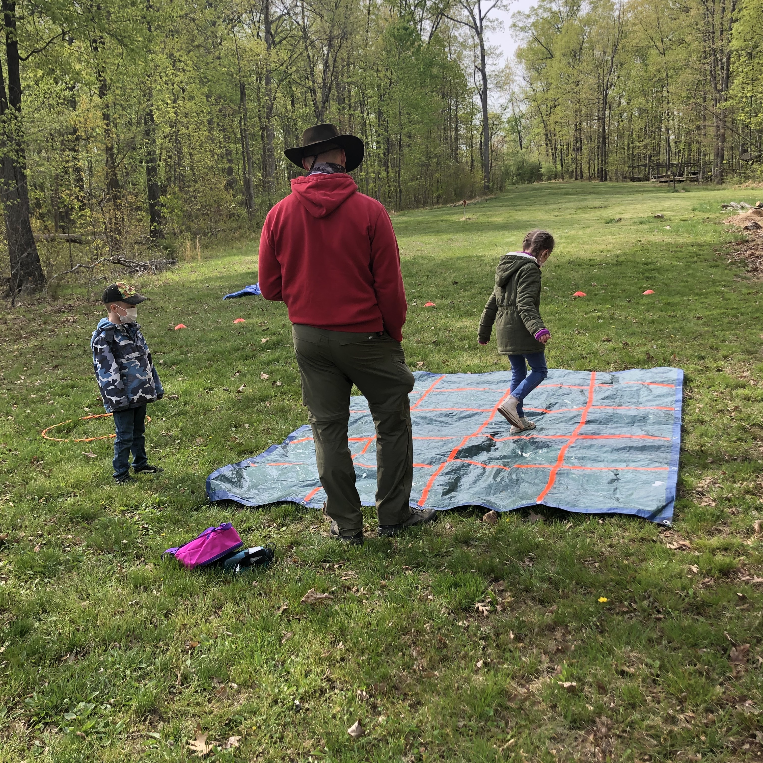
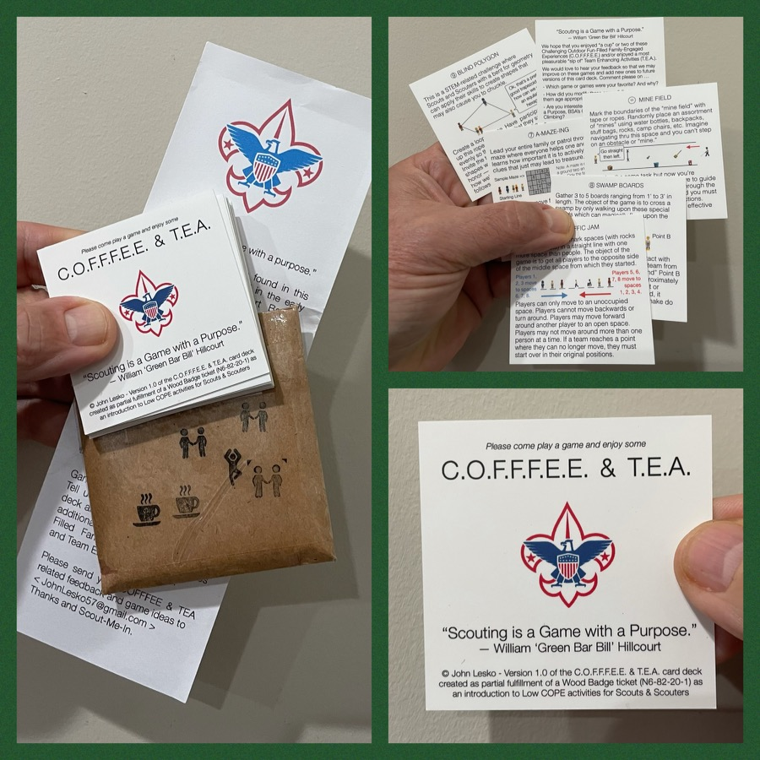
And don’t forget the District’s various COPE and Climbing Opportunities!
Where CUB Scouts learn about teamwork by playing Games with a Purpose
Boy and Girl Scouts learn how to lead their peers while playing these games
And our more senior Scouts, Venturers, and Scouters practice and refine their skills through Challenge Outdoor Fun-Filled Family Engaged Experiences & Team Enhancing Activities (a.k.a. COFFFEE & TEA)
Level 1 & Level 2 training in COPE & Climbing programs need to be coordinated with COPE & Climbing committee chair: Tony Waisanen <ncac.cope@gmail.com>
Interested in obtaining a deck
of COFFFEE & TEA game cards,
E-mail JohnLesko57@gmail.com
—————————————>

Slide 39
Merit Badges
Every merit badge counselor needs to be on the District Charter. The time for action is NOW!
The online Merit Badge Counselor registration works for all Scouters who do not already hold another District position.
Be sure the counselor uses his/her legal name – no nicknames.
Merit Badge Counselors, or the unit Dean/Leader, also need to scan and send Margee the Merit Badge application form listing the badges the counselor is applying to teach and providing a justification of his/her qualifications.
Youth Protection Training is the essential first step. Don’t hit “send” on the application without it!
Contact Margee if you have questions at GM.MB.Dean@hotmail.com.
Online Merit Badge Courses – Watch video, fill out workbook, contact Counselor
Virtual Merit Badge Opportunities (Nation-wide)
Parktakes (select “Scouts” from the Category of Activity)
MeritBadge.Info – Various MB Days throughout the country
Fly Fishing Merit Badge Program, Northern Virginia
Merit Badges Scouts can complete at Home

Slide 40
Other Topics
Order of the Arrow
General Announcements
District Executive Minute
District Commissioner Minute
District Chair Minute
Minutes and slides available on the GMD Website (District Resources, Roundtable)
Next meeting/Program Launch – June 10, 2021 @ 7:30pm

