Slide 1

George Mason District
Roundtable
August 12, 2021

Slide 2


Slide 3

Join Scouting Resources
A Cub Scout Makes the Pack Go

Slide 4
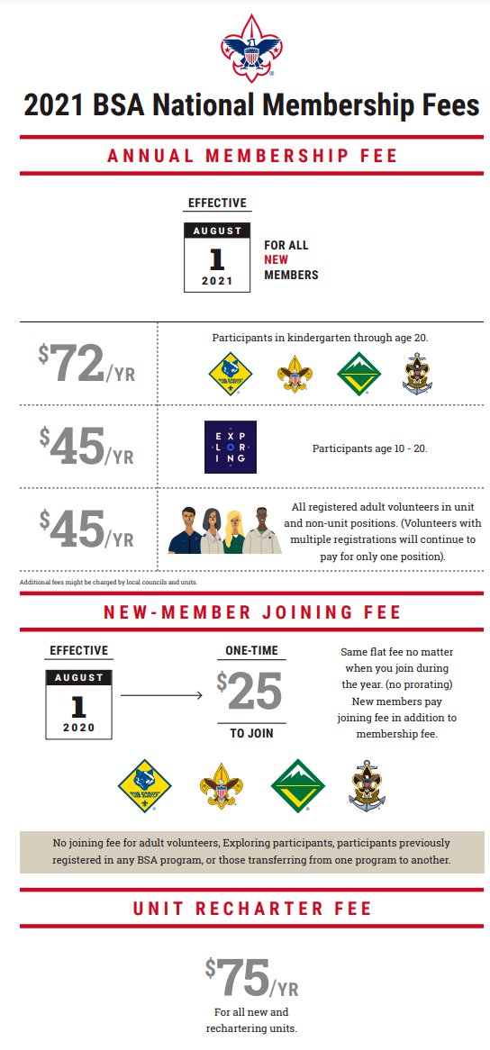
Membership Fees

Slide 5
Membership Training Part Deux
Posted by Stephen A. on Aug 5
When
Mon, Aug 16, 7:00pm - 9:00pm EDT
With
Nobody’s been invited
Notes
Hi there,
You are invited to a Zoom meeting.
When: Aug 16, 2021 07:00 PM Eastern Time (US and Canada)
Register in advance for this meeting:
https://ncacbsa-org.zoom.us/meeting/register/tZcucO2prj8oEtCBy-Q_MtGBKUPOQeUbxDcm
After registering, you will receive a confirmation email containing information about joining the meeting.

Slide 6
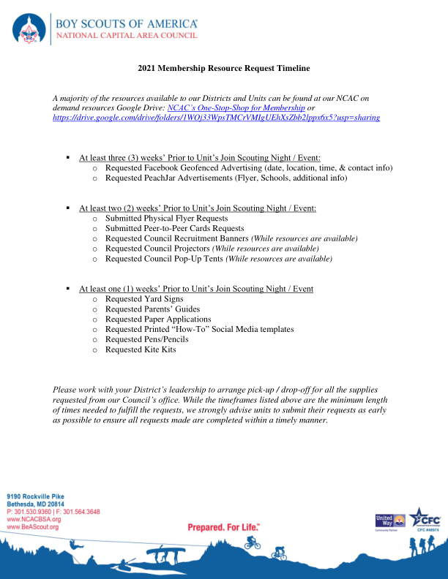

Slide 7
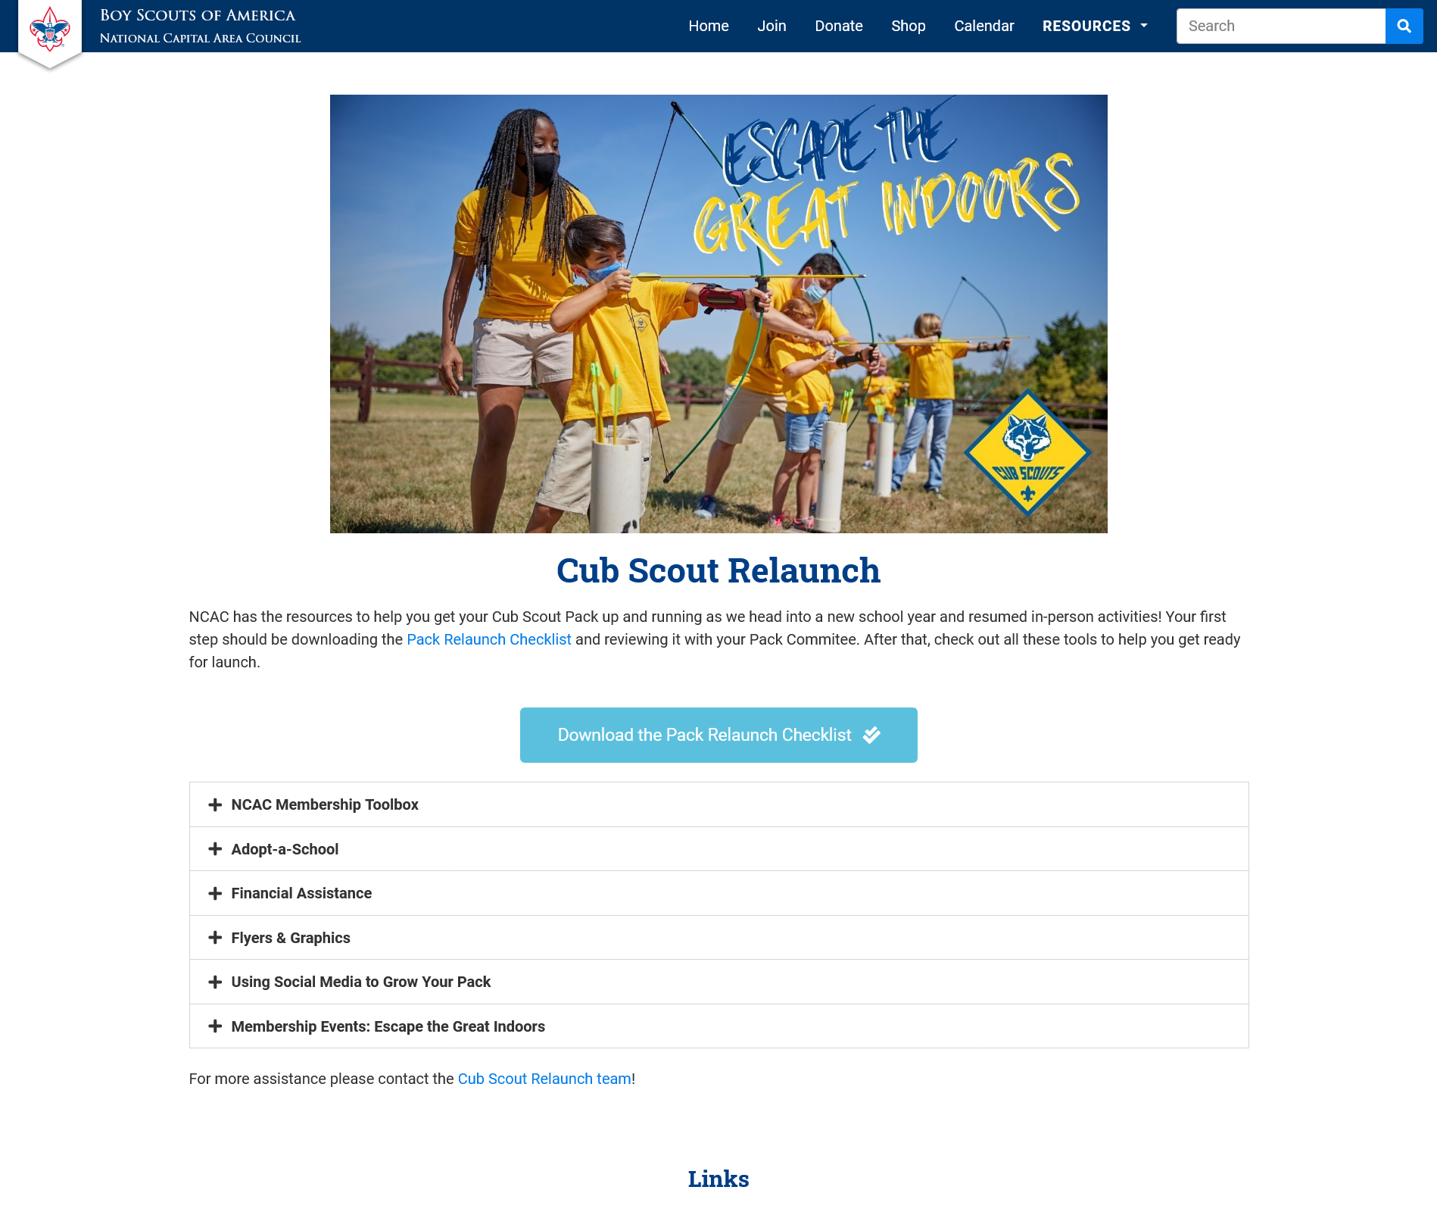

Slide 8
Additional Join Scouting/Resources
National Membership Kickoff Webinar
  Tell the benefits – leadership, normal friend activities, scholarship
  Lead with Volunteers – have the Committee Members/parents pitch Scouting
  Get the commitment – have on-line registration and payment
Cub Scouts – Videos at brand center; sample Scout Life Magazine
Recruitment Kit – online resources available
Update your PIN at BeAScout.org
Council Resources (allow two weeks) – jose.calil@scouting.org
  Flyers, yard signs
  Geofencing for Facebook
  Marketing Materials (email at 5pm today)

Slide 9
2022 Charter Renewal: Changing the Culture
Aug 1 to Oct 14
Membership Inventory
Oct 15 to Oct 31
Data Input
Review
Nov 1
Submit Charter
Annual Agreement
Add Members

Slide 10
Get Ready Now!
Designate a Charter Renewal Coordinator
  This person will keep you on track
Membership Inventory
  Who is in My.Scouting.Org and who is in my local roster
Clean the Roster
  Add new members through online registration for faster results
Get the Annual Charter Agreement signed
  Get your IH to sign it now – don’t wait!
Stay close to your Unit Commissioner
  You are not alone! - your UC will help you through the process
A new Charter Renewal software will be used this cycle – we expect it to be simpler and to gather signatures electronically!
Stay tuned for training sessions in mid-September

Slide 11
Big Rock
Activities your Unit did this summer
Camps/Outings you would recommend/shy away from.

Slide 12


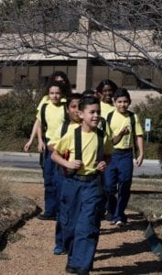

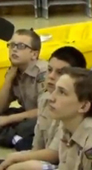


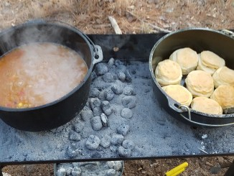
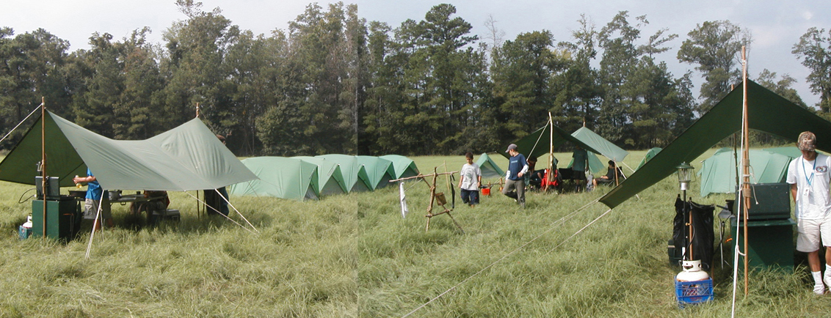
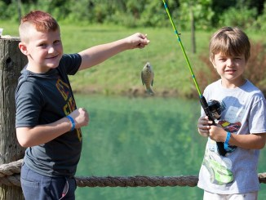
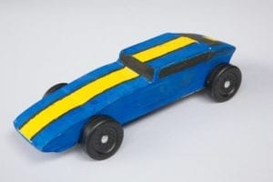
George Mason Program
Matt Burns, Vice Chair Program
Teralyn Carlson, Deputy Vice Chair
George Mason District

Slide 13

Current 2020-2021 GM Calendar
September 25, 2021 – Life to Eagle Seminar
October 15-17, 2021 – GM District STEM Camporee
October 16, 2021 – Jamboree on the Internet/ Jamboree on the Air
November 6, 2021 – Scouting for Food Tag Distribution
November 7, 2021 – Veterans Day Flags In
November 13, 2021 – Scouting for Food Pick Up

Slide 14
Civic and Related Activities of Interest to Scouts – Cont.
National Park Service Birthday – August 25 – Great Falls National Park - Free admission so visitors can enjoy all national parks during this celebration of the National Park Service Birthday.
Fairfax City Labor Day Car Show – September 6 from 8 a.m to 3 p.m.
National Public Lands Day – September 25 – Great Falls National Park – Free admission so visitors can enjoy national parks during this celebration of the National Public Lands Day.
Falls Church Fall Community Clean Up – Date TBD – Another service project opportunity benefitting the community.
Falls Church Halloween Carnival – Saturday, October 30 – For youth, 11 and under at the Community Center.
Falls Church – A Very Victorian Christmas – Visit the Cherry Hill Farmhouse to see how Christmas was celebrated in the 1860s.
Fairfax City Festival of Lights and Carols – December 4 from 12 to 6 p.m in Old Town Square, 10415 North Street

Slide 15
Civic and Related Activities of Interest to Scouts – Cont.
X-Wing Starfighter from “Star Wars” – On display through Jan 1, 2022 at National Air and Space Museum, Udvar-Hazy Center, Dulles
Vienna Halloween Parade – October 27, 2021 at 7 p.m. See website for registration.
Vienna Town Clean Up Days – August, November and April – A great opportunity for units of all ages to conduct a service project and for youth to earn service hours.
Veterans Day at Great Falls – November 11 - Free admission so visitors can remember our veterans by visiting a national park.

Slide 16
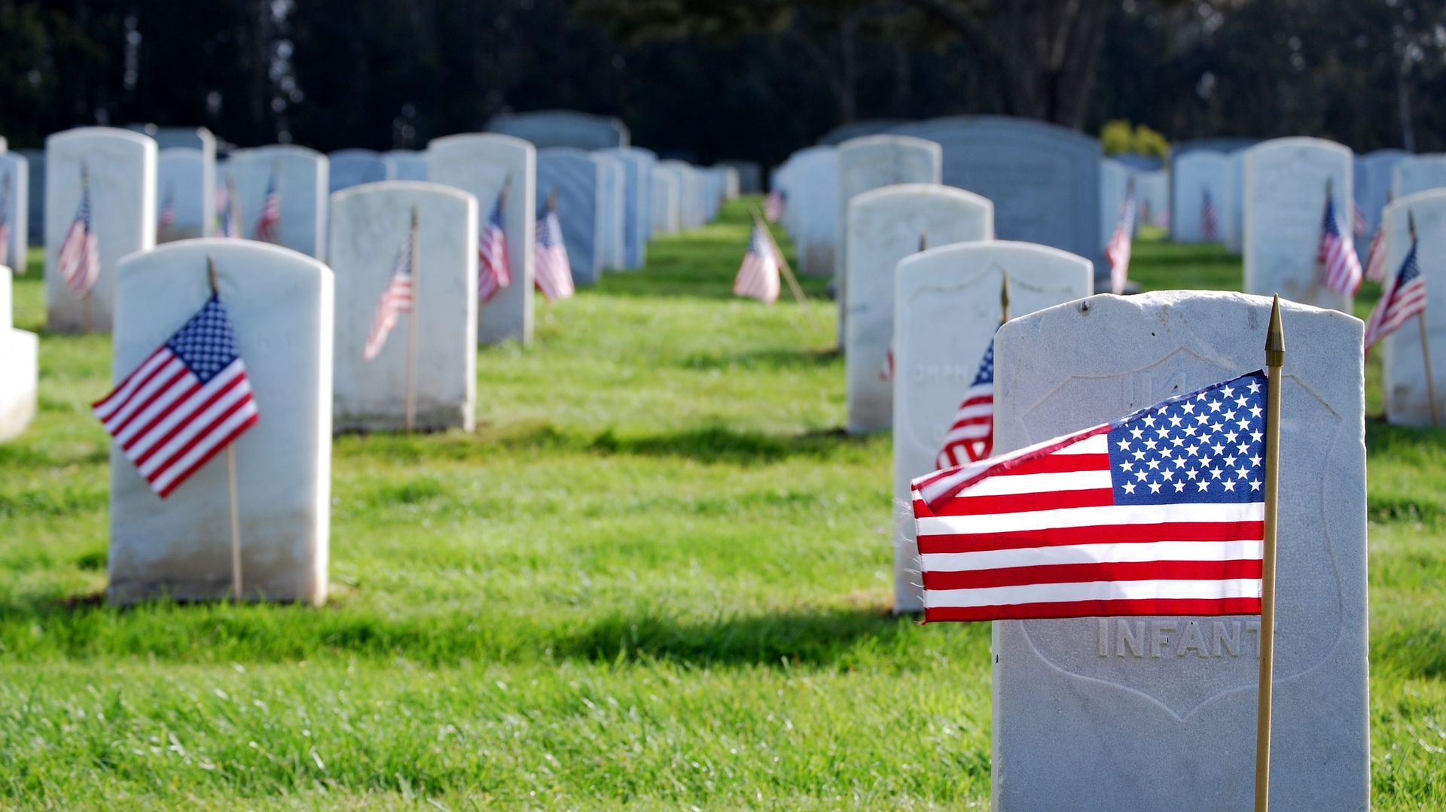
Flags In
November 7, 2021
Flag placement will start at 10:00 am
Social distancing – bring a mask.
National Memorial Park, 7482 Lee Highway, Falls Church
All Scouts, including Girl Scouts, are welcome.
Class A Uniforms
For more info, contact Russell Pittman at ruspittman@gmail.com.

Slide 17
SCOUTS BSA Roundtable

Slide 18

District Life to Eagle Seminar
Saturday, 25 September 2021
1:00 to 4:00 p.m.
Virtual
Register at:
https://site.corsizio.com/c/60eefcdba647dcba68c93d8e
Who should attend:
Life Scouts or advanced Star Scouts who want to pursue the Eagle Rank
Eagle advisors, coaches or unit leaders that haven’t attended a seminar in two years
Parents of Scouts working on Eagle or other adults interested in Scouting
Registration will be done online and must be received by 23 September 2020 to get the Zoom link.
Any questions contact Jack Lundin at 703-938-0369.

Slide 19


GEORGE MASON DISTRICT CAMPOREE
Date:
October 15 – 17, 2021
Location: 4H Camp, Front Royal, VA.
Online registration available now on Council website (below).
Leader Guide available on registration site.
Need unit volunteers to help run event.
Camporee Director Andrew Zaso
(703) 434-2907 - AndrewZaso@gmail.com
Register at: scoutingevent.com/082-49459

Slide 20
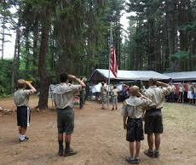
Future Camporees
Save the Dates!!!
George Mason Spring 2022 Camporee – April 29 – May 1, 2022
  Theme and Site TBD
George Mason Fall 2022 Camporee – October 21 – 23, 2022
  Theme and Site TBD
Please factor this into unit calendars/planning.
Scouts are loyal – including loyalty to District activities.

Slide 21
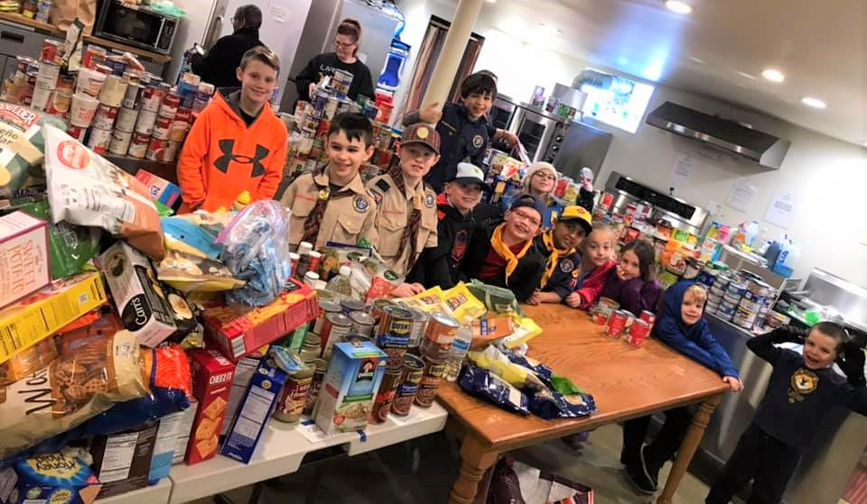
Scouting for Food
November 6 and November 13, 2021
Scott Willey is 2021 District Coordinator

Slide 22
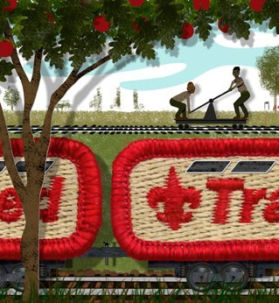
Training
Unit Training – For position-specific training at your unit, contact Roy De Lauder at EagleScout.Roy@cox.net or go to Training Opportunities page on GM Web Site.
Scouts BSA Training
08/27/21 - Powderhorn, Newburg, MD
08/28/21 - Paddle Craft Safety, Riley's Lock, C&O Canal
09/18/21 - SM/ASM Position Specific Training, Bethesda, MD
09/25/21 - Back Country Outdoor Leadership School (BCOLS),
      Alexandria, VA
Cub Scout Training:
08/14/21 - IOLS/BALOO, Hollywood, MD
08/28/21 - Cub Scout Leader Specific Training (CM/ACM, Den Leader,
    Committee Member), Stafford, VA
09/18/21 – In-Person Cub Leader specific training, 11 to 3 p.m. at St. Mark in
    Vienna
09/25/21 - Cub Scout Leader Specific Training (CM/ACM, Den Leader,
    Committee Members), Herndon, VA
10/16/21 - BALOO Training, Reston, VA

Slide 23
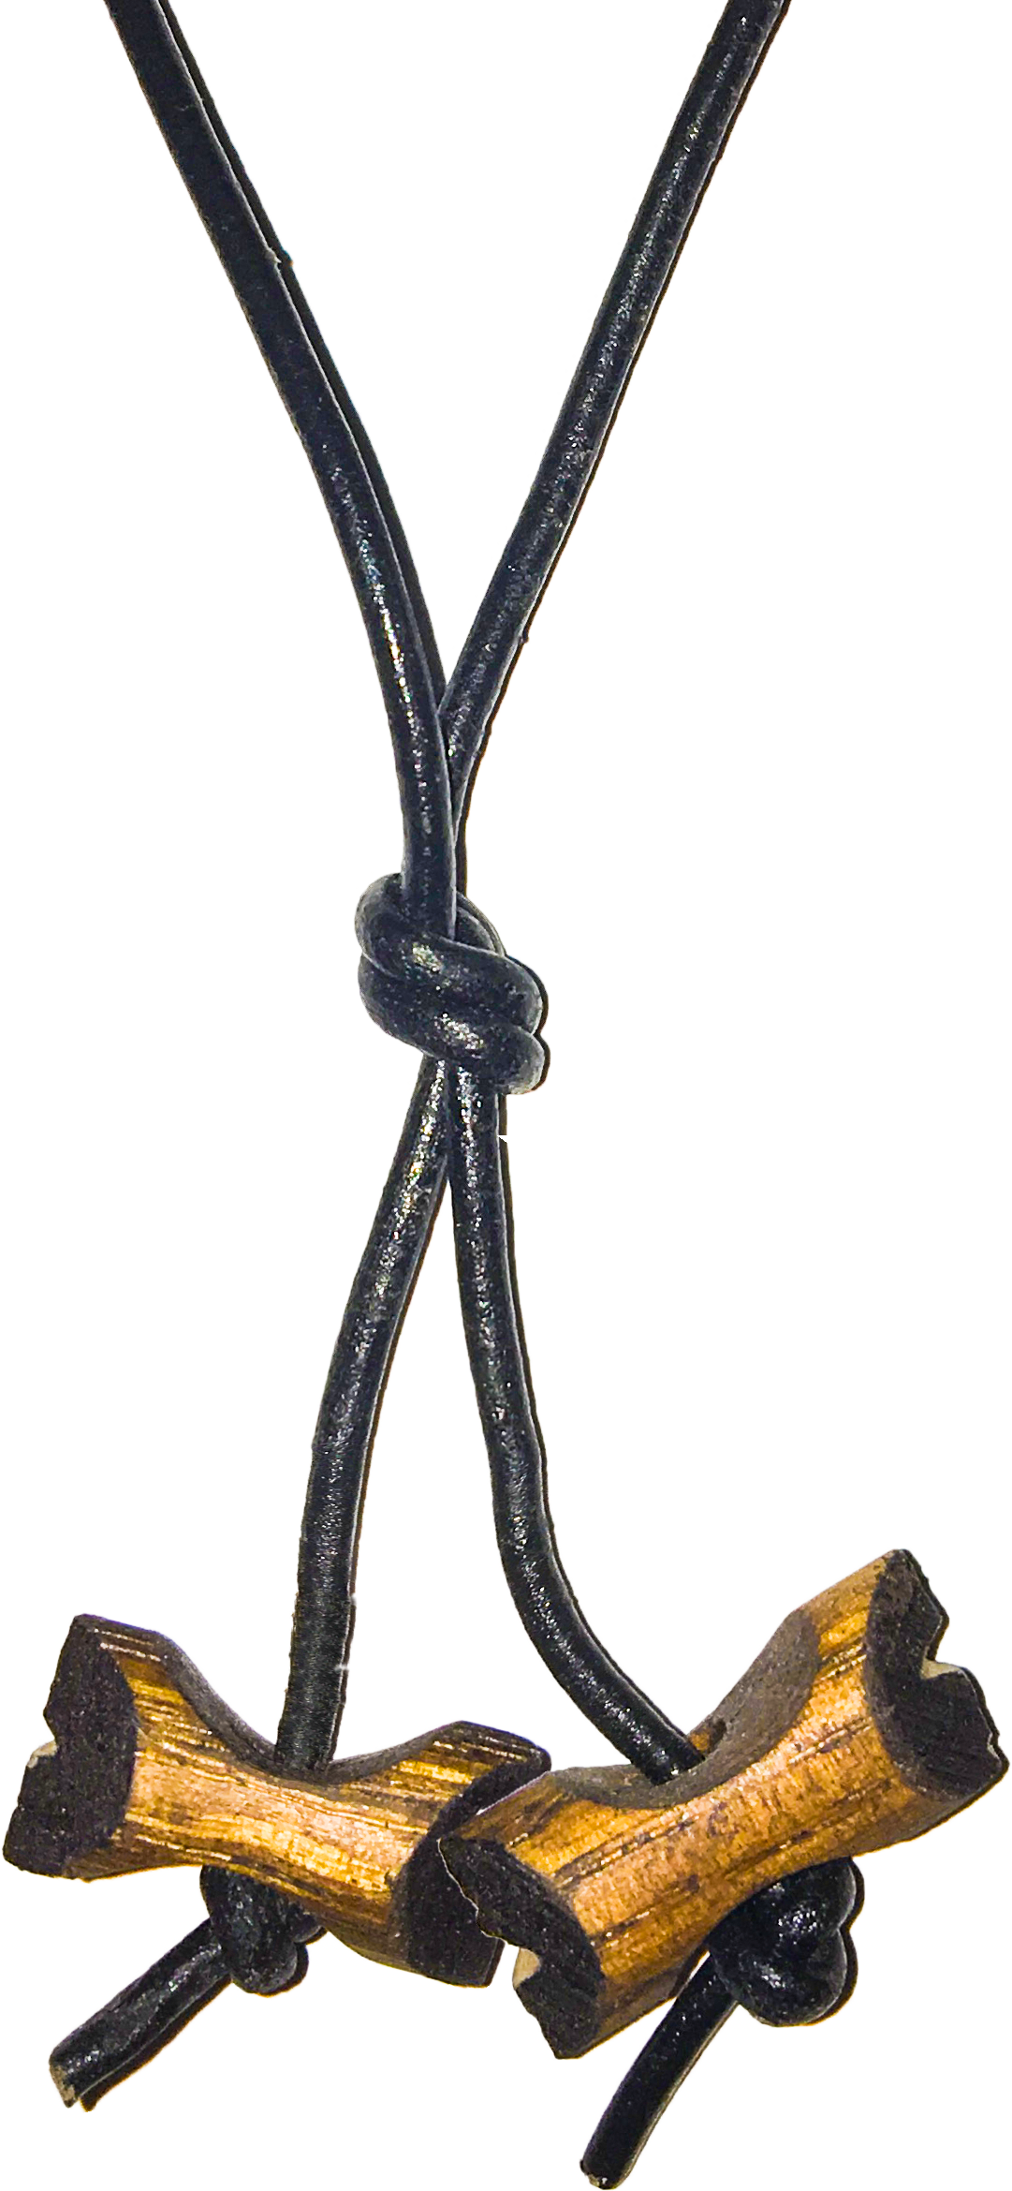
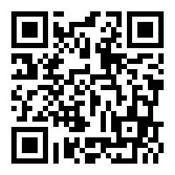
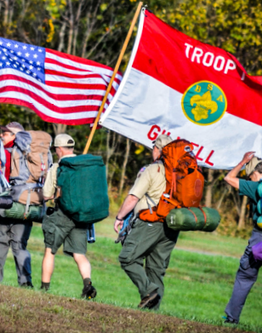
Wood Badge Registration NOW Open
Fall Course
Registration Open 1 May, 2021
Weekend #1: 10 - 12 September
Weekend #2: 9 - 10 October
Course Director: Mrs. Alexandria Keenan
ADLKeenan@gmail.com
Wood Badge could be postponed or delayed based on covid restrictions
Wood Badge is the Boy Scouts of America’s ultimate leadership training designed to meet the advanced leadership needs of Scouters in all aspects of the BSA, whether unit, district, or council level – from assistant den leaders to Scoutmasters, from Cubmasters to Venturing Advisors, from committee members to commissioners. It is a fun, energetic and inspiring course guaranteed to infuse your unit with fun and meaning – all designed to fulfill the mission of the BSA, and ensure our youth is getting everything they are promised from the program.
QUESTIONS?
For information about specific courses, contact the Course Director listed above.

Slide 24
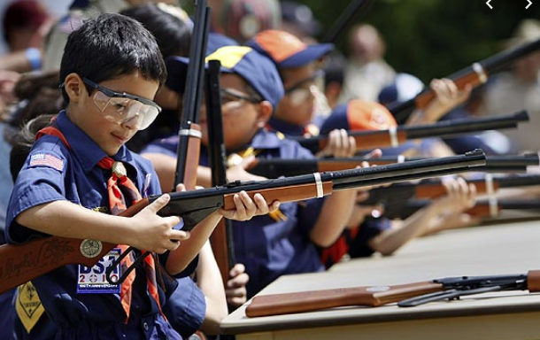
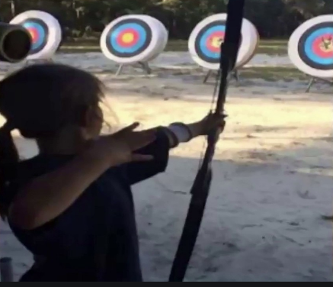
Shooting Sports
Requests for Shooting Events – Lead Time!
  50+ scouts - 6mos
  Less than 50 scouts - 3mos
Shooting on private land:
  Requirements
  Permissions/protocols
Shooting Sports web page
Shooting Sports Instructor Classes:
  Rifle/Shotgun
  Archery (Virtual classes available)

Slide 25
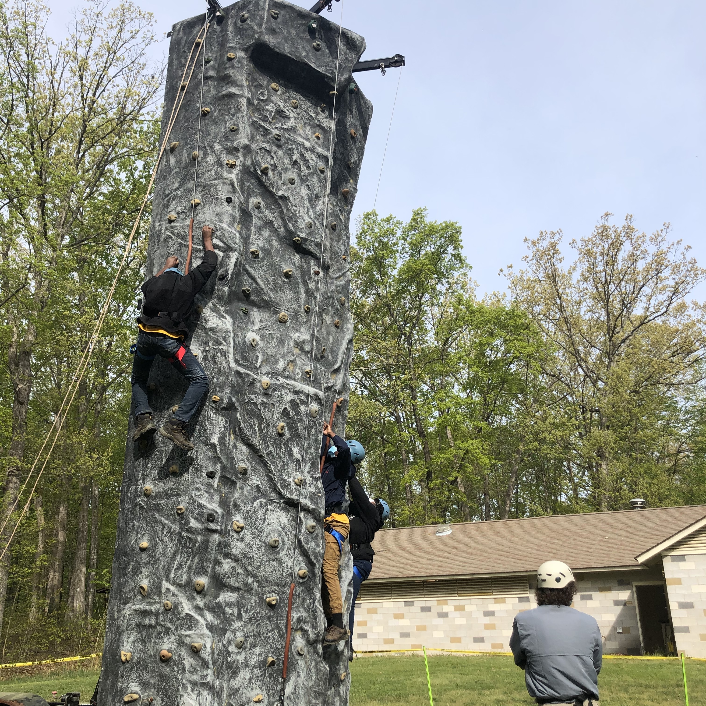
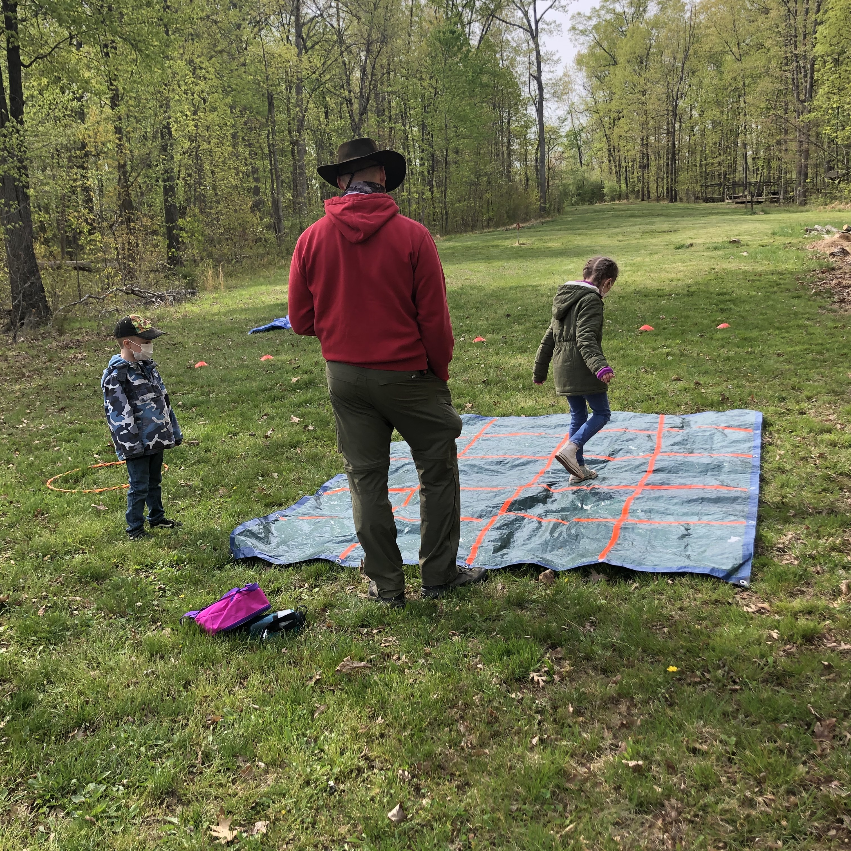
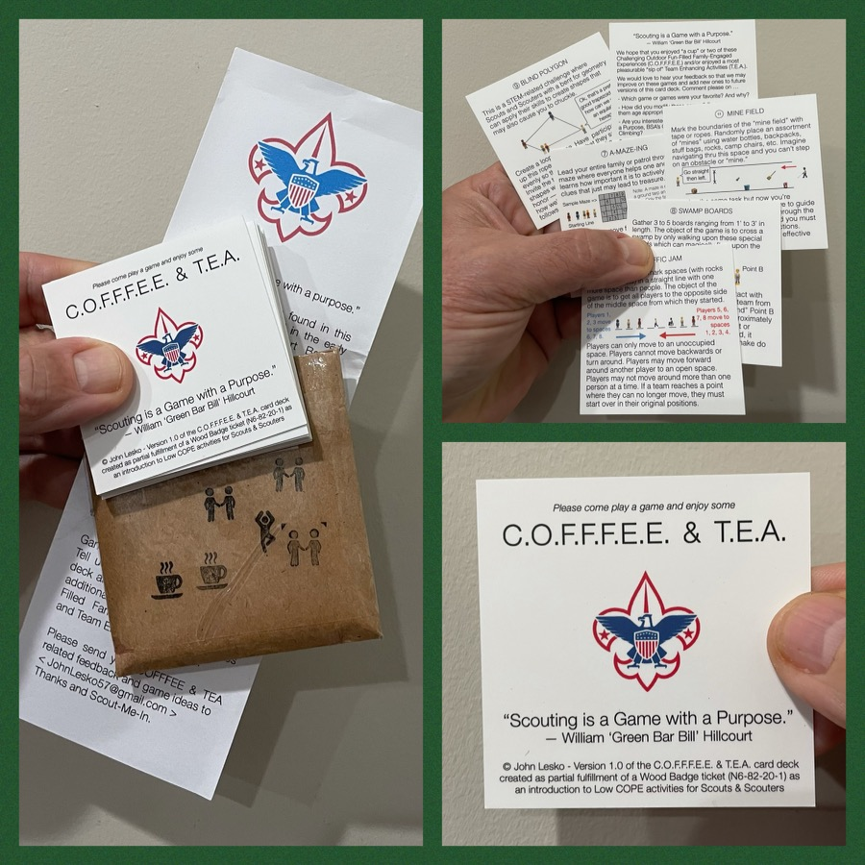
And don’t forget the District’s various COPE and Climbing Opportunities!
Where CUB Scouts learn about teamwork by playing Games with a Purpose
Boy and Girl Scouts learn how to lead their peers while playing these games
And our more senior Scouts, Venturers, and Scouters practice and refine their skills through Challenge Outdoor Fun-Filled Family Engaged Experiences & Team Enhancing Activities (a.k.a. COFFFEE & TEA)
Level 1 & Level 2 training in COPE & Climbing programs need to be coordinated with COPE & Climbing committee chair: Tony Waisanen <ncac.cope@gmail.com>
Interested in obtaining a deck
of COFFFEE & TEA game cards,
E-mail JohnLesko57@gmail.com
—————————————>

Slide 26


Merit Badges
Every merit badge counselor needs to be on the District Charter. The time for action is NOW!
The online Merit Badge Counselor registration works for all Scouters who do not already hold another District position.
Be sure the counselor uses his/her legal name – no nicknames.
Merit Badge Counselors, or the unit Dean/Leader, also need to scan and send Margee the Merit Badge application form listing the badges the counselor is applying to teach and providing a justification of his/her qualifications.
Youth Protection Training is the essential first step. Don’t hit “send” on the application without it!
Contact Margee if you have questions at GM.MB.Dean@hotmail.com.
Online Merit Badge Courses – Watch video, fill out workbook, contact Counselor
Virtual Merit Badge Opportunities (Nation-wide)
Parktakes (select “Scouts” from the Category of Activity)
MeritBadge.Info – Various MB Days throughout the country
Fly Fishing Merit Badge Program, Northern Virginia
Merit Badges Scouts can complete at Home

Slide 27
Other Topics
Order of the Arrow
General Announcements
District Executive Minute
District Chair Minute
District Commissioner Minute
Minutes and slides available on the GMD Website (District Resources, Roundtable)
Next meeting – September 9, 2021 at 7:30pm

