Slide 1

George Mason District
Roundtable
September 9, 2021

Slide 2


Slide 3

Join Scouting Resources
A Cub Scout Makes the Pack Go

Slide 4
Join Scouting/Resources
National Membership Kickoff Webinar
  Tell the benefits – leadership, normal friend activities, scholarship
  Lead with Volunteers – have the Committee Members/parents pitch Scouting
  Get the commitment – have on-line registration and payment
Cub Scouts – Videos at brand center; sample Scout Life Magazine
Recruitment Kit – online resources available
Update your PIN at BeAScout.org
Council Resources (allow two weeks) – jose.calil@scouting.org
  Flyers, yard signs
  Geofencing for Facebook
  Marketing Materials (email at 5pm today)

Slide 5
Council Update/Charter Renewal

Slide 6
2022 Charter Renewal: Changing the Culture
Aug 1 to Oct 14
Membership Inventory
Oct 15 to Oct 31
Data Input
Review
Nov 1
Submit Charter
Annual Agreement
Add Members
A new Charter Renewal software will be used this cycle – we expect it to be simpler and to gather signatures electronically!
Stay tuned for training sessions in mid-September

Slide 7
Get Ready Now!
Designate a Charter Renewal Coordinator
  This person will keep you on track
Membership Inventory
  Who is in My.Scouting.Org and who is in my local roster
Clean the Roster
  Add new members through online registration for faster results
Get the Annual Charter Agreement signed
  Get your IH to sign it now – don’t wait!
Stay close to your Unit Commissioner
  You are not alone! - your UC will help you through the process

Slide 8
Every Scout Deserves a Trained Leader
Attributed to Baden Powell?
Big Rock

Slide 9
Trained Leaders - Why?
Trained leaders show knowledge and confidence and have a positive impact on the quality of programs, retaining youth, providing a safe environment, and a whole lot more.
A trained leader is better prepared to make the Scouting program all it can be!

Slide 10
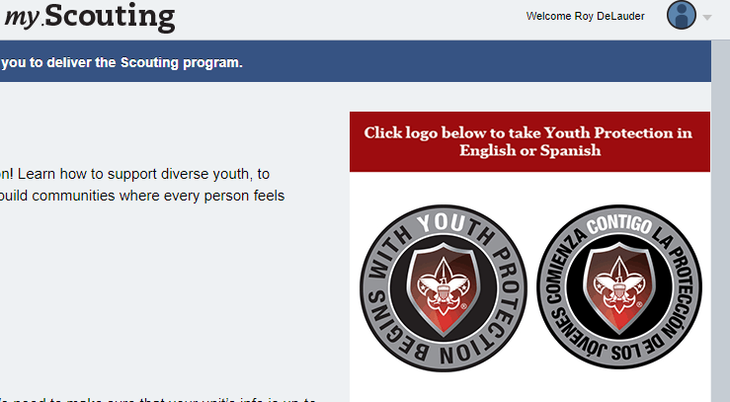
YPT

Slide 11
Youth Protection
“The Boy Scouts of America places the greatest importance on creating the most secure environment possible for our youth members. To maintain such an environment, the BSA developed numerous procedural and leadership selection policies and provides parents and leaders with resources for the Cub Scout, Scouts BSA, and Venturing programs.”

Slide 12

What Makes a Trained Leader?
Cub Scout Leaders - considered trained when they complete Youth Protection, position-specific Cub Scout Leader training, and Hazardous Weather training.
Scoutmaster and Assistant Scoutmasters - considered trained when they have completed Youth Protection, Scoutmaster and Assistant Scoutmaster Leader Specific training, Introduction to Outdoor Leader Skills (IOLS), and Hazardous Weather training.
Committee members - considered trained when they have completed Youth Protection and either Pack Committee Challenge (Cub Scouts) or Troop Committee Challenge (Scouts BSA).

Slide 13
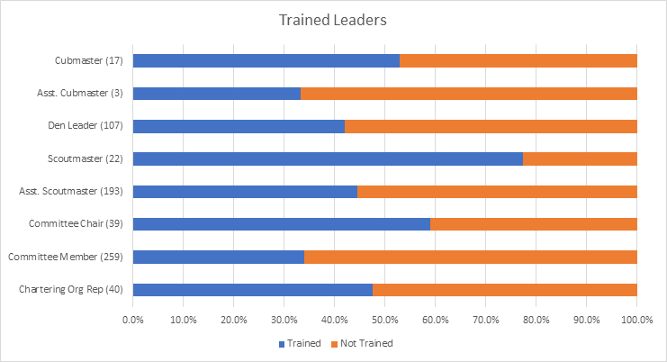
Where does George Mason District stand?

Slide 14
Upcoming Training Opportunities
09/10/21 – 09/12/21 – Introduction to Outdoor Leadership Skills (IOLS), Stafford, VA
09/10/21 – 09/12/21 – Introduction to Outdoor Leadership Skills (IOLS), Haymarket, VA
09/13/21 & 09/18/21 - Leave No Trace/Outdoor Ethics, Virtual/Germantown, MD
09/18/21 - SM/ASM Position Specific Training, Bethesda, MD
09/18/21 - Cub Scout Leader Specific Training (CM/ACM, DL, Committee), St Mark's, Vienna, VA
09/20/21 – Leave No Trace Trainer Course – Outdoor Ethics, Frederick, MD
09/24/21 - 09/26/21 - Basic Adult Leader Outdoor Orientation (BALOO), Stafford, VA
09/25/21 – 09/26/21 – Basic Adult Leader Outdoor Orientation (BALOO), Haymarket, VA
09/25/21 - 09/26/21 - Climbing Level 1 Instructor Training (16 year old and above), Sugarloaf, Dickerson, MD
09/25/21 - Back Country Outdoor Leadership School (BCOLS), Alexandria, VA
09/25/21 - Cub Scout Leader Specific Training (CM/ACM, DL, Committee Members), Herndon, VA
10/01/21 – 10/02/21 – Basic Adult Leader Outdoor Orientation (BALOO), Haymarket, VA
10/02/21 – COR Training, Marriot Scout Center, Bethesda, MD
10/11/21 & 10/16/21 - Leave No Trace/Outdoor Ethics (Trainer Course), Haymarket, VA
10/16/21 – Basic Adult Leader Outdoor Orientation (BALOO), Reston, VA
11/06/21 - 11/07/21 - Introduction to Outdoor Leadership Skills (IOLS), Haymarket, VA

Slide 15
Take aways
Training can be:
  On-line
  In-person
  Can be both
Only YPT is Required – rest is optional
  One BALOO trained is required for Cub Scout Packs to go camping.
Roundtable – great place to find out about Training opportunities.

Slide 16


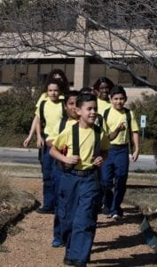

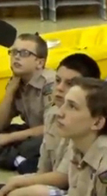


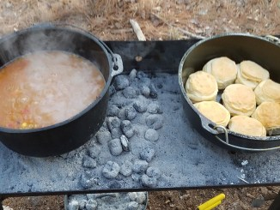
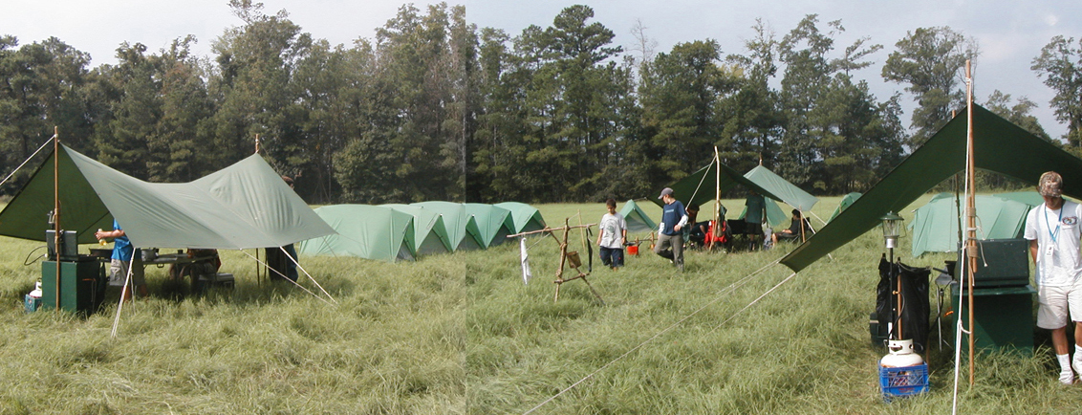
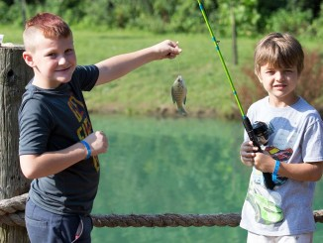
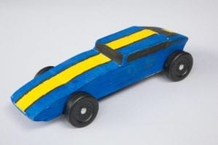
George Mason Program
Matt Burns, Vice Chair Program
Teralyn Carlson, Deputy Vice Chair
George Mason District

Slide 17

Current 2021 GM Calendar
September 25, 2021 – Life to Eagle Seminar
October 15-17, 2021 – GM District STEM Camporee
October 16, 2021 – Jamboree on the Internet/ Jamboree on the Air
November 6, 2021 – Scouting for Food Tag Distribution
November 7, 2021 – Veterans Day Flags In
November 13, 2021 – Scouting for Food Pick Up

Slide 18
Civic and Related Activities of Interest to Scouts
National Public Lands Day – September 25 – Great Falls National Park – Free admission so visitors can enjoy national parks during this celebration of the National Public Lands Day.
Falls Church Fall Community Clean Up – Date TBD – Another service project opportunity benefitting the community.
Falls Church Halloween Carnival – Saturday, October 30 – For youth, 11 and under at the Community Center.
Falls Church – A Very Victorian Christmas – Visit the Cherry Hill Farmhouse to see how Christmas was celebrated in the 1860s.
Fairfax City Festival of Lights and Carols – December 4 from 12 to 6 p.m. in Old Town Square, 10415 North Street

Slide 19
Civic and Related Activities of Interest to Scouts – Cont.
X-Wing Starfighter from “Star Wars” – On display through Jan 1, 2022 at National Air and Space Museum, Udvar-Hazy Center, Dulles
Vienna Halloween Parade – October 27, 2021 at 7 p.m. See website for registration.
Vienna Town Clean Up Days – August, November and April – A great opportunity for units of all ages to conduct a service project and for youth to earn service hours.
Veterans Day at Great Falls – November 11 - Free admission so visitors can remember our veterans by visiting a national park.

Slide 20
Changes to Guide to Advancement
2021 Guide to Advancement (GTA) supersedes the 2019 edition.
2021 Guide had numerous small changes from 2019 Guide.
Only highlighting here changes that are of greatest impact.
If anyone has questions or is uncertain about how to apply the 2021 Guide to Advancement to a specific situation, please contact Matt Burns, George Mason Advancement Chair.

Slide 21
Cub Scouts
Exchanged references to Den Leader Guides with Scoutbook’s Den Leader experience meeting plans and resources
  Identified Scoutbook as the official record of the den and pack
  Simplified the approval process
Removed constraints on the frequency and length of den meetings
Cubs must earn Webelos rank before starting Arrow of Light adventures.
Cubs who are home-schooled should work on the rank that relates to their age.
  Make sure the Cub is able to complete AOL before joining Scouts BSA

Slide 22
Retiring Cub Adventures
Not part of 2021 GTA changes but a 2022 program change
Tigers:
Family Stories
Earning Your Stripes
Tiger Tales
Tiger Theater
Bears
Beat of the Drum
World of Sound
Make it Move
Robotics
Webelos and Arrow of Light
Looking Back, Looking Forward
Maestro
Project Family
Build My Hero
Adventures in Science
Fit it
Movie Making
Wolf
Collections and Hobbies
Grow Something
Hometown Heroes
Motor Away
All are part of Cub program until May 31, 2022
Can no longer be marked as “Completed” in Scoutbook after May 31, 2022
Pin and belt loop supplies may run low as we get into 2022

Slide 23
Scouts BSA
Rank advancement
  Virtual Scoutmaster conferences are OK but not preferred
  NCAC now (9/8/21) authorized video-conference boards of review for Eagle.
  Scout now have twenty-four (24) months after their 18th birthday or end of extension, whichever comes later, to have their Eagle Board of Review. 2019 Guide allowed 3 months.
    After 24 months, Scout has to file a Belated Rank Application.
    Must be approved by National.

Slide 24
Extensions and Palms
Scouts can request extensions of time to earn Eagle, Summit and Quartermaster
  We covered new extension request process earlier in 2021.
  It was incorporated in the 2021 GTA
Scouts that earn merit badges during an approved extension request can use those merit badges to qualify for Palms, even though badges were earned after their 18th birthday.

Slide 25
Merit Badges
2021 GTA recommends, but does not require, using Scoutbook’s digital system and “Blue Cards” to document Scout progress.
Electronic forms of merit badge reporting (non-Blue Card) are acceptable as long as they track partial completions
All counselors, in all settings (virtual included) must be approved by Council as a merit badge counselor for the badge(s) being counseled. This includes Scoutmasters.
Changes in merit badge requirements will be found first on Scouting.org.
NCAC – specific – Merit badge counselors will need to be trained. New ones starting 11/1/21. Existing by 12/31/22.

Slide 26
Other Scouts BSA Changes
Stronger language regarding no retesting.
  Unit leaders carefully select and train those who approve advancement.
Updated safety references for service projects
Communicable disease now acceptable reason to hold a video-conference board of review.
Scout Must not stage an Eagle Scout service project that primarily collects money.
Unit leaders must not ask Scouts to provide blue cards or other proof of merit badge completion for earned badges.

Slide 27
Ventures
Venturing, Discovery, Pathfinder and Summit are now ranks, not awards.
Registration in a Scouts BSA unit no longer required for a youth that has already reached First Class to complete Scouts BSA requirements.
“Multiple credit” section has been rewritten.
Venturing Boards of Review now must be unanimous.
Eagle extension rules/process also applies to Summit
Venture Scouts now have 24 months after their 21rst birthday to participate in a Summit Board of Review.

Slide 28
District Adult Awards
Silver Beaver – Nominations due by October 31, 2021 for sustained superior service at the District level. Limit is at NCAC level.
District Award of Merit – Nominations due by December 31, 2021 for sustained superior service at the District level. George Mason can award two.
District awards committee will review nominations.
Anyone interested in putting forward a candidate should submit the adult volunteer’s name/rationale to gm.adultrecognition@gmail.com by September 30, 2021.

Slide 29
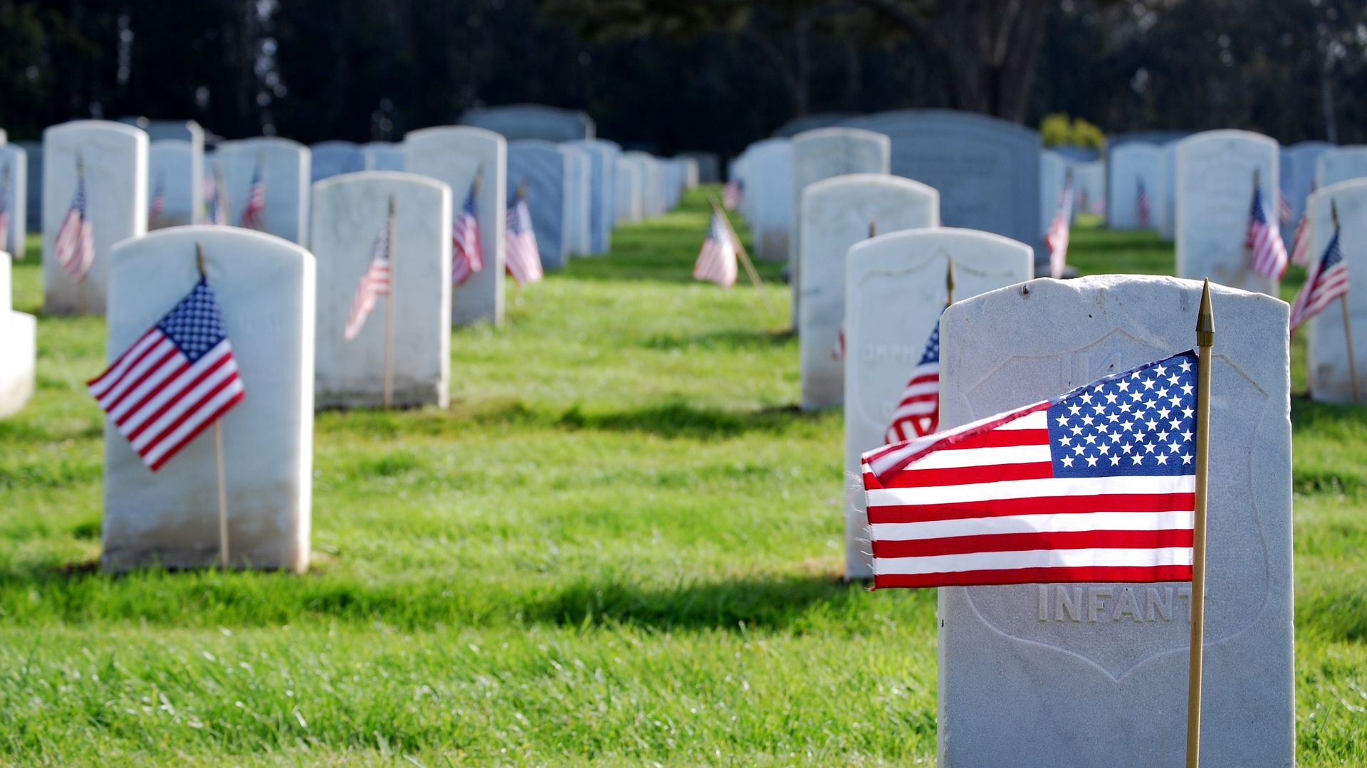
Flags In
November 7, 2021
Flag placement will start at 10:00 am
Social distancing – bring a mask.
National Memorial Park, 7482 Lee Highway, Falls Church
All Scouts, including Girl Scouts, are welcome.
Class A Uniforms
For more info, contact Russell Pittman at ruspittman@gmail.com.

Slide 30
SCOUTS BSA Roundtable

Slide 31

District Life to Eagle Seminar
Saturday, 25 September 2021
1:00 to 4:00 p.m.
Virtual
Register at:
https://site.corsizio.com/c/60eefcdba647dcba68c93d8e
Who should attend:
Life Scouts or advanced Star Scouts who want to pursue the Eagle Rank
Eagle advisors, coaches or unit leaders that haven’t attended a seminar in two years
Parents of Scouts working on Eagle or other adults interested in Scouting
Registration will be done online and must be received by 23 September 2020 to get the Zoom link.
Any questions contact Jack Lundin at 703-938-0369.

Slide 32


GEORGE MASON DISTRICT CAMPOREE
Date:
October 15 – 17, 2021
Location: 4H Camp, Front Royal, VA.
Online registration available now on Council website (below).
Leader Guide available on registration site.
Need unit volunteers to help run event.
Camporee Director Andrew Zaso
(703) 434-2907 - AndrewZaso@gmail.com
Register at: https://scoutingevent.com/082-49459

Slide 33
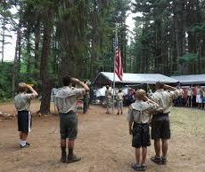
Future Camporees
Save the Dates!!!
George Mason Spring 2022 Camporee – April 29 – May 1, 2022
  Theme and Site TBD
George Mason Fall 2022 Camporee – October 21 – 23, 2022
  Theme and Site TBD
Please factor this into unit calendars/planning.
Scouts are loyal – including loyalty to District activities.

Slide 34
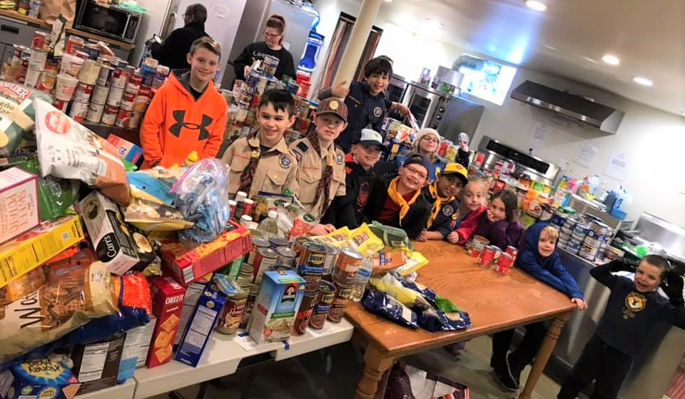
Scouting for Food
November 6 and November 13, 2021
Scott Willey is 2021 District Coordinator

Slide 35

High Adventure
Northern Virginia 4-H Educational Center, Front Royal, VA. Registration is limited to trail capacities of the fifteen trails.
Participation age is 13 years old as of January 1, 2022
Registration on a FIRST COME, FIRST SERVED BASIS begins on September 1, 2021, on the BSA National Capital Area Council website: https://scoutingevent.com/082-50574
Because of the lead-time required to produce the t-shirts, the final date to provide shirt numbers and sizes (S, M, L, XL, 2XL) is October 8. NO ADDITIONAL ORDERS CAN BE TAKEN AFTER THAT DATE.

Slide 36
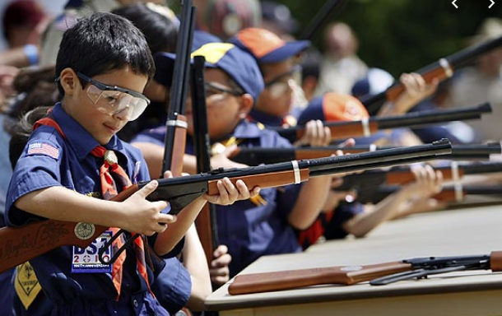
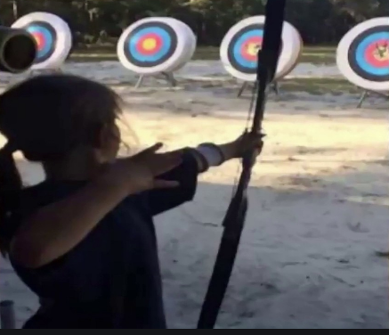
Shooting Sports
Requests for Shooting Events – Lead Time!
  50+ scouts - 6mos
  Less than 50 scouts - 3mos
Shooting on private land:
  Requirements
  Permissions/protocols
Shooting Sports web page
Shooting Sports Instructor Classes:
  Rifle/Shotgun
  Archery (Virtual classes available)

Slide 37
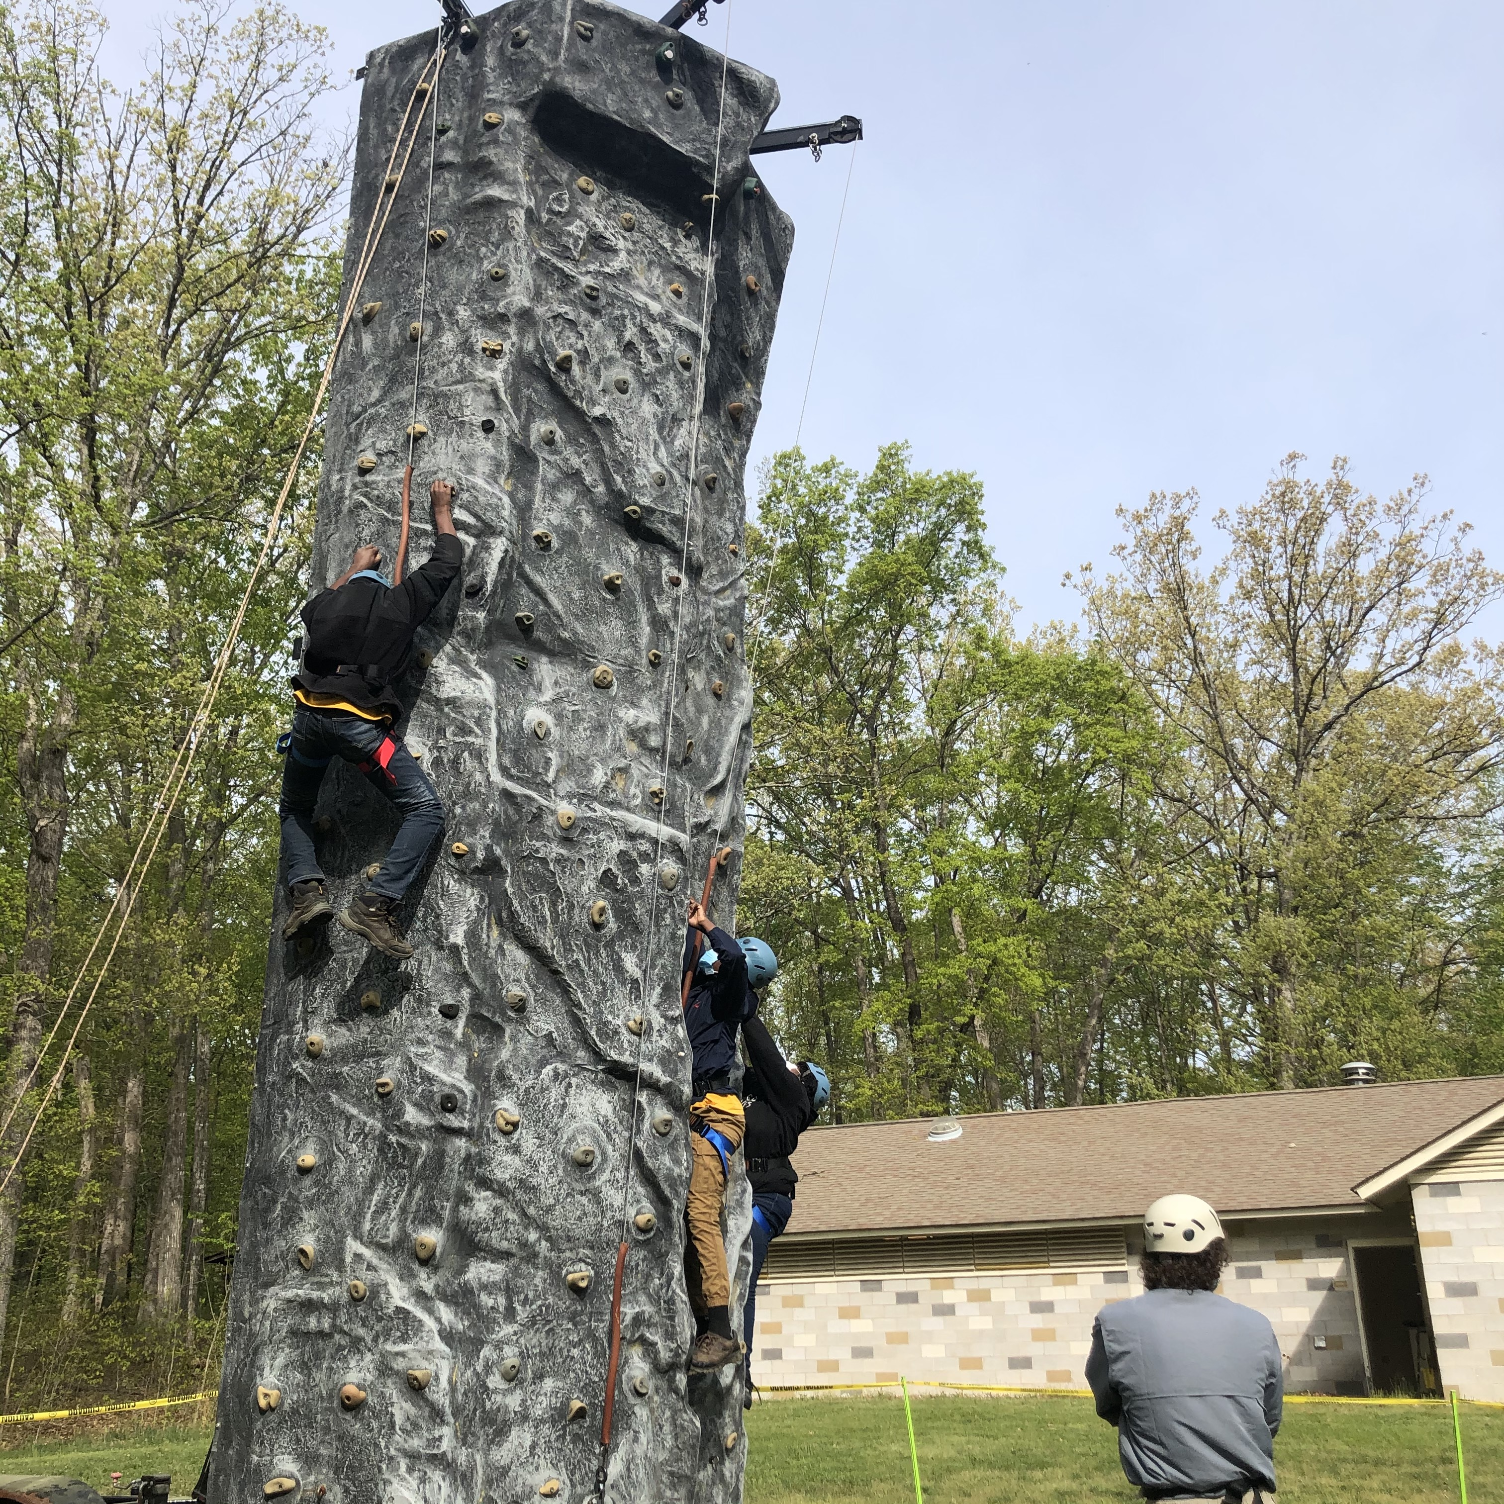
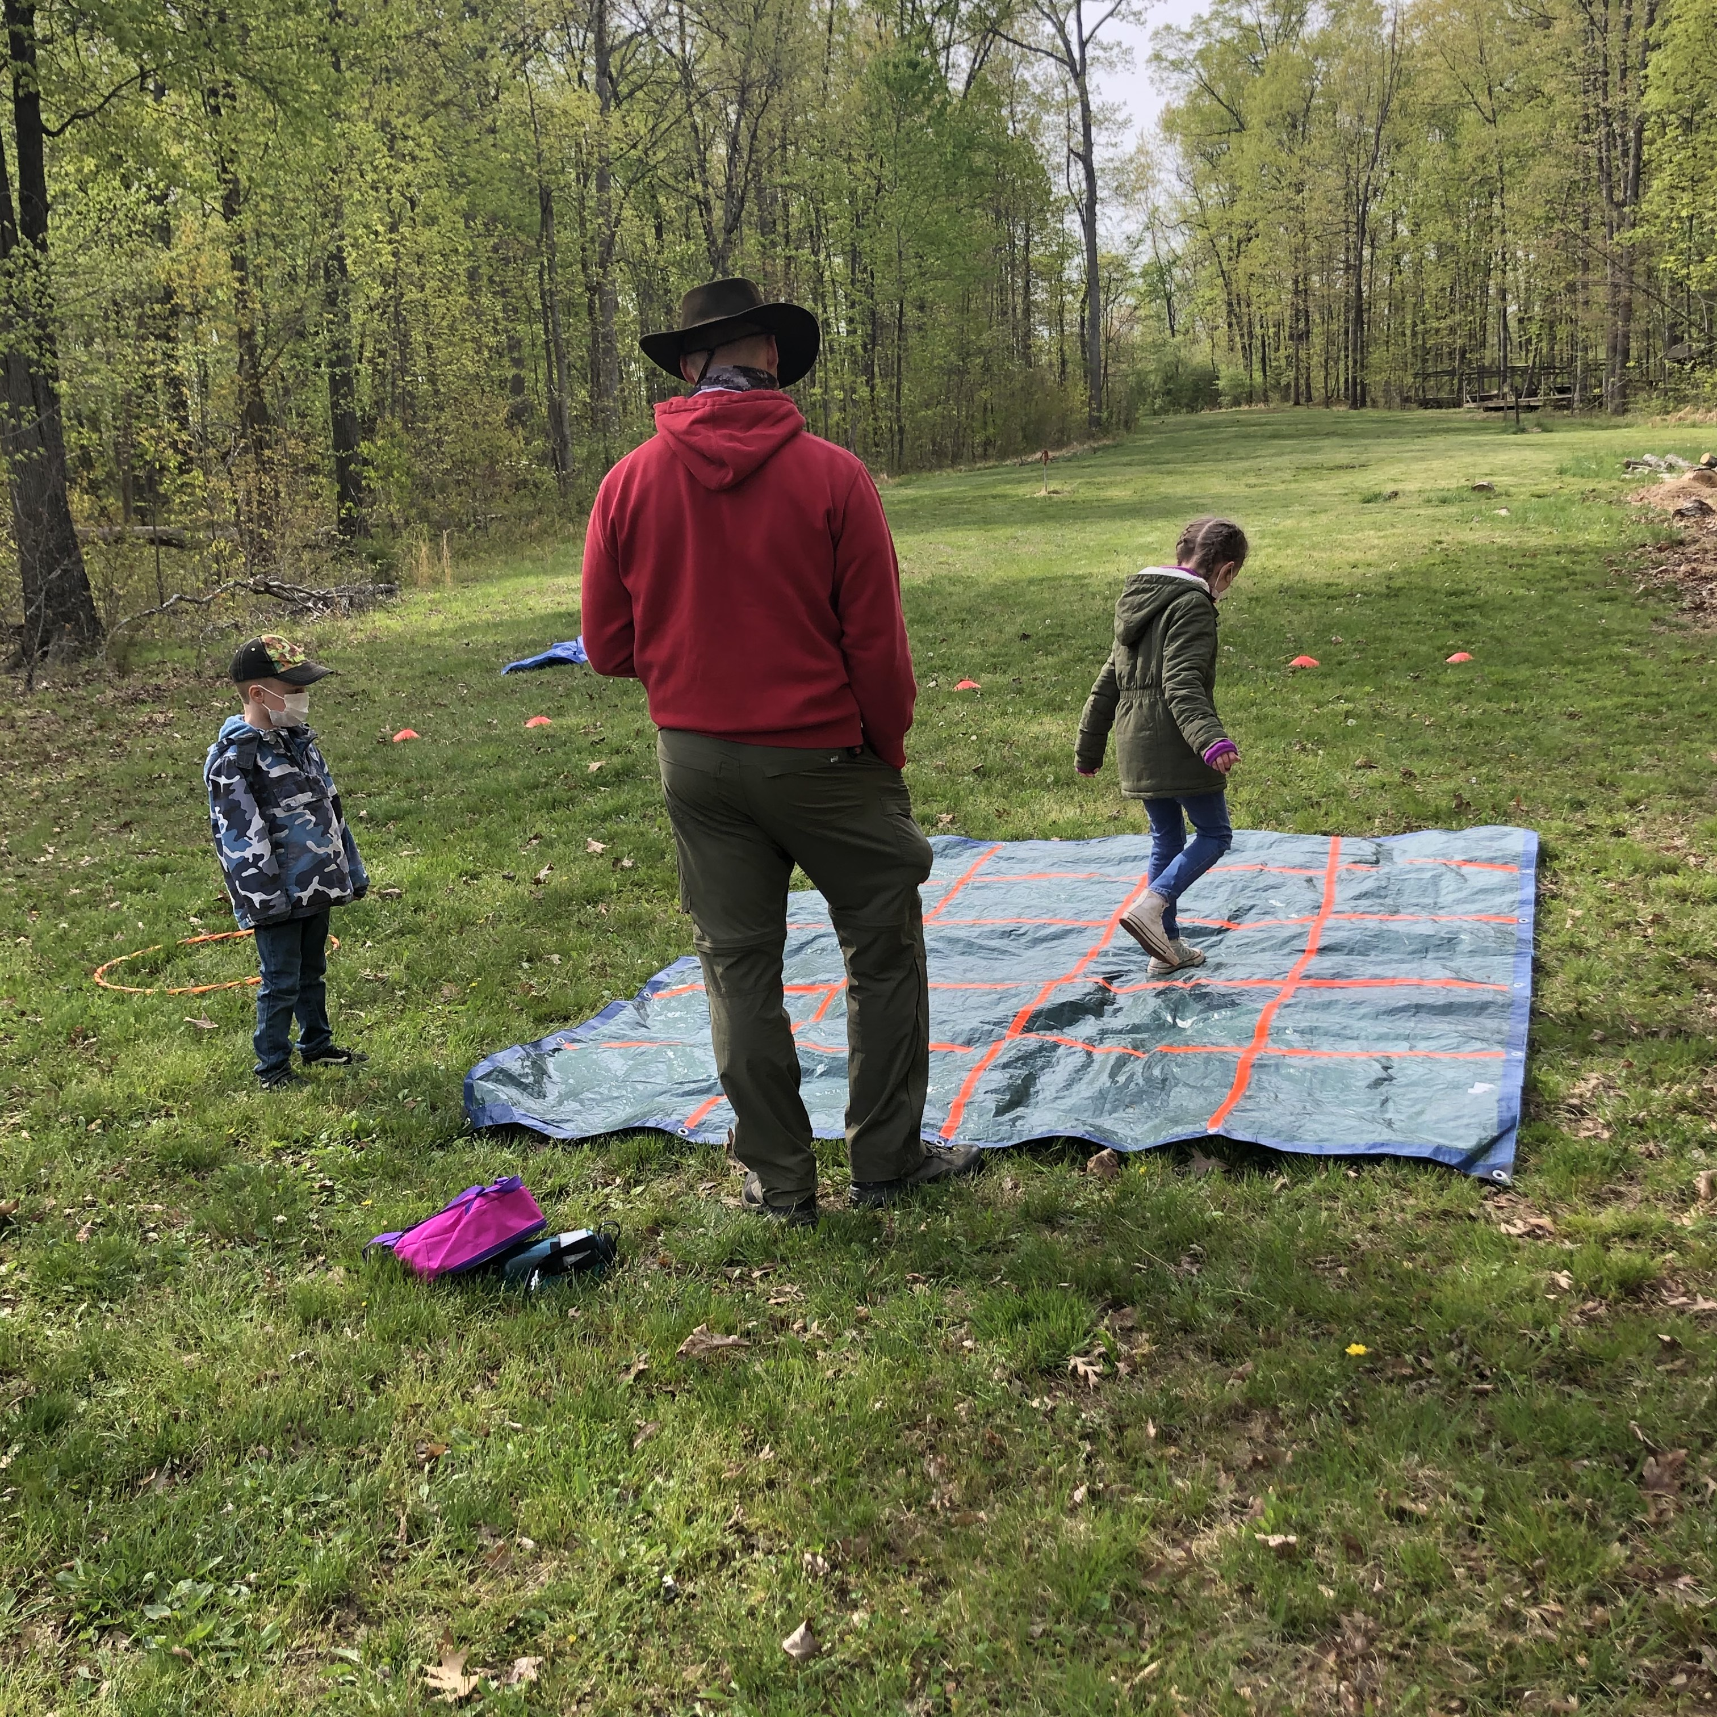
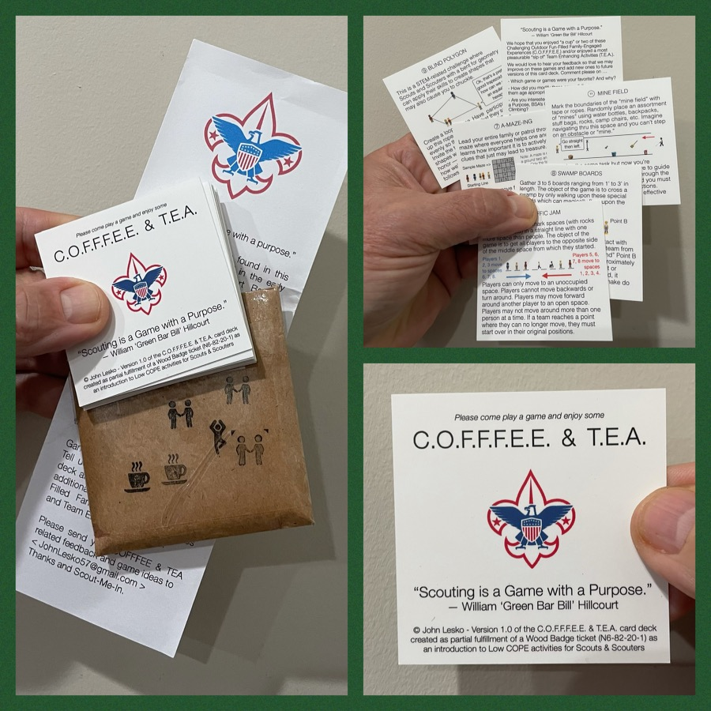
And don’t forget the District’s various COPE and Climbing Opportunities!
Where CUB Scouts learn about teamwork by playing Games with a Purpose
Boy and Girl Scouts learn how to lead their peers while playing these games
And our more senior Scouts, Venturers, and Scouters practice and refine their skills through Challenge Outdoor Fun-Filled Family Engaged Experiences & Team Enhancing Activities (a.k.a. COFFFEE & TEA)
Level 1 & Level 2 training in COPE & Climbing programs need to be coordinated with COPE & Climbing committee chair: Tony Waisanen <ncac.cope@gmail.com>
Interested in obtaining a deck
of COFFFEE & TEA game cards,
E-mail JohnLesko57@gmail.com
—————————————>

Slide 38


Merit Badges
Every merit badge counselor needs to be on the District Charter. The time for action is NOW!
The online Merit Badge Counselor registration works for all Scouters who do not already hold another District position.
New Merit Badge Counselors must complete online merit badge counselor training, in addition to YPT, after November 1, 2021. Existing merit badge counselors have until 12/31/22 to complete training.
Be sure the counselor uses his/her legal name – no nicknames.
Merit Badge Counselors, or the unit Dean/Leader, also need to scan and send Margee the Merit Badge application form listing the badges the counselor is applying to teach and providing a justification of his/her qualifications.
Youth Protection Training is the essential first step. Don’t hit “send” on the application without it!
Contact Margee if you have questions at GM.MB.Dean@hotmail.com.
Online Merit Badge Courses – Watch video, fill out workbook, contact Counselor
Virtual Merit Badge Opportunities (Nation-wide)
Parktakes (select “Scouts” from the Category of Activity)
MeritBadge.Info – Various MB Days throughout the country
Fly Fishing Merit Badge Program, Northern Virginia
Merit Badges Scouts can complete at Home

Slide 39
Other Topics
Order of the Arrow
General Announcements
District Executive Minute
District Chair Minute
District Commissioner Minute
Minutes and slides available on the GMD Website (District Resources, Roundtable)
Next meeting – October 14, 2021 at 7:30pm

