Slide 1

George Mason District
Roundtable
October 14, 2021

Slide 2


Slide 3
Council Update/Charter Renewal

Slide 4
2022 Charter Renewal Milestones
Aug 1 to Oct 14
Membership Inventory
Oct 15 to Oct 31
Data Input
Review
Nov 1
Submit Charter
Annual Agreement
Add Members

Slide 5
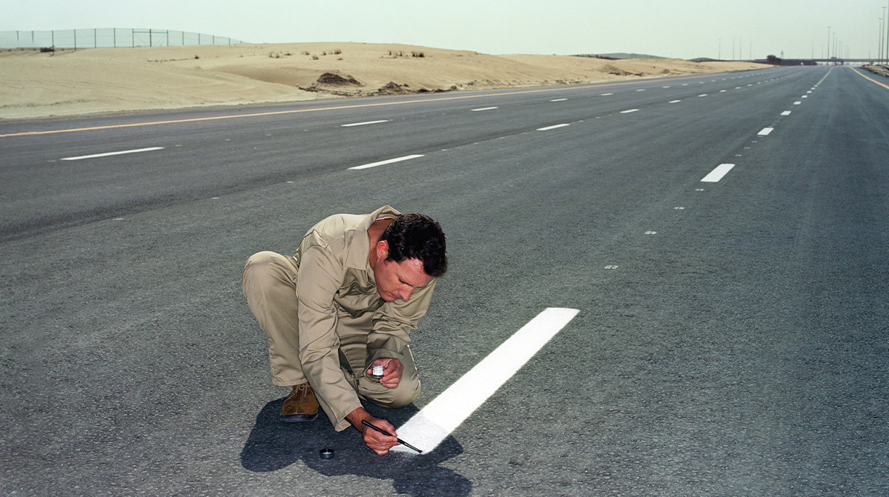
Don’t let perfection be the enemy
of productivity
Nick Dolding/Getty Images

Slide 6
Get Ready to Use the New System
Make the Charter Renewal Coordinator a K-3 delegate
Get trained on the new system
  Basecamp Project
  National Site
    https://www.scouting.org/resources/internet-rechartering/
Get the Annual Charter Agreement signed
  Get your IH to sign it now – don’t wait!
Stay close to your Unit Commissioner
  You are not alone! - your UC will help you through the process

Slide 7
Community Service
Big Rock

Slide 8
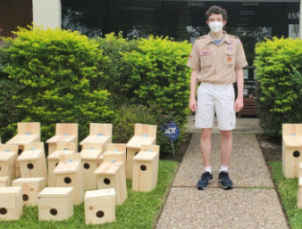
George Mason Service Hours (from our JTE)
Oct 2019-2020 1898.4
Oct 2020-2021 1524.75
Down 19% for COVID

Slide 9
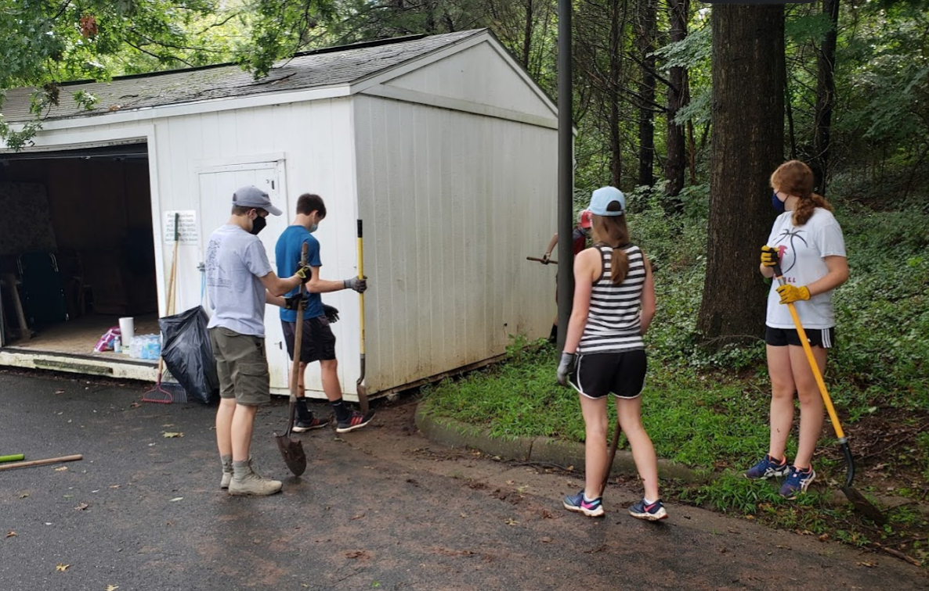
What makes up your Community?
Neighborhoods
Chartering Organization
Schools
Parks
Campgrounds
Camps (e.g., Snyder, Goshen)
Parades

Slide 10
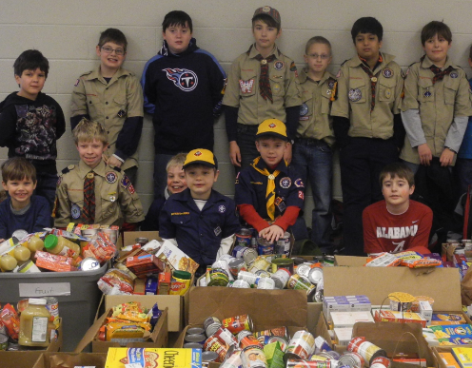
Cub Scout Ideas
Pick up litter at a park.
Put together a book drive for a local children’s shelter.
Write thank you notes to local fire and police stations.
Plant trees or wildflowers.
Perform magic tricks at a retirement center (Outside of Covid)
Collect old eyeglasses and donate them to an organization that recycles them.
Write letters to servicemen and women thanking them for their service.
Collect nonperishable food items. Scouting for Food.
Collect items like old towels, blankets and unopened pet food to donate to animal shelters.
Collect items for a time capsule.
Write greeting cards for a local nursing home.
Develop and maintain a recycling program at school.
Collect and donate clothing and toys to the needy.

Slide 11
Service Ideas
https://scoutlife.org/hobbies-projects/funstuff/166463/15-community-service-projects-perfect-for-kids-and-cub-scouts/
https://cubscoutideas.com/79/community-service-involvement/
https://www.scouting.org/outdoor-programs/conservation-and-environment/youth-service/
Scout Service Request
https://www.bsacac.org/activities/service-projects/

Slide 12

Jamboree-on-the-Air/
Jamboree-on-the-Internet
What: An annual event in which Scouts all over the world connect with each other, by means of amateur radio and/or the Internet, to share ideas and exchange experiences.
When: Starts at 00:00 h local time on 16 October and runs up to 23:59 h local time on 17 October.
More info: https://www.jotajoti.info/

Slide 13


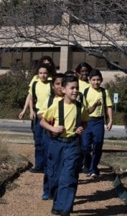

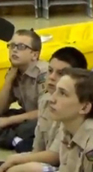

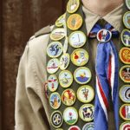
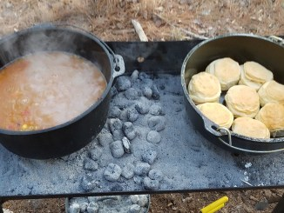
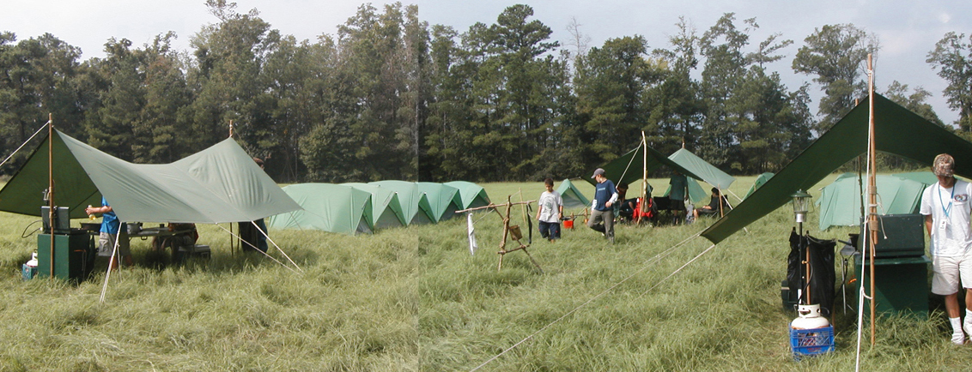
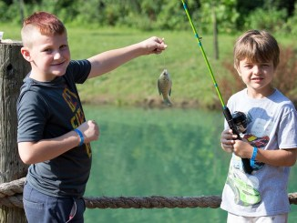
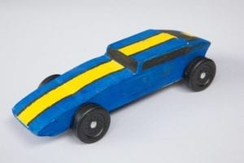
George Mason Program
Matt Burns, Vice Chair Program
Teralyn Carlson, Deputy Vice Chair
George Mason District

Slide 14

Current 2021 GM Calendar
October 15-17, 2021 – GM District STEM Camporee
October 16, 2021 – Jamboree on the Internet/ Jamboree on the Air
November 6, 2021 – Scouting for Food Tag Distribution
November 7, 2021 – Veterans Day Flags In
November 13, 2021 – Scouting for Food Pick Up

Slide 15
Civic and Related Activities of Interest to Scouts
Falls Church Fall Community Clean Up – Date TBD – Another service project opportunity benefitting the community.
Falls Church Halloween Carnival – Saturday, October 30 – For youth, 11 and under at the Community Center.
Falls Church – A Very Victorian Christmas – Visit the Cherry Hill Farmhouse to see how Christmas was celebrated in the 1860s.
Fairfax City Festival of Lights and Carols – December 4 from 12 to 6 p.m. in Old Town Square, 10415 North Street

Slide 16
Civic and Related Activities of Interest to Scouts – Cont.
Vienna Halloween Parade – October 27, 2021 at 7 p.m. See website for registration.
Vienna Town Clean Up Days – August, November and April – A great opportunity for units of all ages to conduct a service project and for youth to earn service hours.
Veterans Day at Great Falls – November 11 - Free admission so visitors can remember our veterans by visiting a national park.
X-Wing Starfighter from “Star Wars” – On display through Jan 1, 2022 at National Air and Space Museum, Udvar-Hazy Center, Dulles

Slide 17
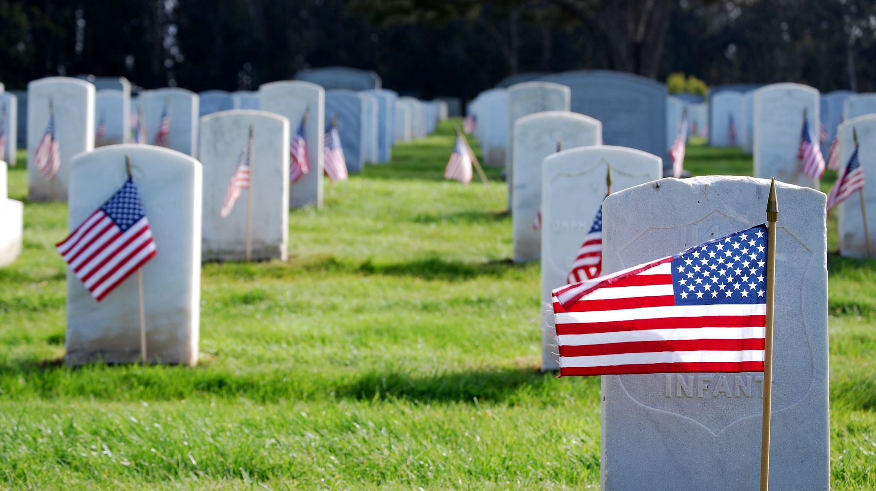
Flags In
November 7, 2021
Flag placement will start at 12:00 noon
Social distancing – bring a mask.
National Memorial Park, 7482 Lee Highway, Falls Church
All Scouts, including Girl Scouts, are welcome.
Class A Uniforms
For more info, contact Russell Pittman at ruspittman@gmail.com.

Slide 18


GEORGE MASON DISTRICT CAMPOREE
Date:
October 15 – 17, 2021
Location: 4H Camp, Front Royal, VA.
Online registration available now on Council website (below).
Leader Guide available on registration site.
Need unit volunteers to help run event.
Camporee Director Andrew Zaso
(703) 434-2907 - AndrewZaso@gmail.com
Register at: https://scoutingevent.com/082-49459

Slide 19
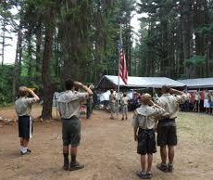
Future Camporees
Save the Dates!!!
George Mason Spring 2022 Camporee – April 29 – May 1, 2022
  Theme and Site TBD
George Mason Fall 2022 Camporee – October 21 – 23, 2022
  Theme and Site TBD
Please factor this into unit calendars/planning.
Scouts are loyal – including loyalty to District activities.

Slide 20
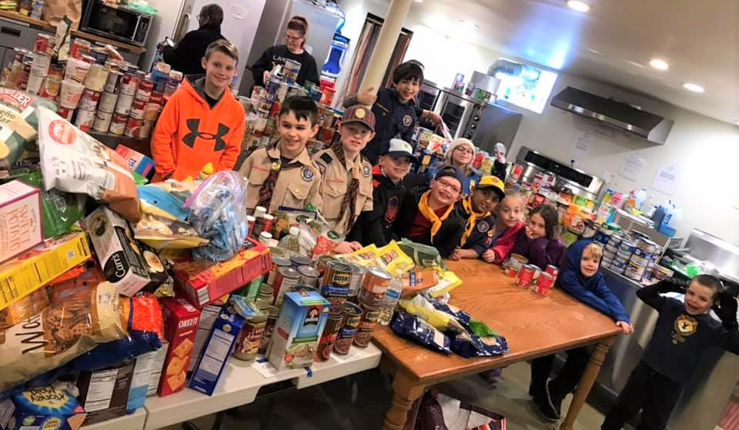
Scouting for Food
November 6 and November 13, 2021
Please email the name and contact information for your Unit's Scouting for Food Coordinator to Scott Willey: willeysj@gmail.com
He will add you to the Basecamp site we are using to convey updates
Good news! NCAC is providing stickers, and this event should be fairly normal this year
Unit Commissioners will be asked if they can help distribute stickers

Slide 21
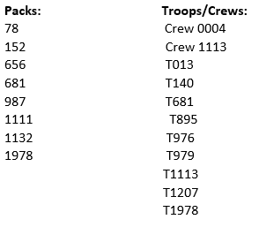
Scouting for Food (cont.)
Still need POCs for:
Link to the map: ArcGIS - George Mason Scouting for Food Last year was weird with COVID so please check for errors
St Leo's Church food pantry has not confirmed yet. If for some reason they don't participate we will have to reassign drop off points. I'll let you know in Basecamp if that's the case.

Slide 22
GM High Adventure
(October 2021)
NCAC High Adventure Committee (HAC) updates and announcements: https://www.ncacbsa.org/high-adventure/
  2022 National High Adventure Base slots still available
  Updated HA Source Book (volumes I and II): https://3.basecamp.com/3958009/buckets/16000091/vaults/2777714268
  Local day hikes, overnight, and multi-day treks: https://3.basecamp.com/3958009/buckets/16000091/uploads/3272427444
New BSA Adventure Planning Resource: The Adventure Plan (TAP) https://tap.scouting.org/
Contact Joe Knecht at knechtjoe@yahoo.com if you have questions regarding high adventure planning or need assistance accessing HAC documents.

Slide 23
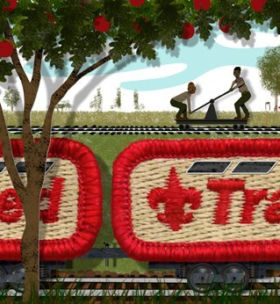
Training
Unit Training – For position-specific training at your unit,
contact Roy De Lauder at EagleScout.Roy@cox.net or
go to Training Opportunities page on GM Web Site.
Scouts BSA Training
10/23/21 - 10/24/21 - IOLS, Camp Snyder, Haymarket, VA
10/30/21 - 10/31/21 - IOLS, Lorton, VA
11/06/21 - 11/07/21 - IOLS, Haymarket, VA
11/20/21 - Scoutmaster Specific Training, Alexandria, VA
12/04/21 - Scoutmaster Specific Training, Alexandria, VA
Cub Scout Training:
10/16/21 - 10/17/21 - BALOO Training, Reston, VA
10/30/21 - 10/31/21 - BALOO Training, Lorton, VA
10/30/21 - Cub Scout Leaders Specific Training (CM, ACM, Committee and Den Leaders), Stafford, VA
11/20/21 - Akela’s Trail (was POW-WOW; Virtual), Bethesda, MD

Slide 24
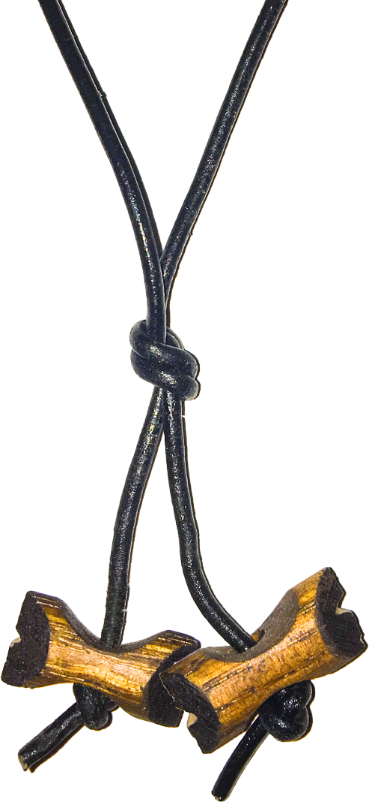
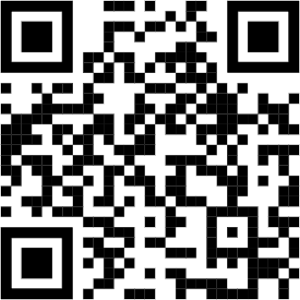
2022 Wood Badge Registration NOW Open
Spring Course
Register at: https://www.ncacbsa.org/wood-badge/
Weekend #1: 29 April - 1 May
Weekend #2: 13 – 15 May
Course Director: Mr. John Howlin
johnhowlinjr@yahoo.com
Fall Course
Registration Open 30 April, 2022
Weekend #1: 9 - 11 September
Weekend #2: 8 - 9 October
Course Director: Mr. Rick Rogers
rsrogers4@gmail.com
Wood Badge could be postponed or delayed based on covid restrictions
Wood Badge is the Boy Scouts of America’s ultimate leadership training designed to meet the advanced leadership needs of Scouters in all aspects of the BSA, whether unit, district, or council level – from assistant den leaders to Scoutmasters, from Cubmasters to Venturing Advisors, from committee members to commissioners. It is a fun, energetic and inspiring course guaranteed to infuse your unit with fun and meaning – all designed to fulfill the mission of the BSA, and ensure our youth is getting everything they are promised from the program.
QUESTIONS?
For information about specific courses, contact the Course Director listed above.

Slide 25

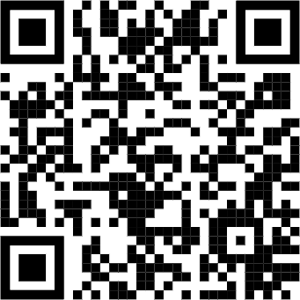
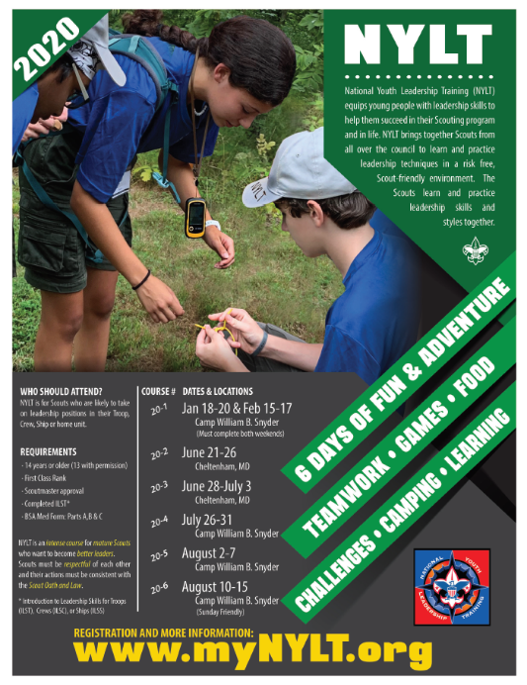
NYLT training – 2022 Schedule
Winter course Registration opens October 24th at 1000
Typically fills very quickly. Waitlist will be available.
May require participants and staff to show proof of vaccination. Still being decided.
Entire 2022 Schedule
Course | Course Dates | location
22-1 | Jan 14-17; Jan 21-23 | Snyder
22-2 | June 19-24 | Snyder
22-3 | June 26 to Jul 1 | Cheltenham
22-4 | July 24-29* | Snyder
22-5 | July 24-29* | Snyder
Updated flyer coming soon
* courses running concurrently
George Mason has sent an increasing percentage of Scouts attending NYLT
2016 | 2017 | 2018 | 2019 | 2020 | 2021
7 Scouts | 9 Scouts | 7 Scouts | 20 Scouts | -- | 16 Scouts
7% of the 292 available slots
11% of the 144 available slots
Questions? Email contact@my.NYLT.org

Slide 26
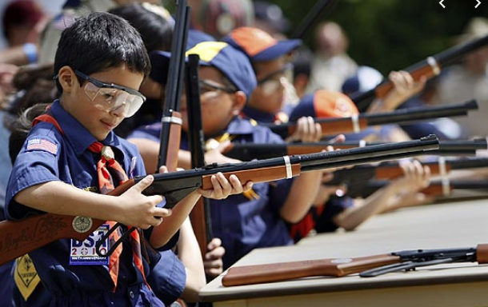
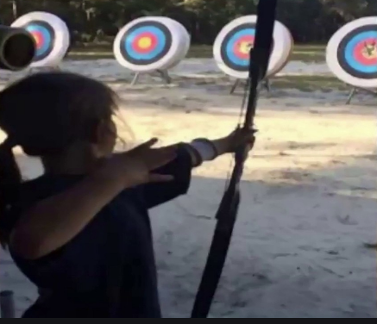
Shooting Sports
Requests for Shooting Events – Lead Time!
  50+ scouts - 6mos
  Less than 50 scouts - 3mos
Shooting on private land:
  Requirements
  Permissions/protocols
Shooting Sports web page
Shooting Sports Instructor Classes:
  Rifle/Shotgun
  Archery (Virtual classes available)

Slide 27
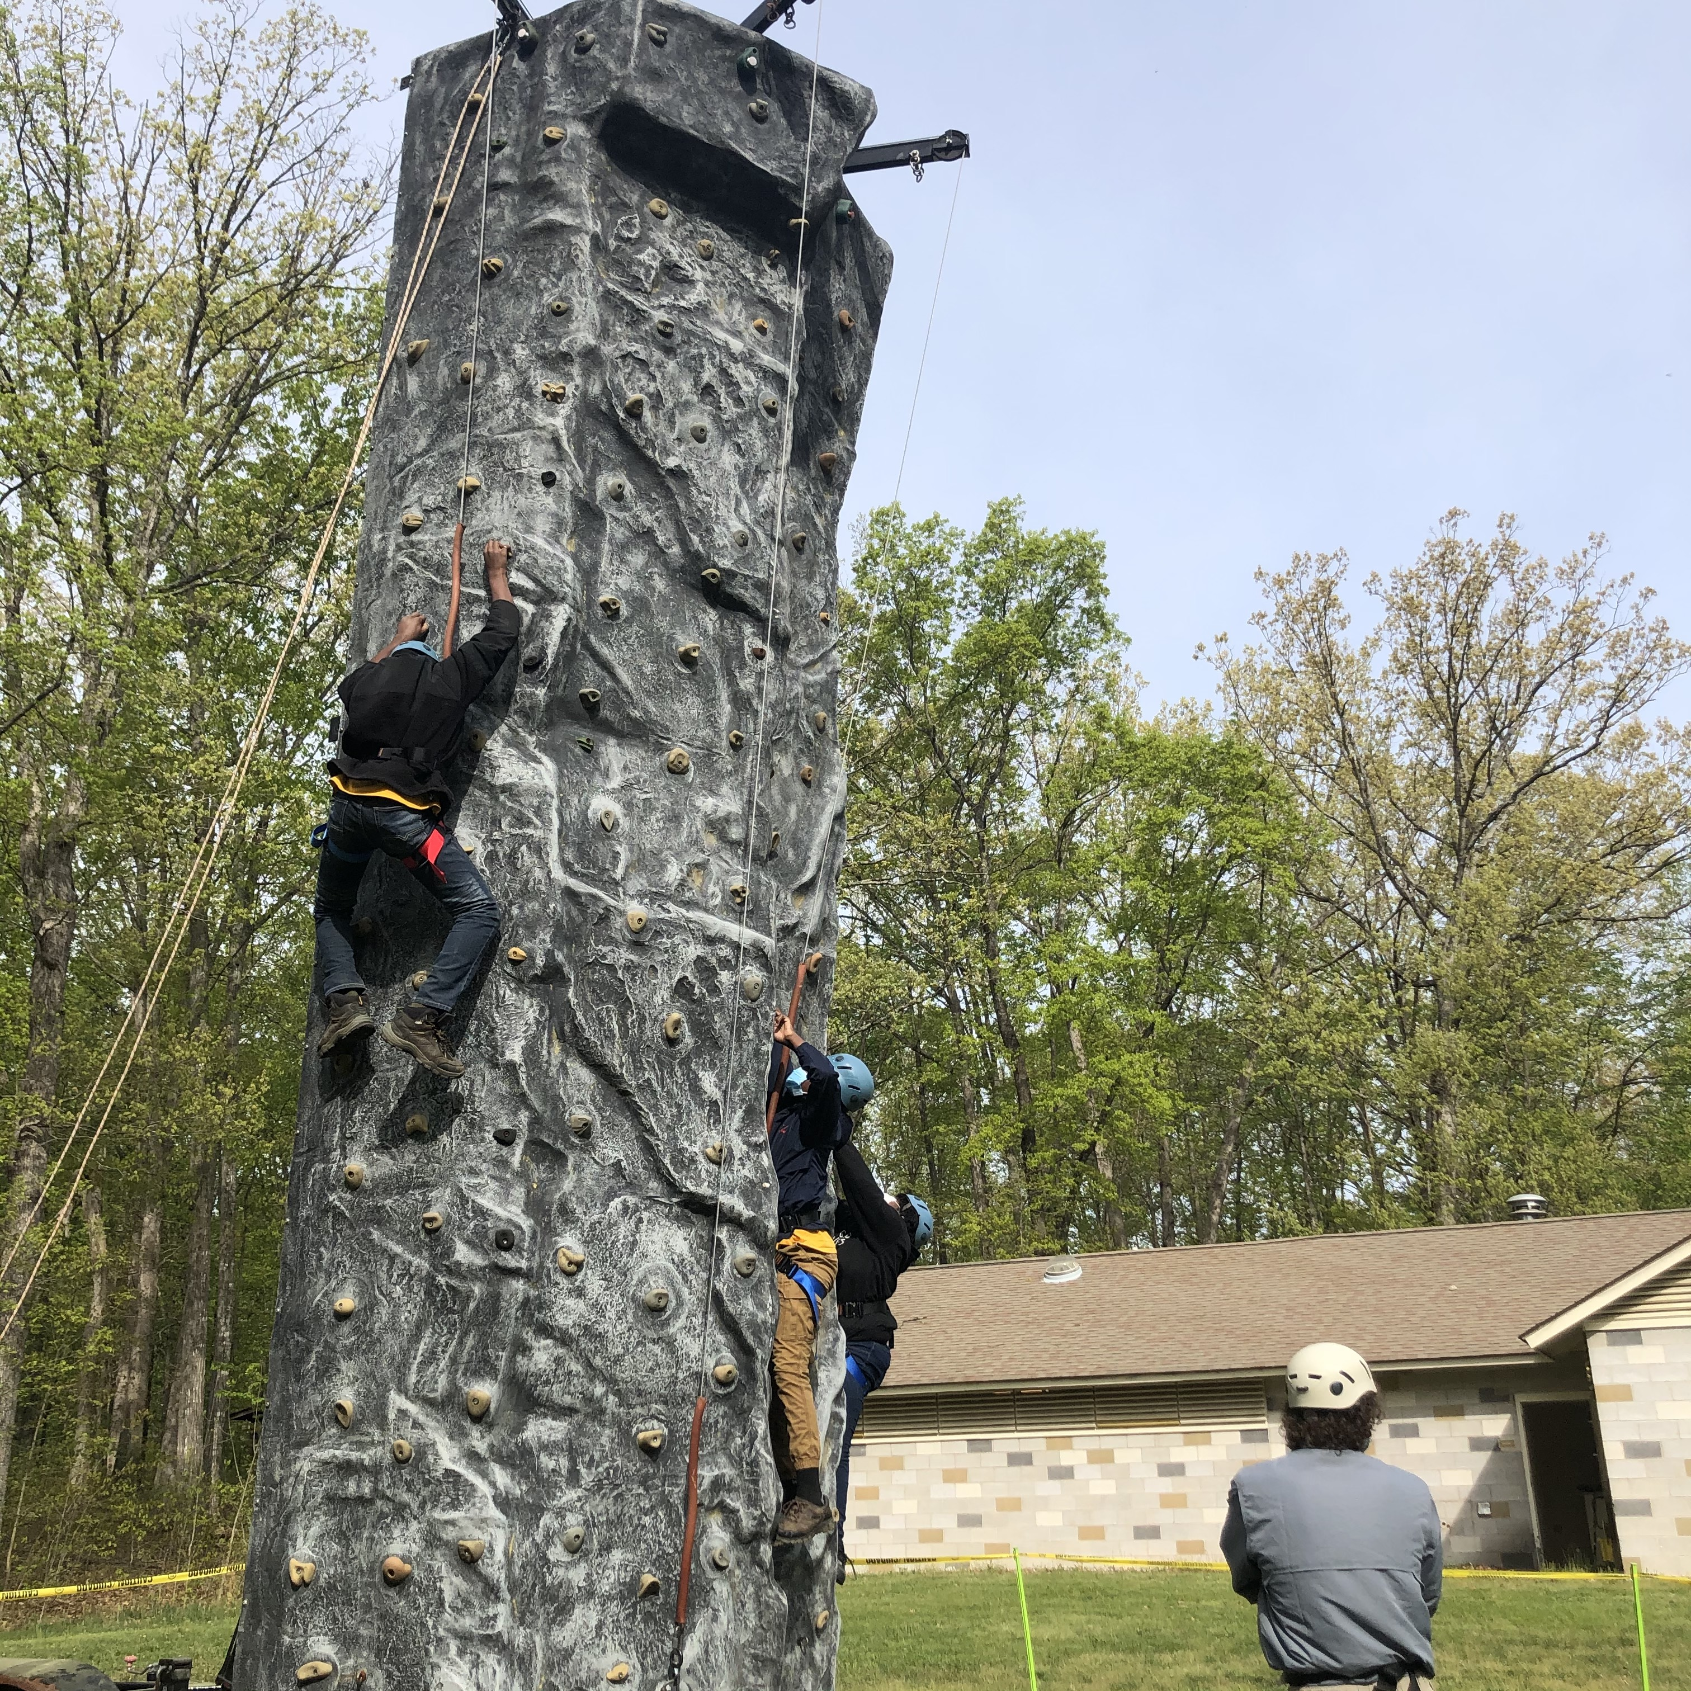
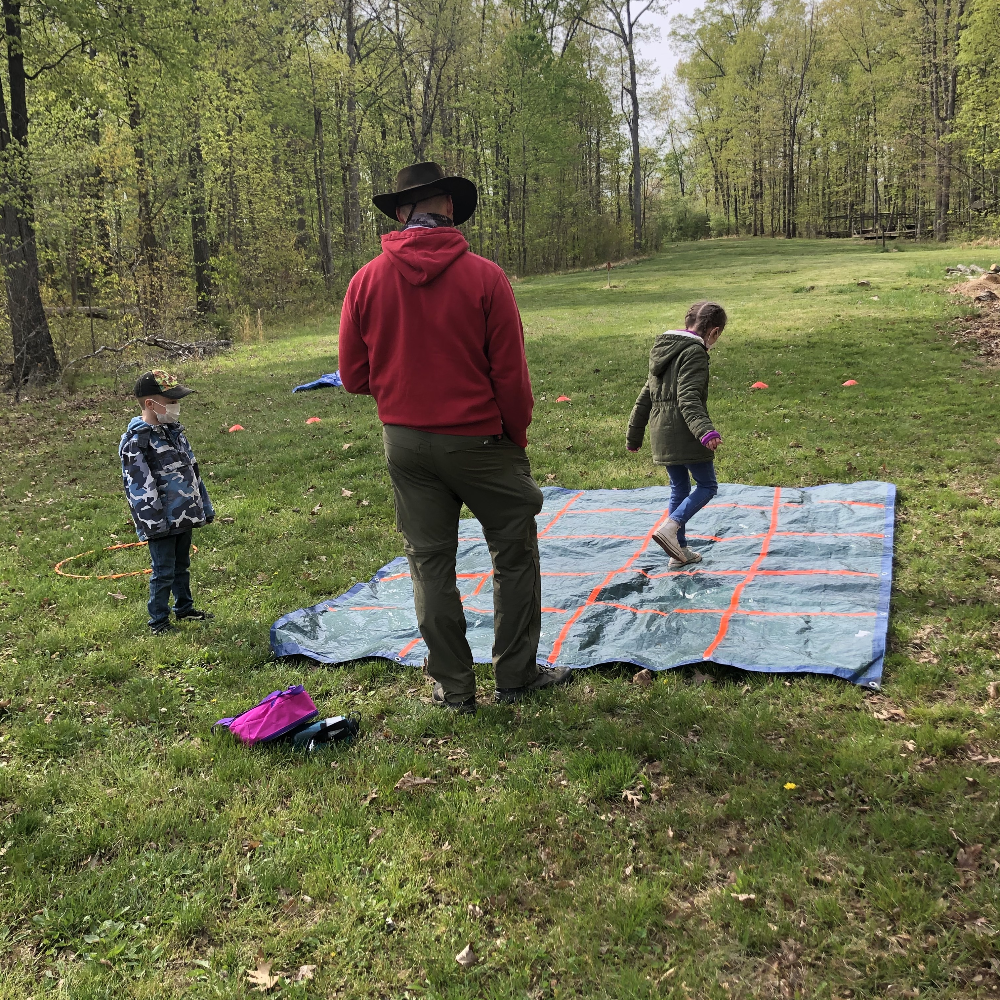
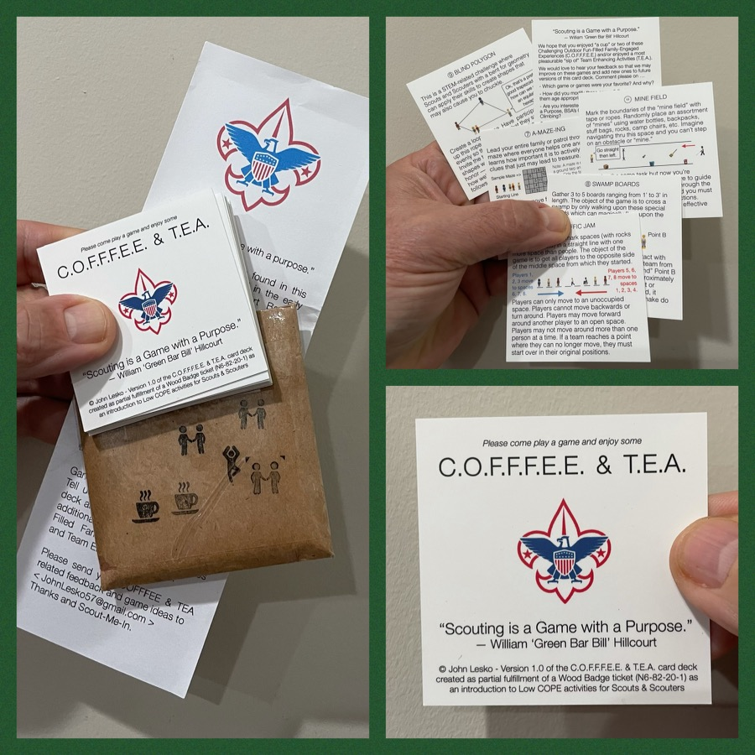
And don’t forget the District’s various COPE and Climbing Opportunities!
Where CUB Scouts learn about teamwork by playing Games with a Purpose
Boy and Girl Scouts learn how to lead their peers while playing these games
And our more senior Scouts, Venturers, and Scouters practice and refine their skills through Challenge Outdoor Fun-Filled Family Engaged Experiences & Team Enhancing Activities (a.k.a. COFFFEE & TEA)
Level 1 & Level 2 training in COPE & Climbing programs need to be coordinated with COPE & Climbing committee chair: Tony Waisanen <ncac.cope@gmail.com>
Interested in obtaining a deck
of COFFFEE & TEA game cards,
E-mail JohnLesko57@gmail.com
—————————————>

Slide 28


Merit Badges
Every merit badge counselor needs to be on the District Charter. The time for action is NOW!
The online Merit Badge Counselor registration works for all Scouters who do not already hold another District position.
New Merit Badge Counselors must complete online merit badge counselor training, in addition to YPT, after November 1, 2021. Existing merit badge counselors have until 12/31/22 to complete training.
Be sure the counselor uses his/her legal name – no nicknames.
Merit Badge Counselors, or the unit Dean/Leader, also need to scan and send Margee the Merit Badge Counselor form listing the badges the counselor is applying to teach and providing a justification of his/her qualifications.
Youth Protection Training is the essential first step. Don’t hit “send” on the application without it!
Contact Margee if you have questions at GM.MB.Dean@hotmail.com.
Online Merit Badge Courses – Watch video, fill out workbook, contact Counselor
Virtual Merit Badge Opportunities (Nation-wide)
Parktakes (select “Scouts” from the Category of Activity)
MeritBadge.Info – Various MB Days throughout the country
Fly Fishing Merit Badge Program, Northern Virginia
Merit Badges Scouts can complete at Home

Slide 29
Order of the Arrow
OA Meeting In-Person – 1st Thursday of month at St. Marks
Awards
  The Servant Leadership Award (Youth) – Those who give exemplary service to the Order of the Arrow, Scouting, and their community over an extended period of time. Each year members of the Order of the Arrow and the Scouting community will be asked to nominate youth who are at least 18 years of age, but not yet 21, who by their leadership and service, exemplify the ideals of the Order and are role models for other Arrowmen and Scouts.
  Founder’s Award (Adult or Youth) - Recognizes Arrowmen who have given outstanding service to their lodge. The award is reserved for an Arrowman who demonstrates that he or she personifies the spirit of selfless service, as advocated by founder E. Urner Goodman and cofounder Carroll A. Edson.
  Nominations due by 10/31/21
NOAC 2022 Registration is open

Slide 30
Other Topics
General Announcements
District Executive Minute
District Chair Minute
District Commissioner Minute
Minutes and slides available on the GMD Website (District Resources, Roundtable). Password is “GMDRT”
Next meeting – November 11, 2021 at 7:30pm

