Slide 1

George Mason District
Roundtable
November 11, 2021

Slide 2


Slide 3
Council Update/Charter Renewal
Internet Rechartering Status as of November 8, 2021:
  14 units out of 40 (35%) have submitted their charter renewal application online
    1 of those has pre-posted
    13 are being reviewed by the registrar (on-hold)
  21 units out of 40 (53%) have started the online process for renewing their charters - we need these units to submit the application.
  Five units have not started the process - we need these five units to start the Charter Renewal process in the new system.
"On Hold" status means the registrar has the file and needs to review any attachments or other paperwork.
Remember, the goal is to recharter the unit; you can always submit applications after your charter renewal application is submitted.
Only paper required is the Annual Charter Agreement and the paper check made out to NCAC-BSA (if paying by check). You can turn these into your Unit Commissioner.
May want to turn in your annual Journey to Excellence at the same time.

Slide 4
What Do Units Need from the District?
Big Rock

Slide 5
George Mason District Organization
District Committee
District Commissioner
District Executive
Program
Membership
Unit Commissioners
Roundtables
Rechartering
Marketing & Communications
Finance
Nominating Committee

Slide 6
District Committee Support
Program - Advancement & Recognition
Program - Activities & Civic Service
Finance
Life to Eagle Seminars (2) (S)
Eagle Boards of Review (S)
District Court of Honor (C & S)
Merit Badge Day (S)
Eagle Recognition Dinner (S)
Camporees (2) (S)
Flags In (2) (C &S)
Pinewood Derby (C)
Scouting for Food (C&S)
Pi Day (C&S)
Hike-O-Ree (C&S)
JOTI/JOTA/JOTT (C&S)
Meet District fundraising goals
Promote Popcorn sales
Lead Friends of Scouting campaign
Solicit donations to fund Scouting programs.
Program - Camping & Outdoor Programs
Marketing & Communications
Cub Day Camp (C)
Scout Camp (S)
High Adventure (S)
Shooting Sports (C & S)
Aquatics (C&S)
COPE & Climbing (S)
Conservation (C & S)
Outdoor Ethics (C & S)
Health & Safety (C &S)
Program - Training
District bi-monthly newsletter
Develop articles for Scouting publications
Submit articles to local news outlets
Cub Leader Training (C)
Scout Leader IOLS (S)
NYLT (S)
Woodbadge (C & S)
Membership
Nominating Committee
Join Scouting Events
Assist new units
Recruit District volunteers
Recommend slate of officers

Slide 7
What are Unit Needs?
Some questions to frame a discussion of unit needs for District support:
What elements of the District program do we need to continue? Start? Stop?
How do unit leaders see their unit’s role in supporting the District? What constitutes unit support?
What can we do to promote greater participation in Cub Scout camps?
How can we better support Cub units?
What can we do to improve recruiting new Cubs, Scouts and volunteer leaders?
How do we increase the percentage of fully trained leaders among our Cub and Scouts BSA units?
What can we do to communicate better?

Slide 8
District Advancement & Recognition Activities
Stop, Start, Continue
Life to Eagle Seminars (2) (S) Lion/Tiger Graduation (C)
District Court of Honor (C & S) Merit Badge Day (S)
Eagle Recognition Dinner (S)
District Volunteer Recognition Dinner/Picnic (inc. Dist. COH)
Ideas____________
Ideas____________
Ideas____________

Slide 9
District Activities
Start, Stop, Continue
Camporees (2) (S) Fishing Derby (C)
Pinewood Derby (C) Haunted Woods (C)
Pi Day (C&S) Water Carnival (C)
Hike-O-Ree (C&S) Webelos Woods (C)
JOTI/JOTA/JOTT (C&S) Family Camp (C)
District Games (C& S) Ideas__________
Klondike Derby (S) Ideas__________
Winterberg (S) Ideas__________

Slide 10
District Civic Service
Start, Stop, Continue
Flags In (2) (C &S)
Scouting for Food (C&S)
Earth Day Service (C&S)
Day of Giving (C&S)
Charter Organization Service Day (Scouting Anniversary) (C&S)
Ideas_________________
Ideas_________________
Ideas_________________

Slide 11
District Training
Start, Stop, Continue
Scheduled In Person/Zoom Cub Leader Training (C)
Hosted In Person/Zoom Cub Leader Training (C)
Scout Leader IOLS (S)
BALOO (C)
Ideas_________________
Ideas_________________
Ideas_________________

Slide 12
Roundtable
What elements of the Roundtable program do we need to continue? Start? Stop?
How do unit leaders see their unit’s role Roundtable?
Participants, Planners, Speakers, Panelist?
Should we continue Zoom even when we have in-person meetings?
What can we do to promote greater participation?
Are there topics/areas of interest that we never seem to cover?

Slide 13
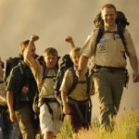

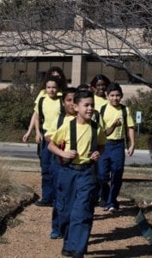

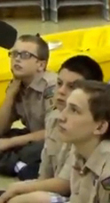

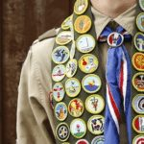
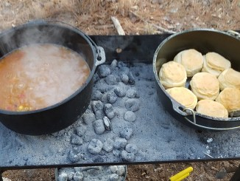
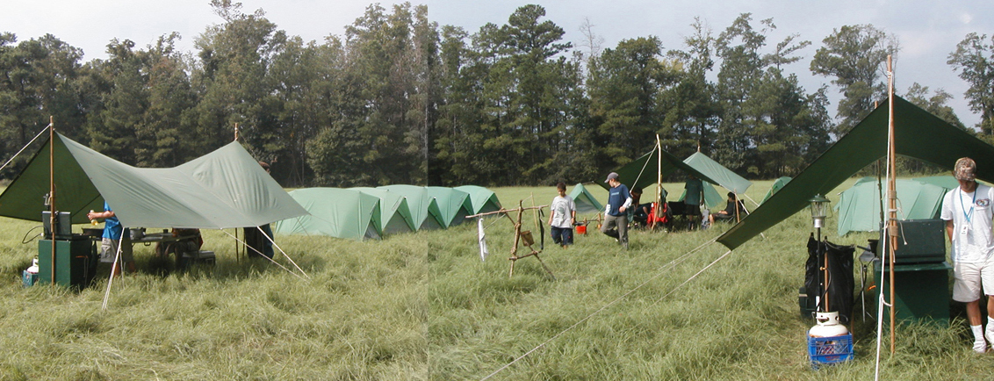
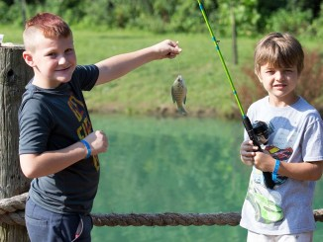
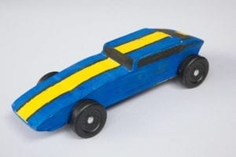
George Mason Program
Matt Burns, Vice Chair Program
George Mason District

Slide 14

Current 2021-2022 GM Calendar
November 13, 2021 – Scouting for Food Pick Up
January 29, 2022 – Life to Eagle Seminar
March 5, 2022 – GM Merit Badge Day
March 14, 2022 – Pi Day
March 19, 2022 – GM Pinewood Derby
April 14, 2022 – GM District COH
April 29 to May 1, 2022 – GM Spring Camporee
May 1 to May 15, 2022 – GM Hike-O-Ree
May 14, 2022 – Jamboree on the Trail
May 30, 2022 – Flags In

Slide 15
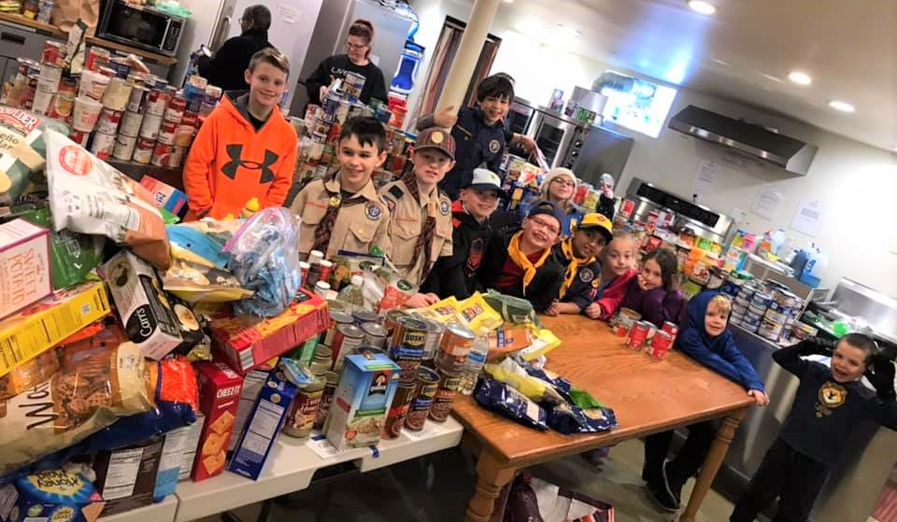
Scouting for Food
Tag Drop-off: Had a strong turnout from George Mason Packs and Units
Pick-up: November 13, 2021
Service Hours: Remember to log the service hours contributed by youth/adult volunteers https://www.ncacbsa.org/scouting-for-food-unit-data/
Basecamp: Check site for any special instructions unique to the food pantry assigned to your unit dropping off a
2021 District Coordinator: Scott Willey
From Scott: “Please convey my sincere thanks to all the units for participating in this service project!”

Slide 16

Pi Day! Monday, March 14, 2022
Open to all (Cubs, Scouts BSA and Venturing Scouts)
Pi Day gives math enthusiasts the opportunity to celebrate their love for numbers and the enigma that is the infinite Pi.
March 14 also is Albert Einstein’s birthday.
Pi is the ratio of a circle’s circumference to its diameter. Amazingly, for all circles of any size, Pi will always be the same.
One can celebrate “Pi Day” with any kind of pie – pizza, apple, cherry, Boston Crème pie, etc. Let your imagination be your guide!
Stay tuned for more “Pi Day” activities as we get closer to the big day!

Slide 17
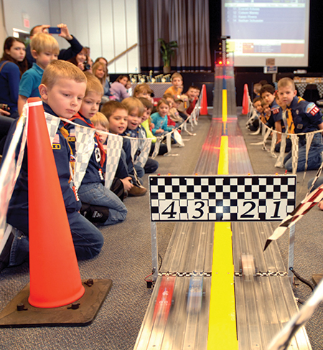
2022 George Mason Pinewood Derby
Race Day is March 19, 2022
All Packs wanting to participate in the 2022 Pinewood Derby MUST hold their Pack Pinewood Derbies by March 10, 2022.
One unit winner from each age bracket (Lions, Tigers, Wolves, etc.) regardless of gender.
Pack winners must register (and pay) on Council website. $15.00 per entry. No money collected at door on day of race. Must register by 3/17/22.
Register at https://scoutingevent.com/082-52774
Race will be held at Fairfax Presbyterian in Fairfax.
For questions, contact Chip McCaslin at chipmccaslin@gmail.com

Slide 18

District Court of Honor
To recognize adults who served/are serving at the unit level.
Two awards:
  Unit Commissioner’s Unit Scouter Award – 1 per unit
  Unit Appreciation Award – Maximum 8 per unit.
Please provide a sentence or two describing the individual’s service.
Submit Unit Commissioner’s Unit Scouter Award to Unit Commissioner.
Unit Appreciate Award to gm.adultrecognition@gmail.com
Must have all submissions by no later than March 11, 2022.
Will confer awards at District COH/April Roundtable.

Slide 19
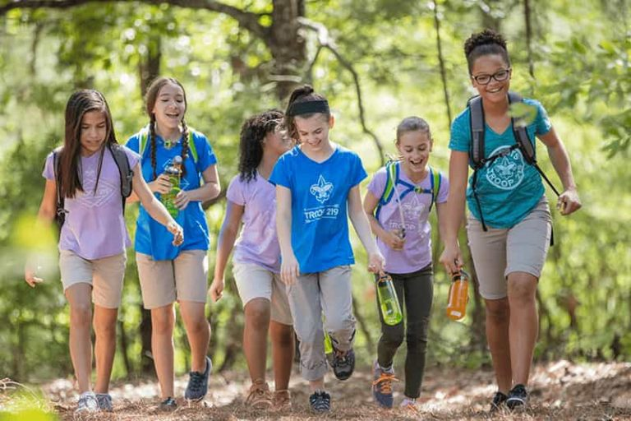
George Mason Hike-O-Ree
2nd Annual GM Hike-O-Ree on weekends of May 7 and May 14 – 5/6/22 to 5/15/22.
Open to all (Cubs, Scouts BSA and Venturing Scouts), families and friends.
Any age, any place and any appropriate grouping – just keep track of how far you hiked.
Register on Council website (registration opening in early 2022). $5.00 for a patch.
Challenge – District Scouts, Scouters and families hike 2,022 miles.
Total the miles for each unit and notify Matt Burns at Burnsmj509@gmail.com. We’ll see how big a total we reach.

Slide 20
Civic and Related Activities of Interest to Scouts
Dyke Marsh Sunday Morning Bird Walks – 8:00 a.m. on Sundays at Dyke Marsh in Alexandria
Huntley Meadows Monday Morning Bird Walk at 7:00 a.m. in Alexandria
Native American Campfire Cookout – 11/14/21 & 11/28/21 at 2:00 p.m. Riverbend Park in Great Falls. $12 per person.
Hot Dogs, Smores! Wagon Ride & Campfire – 11/17/21 at 5:00 p.m. Ellanor C. Lawrence Park $10 per person.
Fairfax Holiday Craft Show – 11/20/21 (10-5) & 11/21/21 (10 – 3) at Fairfax High School
Vienna Church Street Holiday Stroll, 11/29/21 from 6 – 8:30 p.m.

Slide 21
Civic and Related Activities of Interest to Scouts – Cont.
Falls Church – A Very Victorian Christmas – 11/27/21 – Cherry Hill Farmhouse.
Falls Church – Holiday Craft Show – Falls Church Community Center
Bull Run Festival of Lights – Bull Run Regional Park until 1/2/22.
Vienna VA - Meadowlark’s Winter Walk of Lights – 11/11/21 to 1/2/22
Photo With Santa – 11/27/21 – 11:00 a.m. at Sully Historic Site.
Flying Squirrels – Gliding in Tonight – 11/28/21 at 5:30 p.m. Hidden Oaks Nature Center
Fairfax City Festival of Lights and Carols – 12/04/21 from 12 to 6 p.m. in Old Town Square, 10415 North Street

Slide 22
Civic and Related Activities of Interest to Scouts – Cont.
Pet Photos with Santa – Mondays at Springfield Town Center until 12/20/21.
Photos with Santa at Springfield Town Center through 12/21/21.
X-Wing Starfighter from “Star Wars” – On display through 01/01/22 at National Air and Space Museum, Udvar-Hazy Center, Dulles
Friday Night Sky Watching at the Turner Farm Park’s Roll-Top Observatory in Great Falls, VA.
Fairfax Chocolate Lovers Festival 2/4/22 to 2/6/22

Slide 23
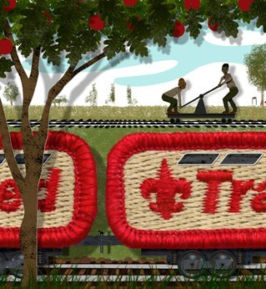
Training
Unit Training – For position-specific training at your unit,
contact Roy De Lauder at EagleScout.Roy@cox.net or
go to Training opportunities page on GM Web Site.
Scouts BSA Training
11/20/21 - Scoutmaster Specific Training, Alexandria, VA
11/20/21 - Wilderness First Aid, Camp Snyder, Haymarket, VA
12/04/21 - Scoutmaster Specific Training, Alexandria, VA
12/18/21 - Wilderness First Aid, Camp Snyder, Haymarket, VA
01/14-17/22 & 01/21-23/22 – NYLT (Winter), Camp Snyder
Cub Scout Training:
11/20/21 - Akela’s Trail (was POW-WOW; Virtual), Bethesda, MD
All:
12/04/21 – Trainer’s Edge, Reston, VA
02/26/22 – University of Scouting, Alexandria, VA

Slide 24
SCOUTS BSA Roundtable

Slide 25

District Life to Eagle Seminar
Saturday, 29 January 2022
1:00 to 4:00 p.m.
Virtual
Register at: https://scoutingevent.com/082-52778
Who should attend:
Life Scouts or advanced Star Scouts who want to pursue the Eagle Rank
Eagle advisors, coaches or unit leaders that haven’t attended a seminar in two years
Parents of Scouts working on Eagle or other adults interested in Scouting
Registration will be done online and must be received by 27 January 2022 to get the Zoom link.
Any questions contact Jack Lundin at 703-938-0369.

Slide 26

GEORGE MASON DISTRICT CAMPOREE
Date:
April 29 – May 1, 2022
Location and Theme: TBD
Leader Guide will be available on registration site a few weeks ahead of event.
Need unit volunteers to help run event.
Camporee Director Andrew Zaso
(703) 434-2907 AndrewZaso@gmail.com
Online registration will open in early 2022

Slide 27
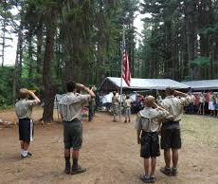
Future Camporees
Save the Dates!!!
George Mason Fall 2022 Camporee – October 21 - 23, 2022
  Theme and Site TBD
George Mason Spring 2023 Camporee – May 5-7, 2023
  Theme and Site TBD
Please factor this into unit calendars/planning.
Scouts are loyal – including loyalty to District activities.

Slide 28
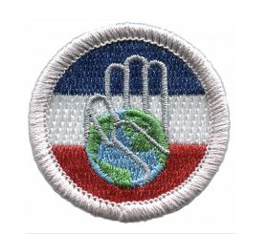
Citizenship in Society Merit Badge
New merit badge encourages Scouts to explore important topics around diversity, equity, inclusion and ethical leadership and learn why these qualities are important in society and in Scouting.
Beginning July 1, 2022, the Citizenship in Society merit badge will be required for any youth seeking to earn Eagle.
NCAC is working on the requirements/process to approve Citizenship in Society merit badge counselors.
We strongly recommend units review roster and identify 17 year old Life Scouts working on Eagle.
Life Scouts need to either finish all Eagle requirements through Scoutmaster conference (but not Board of Review) by June 30, 2022 or plan enough time to earn Citizenship in Society.

Slide 29
2022 District Merit Badge Event
March 5th, 2022 at Fairfax Presbyterian Church in Fairfax.
Registration will open on December 23, 2021
Need Unit Merit Badge Day Coordinator names and contact details by November 30 to John Drisco at gmasonmeritbadgeday@gmail.com
Encourage Scouts to get merit badge books by December 31. Read requirements and start tackling “pre-work” by early January 2022.
Note: The “pre-work” is not the same as a “prerequisite.” The “pre-work” consists of tasks/activities that the Scout is advised to do in advance of the Merit Badge Day. A Scout can still participate in the Merit Badge Day class if he hasn’t completed the pre-work but failure to complete the pre-work may mean the Scout leaves the Merit Badge Day with a partial badge. A prerequisite is something that must be done in order to qualify to take the class. The only prerequisite we are aware of for the George Mason Merit Badge Day is that the Scout must be a registered member of the Boy Scouts in a participating unit.
Feedback to John Drisco at gmasonmeritbadgeday@gmail.com

Slide 30


Merit Badges
Every merit badge counselor needs to be on the District charter. The time for action is NOW!
The online Merit Badge Counselor registration works for all Scouters who do not already hold another District position.
New Merit Badge Counselors must complete online merit badge counselor training, in addition to YPT, after November 1, 2021. Existing merit badge counselors have until 12/31/22 to complete training.
Be sure the counselor uses his/her legal name – no nicknames.
Merit Badge Counselors, or the unit Dean/Leader, also need to scan and send Margee the Merit Badge Counselor Information Form listing the badges the counselor is applying to teach and providing a justification of his/her qualifications.
Youth Protection Training is the essential first step. Don’t hit “send” on the application without it!
Contact Margee if you have questions at GM.MB.Dean@hotmail.com.

Slide 31
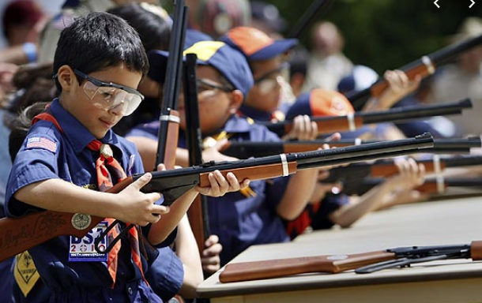
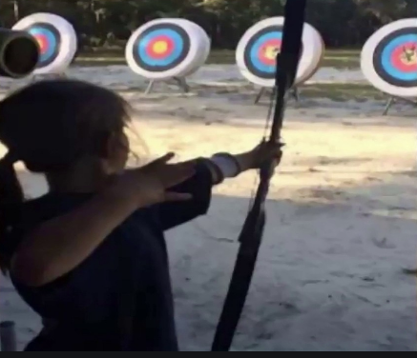
Shooting Sports
Requests for Shooting Events – Lead Time!
  50+ scouts - 6mos
  Less than 50 scouts - 3mos
Shooting on private land:
  Requirements
  Permissions/protocols
Shooting Sports web page
Shooting Sports Instructor Classes:
  Rifle/Shotgun
  Archery (Virtual classes available)

Slide 32
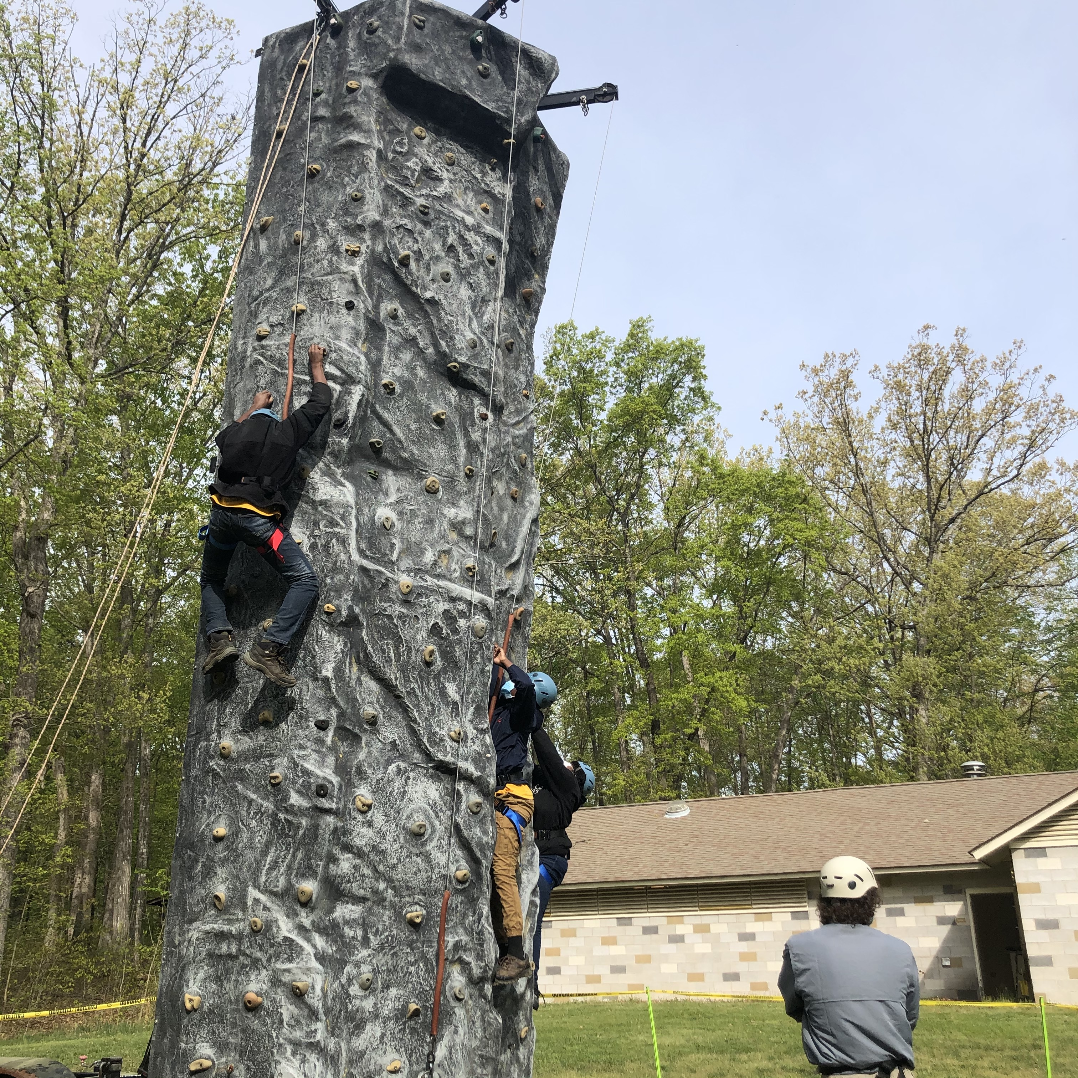
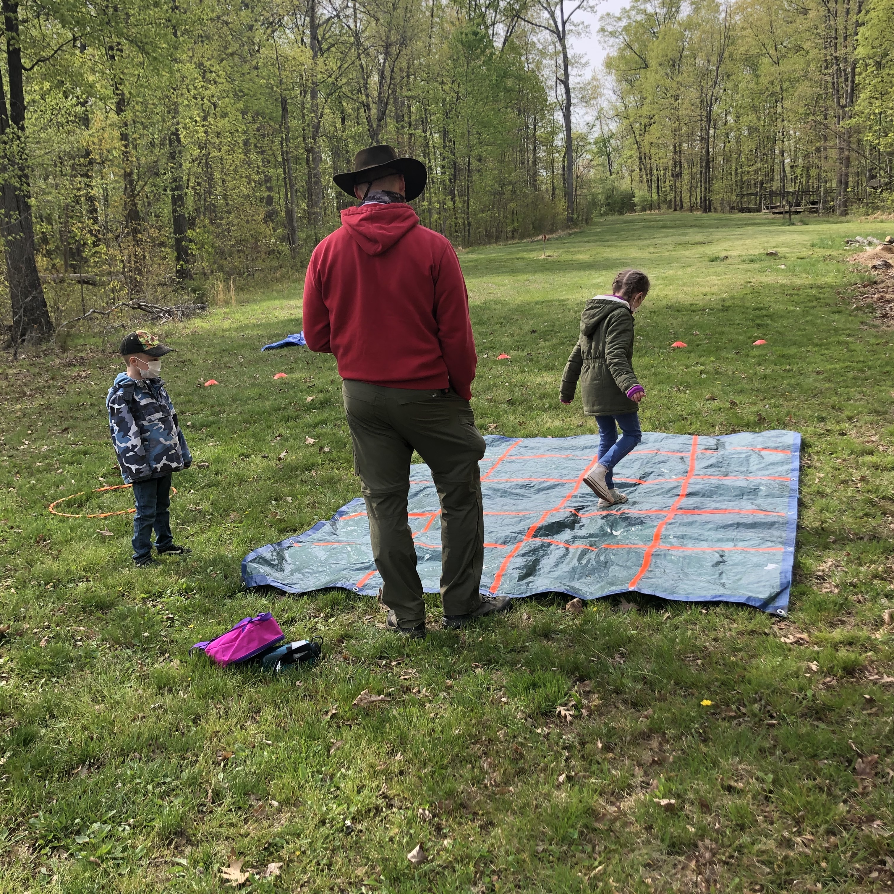
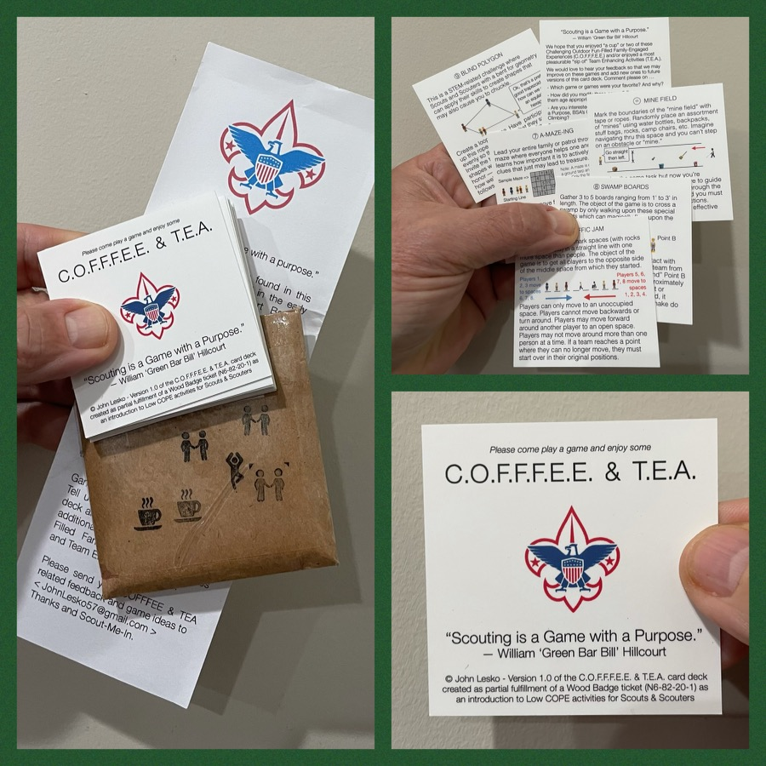
And don’t forget the District’s various COPE and Climbing Opportunities!
Where CUB Scouts learn about teamwork by playing Games with a Purpose
Boy and Girl Scouts learn how to lead their peers while playing these games
And our more senior Scouts, Venturers, and Scouters practice and refine their skills through Challenge Outdoor Fun-Filled Family Engaged Experiences & Team Enhancing Activities (a.k.a. COFFFEE & TEA)
Level 1 & Level 2 training in COPE & Climbing programs need to be coordinated with COPE & Climbing committee chair: Tony Waisanen <ncac.cope@gmail.com >
Interested in obtaining a deck
of COFFFEE & TEA game cards,
E-mail JohnLesko57@gmail.com
—————————————>

Slide 33

SCHOLARSHIPS
Deadlines Approaching!!!
BSA Scholarship page - https://www.scouting.org/awards/scholarships/
Elks Most Valuable Scholar – Deadline Nov 15, 2021 https://www.elks.org/scholars/scholarships/MVS.cfm
Sons of American Revolution – Deadline Dec 15, 2021 Arthur M. & Berdena King Eagle Scout Contest – National Society Sons of the American Revolution (sar.org)
For more info/questions, contact Bill Denk at
thinkdenk3@msn.com.
Campaign Pay it Forward – Deadline December 31, 2021 Free Scholarship (campaignpayitforward.com)
National Eagle Scout Association – Deadline January 31, 2022 Scholarships - The National Eagle Scout Association (nesa.org)

Slide 34

Glenn A. and Melinda W. Adams Award
Recognizes a noteworthy Eagle Scout Service Project.
Deadline is January 21, 2022
Anyone can make a nomination. ADAMS-NATIONAL-EAGLE-SCOUT-SERVICE-PROJECT-OF-THE-YEAR-NOMINATION-FORM.pdf (nesa.org)
Scout must sign application to document their “consent.”
Also needs an electronic copy of the project workbook.
Some nominations include video.
Winners can receive:
  $500 at the Council level.
  $500 at the Regional (Northeast) level.
  $2,500 for National winner.

Slide 35
Other Topics
Order of the Arrow
General Announcements
District Executive Minute
District Chair Minute
District Commissioner Minute
Minutes and slides available on the GMD web site (District Resources, Roundtable). Password is “GMDRT”
Next meeting – December 9, 2021 at 7:30pm (Thoreau MS)

