Slide 1

George Mason District
Roundtable
December 9, 2021

Slide 2


Slide 3
Charter Renewal Status
Status
  Not Started 2
  In Progress 15
  At Council 21
  Posted 2
Action
  Log in to the system (Pack 78, Troop 13)
  Submit the online application
  Turn in your ACA and payment
  Relax and enjoy the holidays!
ACA = Annual Charter Agreement (must be signed by the Executive Officer, the COR, and Committee Chair)
Status as of 12/07/21

Slide 4
What Do Units Need from the District (continued)?
Big Rock
2 responses to Cub survey
15 responses to Scouts BSA survey

Slide 5
2022 Activities – Unit Plans to Participate?

Slide 6
Activities to Add to GM Program
Scouts BSA
Suggestions –
    A competition event that is Scouting focused like a mini-Olympics, where a Troop and Pack join up to make a team and compete against other such teams. I would be happy to elaborate further on this vision.
    OA Chapter lead spaghetti dinner for OA members.
    Klondike Derby can be dependent on weather.

Slide 7
What Changes does your unit want in GM Program?
Cubs
No responses
Scouts BSA
More interaction between Scouts and Packs, perhaps through group games, campouts or some kind of joint activity, really build a relationship between the two. Unique activities and opportunities for the district, several years ago someone was able to bring a group of scouts to visit an embassy near by. I thought that was pretty amazing and educational for all who attended.
Continue current program
Continue Flags In
More Scout led programs
Can’t think of anything now.
None at this time (2)
Start – Single point of contact for CCs and SMs for all items. Start – Single page how to Eagle with single point of contact for each Troop. Stop – Multiple e-mails per month.
Continue District MB Day
Continue – does not feel as if the District program needs to expand – lots of opportunities being offered and they begin to create conflicts with Unit program time.
Execute what you plan. Several times our Troop added a GM District event to our annual plan only for it to be cancelled. As a result, I’m hesitant to add District events to our annual plan.

Slide 8
How Likely Is Your Unit to Supply Volunteers for District Events?
Scouts BSA
Troop has only 5 active scouts, small # of parents makes it unlikely troop will have volunteers to organize and execute District events.
We run a 9 month Troop program with our volunteers. We look to district, council, and national events to give us a break during the three months..

Slide 9
What is Unit’s Role in Supporting District?
Cubs
No response.
Scouts BSA
We are all in it together but when troop size is small, it's the same folks doing everything so to add on additional volunteer work would be difficult I believe we are doing our part, admittedly everyone can do more.
We support district as we are able.
Very limited.
Supply volunteers to help with district events, participate in FOS, Scouting for Food, other service events.
Participate in Scouting for Food covering our unit’s assigned territory, attend district Spring and Fall caomporee when possible (sorry we missed the CY21 Fall Camporee as our Scouts chose to attend Marshall High School homecoming event.)
By attending and supporting the District’s programs.

Slide 10
What is Unit’s Role in Supporting District (cont.)?
Participating in District activities. (2)
Attending local summer camp and camporees.
Part of the team
A unit should provide volunteers to help the District’s activities.
Supporting District w/experienced, seasoned scouters as they age out of the Unit program has been a tradition of our troop. Shortages of adult volunteers has curtailed this somewhat.
A unit has an obligation to support as much as possible District events. The Troop I work with prioritizes attending District Camporees and where possible other District events.
We recruit and train the scouts and adult leaders to attend District events.

Slide 11
Support Your Unit Needs from District?
Cubs
Better direct line of communication
Program support
Scouts BSA
We are good
Easier process for merit badge counselor approval/retention. Current process is onerous and dissuades participation.
Information and training opportunities.
Help with BSA system issues/rechartering, training questions, MB counselor applications/questions. Events that are harder to do at the unit level (like Merit Badge day, Flags In) and need critical mass to run.
None over what is done now. (5)
There is a lot of frustration managing up, weeks without return e-mails or calls, lack of clarity on process and contacts and employee turnover. Single point of contact for each troop and professional follow-up would solve most of the issues.

Slide 12
Support Your Unit Needs from District (Cont.)?
Scouts BSA
Efficient, non-repetitive communications would be helpful. Constant, multiple repetitive communications dilutes attention to the communications – just stop looking at them.
A few well planned and executed district events each year.

Slide 13
Roundtable Attendance
Cubs
One unit has a rep that attends each month. The other unit has someone attend occasionally.
Scouts BSA
14 units responding have a rep attend every month and one unit never attends.
Scouts BSA
If you personally don’t attend Roundtable, why not?
Cubs
If you personally don’t attend Roundtable, why not?

Slide 14
What Changes Would you Make to Roundtable?
Cubs
No Feedback
Scouts BSA
I'm not sure how it can be more useful besides maybe hearing from different Troops and Packs about their struggles and success stories that happened from the last roundtable. I have been going to the Roundtable for several years and unfortunately I know little about what other troops are going through and I feel a like everyone is working in their own little silo. I was once in a Pack in Hawaii and every week we would get together to fellowship and several parents were assigned to bring lunch for the entire pack, I feel the activity of breaking bread together brought the Pack closer. I feel food brings people together and helps build better relationships. Maybe we can ask the RoundTable attendees if they would be interested in doing monthly potlucks. I envision breaking up the attendees and assigning each group to a particular month to be responsible to bring a home cooked meal or snack to share (No store bought packaged meals). I'm sorry but cheese and coldcuts don't really do much for me like someone actually putting effort into cooking a small meal or snack. Ask Mark Serfas about his home made lasagna
More detail in minutes would be helpful..
If you could organize the Cub Scout related materials in one part and the ScoutsBSA materials in another part and put the announcements in the middle that would be helpful. The ScoutsBSA information usually is of limited interest to the Cub Scout people.
Our CO only provides meeting space on Thursday nights. Scoutmaster listens into Roundtable stream while physically attending troop’s meeting.

Slide 15
What Changes Would You Make to Roundtable (cont.)?
Scouts BSA
Content at roundtable is very helpful. Cub scout topics are less relevant to troops and vice versa (not sure how you can really change that, though). If meetings could be kept to an hour, that would be ideal (although has no bearing on usefulness to the unit). Please keep zoom option as sometimes it is not feasible to attend in person. Minutes are detailed and provide lists of dates (this is a good thing) but attending is better, even if virtual.
More sharing of ideas for activities.
Split into two meetings on the same night. Earlier for Cub Scouts and later for Scouts BSA. Do not present material that we already have in writing, just summarize. Keep meetings to one hour each with 30 minutes afterwards for leaders to stay and ask questions.
None (3).
It would be nice if it were an hour long as in the past.
I think the District does a pretty good job of supporting my unit.

Slide 16
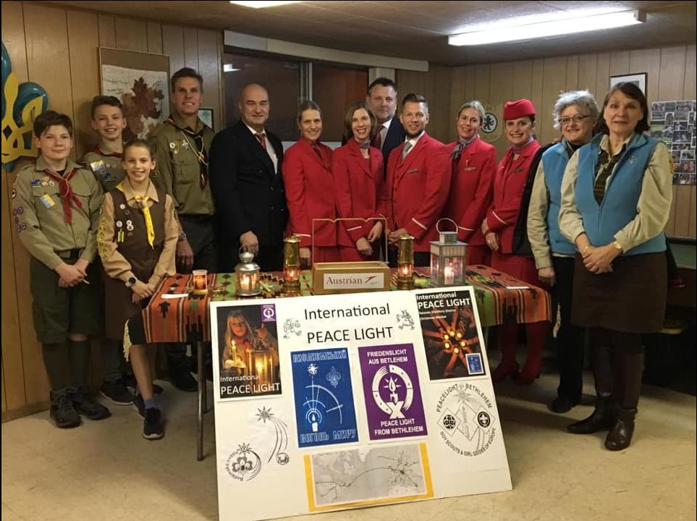
International Peace Light – 12/13 @ 7:30pm - FUMC
The Peace Light, symbolic of the Light of Christ especially evident at Christmas, is meant to promote peace, harmony and unity among all people of the world regardless of race, ethnicity or creed. The Peace Light makes its long journey from the Grotto of the Nativity in the Town of Bethlehem, to Tel Aviv, Israel, to Vienna, Austria and finally safely across the Atlantic Ocean to New York City. Peace Light North America supporters move the Light person-to-person, lantern-to-lantern, across North America and around their local areas, actively promoting global peace.
2021 Peace Light will arrive in Fairfax this Saturday, and the troop will be sharing it with the Scouting community at our Court of Honor on Monday, December 13 at 7:30pm at Fairfax United Methodist Church.

Slide 17
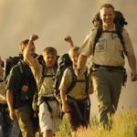

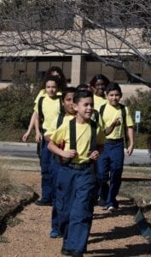

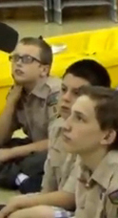

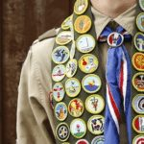
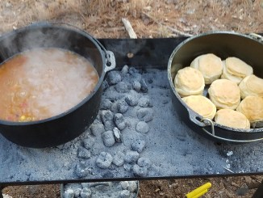
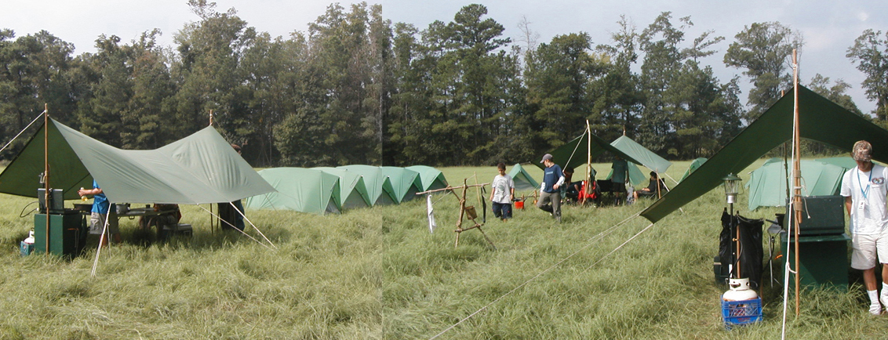
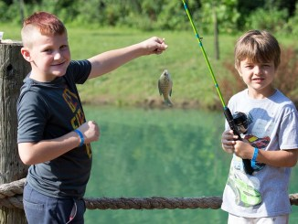
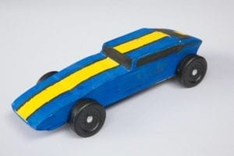
George Mason Program
Matt Burns, Vice Chair Program
George Mason District

Slide 18

Current 2022 GM Calendar
January 29, 2022 – Life to Eagle Seminar
March 5, 2022 – GM Merit Badge Day
March 14, 2022 – PI Day
March 19, 2022 – GM Pinewood Derby
April 14, 2022 – GM District COH
April 29 to May 1, 2022 – GM Spring Camporee
May 1 to May 15, 2022 – GM Hike-O-Ree
May 14, 2022 – Jamboree on the Trail
May 30, 2022 – Flags In

Slide 19
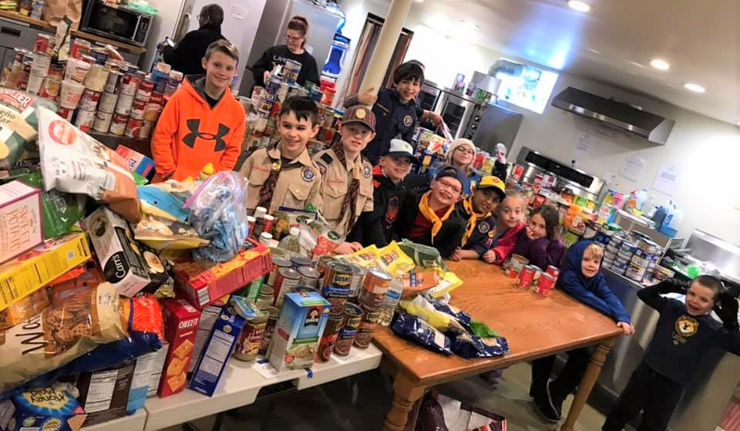
Scouting for Food
Thanks to all units for participating in 2021 Scouting for Food.
George Mason units collected over 50,476 pounds of food.
Food pantries in our area are deeply appreciative. Needs are very high in 2021.
Please remember to log the service hours contributed by youth and adult volunteers.

Slide 20

Pi Day! Monday, March 14, 2022
Open to all (Cubs, Scouts BSA and Venturing Scouts
Pi Day gives math enthusiasts the opportunity to celebrate their love for numbers and the enigma that is the infinite pi.
March 14 also is Albert Einstein’s birthday.
Pi is the ratio of a circle’s circumference to its diameter. Amazingly, for all circles of any size, pi will always be the same.
One can celebrate “Pi Day” with any kind of pie – pizza, apple, cherry, Boston Crème pie, etc. Let your imagination be your guide!
Stay tuned for more “Pi Day” activities as we get closer to the big day!

Slide 21
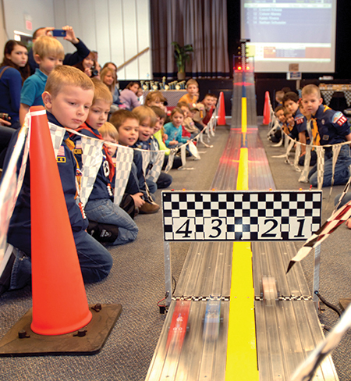
2022 George Mason Pinewood Derby
Race Day is March 19, 2022
All Packs wanting to participate in the 2022 Pinewood Derby MUST hold their Pack Pinewood Derbies by March 10, 2022.
One unit winner from each age bracket (Lions, Tigers, Wolves, etc.) regardless of gender.
Pack winners must register (and pay) on Council website. $15.00 per entry. No money collected at door on day of race. Must register by 3/17/22.
Register at https://scoutingevent.com/082-52774
Race will be held at Fairfax Presbyterian in Fairfax.
For questions, contact Chip McCaslin at chipmccaslin@gmail.com

Slide 22

District Court of Honor
To recognize adults who served/are serving at the unit level.
Two awards:
  Unit Commissioner’s Unit Scouter Award – 1 per unit
  Unit Appreciation Award – Maximum 8 per unit.
Please provide a sentence or two describing the individual’s service.
Submit Unit Commissioner’s Unit Scouter Award to Unit Commissioner.
Unit Appreciate Award to gm.adultrecognition@gmail.com
Must have all submissions by no later than March 11, 2022.
Will confer awards at District COH/April Roundtable.

Slide 23
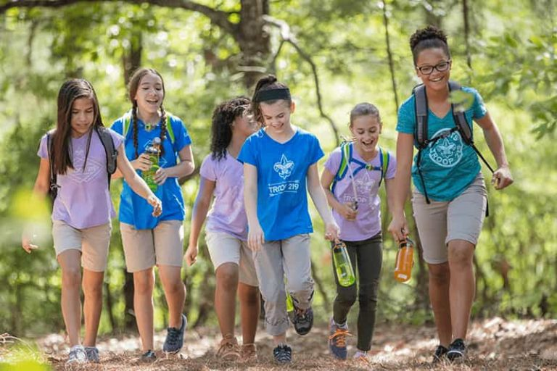
George Mason Hike-O-Ree
2nd Annual GM Hike-O-Ree on weekends of May 7 and May 14 – 5/6 to 5/15/22.
Open to all (Cubs, Scouts BSA and Venturing Scouts), families and friends.
Any age, any place and any appropriate grouping – just keep track of how far you hiked.
Register on Council website (registration opening in early 2022). $5.00 for a patch.
Challenge – District Scouts, Scouters and families hike 2,022 miles.
Total the miles for each unit and notify Matt Burns at Burnsmj509@gmail.com. We’ll see how big a total we reach.

Slide 24
Civic and Related Activities of Interest to Scouts
Dyke Marsh Sunday Morning Bird Walks – 8:00 a.m. on Sundays at Dyke Marsh in Alexandria
Huntley Meadows Monday Morning Bird Walk at 7:00 a.m. in Alexandria
Falls Church – Holiday Craft Show – Falls Church Community Center
Bull Run Festival of Lights – Bull Run Regional Park until 1/2/22.
Vienna VA - Meadowlark’s Winter Walk of Lights – 11/11 to 1/2/22
Pet Photos with Santa – Mondays at Springfield Town Center until 12/20/21.

Slide 25
Civic and Related Activities of Interest to Scouts – Cont.
Photos with Santa at Springfield Town Center through 12/21/21.
X-Wing Starfighter from “Star Wars” – On display through Jan 1, 2022 at National Air and Space Museum, Udvar-Hazy Center, Dulles
Friday Night Sky Watching at the Turner Farm Park’s Roll-Top Observatory in Great Falls, VA.
Fairfax Chocolate Lovers Festival 2/4/22 to 2/6/22

Slide 26
SCOUTS BSA Roundtable

Slide 27

District Life to Eagle Seminar
Saturday, 29 January 2022
1:00 to 4:00 p.m.
Virtual
Register at: https://scoutingevent.com/082-52778
Who should attend:
Life Scouts or advanced Star Scouts who want to pursue the Eagle Rank
Eagle advisors, coaches or unit leaders that haven’t attended a seminar in two years
Parents of Scouts working on Eagle or other adults interested in Scouting
Registration will be done online and must be received by 27 January 2022 to get the Zoom link.
Any questions contact Jack Lundin at 703-938-0369.

Slide 28
2022 District Merit Badge Event
March 5th, 2022 at Fairfax Presbyterian Church in Fairfax.
Registration will open on December 23, 2021
Need Unit Merit Badge Day Coordinator names and contact details by November 30 to John Drisco at gmasonmeritbadgeday@gmail.com
Encourage Scouts to get merit badge books by December 31. Read requirements and start tackling “pre-work” by early January 2022.
Note: The “pre-work” is not the same as a “prerequisite.” The “pre-work” consists of tasks/activities that the Scout is advised to do in advance of the Merit Badge Day. A Scout can still participate in the Merit Badge Day class if he hasn’t completed the pre-work but failure to complete the pre-work may mean the Scout leaves the Merit Badge Day with a partial badge. A prerequisite is something that must be done in order to qualify to take the class. The only prerequisite we are aware of for the George Mason Merit Badge Day is that the Scout must be a registered member of the Boy Scouts in a participating unit.
Feedback to John Drisco at gmasonmeritbadgeday@gmail.com

Slide 29

GEORGE MASON DISTRICT CAMPOREE
Date:
April 29 – May 1, 2022
Location and Theme: Rock Enon Scout Camp, Gore VA.
Online registration available on Council website in early 2022.
Leader Guide will be available on registration site a few weeks ahead of event.
Need unit volunteers to help run event.
Camporee Director Andrew Zaso
(703) 434-2907 - AndrewZaso@gmail.com
Registration will open in early 2022

Slide 30
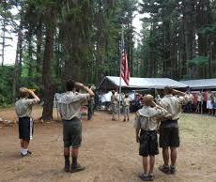
Future Camporees
Save the Dates!!!
George Mason Fall 2022 Camporee – October 21 - 23, 2022
  Theme and Site TBD
George Mason Spring 2023 Camporee – May 5-7, 2023
  Theme and Site TBD
Please factor this into unit calendars/planning.
Scouts are loyal – including loyalty to District activities.

Slide 31
GM High Adventure
(December 2021)
NCAC High Adventure Committee (HAC) updates and announcements: https://www.ncacbsa.org/high-adventure/
  2022 National High Adventure Base slots still available; 2023 registrations begin on 12 January
  2022 Lenhok’sin Canoe Trek provisional slots still available
  Philmont Preparedness Seminars: https://www.philmontscoutranch.org/Philmont-prep-seminars
  Updated HA Source Book (volumes I and II): https://3.basecamp.com/3958009/buckets/16000091/vaults/2777714268
New BSA Adventure Planning Resource: The Adventure Plan (TAP) https://tap.scouting.org/
Contact Joe Knecht at knechtjoe@yahoo.com if you have questions regarding high adventure planning or resources.

Slide 32
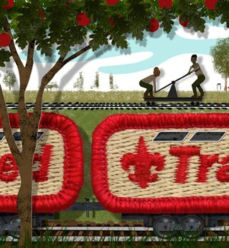
Training
Unit Training – For position-specific training at your unit,
contact Roy De Lauder at EagleScout.Roy@cox.net or
go to Training Opportunities page on GM Web Site.
Back Country Outdoor Leadership Skills – 03/05/22 Huntingtown, MD
Cub Scout Leader – 01/22/22 – Herndon, VA
NYLT - 01/14-17/22 & 01/21-23/22 – Camp Snyder, Haymarket, VA
University of Scouting - 02/26/22 – Alexandria, VA
Wilderness First Aid
12/18/21 – Camp Snyder, Haymarket, VA
01/08/22 – Camp Snyder, Haymarket, VA
02/12/22 – Camp Snyder, Haymarket, VA
03/12/22 – Camp Snyder, Haymarket, VA
04/09/22 – Camp Snyder, Haymarket, VA
Wood Badge
04/29/22 – 05/01/22 & 05/13/22 – 05/15/22 – Camp Snyder, Haymarket, VA
09/09/22 – 09/11/22 & 10/08/22 – 10/09/22 – Camp Snyder, Haymarket, VA

Slide 33

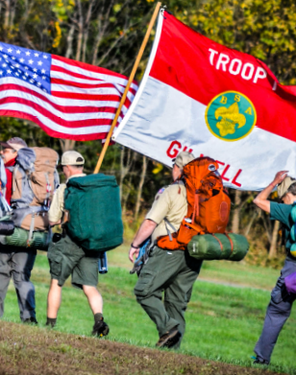
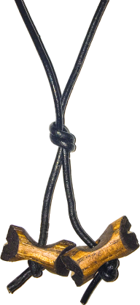
BSA’s ultimate leadership training for ALL adult leaders
Applicable to every program: Cubs, Scouts BSA, Venturing, Sea Scouts
Applicable to every level: unit, district, or council level
An exciting & inspiring course that infuses your units with fun & meaning
Leaders develop real-world, hands-on skills to ensure our youth are getting everything they are promised from the program
Spring Course
Register at:
https://www.ncacbsa.org/wood-badge/
Weekend #1: April 29 – May 1
Weekend #2: May 14 – 15
Course Director: Mr. John Howlin
johnhowlinjr@yahoo.com
Fall Course
Registration Opens
April 30, 2022
Weekend #1: September 9 – 11
Weekend #2: October 8 – 9
Course Director: Mr. Rick Rogers
rsrogers4@gmail.com

Slide 34
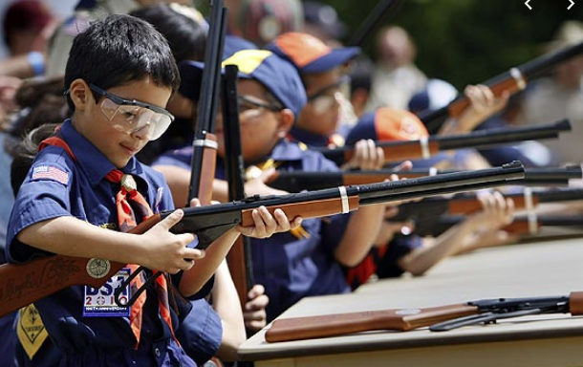
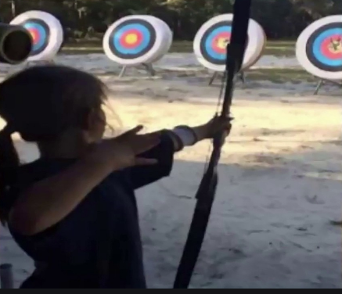
Shooting Sports
Requests for Shooting Events – Lead Time!
  50+ scouts - 6mos
  Less than 50 scouts - 3mos
Shooting on private land:
  Requirements
  Permissions/protocols
Shooting Sports web page
Shooting Sports Instructor Classes:
  Rifle/Shotgun
  Archery (Virtual classes available)

Slide 35
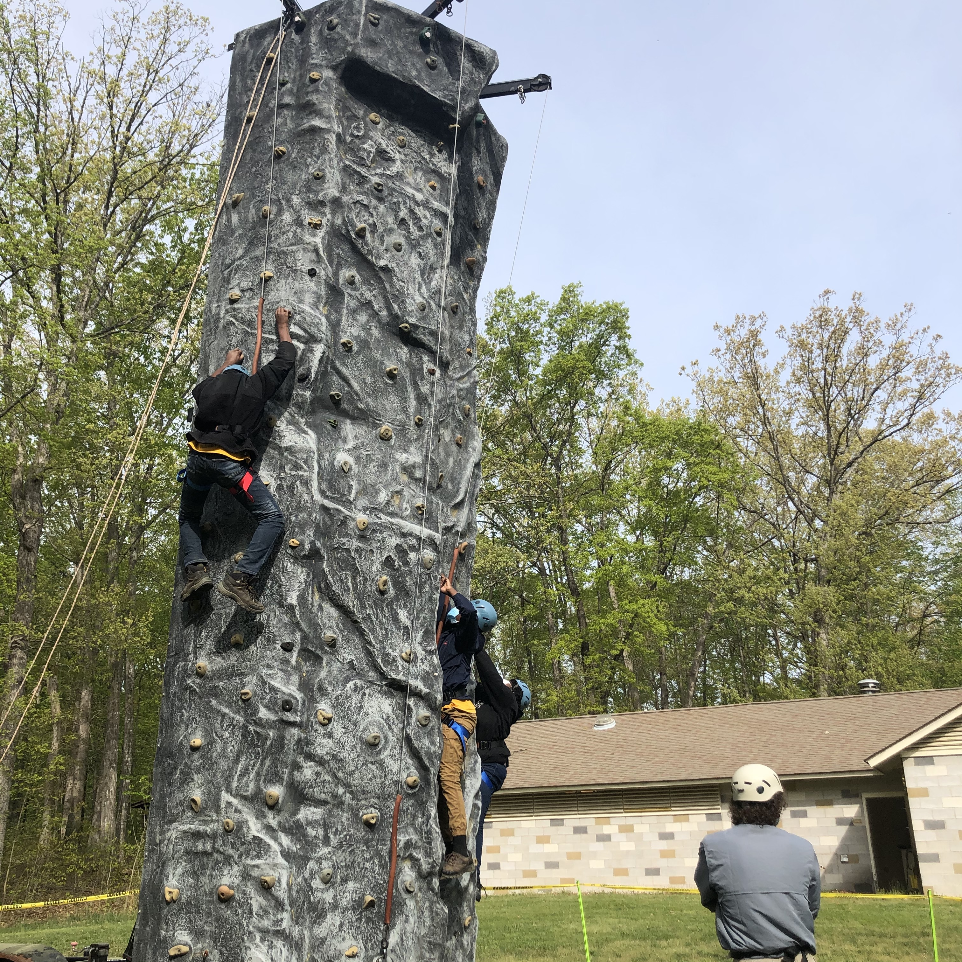
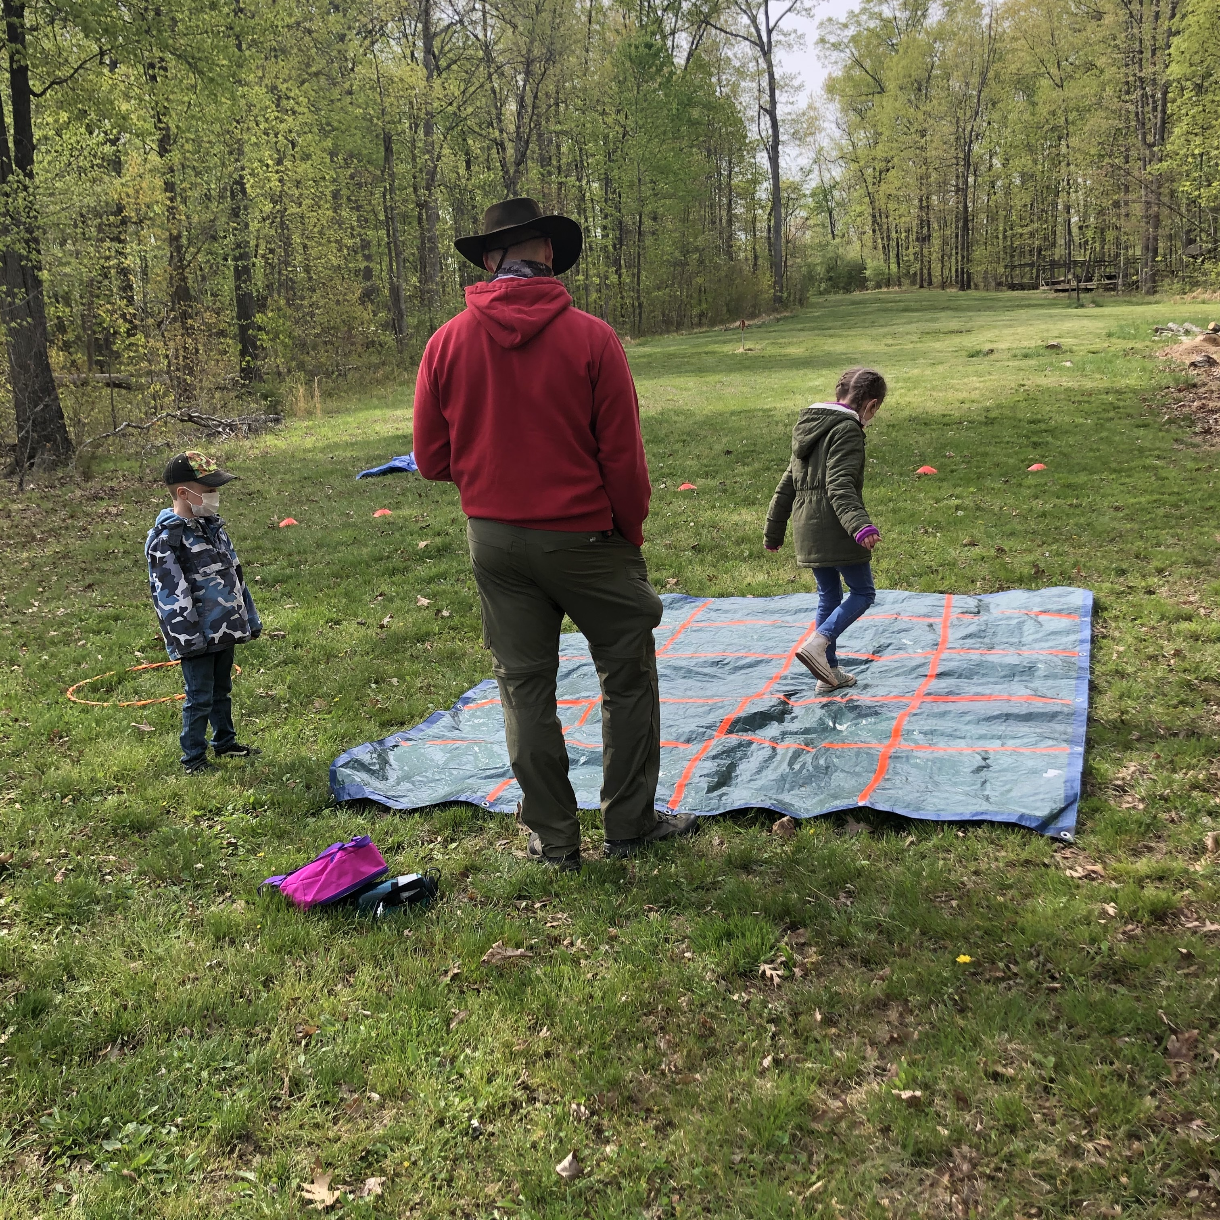
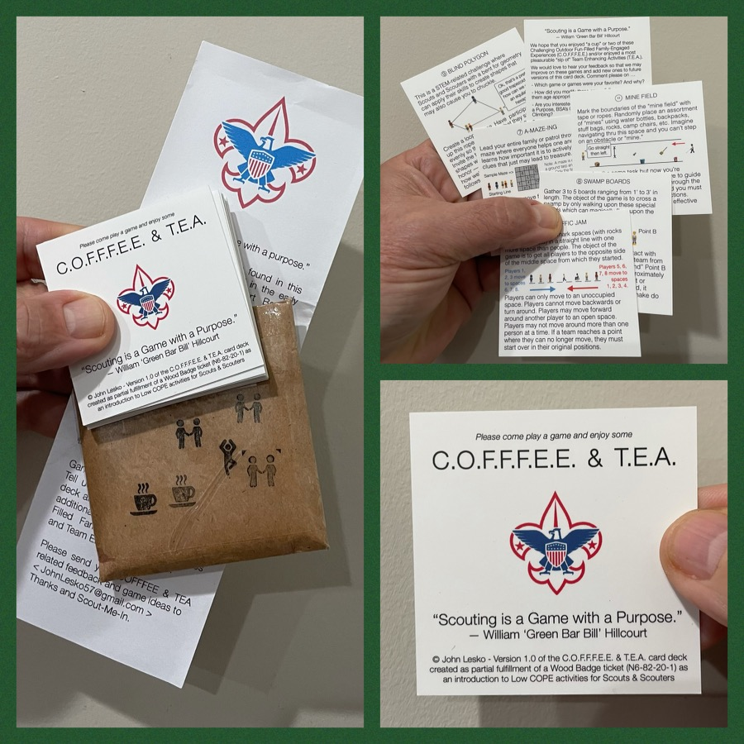
And don’t forget the District’s various COPE and Climbing Opportunities!
COPE Game Day – Camp Snyder from
9:00 a.m. to 12:00 p.m.
Dec 11, 2021 (Sat.)
January 8, 2022 (Sat.)
February 13, 2022 (Sun.)
Level 1 & Level 2 training in COPE & Climbing programs need to be coordinated with COPE & Climbing committee chair: Tony Waisanen <ncac.cope@gmail.com>
Interested in obtaining a deck
of COFFFEE & TEA game cards,
E-mail JohnLesko57@gmail.com
—————————————>

Slide 36


Merit Badges
Every merit badge counselor needs to be on the District charter. The time for action is NOW!
The online Merit Badge Counselor registration works for all Scouters who do not already hold another District position.
New Merit Badge Counselors must complete online merit badge counselor training, in addition to YPT, after November 1, 2021. Existing merit badge counselors have until 12/31/22 to complete training.
Be sure the counselor uses his/her legal name – no nicknames.
Merit Badge Counselors, or the unit Dean/Leader, also need to scan and send Margee the Merit Badge Counselor Information Form listing the badges the counselor is applying to teach and providing a justification of his/her qualifications.
Youth Protection Training is the essential first step. Don’t hit “send” on the application without it!
Contact Margee if you have questions at GM.MB.Dean@hotmail.com.

Slide 37

SCHOLARSHIPS
Deadlines Approaching!!!
BSA Scholarship page - https://www.scouting.org/awards/scholarships/
Sons of American Revolution – Deadline Dec 15, 2021 Arthur M. & Berdena King Eagle Scout Contest – National Society Sons of the American Revolution (sar.org)
For more info/questions, contact Bill Denk at thinkdenk3@msn.com.
Campaign Pay it Forward – Deadline December 31, 2021 Free Scholarship (campaignpayitforward.com)
National Eagle Scout Association – Deadline January 31, 2022 Scholarships - The National Eagle Scout Association (nesa.org)

Slide 38

Glenn A. and Melinda W. Adams Award
Recognizes a noteworthy Eagle Scout Service Project.
Deadline is January 21, 2022
Anyone can make a nomination. ADAMS-NATIONAL-EAGLE-SCOUT-SERVICE-PROJECT-OF-THE-YEAR-NOMINATION-FORM.pdf (nesa.org)
Scout must sign application to document their “consent.”
Also needs an electronic copy of the project workbook.
Some nominations include video.
Winners can receive:
  $500 at the Council level.
  $500 at the Regional (Northeast) level.
  $2,500 for National winner.

Slide 39
OA Leadership to Troops Report

Slide 40
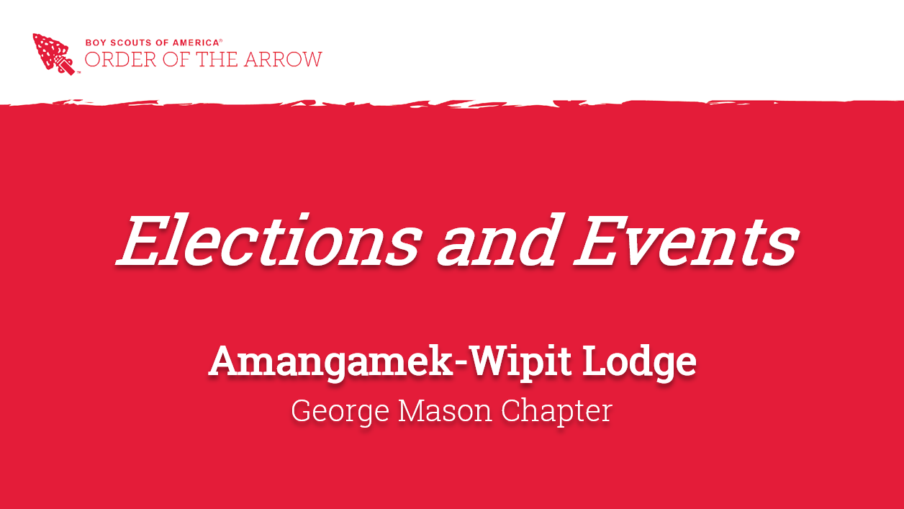

Slide 41
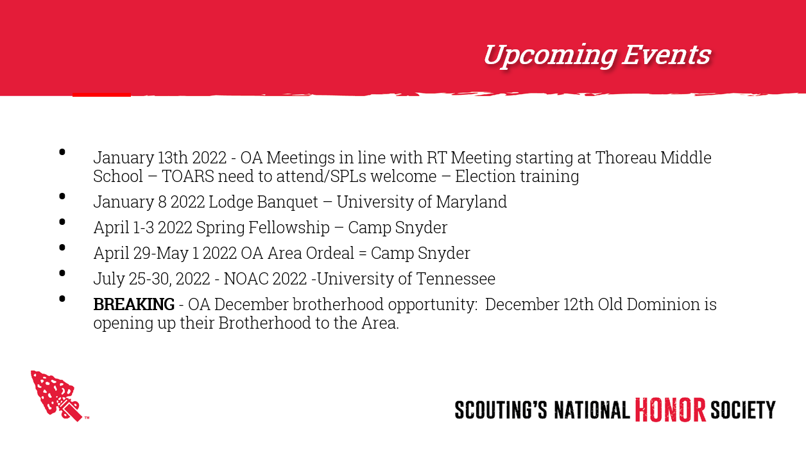

Slide 42
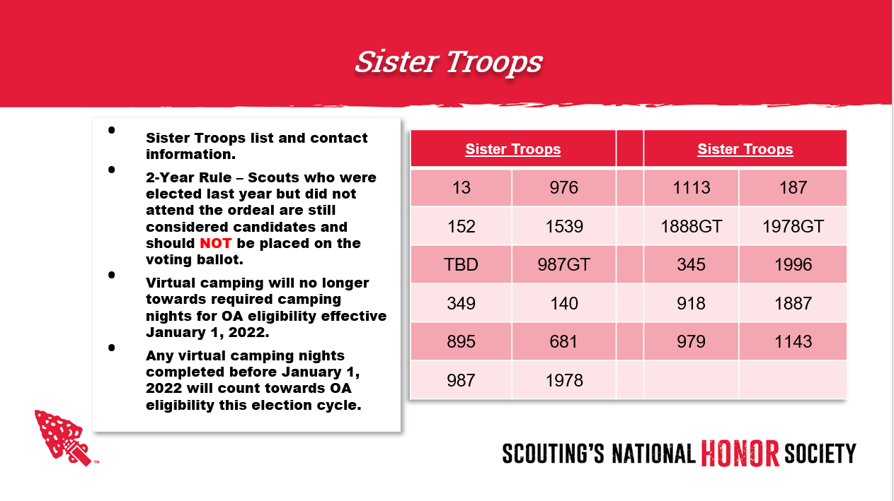

Slide 43
Other Topics
General Announcements
District Executive Minute
District Chair Minute
District Commissioner Minute
Minutes and slides available on the GMD web site (District Resources, Roundtable). Password is “GMDRT”
Next meeting – January 13, 2022 at 7:30pm (Thoreau MS)

