Slide 1

George Mason District
Roundtable
January 13, 2022

Slide 2


Slide 3
Council Update

Slide 4
Big Rock – Open Discussion
Cub Scout Adult Participation – How do I get parents to volunteer?
Recharter “on-hold” – What does that mean, when will I get updates, will we lose access like last year?
Merit Badge Counselors – Lost several last year due to the switch to the new system. How to get them reregistered? Paperwork seems to get lost when we send it in.
Recruiting event in Spring – Does anyone else do a spring recruitment? Do you hold a special event or invite to a unit meeting? Can we use the Geofencing for recruiting during the Spring?
System issues – I have had issues with my.scouting.org and Scoutbook and the recharter system in IA. Is there a better way than email to resolve?
Charter Renewal – Still have some adults that haven’t turned in their paperwork (Incomplete App, CBC, or YPT). How do you get them to do this timely? We are late on Charter Renewal.
Cub Campout – What has been your best location for a cub campout?

Slide 5


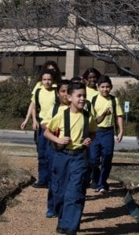

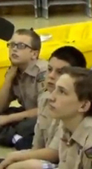


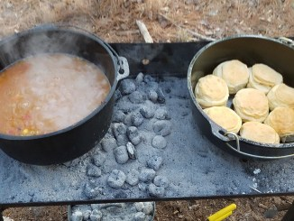
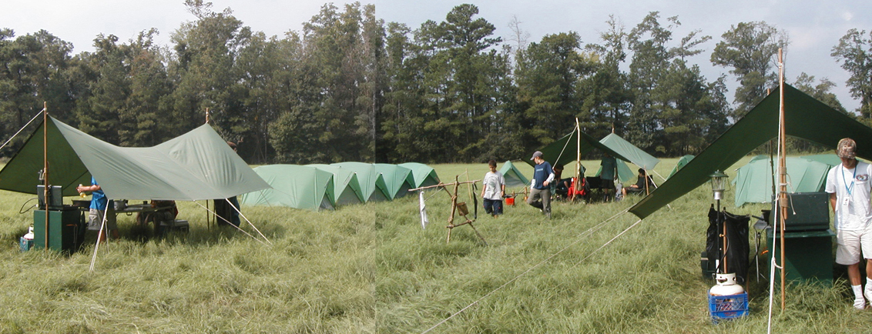
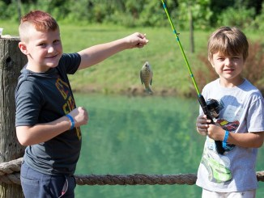
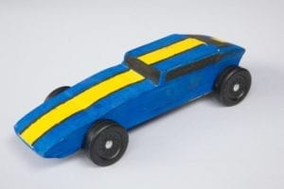
George Mason Program
Matt Burns, Vice Chair Program
George Mason District

Slide 6

Current 2022 GM Calendar
January 29, 2022 – Life to Eagle Seminar
March 5, 2022 – GM Merit Badge Day
March 14, 2022 – PI Day
March 19, 2022 – GM Pinewood Derby
April 14, 2022 – GM District COH
April 29 to May 1, 2022 – GM Spring Camporee
May 1 to May 15, 2022 – GM Hike-O-Ree
May 14, 2022 – Jamboree on the Trail
May 30, 2022 – Flags In

Slide 7


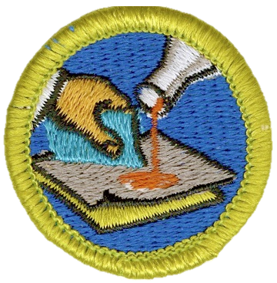

STEM
NCAC Akela Chess Classic Tournament
  Hosted by NCAC STEM, hosted at NCAC HQ in Bethesda, MD
  5 Feb – Cubs Tournament; 12 Feb – Scouts Tournament
  Sign up at www.ncacbsa.org/stem
Pi Day! – March 14
  Open to all – Cubs, Scouts, and parents
  Will provide activities to do at home or in small groups
  Some specific activities tied to advancement
Welding & Composite Materials MB Sessions
  Hosted by Building Momentum in Alexandria, VA
  23 April and 21 May
  Sign up at www.ncacbsa.org/stem

Slide 8
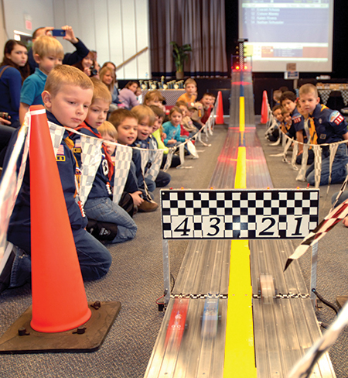
2022 George Mason Pinewood Derby
Race Day is March 19, 2022
All Packs wanting to participate in the 2022 Pinewood Derby MUST hold their Pack Pinewood Derbies by March 10, 2022.
One unit winner from each age bracket (Lions, Tigers, Wolves, etc.) regardless of gender.
Pack winners must register (and pay) on Council website. $15.00 per entry. No money collected at door on day of race. Must register by 3/17/22.
Register at https://scoutingevent.com/082-52774
Race will be held at Fairfax Presbyterian in Fairfax.
For questions, contact Chip McCaslin at chipmccaslin@gmail.com

Slide 9

District Court of Honor
To recognize adults who served/are serving at the unit level.
Two awards:
  Unit Commissioner’s Unit Scouter Award – 1 per unit
  Unit Appreciation Award – Maximum 8 per unit.
Please provide a sentence or two describing the individual’s service.
Submit Unit Commissioner’s Unit Scouter Award to Unit Commissioner.
Unit Appreciate Award to gm.adultrecognition@gmail.com
Must have all submissions by no later than March 11, 2022.
Will confer awards at District COH/April Roundtable.

Slide 10
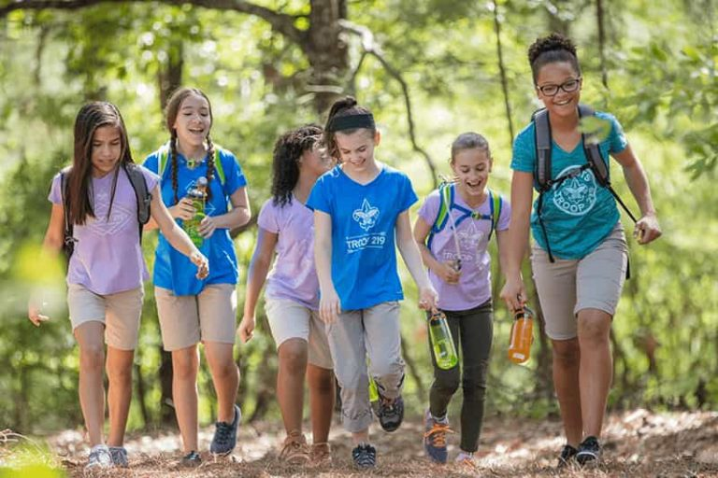
George Mason Hike-O-Ree
2nd Annual GM Hike-O-Ree on weekends of May 7 and May 14 – 5/6 to 5/15/22.
Open to all (Cubs, Scouts BSA and Venturing Scouts), families and friends.
Any age, any place and any appropriate grouping – just keep track of how far you hiked.
Register on Council website (registration opening in early 2022). $5.00 for a patch.
Challenge – District Scouts, Scouters and families hike 2,022 miles.
Total the miles for each unit and notify Matt Burns at Burnsmj509@gmail.com. We’ll see how big a total we reach.

Slide 11
Civic and Related Activities of Interest to Scouts
Dyke Marsh Sunday Morning Bird Walks – 8:00 a.m. on Sundays at Dyke Marsh in Alexandria
Huntley Meadows Monday Morning Bird Walk at 7:00 a.m. in Alexandria
Sully Historic Site Tours – Recurring weekly on Sunday, Thursday, Friday and Saturday.
Winter Waterfowl Hike – Jan 14 and Feb 11, 2022 from 9:00 a.m. to 11:00 a.m., Riverbend Park in Great Falls, VA.
Drawing and Learning About Animal Tracks & Signs, 1/15/22 from 9:30 AM to 11:30 AM, Hidden Oaks Nature Center in Annadale
Family Fun – Bedrock to Gardenbed – 1/15/22 from 11:00 a.m to 12:00 at Green Spring Gardens and Horticultural Center, Alexandria, VA.
Beginning Wood Carving – 1/16/22, 2/6/22 and 2/20/22, from 1:00 to 3:00 p.m. at Colvin Run Mill in Great Falls

Slide 12
Civic and Related Activities of Interest to Scouts – Cont.
Nature Explorers Virtual Club – Winter – Eight sessions from 1/17 to 3/9 at 10 a.m. on Mondays and 4 p.m. on Wednesdays, Huntley Meadows Park in Alexandria, VA.
Wildlife Walk at Huntley Meadows – 1/17 and 2/8/22 at Huntley Meadows Park in Alexandria
Friday Night Skywatching – The Turner Farm in Great Falls at 8:30 p.m.
Note: Tickets may be required or there may be charges for these activities. We recommend checking the event website in advance.

Slide 13
SCOUTS BSA Roundtable

Slide 14
Advancement Topics
BSA COVID Advancement Exceptions
  Any requirements earned are earned – and must be counted toward advancement including after 3/1/22.
  Examples of COVID Advancement Exceptions (see COVID-19 FAQ | Boy Scouts of America (scouting.org))
    Swimming – Second and First Class requirements deferred up to Life ranks.
    Camping – Up to three nights of virtual camping per month allowed.
  Effective February 28, 2022, these exceptions expire. As of March 1, 2022, youth must complete all original rank and merit badge requirements as published by the BSA.
Citizenship in Society Merit Badge – Required as of 7/1/22
New BSA Software for Councils – Issues impacting units – Procedural Changes Coming Soon
  Temporary delays in ESRA verification
  Council working on new verification procedures. Expect approval soon and delegation of verification to District Eagle Representatives.
  Units will send ONLY ESRA electronically to Bethesda after Eagle Board of Review

Slide 15

District Life to Eagle Seminar
Saturday, 29 January 2022
1:00 to 4:00 p.m.
Virtual
Register at: https://scoutingevent.com/082-52778
Who should attend:
Life Scouts or advanced Star Scouts who want to pursue the Eagle Rank
Eagle advisors, coaches or unit leaders that haven’t attended a seminar in two years
Parents of Scouts working on Eagle or other adults interested in Scouting
Registration will be done online and must be received by 27 January 2022 to get the Zoom link.
Any questions contact Jack Lundin at 703-938-0369.

Slide 16
2022 District Merit Badge Event
March 5th, 2022 at Fairfax Presbyterian Church in Fairfax.
Registration opened on December 23, 2021
Encourage Scouts to get merit badge books, read requirements and start tackling “pre-work” by early January 2022.
Adults needed to help staff merit badge classes and comply with YPT requirements.
Will need to meet NCAC, Virginia and Fairfax Presbyterian COVID protocols. Policy coming soon to unit POCs.
Be prepared for possible changes.
Feedback to John Drisco at gmasonmeritbadgeday@gmail.com

Slide 17

GEORGE MASON DISTRICT CAMPOREE
Date:
April 29 – May 1, 2022
Location and Theme: Rock Enon Scout Camp, Gore VA.
Shooting Sports
Online registration available on Council website in early 2022.
Leader Guide will be available on registration site a few weeks ahead of event.
Need unit volunteers to help run event.
Camporee Director Andrew Zaso
(703) 434-2907 - AndrewZaso@gmail.com
Registration will open in early 2022

Slide 18
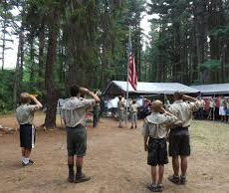
Future Camporees
Save the Dates!!!
George Mason Fall 2022 Camporee – October 21 - 23, 2022
  Theme and Site TBD
George Mason Spring 2023 Camporee – May 5-7, 2023
  Theme and Site TBD
Please factor this into unit calendars/planning.
Scouts are loyal – including loyalty to District activities.

Slide 19
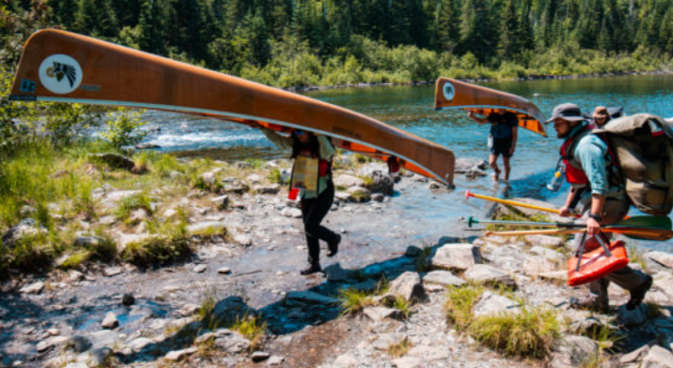
GM High Adventure
NCAC High Adventure Committee (HAC) updates and announcements: https://www.ncacbsa.org/high-adventure/
  2022 National High Adventure Base slots still available; 2023 registrations underway now (began 12 January). Unified registration site: https://www.scouting.org/outdooradventures/open4adventure/
  2022 Lenhok’sin James River Canoe Trek (provisional and unit) spaces available for the 17-23 July expedition
  2022 Philmont Camperships deadline extended into January
  Philmont Preparedeness Seminars (virtual)
  High Adventure Source Book, Volumes I and II
  Wilderness First Aid vendor list updated (minimum 1 adult per crew)
New BSA Adventure Planning Resource: The Adventure Plan (TAP) https://tap.scouting.org/
Contact Joe Knecht at knechtjoe@yahoo.com if you have questions regarding high adventure planning or resources.
January 2022

Slide 20

Training
Unit Training – For position-specific training at your unit,
contact Roy De Lauder at EagleScout.Roy@cox.net or
go to Training Opportunities page on GM Web Site.
Back Country Outdoor Leadership Skills – 03/05/22 Huntingtown, MD
IOLS/BALOO – 2/19, 2/26 in Cheltenham, MD. Campout on 3/19/22-3/20/22. https://scoutingevent.com/082-PAXIOLSSPRING2022
BALOO – 03/26/22 Camp Snyder, Haymarket, VA
University of Scouting - 02/26/22 – Alexandria, VA
Wilderness First Aid
02/12/22 – Camp Snyder, Haymarket, VA
03/12/22 – Camp Snyder, Haymarket, VA
04/09/22 – Camp Snyder, Haymarket, VA

Slide 21

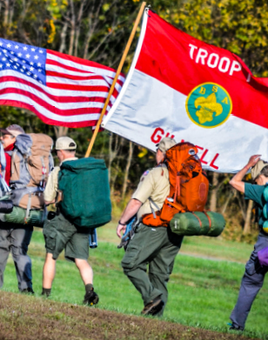
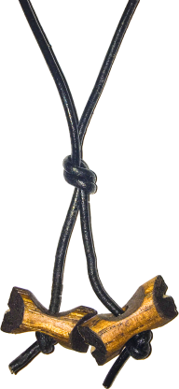
BSA’s ultimate leadership training for ALL adult leaders
Applicable to every program: Cubs, Scouts BSA, Venturing, Sea Scouts
Applicable to every level: unit, district, or council level
An exciting & inspiring course that infuses your units with fun & meaning
Leaders develop real-world, hands-on skills to ensure our youth are getting everything they are promised from the program
Spring Course
Register at:
https://www.ncacbsa.org/wood-badge/
Weekend #1: April 29 – May 1
Weekend #2: May 14 – 15
Course Director: Mr. John Howlin
johnhowlinjr@yahoo.com
Fall Course
Registration Opens
April 30, 2022
Weekend #1: September 9 – 11
Weekend #2: October 8 – 9
Course Director: Mr. Rick Rogers
rsrogers4@gmail.com

Slide 22
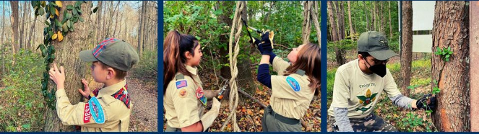
Invasive Species (Vine) Webinar – 1/19/22 @7:30pm
Join the tree rescuers: Learn how to spot and report trees that are being killed by invasive non-native vines. Help educate your community and save our trees. Open to all (Cubs, Scouts BSA and Venturing Scouts).
Participation in the Tree Rescuer project will meet the requirement for conservation hours and several BSA conservation awards.
Register at - https://bit.ly/3flsIss or here.
Other details - https://www.facebook.com/events/347492930170297/

Slide 23
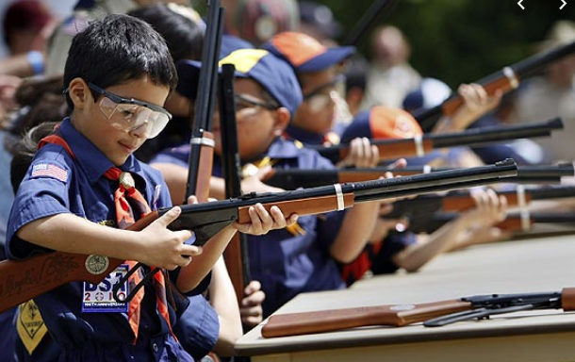
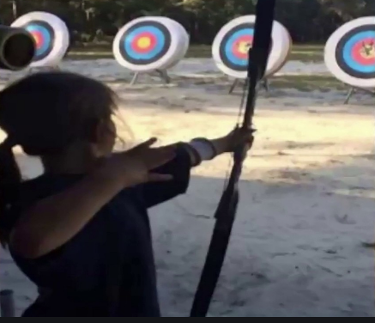
Shooting Sports
Requests for Shooting Events – Lead Time!
  50+ scouts - 6mos
  Less than 50 scouts - 3mos
Shooting on private land:
  Requirements
  Permissions/protocols
Shooting Sports – scouting.org/outdoor-programs/shooting Sports
Shooting Sports Instructor Classes:
  Rifle/Shotgun
  Archery (Virtual classes available)

Slide 24
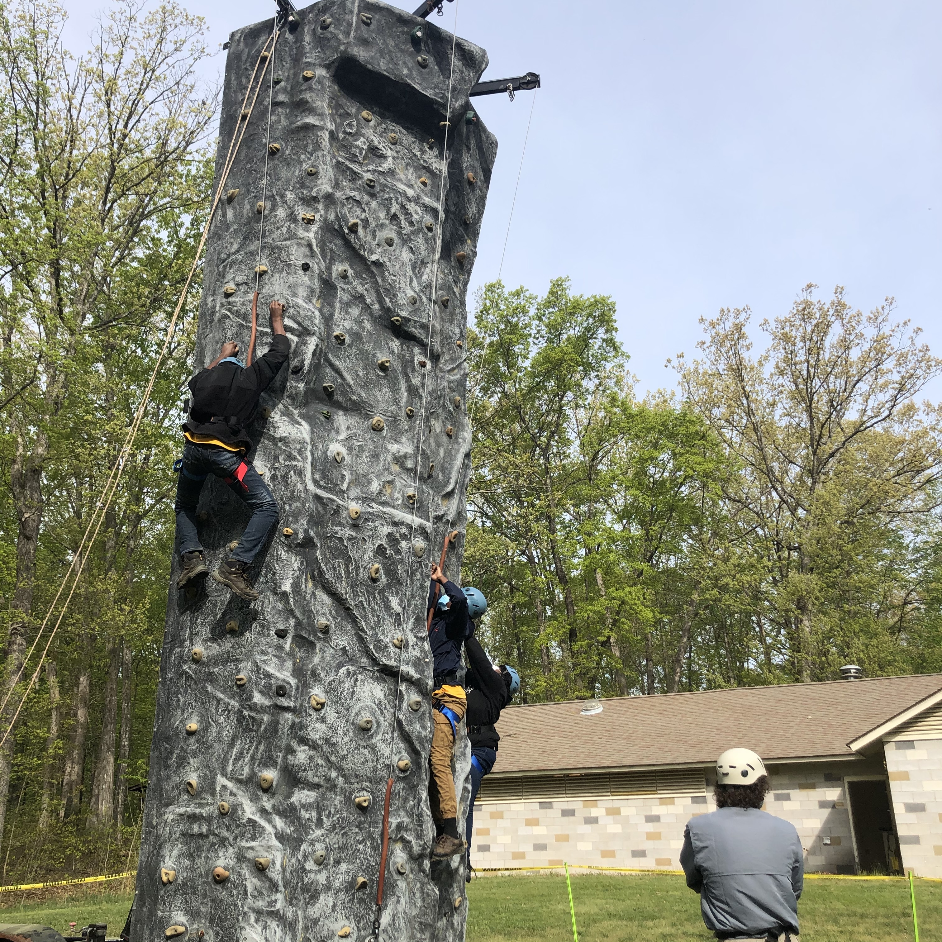
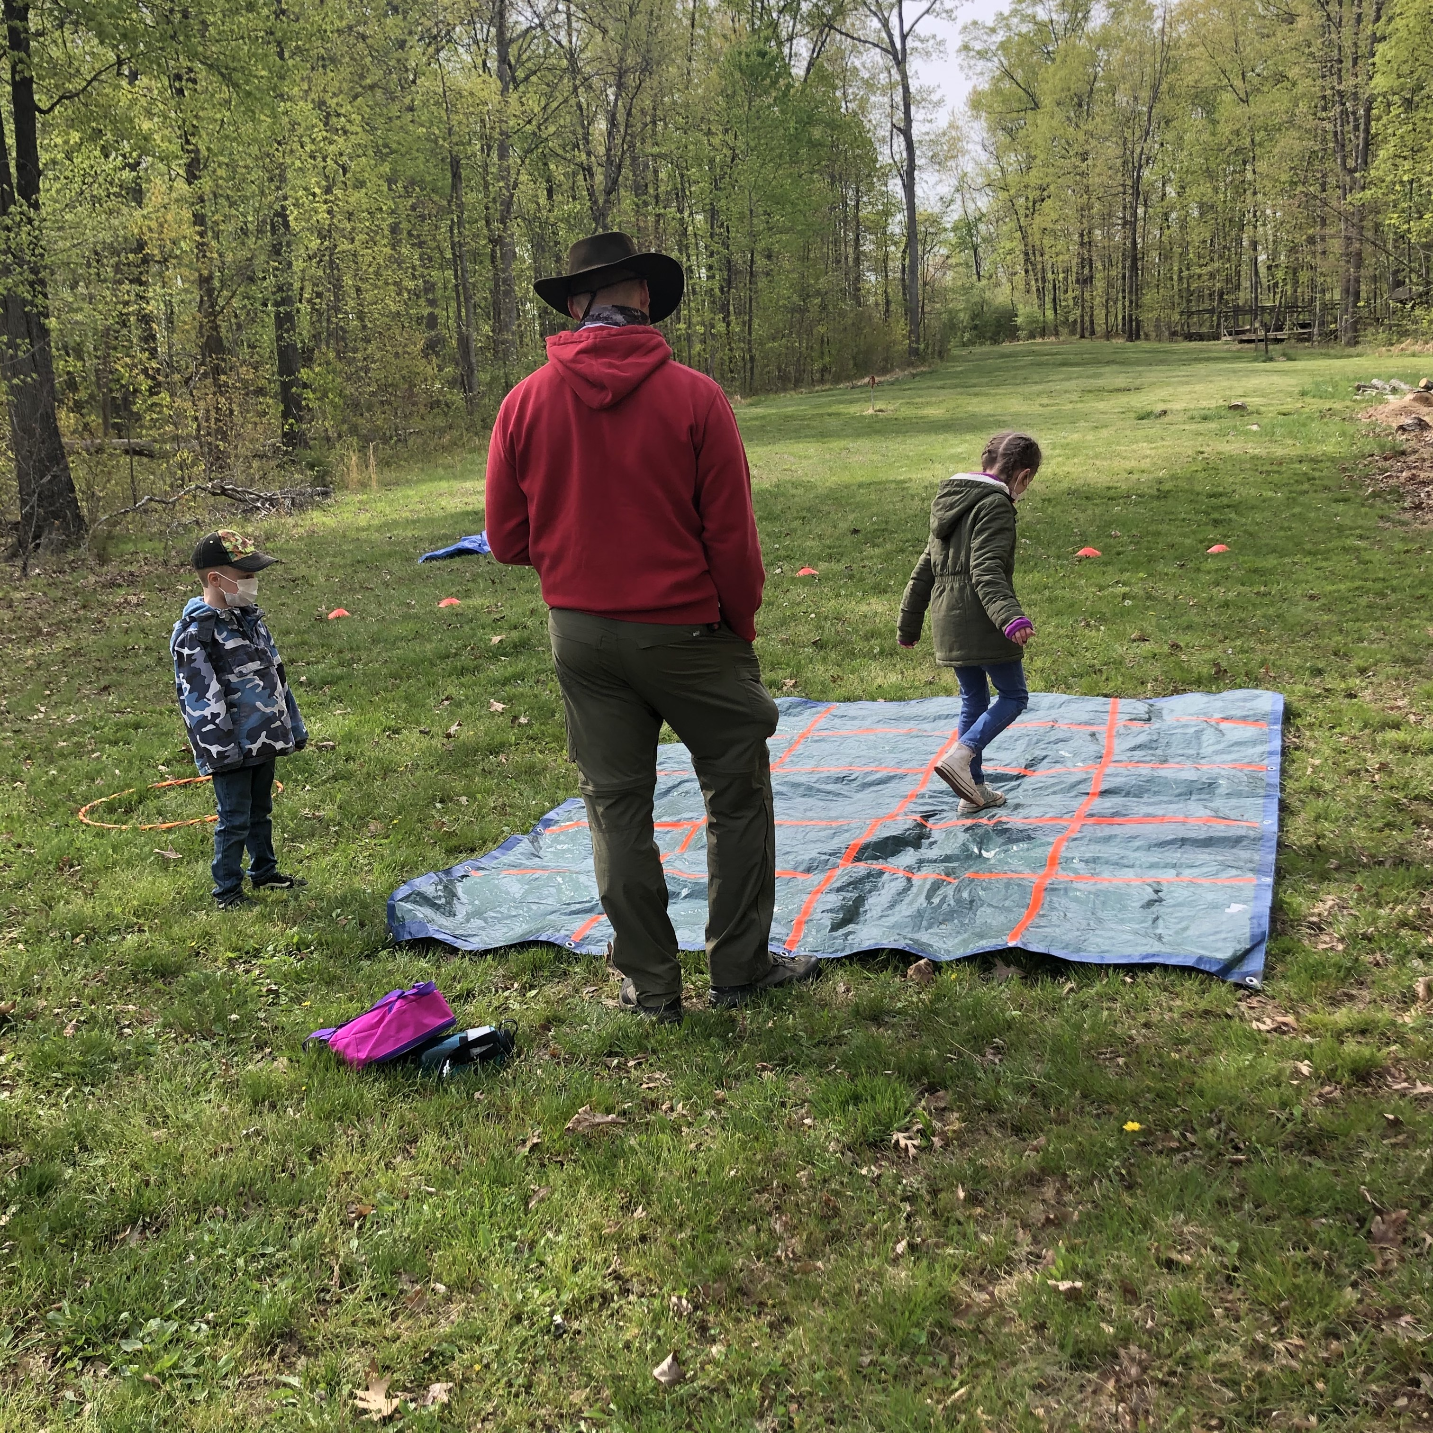
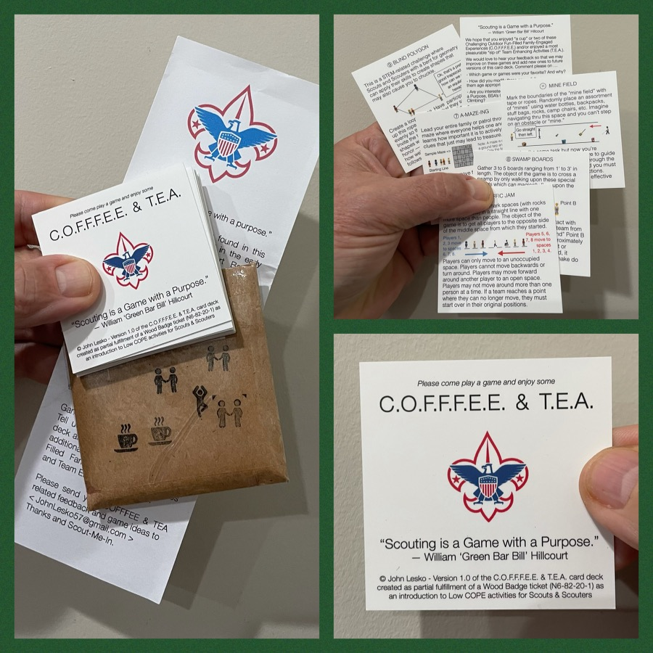
And don’t forget the District’s various COPE and Climbing Opportunities!
COPE Game Day – Camp Snyder from
9:00 a.m. to 12:00 p.m.
February 13, 2022 (Sun.)
Level 1 & Level 2 training in COPE & Climbing programs need to be coordinated with COPE & Climbing committee chair: Tony Waisanen <ncac.cope@gmail.com>
Interested in obtaining a deck
of COFFFEE & TEA game cards,
E-mail JohnLesko57@gmail.com
—————————————>

Slide 25


Merit Badges
Every merit badge counselor needs to be on the District charter. The time for action is NOW!
The online Merit Badge Counselor registration works for all Scouters who do not already hold another District position.
New Merit Badge Counselors must complete online merit badge counselor training, in addition to YPT, after November 1, 2021. Existing merit badge counselors have until 12/31/22 to complete training.
Be sure the counselor uses his/her legal name – no nicknames.
Merit Badge Counselors, or the unit Dean/Leader, also need to scan and send Margee the Merit Badge Counselor Information Form listing the badges the counselor is applying to teach and providing a justification of his/her qualifications.
Youth Protection Training is the essential first step. Don’t hit “send” on the application without it!
Contact Margee if you have questions at GM.MB.Dean@hotmail.com.

Slide 26

Glenn A. and Melinda W. Adams Award
Recognizes a noteworthy Eagle Scout Service Project.
Deadline is January 21, 2022
Anyone can make a nomination. ADAMS-NATIONAL-EAGLE-SCOUT-SERVICE-PROJECT-OF-THE-YEAR-NOMINATION-FORM.pdf (nesa.org)
Scout must sign application to document their “consent.”
Also needs an electronic copy of the project workbook.
Some nominations include video.
Winners can receive:
  $500 at the Council level.
  $500 at the Regional (Northeast) level.
  $2,500 for National winner.

Slide 27
Other Topics
Order of the Arrow
General Announcements
District Executive Minute
District Chair Minute
District Commissioner Minute
Minutes and slides available on the GMD web site (District Resources, Roundtable).
Next meeting – February 10, 2022 at 7:30pm (Thoreau MS)

