Slide 1

George Mason District
Roundtable
February 10, 2022

Slide 2


Slide 3
The Scout Law & Oath as of 1910
(St. Paul Pioneer Press, Oct. 28, 1910)
Scout Law
A scout's honor is to be trusted. If he declares: “ On my honor it is so,” that settles it.
A scout is loyal. The obligation of loyalty embraces country and rulers, parents, employers, and scout masters.
A scout's duty is to be useful and to help others. He must try to do his best to do a good turn to somebody each day.
A scout is a friend to all and a brother to every other scout, no matter what social class the other belongs. He must eschew snobbery and cultivate democratic good fellowship.
A scout is courteous. He must, furthermore, take no reward for his courtesy: this means, “no tips.”
Scout Law (Continued)
A scout is a friend to animals. He must not give pain to any creature unnecessarily.
A scout obeys orders. He must, too, render obedience without question: but after carrying out an order he may state reasons for objecting to it.
A scout smiles and whistles under all circumstances. The duty of cheerfulness is second only to that of obedience.
A scout is thrifty. He opens a savings bank account.
Scout Oath
“I give my word of honor that I will do my best
To do my duty to God and the country.
  To help other people at all times.
    To obey the Scout Law.”

Slide 4
Council Update
GMD Charter Renewals (40 Units)
  21 Complete
    Check your roster; some units have added/missing members
      Contact UC/DE if corrections needed
        Remove
        Add
  19 In Process
    15 On-Hold
      6 have follow-up needed
    4 Initiated (P152, T13, T187, T918)
How to add people during charter renewal/submitted individuals can participate
Awards
YPTs Expiring
In-person District meetings

Slide 5
Big Rock – Open Discussion
OA Ceremonies - Can we get the OA Ceremonies Team for Bridging?
Safe Scouting - We have a parent that wants to let their den use power tools to help with their PWD cars. How do we keep their enthusiasm while informing them about safe scouting?
Need skills - Have parents that would like to participate more in scouting, but have not experience camping or scouting skills. How do you bring your parents (and adult leaders) up to speed?
Recognition - How do you recognize your volunteers?
People Don’t Get the Information – Do we have the right channels (Newsletter, Roundtable, Minutes, Email, Basecamp)? How do you spread the information within your units.
Events in other Districts – Can we participate?

Slide 6


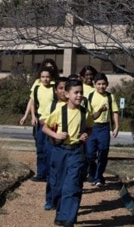

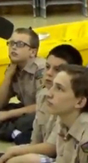

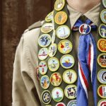
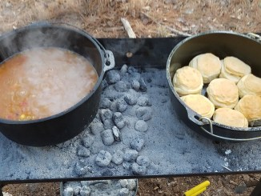
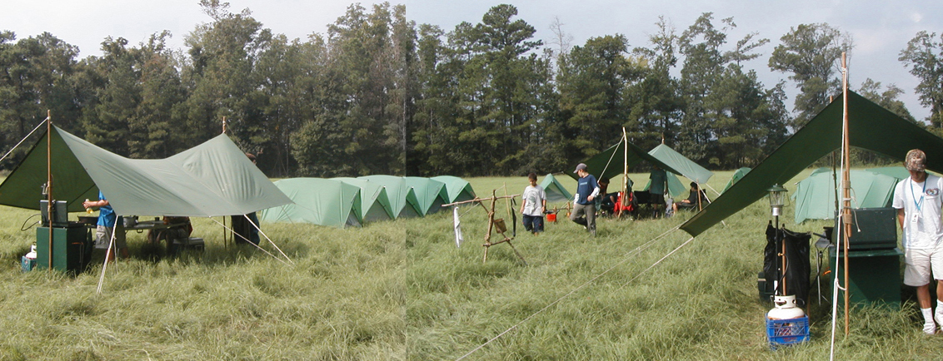
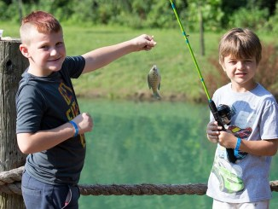
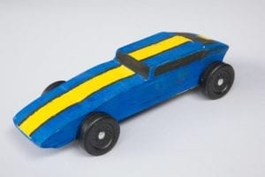
George Mason Program
Matt Burns, Vice Chair Program
George Mason District

Slide 7

Current 2022 GM Calendar
March 5, 2022 – GM Merit Badge Day
March 14, 2022 – PI Day
March 19, 2022 – GM Pinewood Derby
April 14, 2022 – GM District COH
April 29 to May 1, 2022 – GM Spring Camporee
May 1 to May 15, 2022 – GM Hike-O-Ree
May 14, 2022 – Jamboree on the Trail
May 30, 2022 – Flags In
June 4, 2022 – NCAC Stem Expo and Pinewood Derby
June/July 2022 – Cub Summer Camp

Slide 8

Cub Summer Camp
Why?
  It’s Fun!!!
  Prepares for Scouts BSA Camp
Options
  Goshen Camp Ross (Webelos) – Filling fast.
  Camp Snyder – Day Camp for Cubs (Rising Tigers to Webelos)
  Camp Snyder – Resident Weekend Camp for Cubs (Rising Tigers to AOL)
  District-sponsored Day Camps – List on NCAC website under “Day Camp”

Slide 9

Council STEM Expo and Pinewood Derby
June 4, 2022
Location: TBD

Slide 10

22nd Annual Train Show
Lakeridge Middle School, Lake Ridge, VA
Lots of fun
Opportunity to earn railroad merit badge.
Can register for badge online.

Slide 11
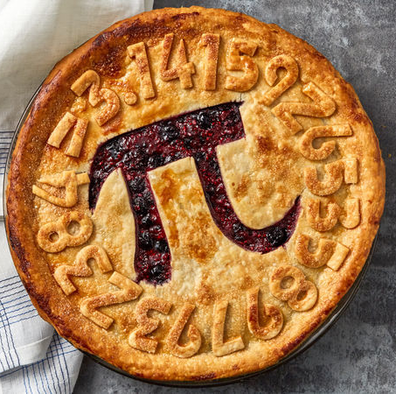
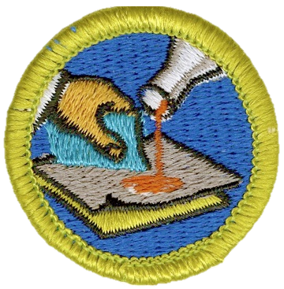

STEM
Pi Day! – March 14
  Try out the Sudoku puzzle
  Open to all – Cubs, Scouts, and parents
  Will provide activities to do at home or in small groups
  Some specific activities tied to advancement
Welding & Composite Materials MB Sessions
  Hosted by Building Momentum in Alexandria, VA
  23 April and 21 May
  Sign up at www.ncacbsa.org/stem

Slide 12
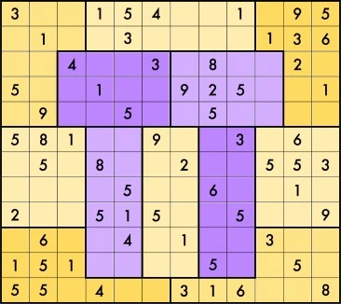
Pi Day Sudoku
The rules are a little different from standard Sudoku, in part because the blocks are jigsaw pieces rather than 3×3, and in part because the first 12 digits of π are used instead of the standard 1-9. Each row, each column, and each colored block (“jigsaw region”) contains the first 12 digits of Pi
3 1 4 1 5 9 2 6 5 3 5 8
in some order. In particular, there are two 1s, one 2, two 3s, one 4, three 5s, one 6, no 7s one 8, and one 9.

Slide 13
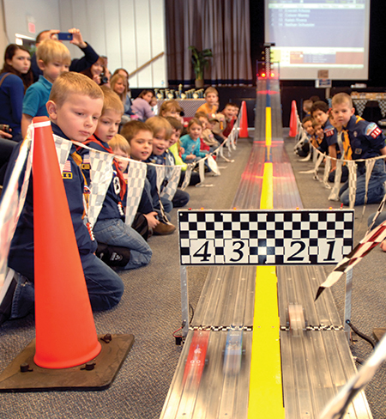
2022 George Mason Pinewood Derby
Race Day is March 19, 2022
All Packs wanting to participate in the 2022 Pinewood Derby MUST hold their Pack Pinewood Derbies by March 10, 2022.
One unit winner from each age bracket (Lions, Tigers, Wolves, etc.) regardless of gender.
Pack winners must register (and pay) on Council website. $15.00 per entry. No money collected at door on day of race. Must register by 3/17/22.
Register at https://scoutingevent.com/082-52774
Race will be held at Fairfax Presbyterian in Fairfax.
For questions, contact Chip McCaslin at chipmccaslin@gmail.com

Slide 14

District Court of Honor
To recognize adults who served/are serving at the unit level.
Two awards:
  Unit Commissioner’s Unit Scouter Award – 1 per unit
  Unit Appreciation Award – Maximum 8 per unit.
Please provide a sentence or two describing the individual’s service.
Submit Unit Commissioner’s Unit Scouter Award to Unit Commissioner.
Unit Appreciate Award to gm.adultrecognition@gmail.com
Must have all submissions by no later than March 11, 2022.
Will confer awards at District COH/April Roundtable.

Slide 15
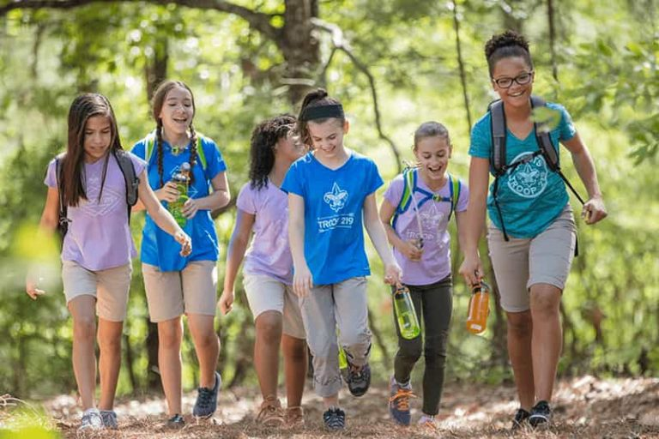
George Mason Hike-O-Ree
2nd Annual GM Hike-O-Ree on weekends of May 7 and May 14 – 5/6 to 5/15/22.
Open to all (Cubs, Scouts BSA and Venturing Scouts), families and friends.
Any age, any place and any appropriate grouping – just keep track of how far you hiked.
Register on Council website (registration opening in early 2022). $5.00 for a patch.
Challenge – District Scouts, Scouters and families hike 2,022 miles.
Total the miles for each unit and notify Matt Burns at Burnsmj509@gmail.com. We’ll see how big a total we reach.

Slide 16
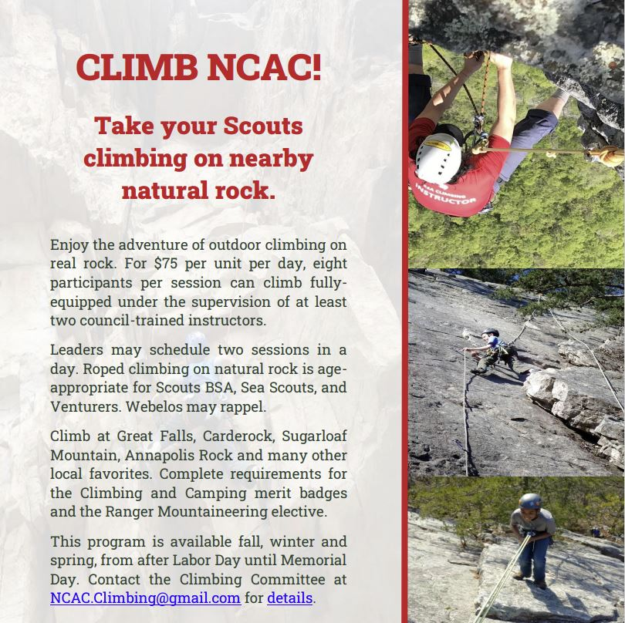

Slide 17
Civic and Related Activities of Interest to Scouts
Dyke Marsh Sunday Morning Bird Walks – 8:00 a.m. on Sundays at Dyke Marsh in Alexandria
Huntley Meadows Monday Morning Bird Walk at 7:00 a.m. in Alexandria
Sully Historic Site Tours – Recurring weekly on Sunday, Thursday, Friday and Saturday.
Winter Waterfowl Hike – Feb 11, 2022 from 9:00 a.m. to 11:00 a.m., Riverbend Park in Great Falls, VA.
Green Spring Gardens – Family Fun – Forcing Flowers – 2/12/22, 10 to 11:30 a.m.
Riverbend Park Klondike Campfire Cookout – 2/19/22, 3:00 to 4:30 p.m.
Beginning Wood Carving – 2/20/22, from 1:00 to 3:00 p.m. at Colvin Run Mill in Great Falls

Slide 18
Civic and Related Activities of Interest to Scouts – Cont.
Birding for Beginners, Huntley Meadows Park, 2/20/22 – 8:00 to 11:00 a.m.
Mount Vernon – Free Admission on 2/21/22 from 8:00 a.m. to 5:00 p.m. – Reservations Required
Riverbend Park Tree ID – Bark & Buds 2/26 and 2/27/22 from 12:00 to 2:00 p.m.
Woodlawn Needlework Show & Sale, Woodlawn Historic Site in Alexandria. March 3 to March 31 from 10:00 a.m. to 4:00 p.m. (except Tuesday)
Nature Explorers Virtual Club – Winter – Twice weekly sessions until 3/9 at 10 a.m. on Mondays and 4 p.m. on Wednesdays, Huntley Meadows Park in Alexandria, VA.
Friday Night Skywatching – The Turner Farm in Great Falls at 8:30 p.m.
Falls Church Easter Egg Hunt – April 16, 2022 – Children 1 to 11 – Cherry Hill Park 10:00 a.m. to Noon.
Note: Tickets may be required or there may be charges for these activities. We recommend checking the event website in advance.

Slide 19
SCOUTS BSA Roundtable

Slide 20
Advancement Topics
BSA COVID Advancement Exceptions
  Any requirements earned are earned – and must be counted toward advancement including after 3/1/22.
  Examples of COVID Advancement Exceptions (see COVID-19 FAQ | Boy Scouts of America (scouting.org))
    Swimming – Second and First Class requirements deferred up to Life ranks.
    Camping – Up to three nights of virtual camping per month allowed.
  Effective February 28, 2022, these exceptions expire. As of March 1, 2022, youth must complete all original rank and merit badge requirements as published by the BSA.
Citizenship in Society Merit Badge – Required as of 7/1/22
New BSA Software for Councils – Issues impacting units – Procedural Changes Coming Soon
  Temporary delays in ESRA verification
  Council working on new verification procedures. Expect approval soon and delegation of verification to District Eagle Representatives.
  Units will send ONLY ESRA electronically to Bethesda after Eagle Board of Review

Slide 21
2022 District Merit Badge Event
Masks Required inside Fairfax Presbyterian
March 5th, 2022 at Fairfax Presbyterian Church in Fairfax.
Most classes are full. Personal Management has some spots available. Check website for possible cancellations.
Adults needed to help staff merit badge classes and comply with YPT requirements.
Be prepared for possible changes.
Feedback to John Drisco at gmasonmeritbadgeday@gmail.com

Slide 22

GEORGE MASON DISTRICT CAMPOREE
Date:
April 29 – May 1, 2022
Location and Theme: Rock Enon Scout Camp, Gore VA.
Shooting Sports
Number of spots limited by need to keep shooters safe!
Online registration available on Council website in early March 2022.
Leader Guide will be available on registration site a few weeks ahead of event.
Need unit volunteers to help run event.
Camporee Director Andrew Zaso
(703) 434-2907 - AndrewZaso@gmail.com
Registration will open in early March 2022

Slide 23
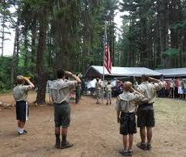
Future Camporees
Save the Dates!!!
George Mason Fall 2022 Camporee – October 21 - 23, 2022
  Theme and Site TBD
George Mason Spring 2023 Camporee – May 5-7, 2023
  Theme and Site TBD
Please factor this into unit calendars/planning.
Scouts are loyal – including loyalty to District activities.

Slide 24
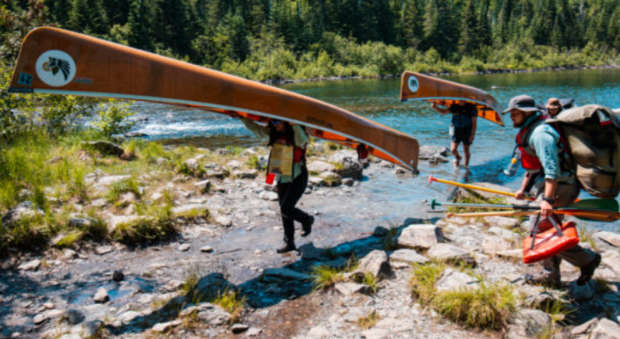
GM High Adventure
NCAC High Adventure Committee (HAC) updates and announcements: https://www.ncacbsa.org/high-adventure/
  2022 National High Adventure Base slots still available; 2023 registrations underway now. Unified registration site: https://www.scouting.org/outdooradventures/open4adventure/
  2022 Lenhok’sin James River Canoe Trek (provisional and unit) spaces available for the 17-23 July expedition
  Philmont Preparedness Seminars (16 Feb: Trail food and cooking)
  High Adventure Source Book, Volumes I and II (Vol. III forthcoming)
  Wilderness First Aid vendor list updated (minimum 1 adult per crew)
New BSA Adventure Planning Resource: The Adventure Plan (TAP) https://tap.scouting.org/
Contact Joe Knecht at knechtjoe@yahoo.com if you have questions regarding high adventure planning or resources.
February 2022

Slide 25
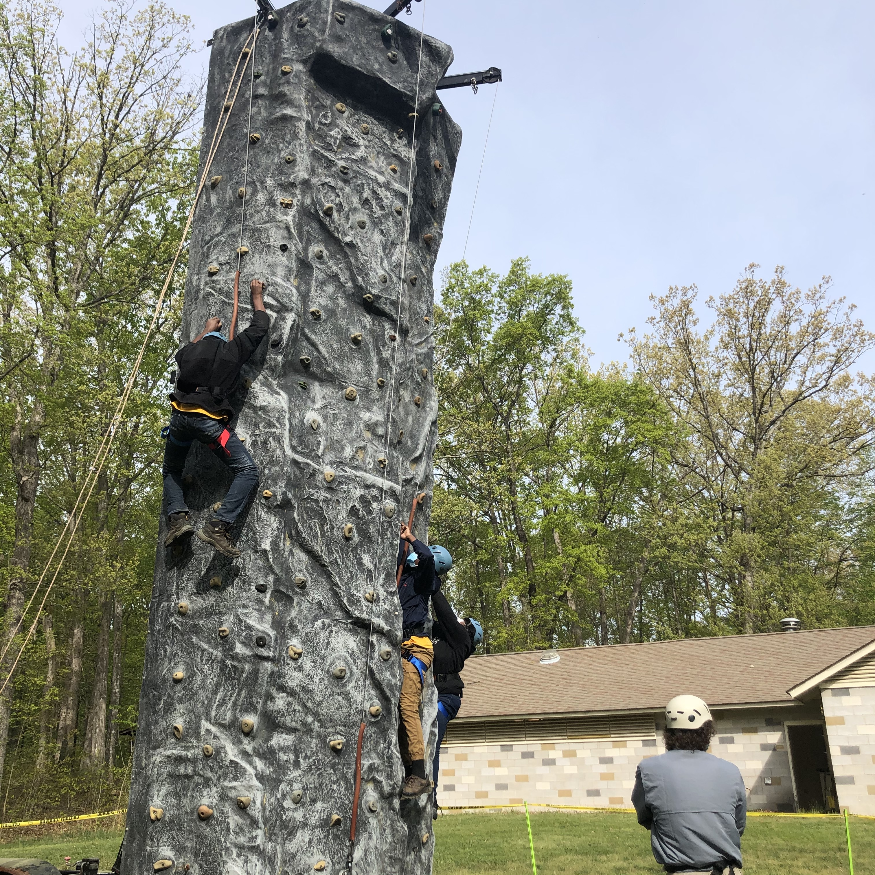
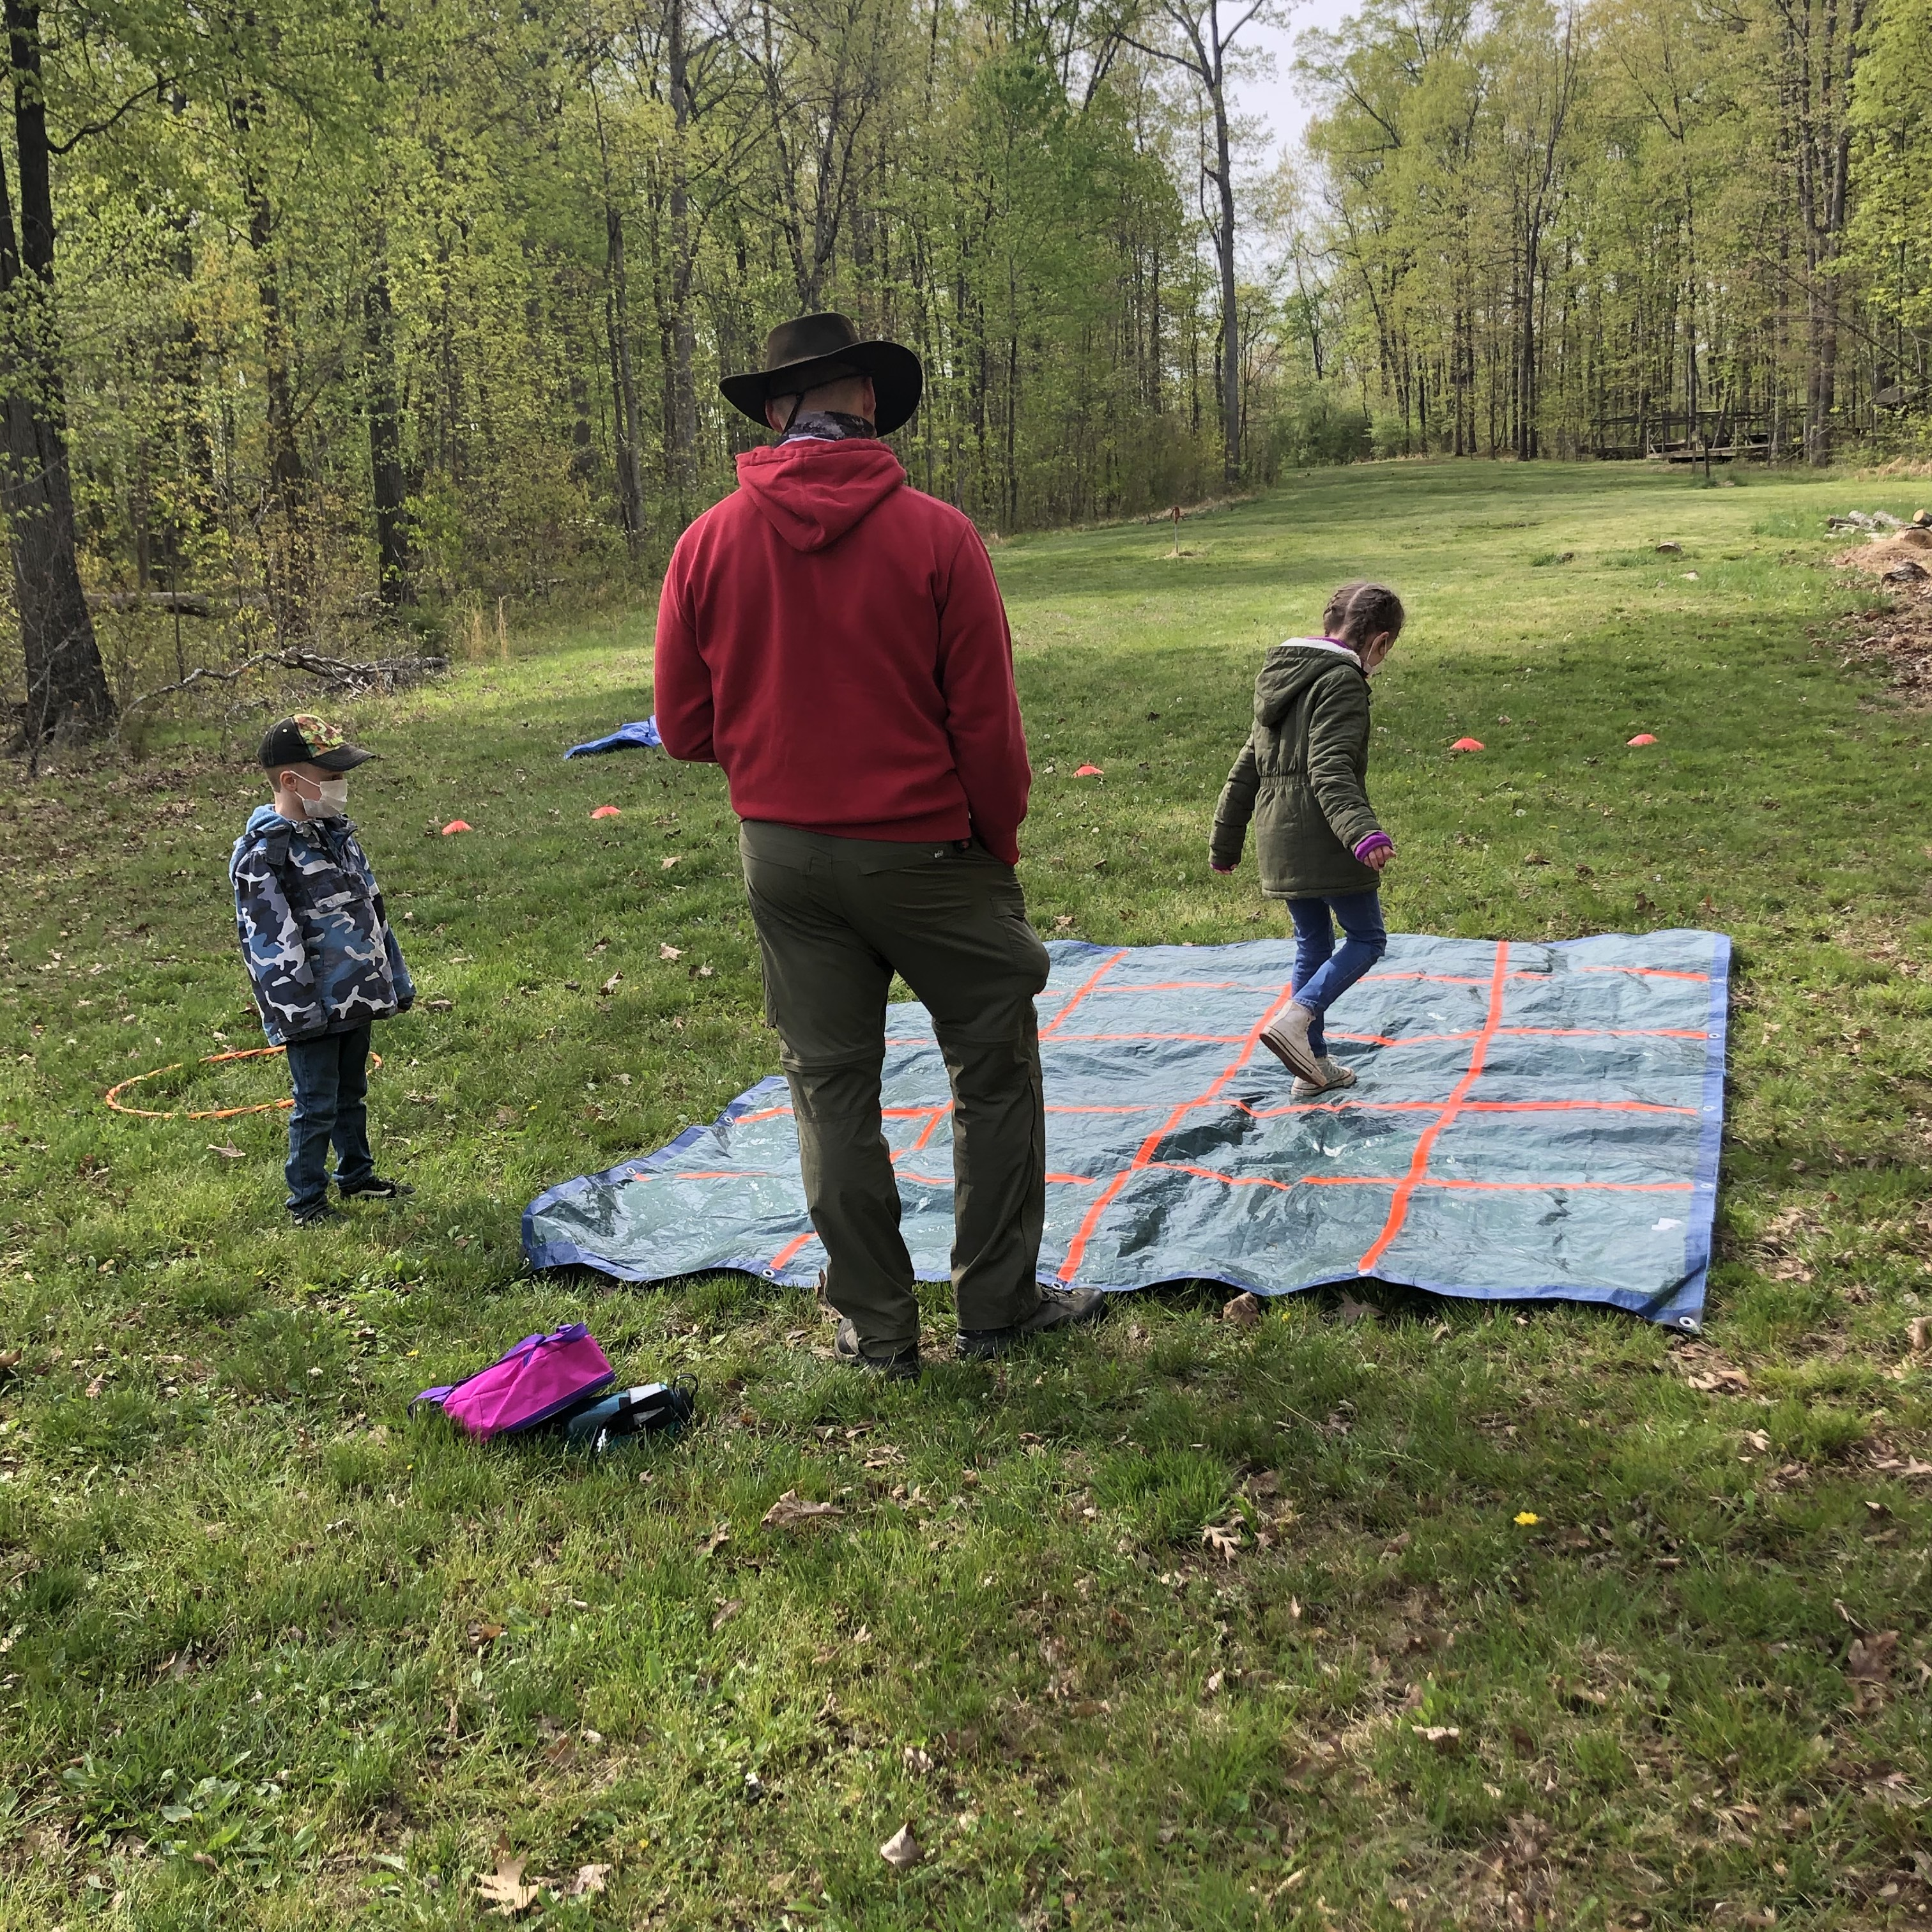
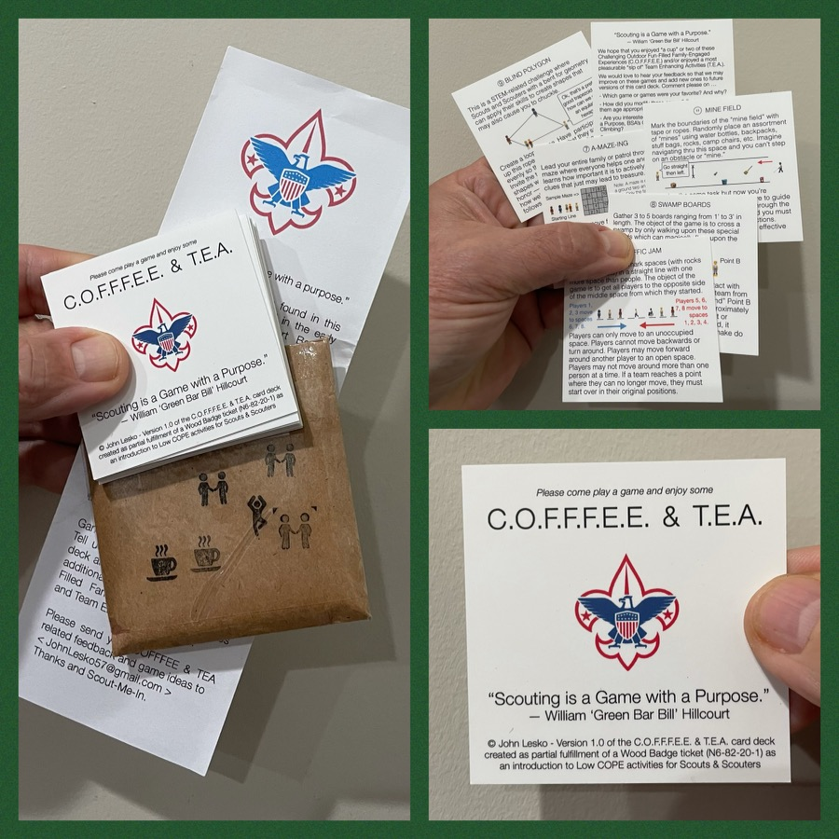
And don’t forget the District’s various COPE and Climbing Opportunities!
At any Family or Unit Camping Event held at Camp Synder, you’ll likely find the mobile climbing wall (a.k.a. “Scouterhorn”), a Slackline, as well as Challenging Outdoor Fun-Filled Family-Engaged Experiences or Team Enhancing Activities (a.k.a. COFFFEE and TEA).
Check the Camp Synder schedule to register.
Level 1 & Level 2 training in COPE & Climbing programs need to be coordinated with COPE & Climbing committee chair: Tony Waisanen <ncac.cope@gmail.com>
Interested in obtaining a deck
of COFFFEE & TEA game cards,
E-mail JohnLesko57@gmail.com
—————————————>

Slide 26

Training
Unit Training – For position-specific training at your unit, contact Roy De Lauder at EagleScout.Roy@cox.net or go to Training Opportunities page on GM Web Site.
Back Country Outdoor Leadership Skills – 03/05/22 Huntingtown, MD
Basic Adult Leader Outdoor Orientation (BALOO;C32)
  03/19/22 – 03/20/22 – Cheltenham, MD
  03/26/22 – 03/27/22 – Camp Snyder, Haymarket, VA
  04/09/22 – 04/10/22 – Huntingtown, MD
Climbing Level 1 Instructor – 4/23-4/24/22 at Sugarloaf Mountain, MD. Second course, same place, 4/30-5/1/22. Contact Course director at ncac.climbing@gmail.com to register. Fee is $40.00
Introduction to Outdoor Leadership Skills (IOLS; S11)
  (02/19/22 or 02/26/22) and (03/19/22 – 03/20/22) – Cheltenham, MD
  04/09/22 – 04/10/22 – Huntingtown, MD
Powderhorn (P50) - 08/26/22 – 08/28/22 – Camp St. Charles, Newburg, MD
Scouterhorn Training Assessment – February 19, 10 a.m. to 1:00 p.m., Camp Snyder. Pre-requisite to be a “Climb Master.” Must first complete the on-line training and then pass hands on assessment at Camp Snyder. E-mail NCAC.COPE@gmail.com with “Scouterhorn” in the subject.
University of Scouting - 02/26/22 – Virtual
Wood Badge (A90)
09/09/22 – 09/11/22 & 10/08/22 – 10/09/22 – Camp Snyder, Haymarket, VA

Slide 27

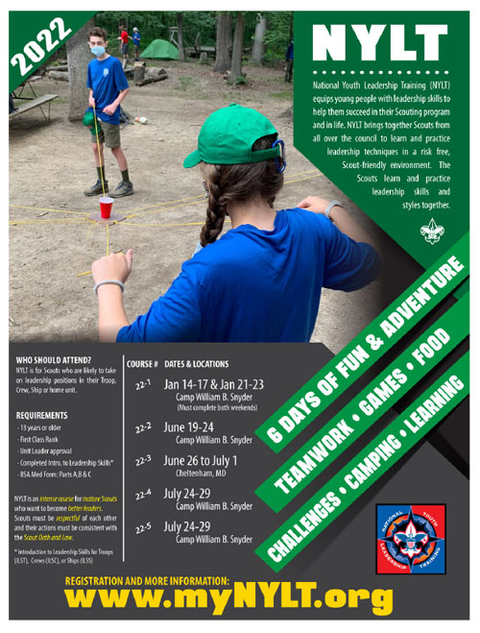
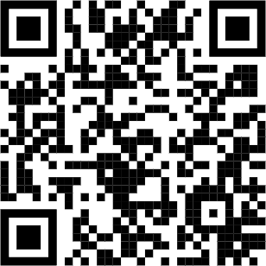
National Youth Leadership Training (NYLT)
Give your future leaders a new set of tools!
NYLT is a 6 day course that equips young people with leadership skills to help them succeed in their Scouting program and in life.
REQUIREMENTS
· Unit Leader approval
· 13 years or older
· First Class Rank or higher
· Completed Introduction to Leadership Skills
· BSA Med Form: Parts A, B & C
Registration OPEN on March 5th at 10am
2022 Schedule
Course | Course Dates | location
22-1 | Jan 14-17; Jan 21-23 | Snyder
22-2 | June 19-24 | Snyder
22-3 | June 26 to Jul 1 | Cheltenham
22-4 | July 24-29* | Snyder
22-5 | July 24-29* | Snyder
Questions? Email contact@my.NYLT.org
* courses running concurrently

Slide 28

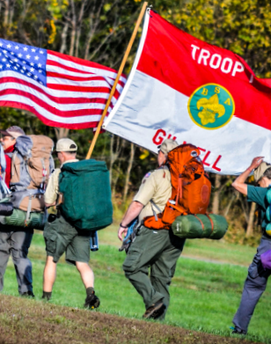
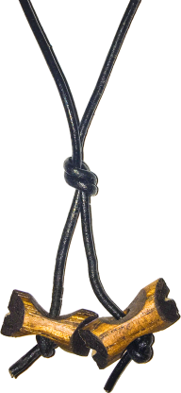
BSA’s ultimate leadership training for ALL adult leaders
Applicable to every program: Cubs, Scouts BSA, Venturing, Sea Scouts
Applicable to every level: unit, district, or council level
An exciting & inspiring course that infuses your units with fun & meaning
Leaders develop real-world, hands-on skills to ensure our youth are getting everything they are promised from the program
Spring Course
Register at:
https://www.ncacbsa.org/wood-badge/
Weekend #1: April 29 – May 1
Weekend #2: May 14 – 15
Course Director: Mr. John Howlin
johnhowlinjr@yahoo.com
Fall Course
Registration Opens
April 30, 2022
Weekend #1: September 9 – 11
Weekend #2: October 8 – 9
Course Director: Mr. Rick Rogers
rsrogers4@gmail.com

Slide 29
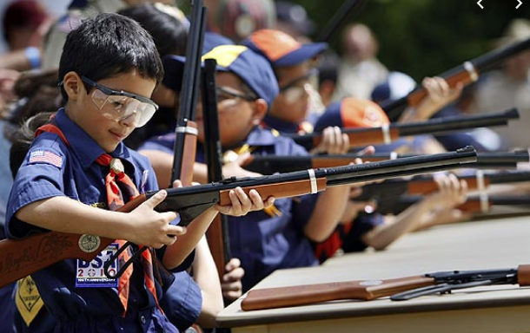
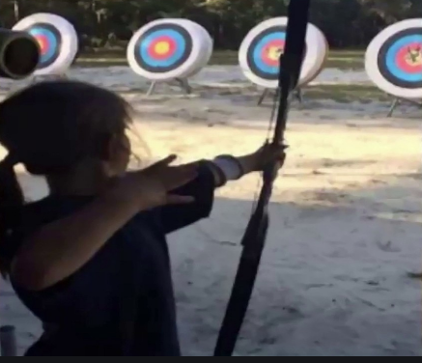
Shooting Sports
Requests for Shooting Events – Lead Time!
  50+ scouts - 6mos
  Less than 50 scouts - 3mos
Shooting on private land:
  Requirements
  Permissions/protocols
Shooting Sports web page
Shooting Sports Instructor Classes:
  Rifle/Shotgun
  Archery (Virtual classes available)

Slide 30


Merit Badges
Every merit badge counselor needs to be on the District charter. The time for action is NOW!
The online Merit Badge Counselor registration works for all Scouters who do not already hold another District position.
New Merit Badge Counselors must complete online merit badge counselor training, in addition to YPT, after November 1, 2021. Existing merit badge counselors have until 12/31/22 to complete training.
Be sure the counselor uses his/her legal name – no nicknames.
Merit Badge Counselors, or the unit Dean/Leader, also need to scan and send Margee the Merit Badge Counselor Information Form listing the badges the counselor is applying to teach and providing a justification of his/her qualifications.
Youth Protection Training is the essential first step. Don’t hit “send” on the application without it!
Contact Margee if you have questions at GM.MB.Dean@hotmail.com.

Slide 31
Other Topics
Order of the Arrow
General Announcements
New Roundtable Commissioner
District Executive Minute
District Chair Minute
District Commissioner Minute
Minutes and slides available on the GMD web site (District Resources, Roundtable). Password is “GMDRT”
Next meeting – March 10, 2022 at 7:30pm (Thoreau MS)

