Slide 1

George Mason District
Roundtable
March 10, 2022

Slide 2


Slide 3
Council Update
Journey to Excellence – Continue to use 2021 Unit Scorecards
Restructuring – Estimate date to exit bankruptcy is June 2022
Council-Wide Roundtable - 03/19/22, 7:30pm, Zoom
District Collaboration – Day Camps, Camporee, OA, Training
Other Fund-raising Opportunities
  (Trial Program) First Response – First Aid Kits – 25% Unit, 25% Council
  (Trial Program) Businesses Sponsoring MB
College of Commissioner Service (3/12/22 – 03/13/22) – open to all adults
MB Day – Thanks to John and all who helped. Great event!

Slide 4
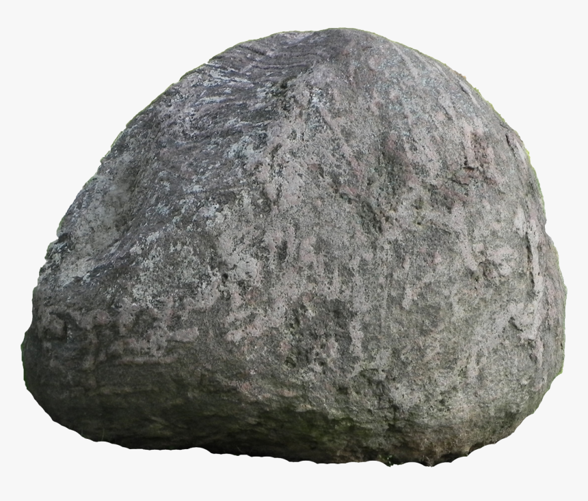
How to prepare for an Outing
(but not what you think)
Big Rock

Slide 5
Questions to think about?
Do your leaders or adults look beyond planning and logistics for an event?
Do you provide a safety briefing for all activities?
Do your remind your scouts about the 3 R’s?
How do you prepare your scout and adult leadership on reporting issues?
Are all your scouts able to participate in the activity and if not what alternatives do you provide?
What resources do you use for activities or events (old and new)?
Do you conduct roses, buds and thorns?
Do you keep a log of lessons learned?
Do you know how to report a “near miss?”

Slide 6
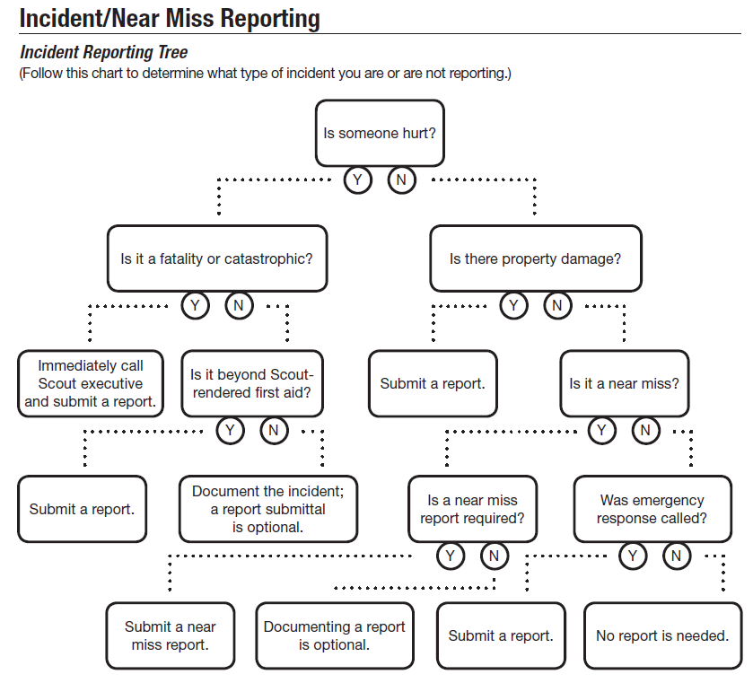

Slide 7
Resources
Guide to Safe Scouting
  https://www.scouting.org/health-and-safety/gss/toc/
Reporting an Incident
  https://www.scouting.org/health-and-safety/incident-report/
Shooting Sports Info and Shooting Sports Manual
  https://www.ncacbsa.org/shooting-sports/
Scouting Aquatics
  https://www.scouting.org/outdoor-programs/aquatics/forms/
Shenandoah National Park
  https://www.nps.gov/shen/index.htm

Slide 8
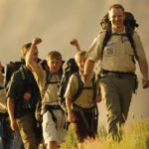

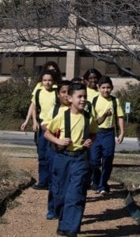

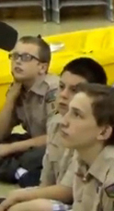
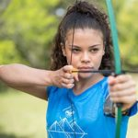
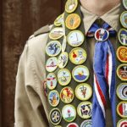
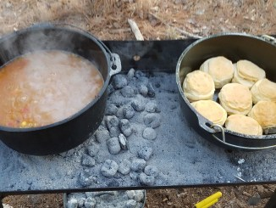
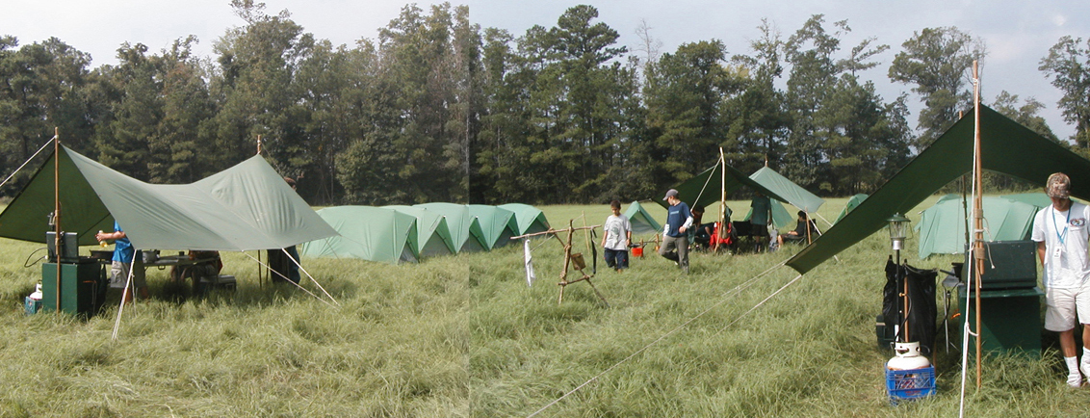
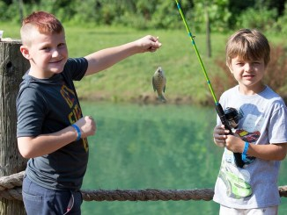
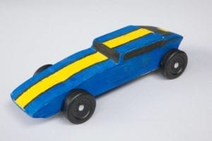
George Mason Program
Matt Burns, Vice Chair Program
George Mason District

Slide 9

Current 2022 GM Calendar
March 14, 2022 – PI Day
March 19, 2022 – GM Pinewood Derby
April 14, 2022 – GM District COH
April 29 to May 1, 2022 – GM Spring Camporee
May 1 to May 15, 2022 – GM Hike-O-Ree
May 14, 2022 – Jamboree on the Trail
May 30, 2022 – Flags In
June 2, 2022 – Elks Youth Recognition Dinner
June 4, 2022 – NCAC Stem Expo and Pinewood Derby
June/July 2022 – Cub Summer Camp

Slide 10

Cub Summer Camp
Why?
  It’s Fun!!!
  Prepares for Scouts BSA Camp
Options
  Goshen Camp Ross (Webelos) – Filling fast.
  Camp Ross recently added a sixth week (7/31 to 8/6)
  Camp Snyder – Day Camp for Cubs (Rising Tigers to Webelos)
  Camp Snyder – Resident Weekend Camp for Cubs (Rising Tigers to AOL)
  District-sponsored Day Camps – List on NCAC website under “Day Camp”

Slide 11
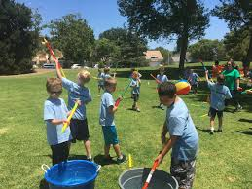
Parent Meetings on Summer Camp
How do Cub leaders feel about District hosting virtual meetings for parents to describe summer camp options?
Two evening sessions in late March/early April?
Unit commissioners have a slide deck describing the options. Would use same slides.
Can we count on unit leaders to encourage attendance?

Slide 12

Council STEM Expo and Pinewood Derby
June 4, 2022
Location: Camp Snyder
Registration: National Capital Area Council - Council Pinewood Derby & STEM Expo (scoutingevent.com)
Cost: $30.00 – entrance to race & STEM – See registration site for race rules & details.
Race your car in a Council Pinewood Derby Championship race and explore a wide-range of STEM stations at Camp Snyder on June 4, 2022!
The NCAC STEM Committee (and friends!) will host a myriad of stations targeted to Cub Scouts to include underwater ROVs, robotics, chemistry and physics.
The Championship race welcomes: winners of a NCAC District championship of the last 2.5 years (2020 - 2022). Didn't place in a district race, but want to compete in the Council Championship? Great! We have a track for you too! Select your choice of race upon registration.

Slide 13

22nd Annual Train Show
Lakeridge Middle School, Lake Ridge, VA
Lots of fun
Opportunity to earn railroad merit badge.
Can register for badge online.

Slide 14
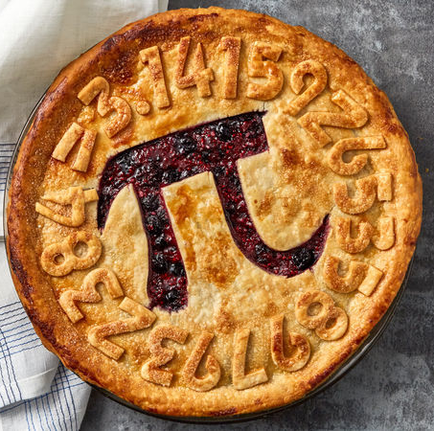
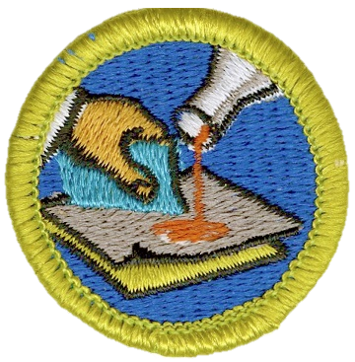

STEM
Pi Day! – March 14
  Try out the Sudoku puzzle
  Open to all – Cubs, Scouts, and parents
  Will provide activities to do at home or in small groups
  Some specific activities tied to advancement
Welding & Composite Materials MB Sessions
  Hosted by Building Momentum in Alexandria, VA
  23 April and 21 May
  Sign up at www.ncacbsa.org/stem

Slide 15
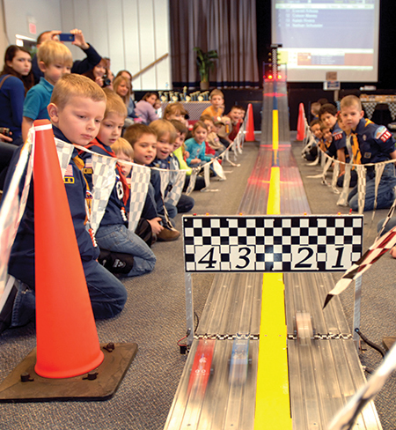
2022 George Mason Pinewood Derby
Race Day is March 19, 2022
Participating units – please contribute a volunteer to staff car drop off, technical inspection, minor repairs.
All Packs wanting to participate in the 2022 Pinewood Derby MUST hold their Pack Pinewood Derbies by March 10, 2022.
One unit winner from each age bracket (Lions, Tigers, Wolves, etc.) regardless of gender.
Pack winners must register (and pay) on Council website. $15.00 per entry. No money collected at door on day of race. Must register by 3/17/22.
Register at https://scoutingevent.com/082-52774
Race will be held at Fairfax Presbyterian in Fairfax.
For questions, contact Chip McCaslin at chipmccaslin@gmail.com

Slide 16

District Court of Honor
To recognize adults who served/are serving at the unit level.
Two awards:
  Unit Commissioner’s Unit Scouter Award – 1 per unit
  Unit Appreciation Award – Maximum 8 per unit.
Please provide a sentence or two describing the individual’s service.
Submit Unit Commissioner’s Unit Scouter Award to Unit Commissioner.
Unit Appreciate Award to gm.adultrecognition@gmail.com
Must have all submissions by no later than March 11, 2022.
Will confer awards at District COH/April Roundtable.

Slide 17
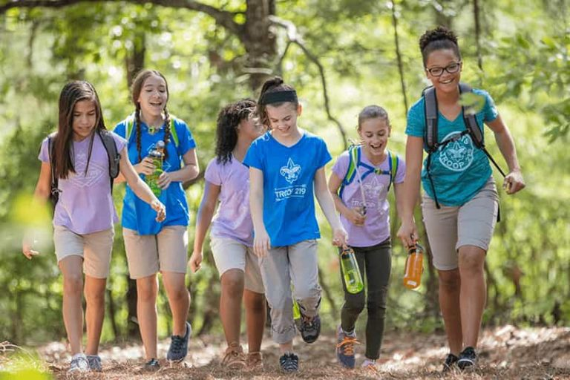
George Mason Hike-O-Ree
2nd Annual GM Hike-O-Ree on weekends of May 7 and May 14 – 5/6 to 5/15/22.
Open to all (Cubs, Scouts BSA and Venturing Scouts), families and friends.
Registration – Coming soon.
Any age, any place and any appropriate grouping – just keep track of how far you hiked.
Register on Council website (registration opening in early 2022). $5.00 for a patch.
Challenge – District Scouts, Scouters and families hike 2,022 miles.
Total the miles for each unit and notify Matt Burns at Burnsmj509@gmail.com. We’ll see how big a total we reach.

Slide 18
Civic and Related Activities of Interest to Scouts
Dyke Marsh Sunday Morning Bird Walks – 8:00 a.m. on Sundays at Dyke Marsh in Alexandria
Colvin Run Mill Tours – Everyday except Tuesday. Great Falls, VA. See Website for times and costs.
Soar Together – Airs and Space Family Day – March 12 from 10:00 a.m. to 2:00 p.m. $15.00 per car. Udvar-Hazy Center, Chantilly, VA. A day of activities and programs to commemorate the 100th anniversary of aircraft carriers.
Huntley Meadows Monday Morning Bird Walk at 7:00 a.m. in Alexandria
Sully Historic Site Tours – Recurring weekly on Sunday, Thursday, Friday and Saturday.
Celebrate Pi Day – Sully Historic Site, Chantilly, VA from 3:14 pm to 5:00 p.m. Cost is $3.14. Join with those who understand that Pi is a number that goes on forever. Also visit our 1794 kitchen and see an interpreter bake a traditional recipe over an open-hearth fire and sample a piece as you learn about this historically delicious food.
National Cherry Blossom Festival – Around the Tidal Basin, Washington DC after March 20. Parade is April 9 from 10:00 a.m. to 12:00 p.m. – See website for tickets to grandstand seating or map of standing areas along parade route.

Slide 19
Civic and Related Activities of Interest to Scouts – Cont.
Blossom Kite Festival – March 26 from 10 a.m. to 4:30 p.m., Washington Monument Grounds in Washington, DC – free admission. Rediscover the joy of kite flying!
Woodlawn Needlework Show & Sale, Woodlawn Historic Site in Alexandria. March 3 to March 31 from 10:00 a.m. to 4:00 p.m. (except Tuesday)
The Ides of Bark – Grist Mill Park from 1:00 p.m. to 4:00 p.m. – Free admission. Games, prizes, food and fun for everyone in the family – on two feet or four feet.
Friday Night Skywatching – The Turner Farm in Great Falls at 8:30 p.m.
Historic Egg Roll – Freeman House Museum, Vienna – April 1 from 5:30 to 7:00 p.m. – Free admission.
Paddington Gets in a Jam – April 3, Hylton Performing Arts Center, Manassas.
Rediscover Spring: Head into the woods at Frying Pan Park, Herndon, VA. on April 2 at 1:00, 1:30 and 2 p.m. – Explore the Frying Pan Park nature trails and explore stations scattered throughout the woods.
Spring Garden Market at Historic River Farm on April 8 from 10 a.m. to 4 p.m., Alexandria, Va. Celebrate the start of the new gardening season with the American Horticultural Society.
Falls Church Easter Egg Hunt – April 16, 2022 – Children 1 to 11 – Cherry Hill Park 10:00 a.m. to Noon.
City of Fairfax Fishing Derby – Ashby Pond Conservatory – April 16 – 9:30, 10:15 and 11:00 a.m. sessions.

Slide 20
Civic and Related Activities of Interest to Scouts – Cont.
Revolutionary War Weekend – Mount Vernon – April 30 to May 1 – 9:00 to 5:00 – Step back in time during a Revolutionary War re-enactment at Mount Vernon.
Taste of Vienna – April 30 from 11:00 a.m. to 8:00 p.m. – Vienna Fire Department parking lot will be lined with many local favorites showcasing the many excellent restaurants in Vienna.
Horse Expo at Frying Pan Park – Herndon, VA. on April 30 from 11:00 to 5:00. Learn about horses and equestrian sports.
Spring-It On – A Family Volunteer Festival – April 30 from 1 to 4 p.m. at Bethlehem Lutheran Church in Fairfax – Your family can participate in service projects like filling 500+ snack packs for individuals in need, preparing gifts for senior citizens, making cards for first responders and more.
McLean Day 2022, May 21 from 11:00 to 5:00 p.m. at Lewinsville Park in McLean. Admission is free. Bring the family and joy the fun at McLean’s biggest annual festival. he Ides of Bark – Grist Mill Park from 1:00 p.m. to 4:00 p.m. – Free admission. Games, prizes, food and fun for everyone in the family – on two feet or four feet.
Great Falls Memorial Day Ceremony – May 30 at Great Falls Freedom Memorial, 11:00 to 12:00 p.m.
Note: Tickets may be required or there may be charges for these activities. We recommend checking the event website in advance.

Slide 21
SCOUTS BSA Roundtable

Slide 22

GEORGE MASON DISTRICT CAMPOREE
Date:
April 29 – May 1, 2022
Location and Theme: Rock Enon Scout Camp, Gore VA.
Shooting Sports
120 Scouts BSA slots - limited by need to keep shooters safe!
Troops can invite Webelos – Max of 20 Webelos total for camporee.
Troops need to provide adult supervision and program for Webelos while Scouts are doing rifle, shotgun and tomahawks.
Leader Guide will be available on registration site a few weeks ahead of event.
Still need unit volunteers to help run event.
Camporee Director Andrew Zaso
(703) 434-2907 - AndrewZaso@gmail.com
Registration - George Mason Spring Camporee

Slide 23
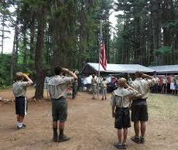
Future Camporees
Save the Dates!!!
George Mason Fall 2022 Camporee – October 21 - 23, 2022
  Theme and Site TBD
George Mason Spring 2023 Camporee – May 5-7, 2023
  Theme and Site TBD
Please factor this into unit calendars/planning.
Scouts are loyal – including loyalty to District activities.

Slide 24

2022 Elks Youth Recognition Dinner
For youth that earned Eagle in 2021 (i.e. their Eagle Board of Review was held in the 2021 calendar year) and their Scoutmasters.
Thursday, June 2, 2022
Elks Lodge 2188, 8421 Arlington Blvd., Fairfax, VA.
Will need unit leader help in contacting Scouts and obtaining an RSVP.

Slide 25
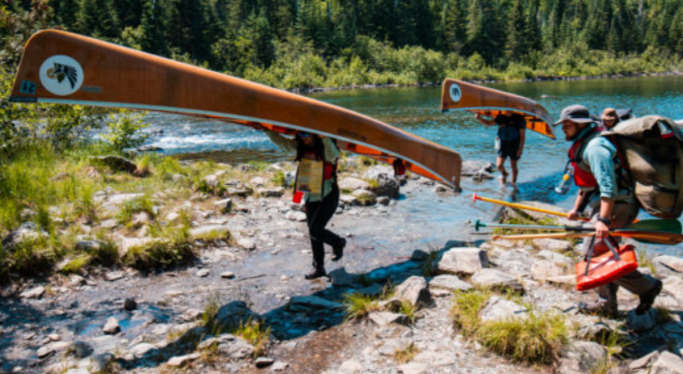
GM High Adventure
NCAC High Adventure Committee (HAC) updates and announcements: https://www.ncacbsa.org/high-adventure/
  University of Scouting HA training material available on Basecamp: https://3.basecamp.com/3958009/buckets/16000091/vaults/2777714268
    “High Adventure 101” provides links to National Base presentations, training guidelines, Sourcebooks, and other great resources.
  Philmont Preparedness Seminars (16 March: Base Camp Procedures) https://www.philmontscoutranch.org/philmont-prep-seminars/
  Spring is prime time for summer high adventure trek training, prep hikes, and breaking in new boots and equipment.
  All BSA high adventure treks require Medical forms A, B, and C – both Scouts and adults – certain programs have additional medical screening requirements. (Schedule that physical exam soon!)
Contact Joe Knecht at knechtjoe@yahoo.com if you have questions regarding high adventure planning or resources.
March 2022

Slide 26
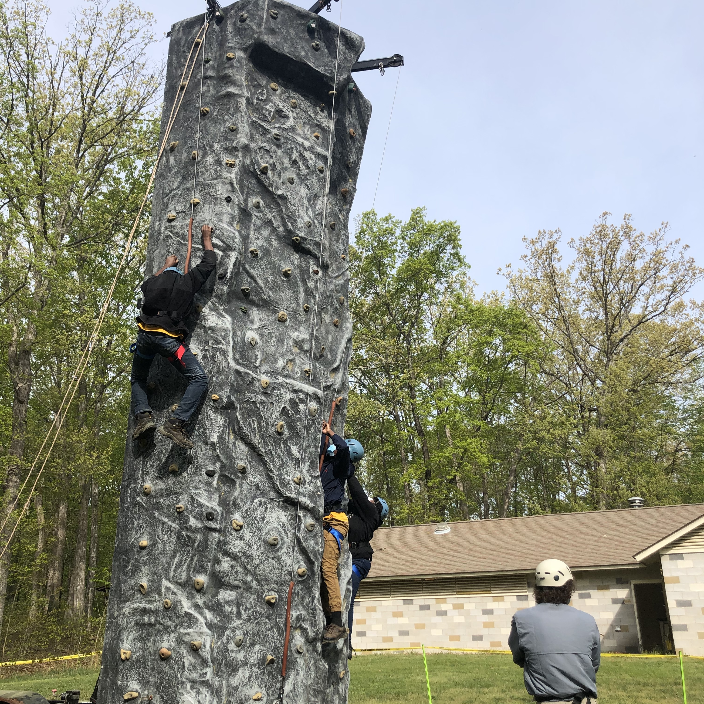
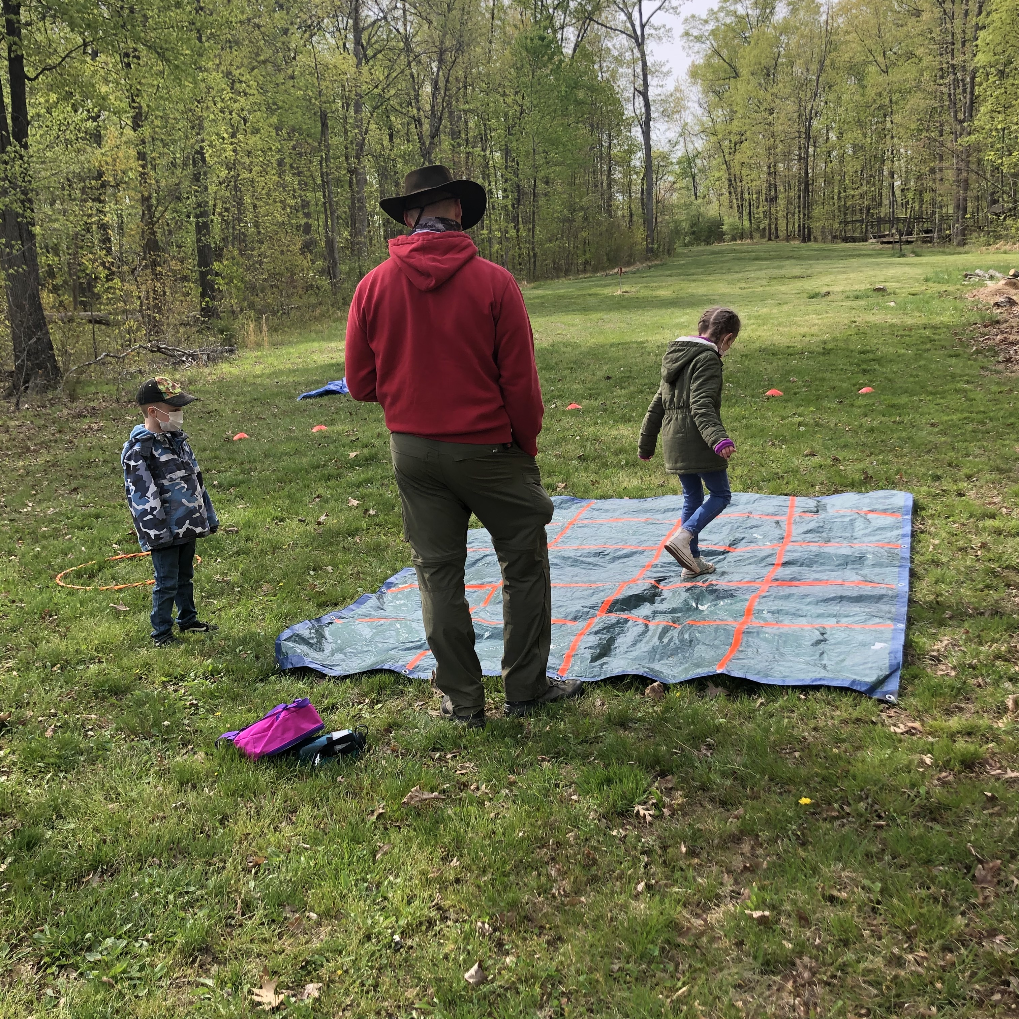
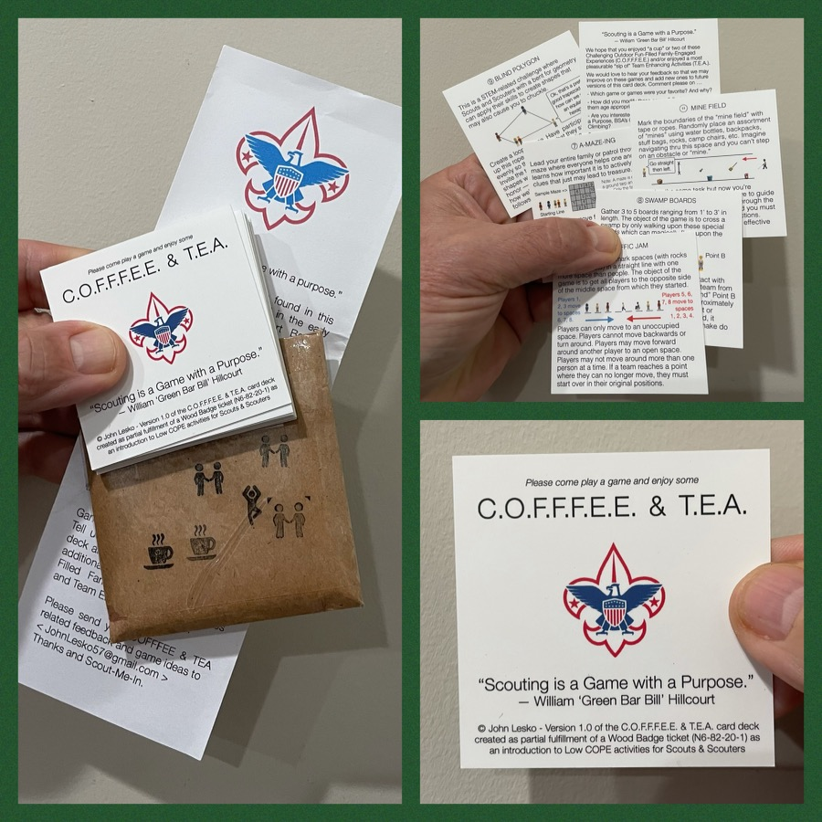
And don’t forget the District’s various COPE and Climbing Opportunities!
At any Family or Unit Camping Event held at Camp Synder, you’ll likely find the mobile climbing wall (a.k.a. “Scouterhorn”), a Slackline, as well as Challenging Outdoor Fun-Filled Family-Engaged Experiences or Team Enhancing Activities (a.k.a. COFFFEE and TEA).
Check the Camp Synder schedule to register.
Level 1 & Level 2 training in COPE & Climbing programs need to be coordinated with COPE & Climbing committee chair: Tony Waisanen <ncac.cope@gmail.com>
Interested in obtaining a deck
of COFFFEE & TEA game cards,
E-mail JohnLesko57@gmail.com
—————————————>

Slide 27

Training
IOLS and Basic Adult Leader Outdoor Orientation (BALOO) 4/9 – 4/10/22
https://scoutingevent.com/082-wsdbaloo#
IOLS – 6/4 -6/5 @ Camp Snyder https://scoutingevent.com/082-PATRIOTSPRING22IOLS
Climbing Level 1 Instructor – 4/23 - 4/24/22. Contact ncac.climbing@gmail.com to register.
SM Specific in-person – 4/8 @ Huntingtown, MD https://scoutingevent.com/082-55207
NYLT summer courses – registration now open
Cub Leader Specific Training in-person 4/9 or 5/7 or 6/4 @ Alexandria https://scoutingevent.com/082-56464
Outdoor Ethics/Leave No Trace (D78) - Introduction 3/21/22 (Virtual) & Fieldwork 3/26/22 (Germantown, MD)
Powderhorn (P50) - 08/26/22 – 08/28/22 – Camp St. Charles, Newburg, MD. https://scoutingevent.com/082-49585

Slide 28

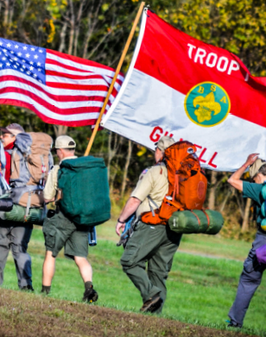
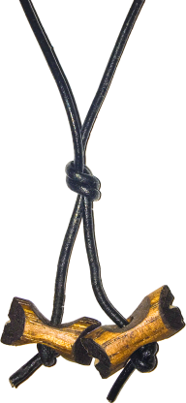
BSA’s ultimate leadership training for ALL adult leaders
Applicable to every program: Cubs, Scouts BSA, Venturing, Sea Scouts
Applicable to every level: unit, district, or council level
An exciting & inspiring course that infuses your units with fun & meaning
Leaders develop real-world, hands-on skills to ensure our youth are getting everything they are promised from the program
Spring Course
Register at:
https://www.ncacbsa.org/wood-badge/
Weekend #1: April 29 – May 1
Weekend #2: May 14 – 15
Course Director: Mr. John Howlin
johnhowlinjr@yahoo.com
Fall Course
Registration Opens
April 30, 2022
Weekend #1: September 9 – 11
Weekend #2: October 8 – 9
Course Director: Mr. Rick Rogers
rsrogers4@gmail.com

Slide 29
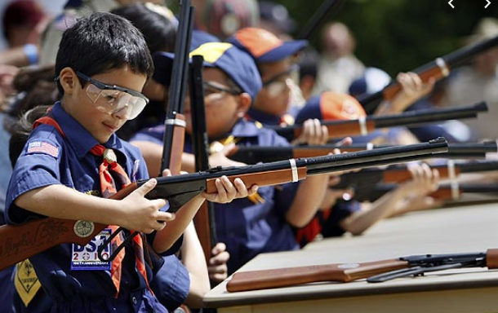
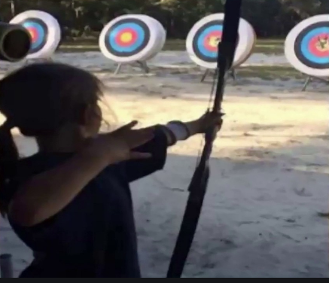
Shooting Sports
Requests for Shooting Events – Lead Time!
  50+ scouts - 6mos
  Less than 50 scouts - 3mos
Shooting on private land:
  Requirements
  Permissions/protocols
Shooting Sports web page
Shooting Sports Instructor Classes:
  Rifle/Shotgun
  Archery (Virtual classes available)

Slide 30


Merit Badges
New Merit Badge Counselors must complete online merit badge counselor training, in addition to YPT, after November 1, 2021. Existing merit badge counselors have until 12/31/22 to complete training.
You can register for Merit Badge Counselor training at:
    My Scouting
The online Merit Badge Counselor registration works for all Scouters who do not already hold another District position.
Be sure the counselor uses his/her legal name – no nicknames.
Merit Badge Counselors, or the unit Dean/Leader, also need to scan and send Margee the Merit Badge Counselor Information Form listing the badges the counselor is applying to teach and providing a justification of his/her qualifications.
Youth Protection Training is the essential first step. Don’t hit “send” on the application without it! Completing Merit Badge Counselor training is the second critical step.
Contact Margee if you have questions at GM.MB.Dean@hotmail.com.

Slide 31
Other Topics
Order of the Arrow
General Announcements
District Executive Minute
District Chair Minute
District Commissioner Minute
Minutes and slides available on the GMD web site (District Resources, Roundtable). Password is “GMDRT”
Next meeting – April 14, 2022 at 7:30pm (Thoreau MS)

