Slide 1

George Mason District
Roundtable
April 14, 2022

Slide 2


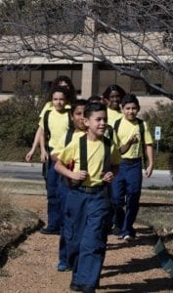

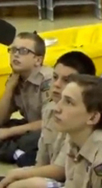


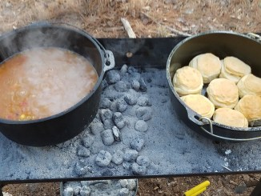
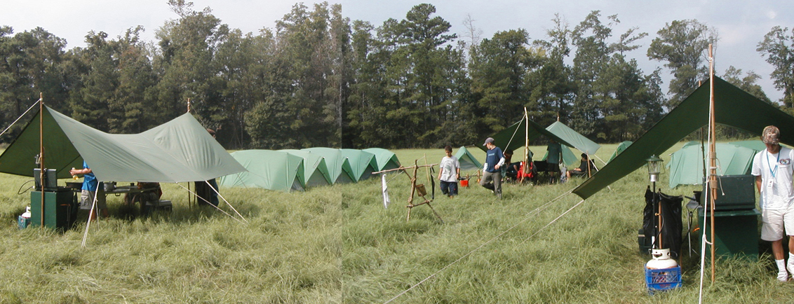
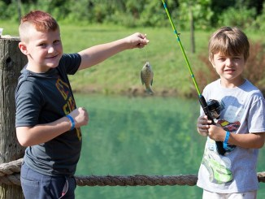
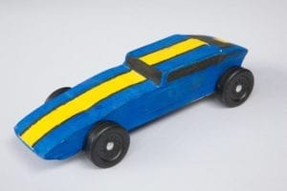
George Mason Program
Matt Burns, Vice Chair Program
George Mason District

Slide 3

Current 2022 GM Calendar
April 29 to May 1, 2022 – GM Spring Camporee
May 1 to May 15, 2022 – GM Hike-O-Ree
May 14, 2022 – Jamboree on the Trail
May 30, 2022 – Flags In
June 2, 2022 – Elks Youth Recognition Dinner
June 4, 2022 – NCAC Stem Expo and Pinewood Derby
June/July 2022 – Cub Summer Camp

Slide 4
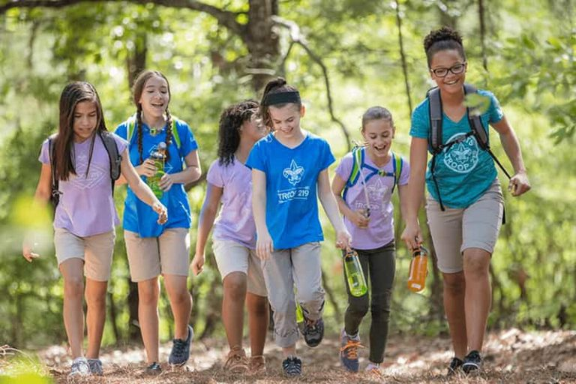
George Mason Hike-O-Ree
2nd Annual GM Hike-O-Ree on weekends of May 7 and May 14 – 5/6 to 5/15/22.
Open to all (Cubs, Scouts BSA and Venturing Scouts), families and friends.
Registration – Coming soon.
Any age, any place and any appropriate grouping – just keep track of how far you hiked.
Register on Council website (registration opening in early 2022). $5.00 for a patch.
Challenge – District Scouts, Scouters and families hike 2,022 miles.
Total the miles for each unit and notify Matt Burns at Burnsmj509@gmail.com. We’ll see how big a total we reach.

Slide 5
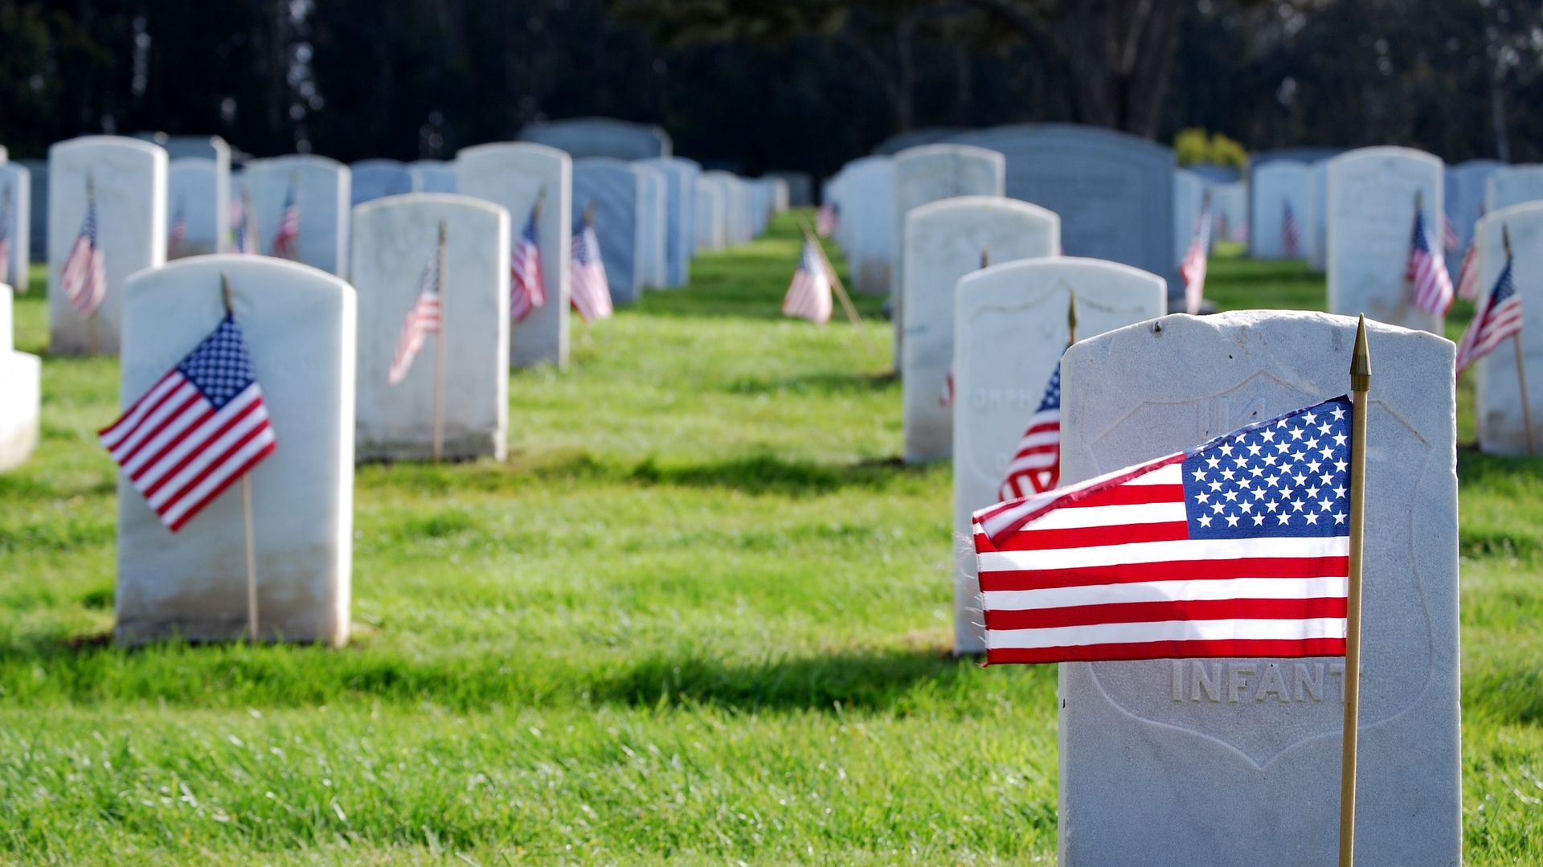
Flags In
May 30, 2022
Flag placement will start at 10:00 am
Social distancing – bring a mask.
National Memorial Park, 7482 Lee Highway, Falls Church
All Scouts, including Girl Scouts, are welcome.
Class A Uniforms
For more info, contact Russell Pittman at ruspittman@gmail.com.

Slide 6
SCOUTS BSA Roundtable

Slide 7

GEORGE MASON DISTRICT CAMPOREE
Date:
April 29 – May 1, 2022
Location and Theme: Rock Enon Scout Camp, Gore VA.
Shooting Sports
120 Scouts BSA slots - limited by need to keep shooters safe!
Troops can invite Webelos – Max of 20 Webelos total for camporee.
Troops need to provide adult supervision and program for Webelos while Scouts are doing rifle, shotgun and tomahawks.
Leader Guide will be available on registration site a few weeks ahead of event.
Still need unit volunteers to help run event.
Camporee Director Andrew Zaso
(703) 434-2907 - AndrewZaso@gmail.com
Registration - George Mason Spring Camporee

Slide 8
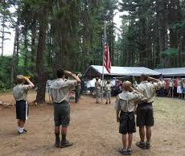
Future Camporees
Save the Dates!!!
George Mason Fall 2022 Camporee – October 21 - 23, 2022
  Theme and Site TBD
George Mason Spring 2023 Camporee – May 5-7, 2023
  Theme and Site TBD
Please factor this into unit calendars/planning.
Scouts are loyal – including loyalty to District activities.

Slide 9

2022 Elks Youth Recognition Dinner
For youth that earned Eagle in 2021 (i.e. their Eagle Board of Review was held in the 2021 calendar year) and their Scoutmasters.
Thursday, June 2, 2022
Elks Lodge 2188, 8421 Arlington Blvd., Fairfax, VA.
Will need unit leader help in contacting Scouts and obtaining an RSVP.

Slide 10

Training
IOLS – 6/4 -6/5 @ Camp Snyder https://scoutingevent.com/082-PATRIOTSPRING22IOLS
Climbing Level 1 Instructor – 4/23 - 4/24/22. Contact ncac.climbing@gmail.com to register.
Canoe Clinic – April 29 at Camp Snyder 6 to 8 p.m.
April 30 & May 1 @ 8 a.m. – on the water at Silver Lake – Meet at Camp Snyder – register on council website.
NYLT summer courses – registration now open
Cub Leader Specific Training in-person 5/7 or 6/4 @ Alexandria https://scoutingevent.com/082-56464
Powderhorn (P50) - 08/26/22 – 08/28/22 – Camp St. Charles, Newburg, MD. https://scoutingevent.com/082-49585

Slide 11
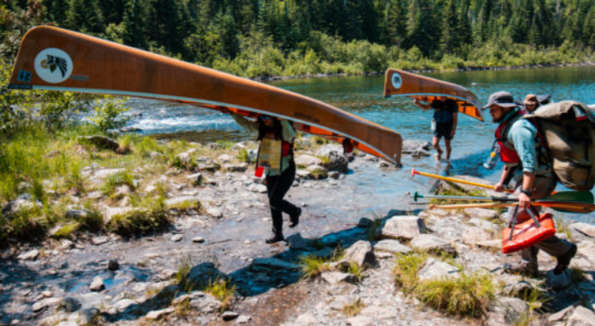
GM High Adventure
NCAC High Adventure Committee (HAC) updates and announcements: https://www.ncacbsa.org/high-adventure/
  Vacancies list updated 11 April: https://public.3.basecamp.com/p/xWpkdrKHKAA9pCzwmHMNdbWb
  NCAC Paddle Craft Safety Class at Camp Snyder - 4/29-5/1. See website.
  Philmont Preparedness Seminars (20 April: Recap and Updates) https://www.philmontscoutranch.org/philmont-prep-seminars/
  NCAC Northern Tier training is available to all interested -- not just those scheduled for a summer trek. Contact Craig Reichow: bsa2xs@gmail.com
  HA Sourcebook update: https://www.ncacbsa.org/high-adventure-information/
  All BSA high adventure treks require Medical forms A, B, and C – both Scouts and adults – certain programs have additional medical screening requirements. (Schedule that physical exam soon!)
Contact Joe Knecht at knechtjoe@yahoo.com if you have questions regarding high adventure planning or resources.
April 2022

Slide 12
Other Topics
Order of the Arrow
General Announcements
District Executive Minute
District Chair Minute
District Commissioner Minute
Minutes and slides available on the GMD web site (District Resources, Roundtable). Password is “GMDRT”
Next meeting – May 12, 2022 at 7:30pm (Thoreau MS)

