Slide 1
Join Scouting

Slide 2
Join Scouting Night/Event Prep
Goal: Provide information and resources that can assist your Unit for upcoming recruitment events. This includes:
Online Tools
Resources Available from Council
Planning Timelines
Best Practices – Please share your successes!

Slide 3
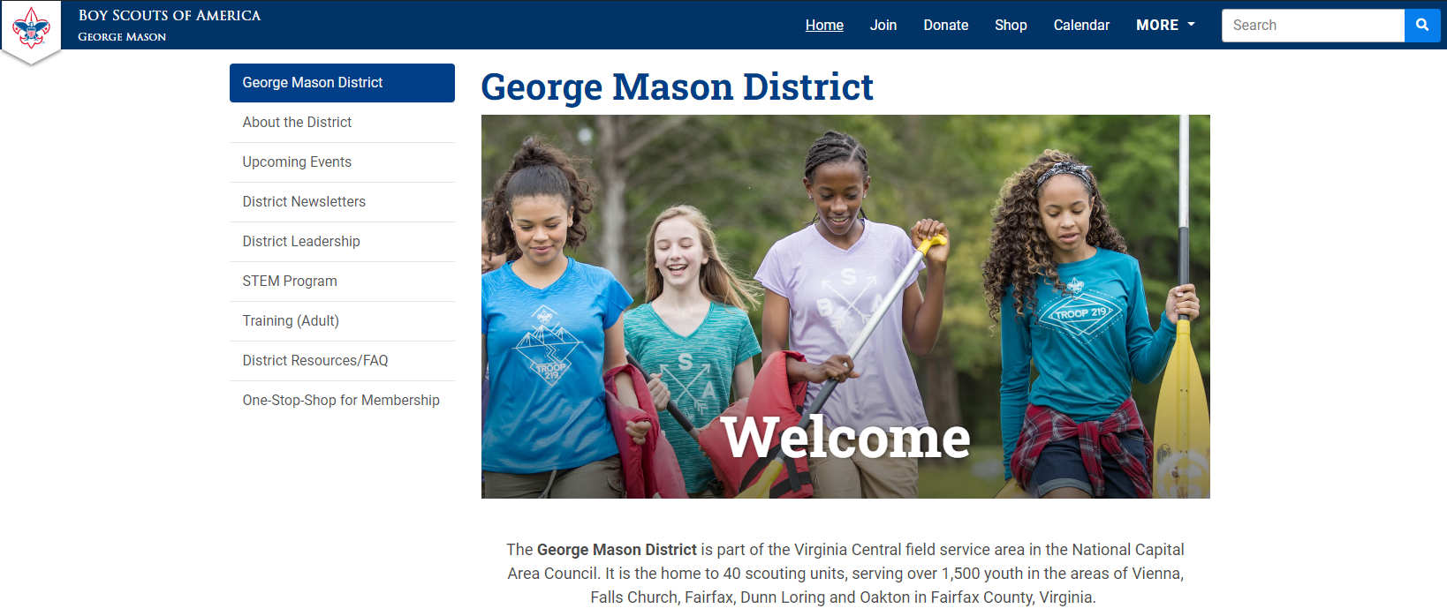
On-Stop Shop for Membership https://ncacbsa.org/george-mason/

Slide 4
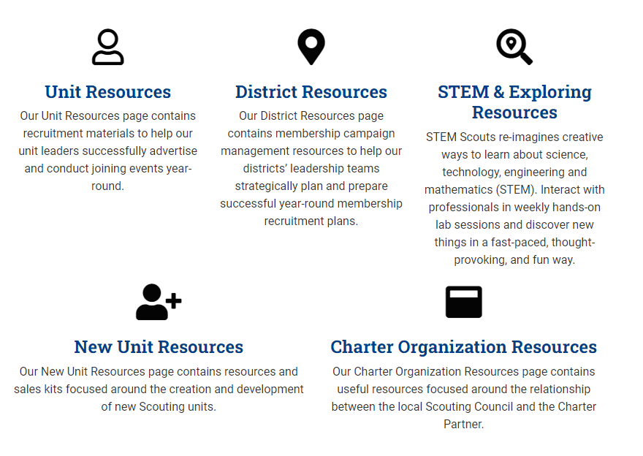
On-Stop Shop for Membership https://ncacbsa.org/membership-resources/

Slide 5
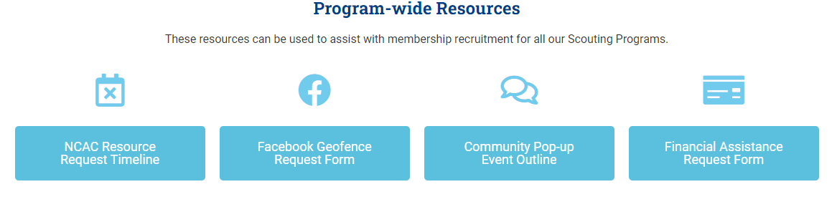
On-Stop Shop for Membership https://ncacbsa.org/unit-resources/

Slide 6
Geofence Request Form
Information Needed:
Email
District
Unit Number
Unit Type (Pack, Troop)
Name of Chartering Organization
Is the event In-Person or On-line
  Address of In-Person Event
  URL (if virtual event) w/ login instructions
Event Date/Time and description of activity
Unit Facebook Page info (if applicable)
Flyer (if available)

Slide 7
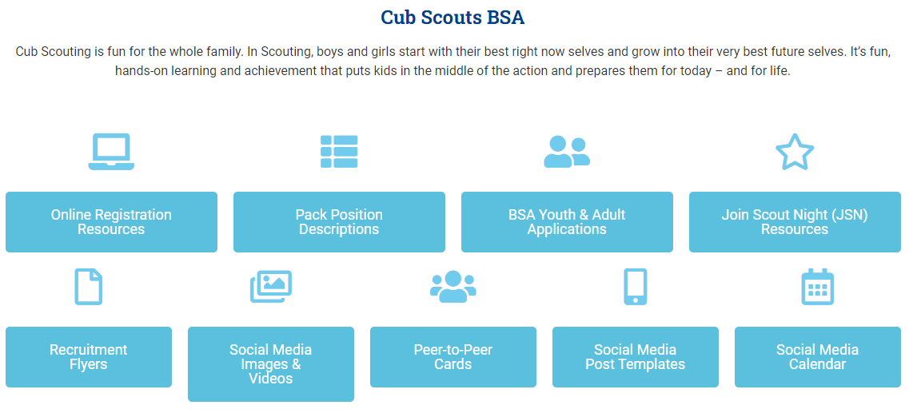
On-Stop Shop for Membership https://ncacbsa.org/unit-resources/

Slide 8
JSN Resources
Scout Talks – Videos
JSN Logistics – Resources for various stations – Activities, Advancement, Ideals of Scouting, Calendar, Application, etc.
New Leader Welcome Packet
Program Information
Unit Guides

Slide 9

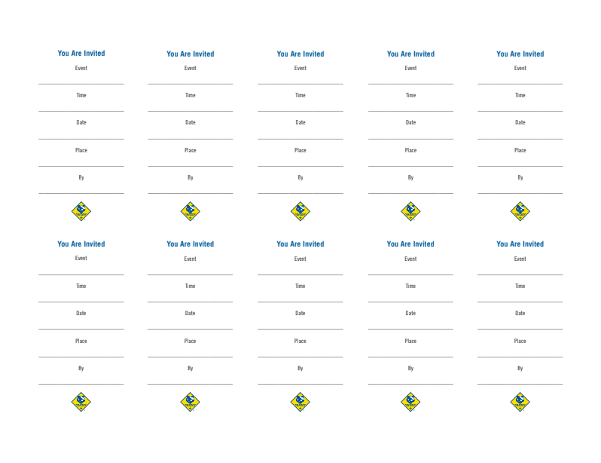
Peer-to-Peer Cards

Slide 10
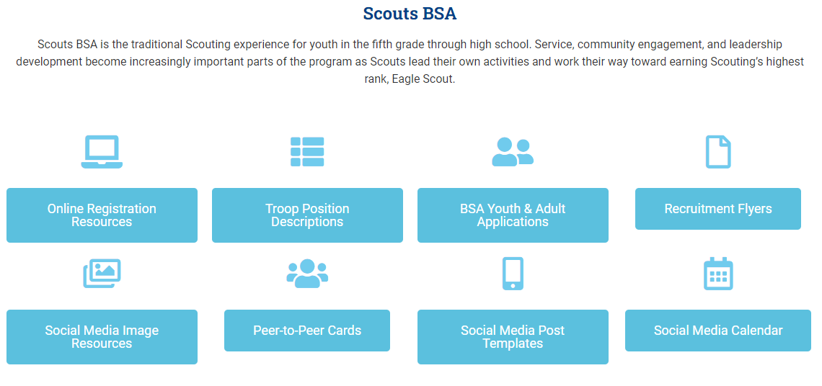
On-Stop Shop for Membership https://ncacbsa.org/unit-resources/

Slide 11

NCAC Resources Available
Items to request/keep on-hand:
Flyers – Please give Keenan a week’s notice
Yard Signs
BeAScout.org Pencils
Stickers
Parent’s Guides
Paper Applications
Items to borrow and return:
Roll-out recruitment banners
Pup-up Tents

Slide 12
Planning Timelines (Suggested)
Three Weeks Prior:
Requested Facebook Geofenced Advertising (date, location, time, & contact info)
Requested PeachJar Advertisements (Flyer, Schools, additional info)
Two Weeks Prior:
Submitted Physical Flyer Requests (Color: 10 cents per page)
Submitted Peer-to-Peer Cards Requests
Requested Council Recruitment Banners (While resources are available)
Requested Council Projectors (While resources are available)
Requested Council Pop-Up Tents (While resources are available)
One Week Prior:
Requested Yard Signs
Requested Parents’ Guides
Requested Paper Applications
Requested Printed “How-To” Social Media templates
Requested Pens/Pencils

Slide 13
Best Practices Some Units Use
(Please share your successes/ideas!)
Have information they need – ideally one page
  Meeting location, day of week/month and time
  Background about the unit (size, history, typical events)
  Contact information
  Costs – BSA, NCAC insurance, Unit fees, how you raise funds
  Other needed items – uniform, equipment, books, etc.
Have a way to sign up immediately
  Tablet / Computer for adults to register their youth
  Paper forms and pens
  A way to collect fees (Square, check, etc.)
Have a way for Parents to volunteer/be informed of unit needs
  Emphasize that your unit is a volunteer organization
  Have a list of possible jobs they can volunteer to do
  Emphasize the need for YPT when recruiting Adults

