Slide 1

George Mason District
Roundtable
June 9, 2022

Slide 2


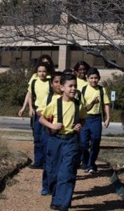

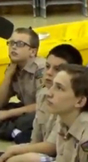


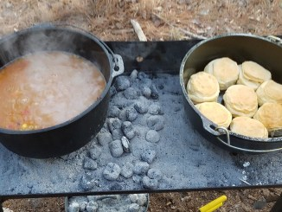
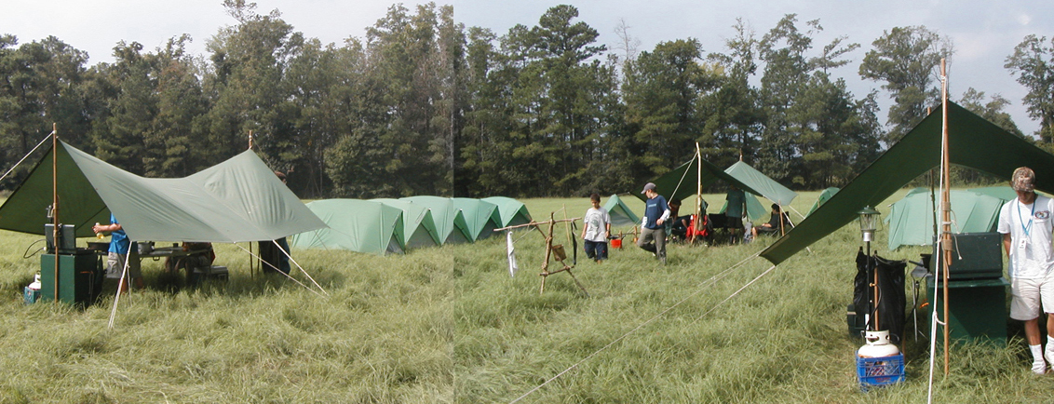
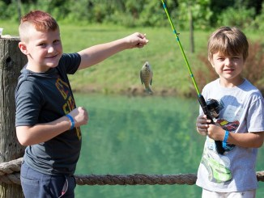
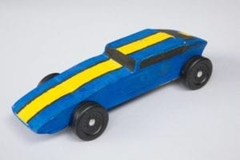
George Mason Program
John Drisco, Vice Chair Program
Matt Burns, Deputy Vice Chair Program
George Mason District

Slide 3

Current 2022 GM Calendar
June/July 2022 – Cub Summer Camp
September 24, 2022 – Life to Eagle Seminar
October 21-23, 2022 – Fall Camporee
November 5, 2022 – Scouting for Food Tag Distribution
November 6, 2022- Flags in, National Memorial Park, Falls Church
November 12,2022 Scouting for Food Bag Collection
December 2022- Peace Light of Bethlehem
March 2023 (TBD) – Pinewood Derby, Merit Badge Day
May 5-7, 2023- Spring Camporee

Slide 4
SCOUTS BSA Roundtable

Slide 5
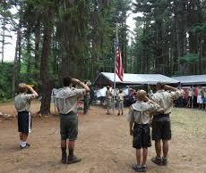
Future Camporees
Save the Dates!!!
George Mason Fall 2022 Camporee – October 21 - 23, 2022
  Theme and Site TBD
George Mason Spring 2023 Camporee – May 5-7, 2023
  Theme and Site TBD
Please factor this into unit calendars/planning.
Scouts are loyal – including loyalty to District activities.

Slide 6

District Life to Eagle Seminar
Saturday, 24 September 2022
1:00 to 4:00 p.m.
Christ Lutheran Church, 3810 Meredith Drive, Fairfax, VA. Check-in starts at 12:30 p.m.
Who should attend:
Life Scouts or advanced Star Scouts who want to pursue the Eagle Rank
Eagle advisors, coaches or unit leaders that haven’t attended a seminar in two years
Parents of Scouts working on Eagle or other adults interested in Scouting
Registration applications must be received by Thursday, 22 September 2022
Fees ($5 per person) will be collected at registration. Registrations ensure adequate handouts and refreshments. To register go to:
https://scoutingevent.com/082-59744
Any questions contact Jack Lundin at 703-938-0369.

Slide 7

Training
NYLT summer courses – registration now open
https://scoutingevent.com/082-49373
Cub Leader Specific Training in-person 6/4 @ Alexandria https://scoutingevent.com/082-56464
IOLS - 10/1/22 – 10/02/22 @ Camp Snyder https://scoutingevent.com/082-PWDIOLSOct2022
Back Country Outdoor Leadership Skills – 09/24/22 & 10/22/22-10/23/22 @ Camp Big Mac https://scoutingevent.com/082-59004#
Leave No Trace Trainer/Outdoor Ethics – 09/26/22 & 10/01/22 @ Germantown, MD https://scoutingevent.com/082-55113#
Powderhorn (P50) - 08/26/22 – 08/28/22 – Camp St. Charles, Newburg, MD. https://scoutingevent.com/082-49585
Woodbadge - 09/09/22 – 09/11/22 & 10/08/22 – 10/09/22 @ Camp Snyder https://www.ncacbsa.org/wood-badge/

Slide 8
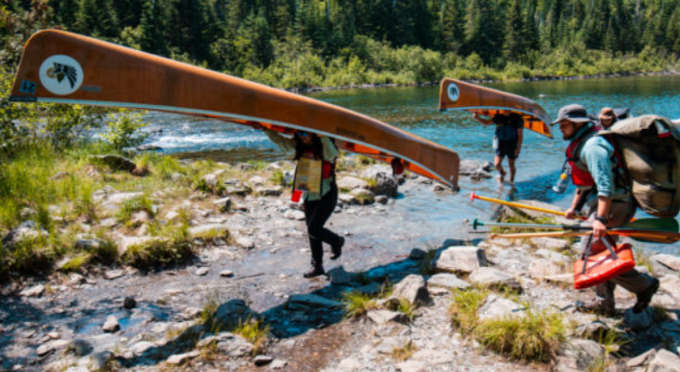
GM High Adventure
NCAC High Adventure Committee (HAC) updates and announcements: https://www.ncacbsa.org/high-adventure/
  Vacancies list updated 3 June: https://public.3.basecamp.com/p/xWpkdrKHKAA9pCzwmHMNdbWb
  Philmont Preparedness Seminars (3 June: Recap and Updates) https://www.philmontscoutranch.org/philmont-prep-seminars/
  NCAC Northern Tier training is available to all interested -- not just those scheduled for a summer trek. Contact Craig Reichow: bsa2xs@gmail.com
  HA Sourcebook update: https://www.ncacbsa.org/high-adventure-information/
  All BSA high adventure treks require Medical forms A, B, and C – both Scouts and adults – certain programs have additional medical screening requirements. (Schedule that physical exam soon!)
Contact Joe Knecht at knechtjoe@yahoo.com if you have questions regarding high adventure planning or resources.
June 2022

Slide 9
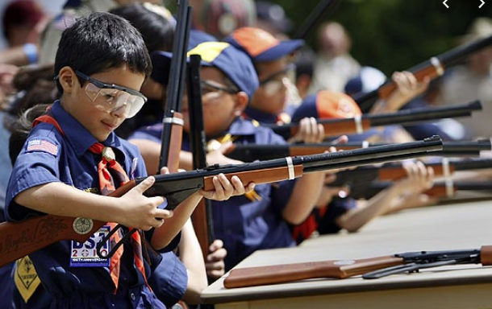
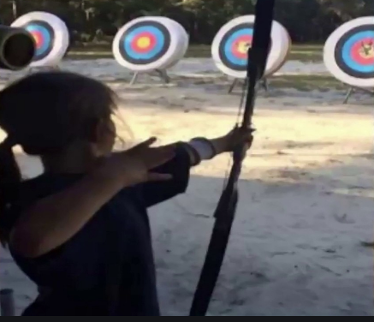
Shooting Sports
Requests for Shooting Events – Lead Time!
  50+ scouts - 6mos
  Less than 50 scouts - 3mos
Shooting on private land:
  Requirements
  Permissions/protocols
Shooting Sports web page
Shooting Sports Instructor Classes:
  Rifle/Shotgun
  Archery (Virtual classes available)

Slide 10
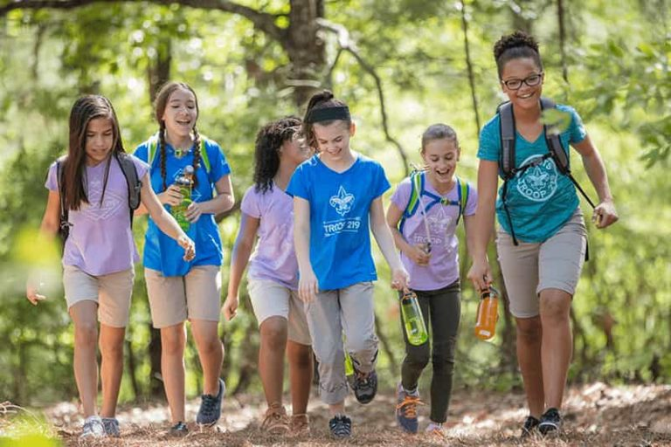
George Mason Hike-O-Ree
2nd Annual GM Hike-O-Ree on weekends of May 7 and May 14 – 5/6 to 5/15/22.
12 units participated. 3 more than 2021.
More than 110 youth and adults engaged in a hike of some type
Total mileage was 812
2021 total mileage was 741 so we hiked 71 more miles in 2022.
Patches are ordered and should be coming soon.
I’ll let unit leaders know when the patches can be picked up.
Matt Burns at Burnsmj509@gmail.com.

Slide 11


Merit Badges
Every merit badge counselor needs to be on the District charter. The time for action is NOW!
The online Merit Badge Counselor registration works for all Scouters who do not already hold another District position.
New Merit Badge Counselors must complete online merit badge counselor training, in addition to YPT, after November 1, 2021. Existing merit badge counselors have until 12/31/22 to complete training.
Be sure the counselor uses his/her legal name – no nicknames.
Merit Badge Counselors, or the unit Dean/Leader, also need to scan and send Margee the Merit Badge Counselor Information Form listing the badges the counselor is applying to teach and providing a justification of his/her qualifications.
Youth Protection Training is the essential first step. Don’t hit “send” on the application without it!
Contact Margee if you have questions at GM.MB.Dean@hotmail.com.

Slide 12


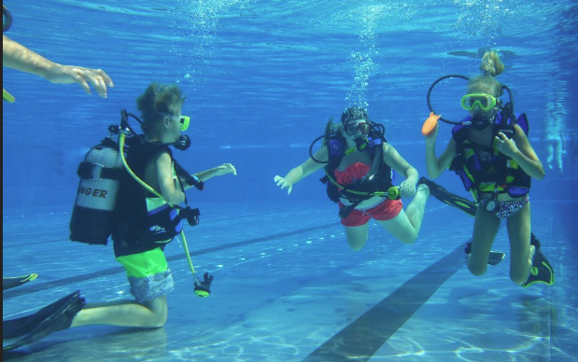

Aquatics
Pre-Camp Swim Test – had over 250 scouts/adults participate
SCUBA (Email Andrew Blanco; ABSEAS2@aol.com)
  Aug 6-7 (Pool) and Aug 13-14 (Open Water)
  Aug 20-21 (Pool) and Aug 27-28 (Open Water)
James River Canoe Trek – Lenhok’sin - https://www.gotogoshen.org/camps-programs/lenhoksin-high-adventure/
Partial MB Completion Clinic - Oct 3 – location TBD
Canoe Clinics ($60) - Sept 9-11 at Camp Snyder
Paddle Craft Safety ($30 each)
  Sept 17 – Still Water Safety w/Canoe MB Certification (Camp Snyder)
  Sept 18 – Moving Water Safety (Potomac – Riley’s Lock)

Slide 13
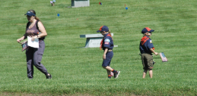
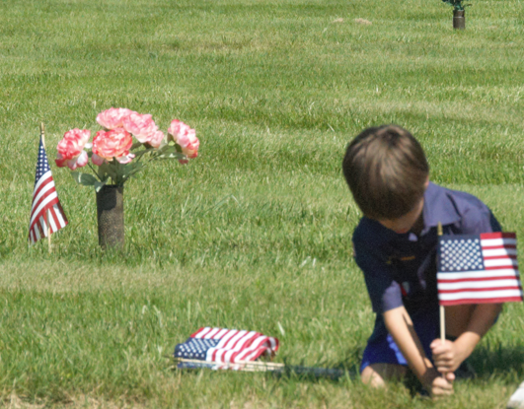
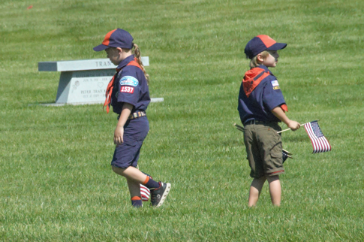
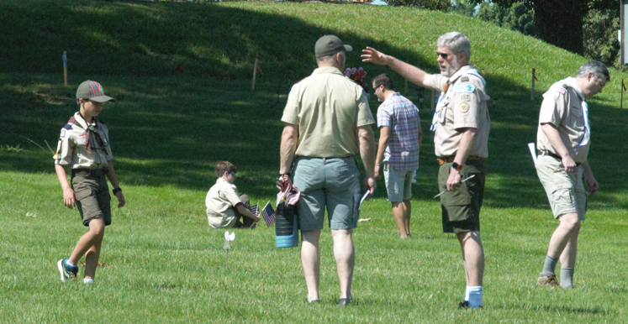
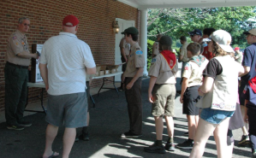
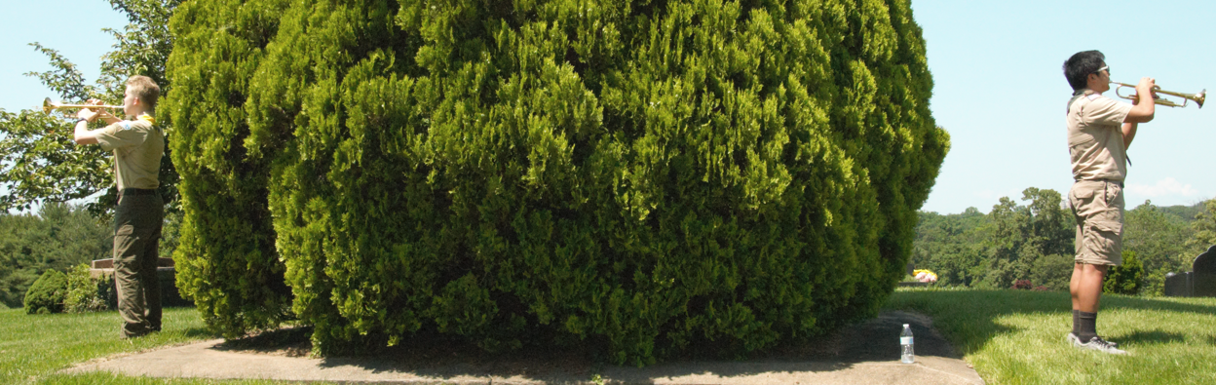
Flags In – Memorial Day

Slide 14
Other Topics
Order of the Arrow
General Announcements
District Executive Minute
District Chair Minute
District Commissioner Minute
Minutes and slides available on the GMD web site (District Resources, Roundtable). Password is “GMDRT”
Next meeting – August 11, 2022 at 7:30pm (Thoreau MS)

