Slide 1

George Mason District
Roundtable
August 11, 2022

Slide 2

Pledge

Slide 3
Council Update
MSSC/Scout Store – Reopened this week (M-F 8:30am-5pm; Sat 10am-3pm)
iContact – New mail list server. Need to whitelist/move messages in the SPAM/Junk folder that are from georgemason@ncacbsa.org.
NCAC Insurance Fee - $2.04/person (full year)
Family Den Pilot – Mixed dens M/F youth. Pilot program – MOU needed to participate. https://public.3.basecamp.com/p/uYFRgeombPuJe37tUCAPoYKK
Awards – NCAC continues to work backlog. Let Rus or Keenan know if you haven’t received after six weeks
Safety Moments - Opportunities to prepare for an activity, review safety measures, and report incidents correctly. Topics of this new series include incident reporting helps, safe use of medication in Scouting, weather-related safety, winter activity, and winter sports. (https://www.scouting.org/health-and-safety/safety-moments/)

Slide 4
Council Update - Scoutbook
Fixes
  Calendar - An issue that prevented Scouts who are not calendar editors from seeing the unit or sub-unit calendars has been fixed.
  Eagle Palms
    An issue that caused the percent complete calculation for Eagle Palms to be incorrect has been fixed. Eagle Palms with incorrect percent complete need to have 1 requirement edited to correct the percent complete value.
    An issue that prevented Eagle Palm requirement 4, Merit Badges, from being auto completed when Eagle 2022 is selected has been fixed. A script has been run to correct any Eagle Palms that should have had requirement 4 completed.
Scoutbook Forum - https://discussions.scouting.org/

Slide 5
NCAC Aquatics Committee
Paddle Craft Safety (Course Fee: $30/day) – Limit 12 Scouts/Leaders
- Still water course includes Canoe Merit Badge Councilor Certification
- Still water course required for Moving Water course
- Sept 10 – Still Water Safety – (am – Hylton Center; pm – Silver Lake)
- Sept 11 – Moving Water Safety – On the Potomac (Meet at Riley’s Lock)
Merit Badges Afloat – Ship 1942’s Merit Badge Afloat weekend is an opportunity for Scouts BSA scouts to earn three merit badges (Small-Boat Sailing, Weather, and Oceanography), be introduced to Sea Scouts, and learn more about the activities of Sea Scout Ship 1942. Saturday, September 10, 2022; 8:30am to 6:00pm and Sunday, September 11, 2022; 8:30am to 6:00pm at the Washington Sailing Marina.
SCUBA (Course Fee: $650) – PADI Certification by Age / Scouts BSA Merit Badge
Contact the PADI Divemaster Andrew Blanco to schedule
Minimum age 14 years
Aug 20 &21 – Pool Session & Aug 27 & 28 – Open Water
Partial Merit Badge Completion Clinic – 18 Scout Limit
Oct 3 – Tentative -TBD

Slide 6
Join Scouting

Slide 7
Join Scouting Night/Event Prep
Goal: Provide information and resources that can assist your Unit for upcoming recruitment events. This includes:
Online Tools
Resources Available from Council
Planning Timelines
Best Practices – Please share your successes!

Slide 8
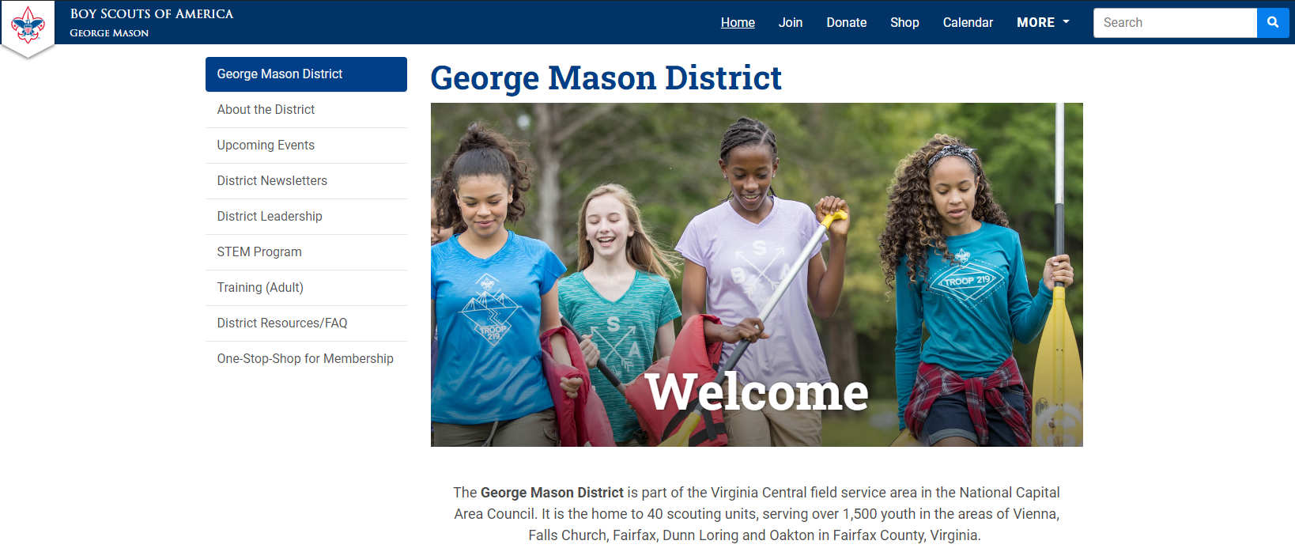
On-Stop Shop for Membership https://ncacbsa.org/george-mason/

Slide 9
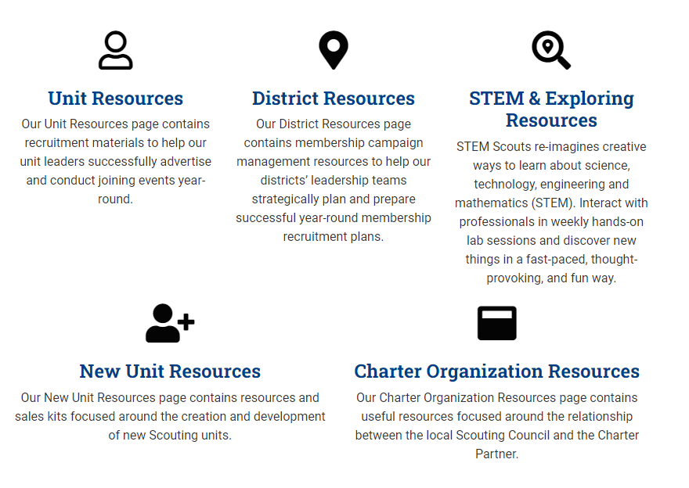
On-Stop Shop for Membership https://ncacbsa.org/membership-resources/

Slide 10
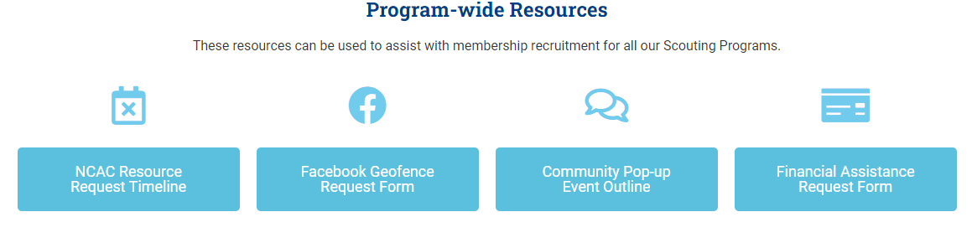
On-Stop Shop for Membership https://ncacbsa.org/unit-resources/

Slide 11
Geofence Request Form
Information Needed:
Email
District
Unit Number
Unit Type (Pack, Troop)
Name of Chartering Organization
Is the event In-Person or On-line
  Address of In-Person Event
  URL (if virtual event) w/ login instructions
Event Date/Time and description of activity
Unit Facebook Page info (if applicable)
Flyer (if available)

Slide 12
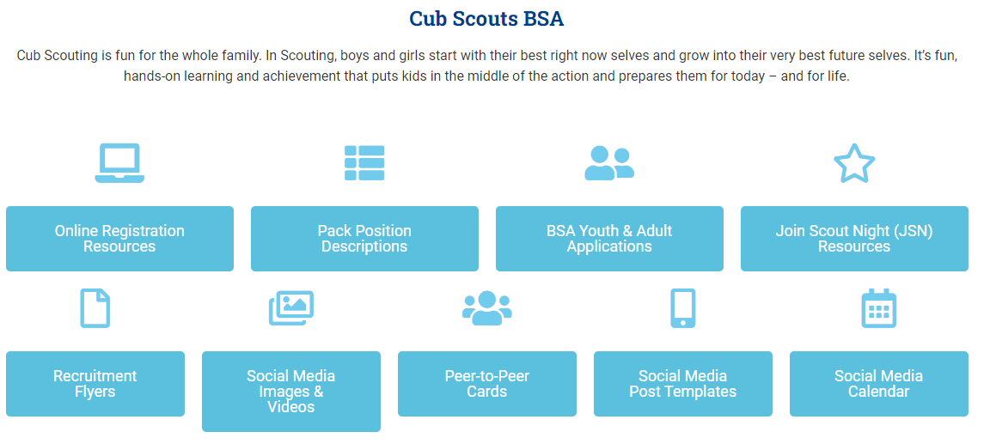
On-Stop Shop for Membership https://ncacbsa.org/unit-resources/

Slide 13
JSN Resources
Scout Talks – Videos
JSN Logistics – Resources for various stations – Activities, Advancement, Ideals of Scouting, Calendar, Application, etc.
New Leader Welcome Packet
Program Information
Unit Guides

Slide 14

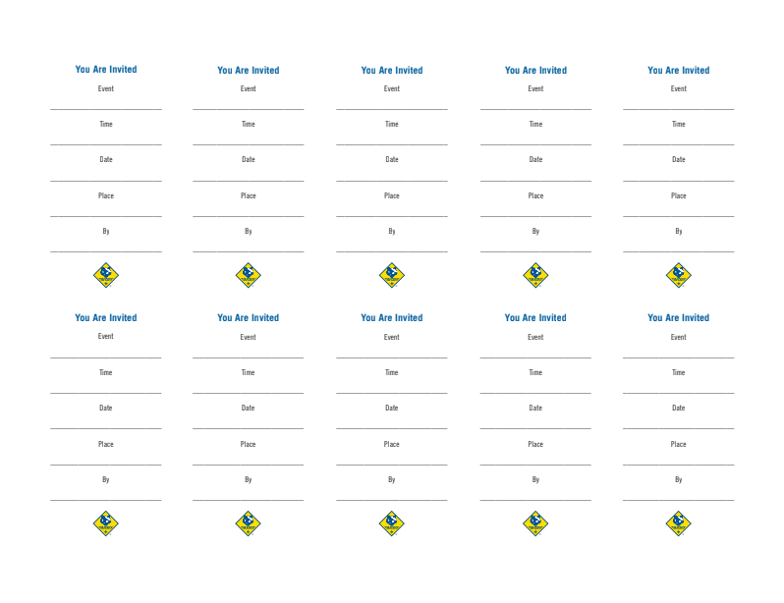
Peer-to-Peer Cards

Slide 15
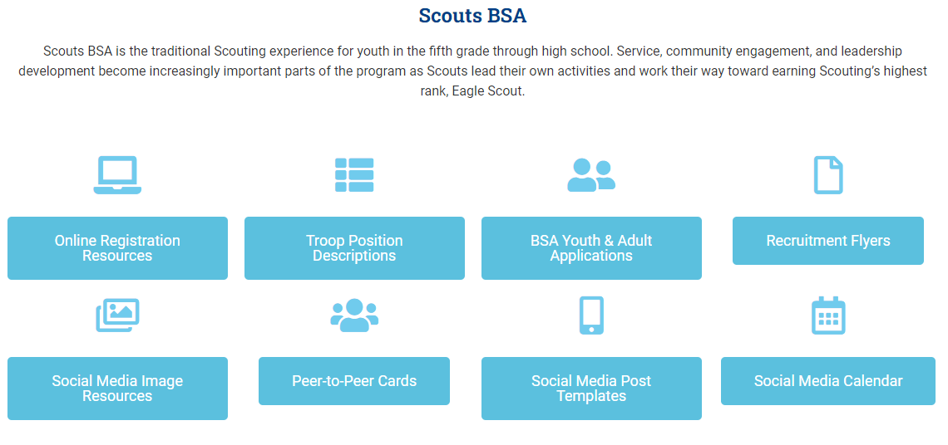
On-Stop Shop for Membership https://ncacbsa.org/unit-resources/

Slide 16

NCAC Resources Available
Items to request/keep on-hand:
Flyers – Please give Keenan a week’s notice
Yard Signs
BeAScout.org Pencils
Stickers
Parent’s Guides
Paper Applications
Items to borrow and return:
Roll-out recruitment banners
Pup-up Tents

Slide 17
Planning Timelines (Suggested)
Three Weeks Prior:
Requested Facebook Geofenced Advertising (date, location, time, & contact info)
Requested PeachJar Advertisements (Flyer, Schools, additional info)
Two Weeks Prior:
Submitted Physical Flyer Requests (Color: 10 cents per page)
Submitted Peer-to-Peer Cards Requests
Requested Council Recruitment Banners (While resources are available)
Requested Council Projectors (While resources are available)
Requested Council Pop-Up Tents (While resources are available)
One Week Prior:
Requested Yard Signs
Requested Parents’ Guides
Requested Paper Applications
Requested Printed “How-To” Social Media templates
Requested Pens/Pencils

Slide 18
Best Practices Some Units Use
(Please share your successes/ideas!)
Have information they need – ideally one page
  Meeting location, day of week/month and time
  Background about the unit (size, history, typical events)
  Contact information
  Costs – BSA, NCAC insurance, Unit fees, how you raise funds
  Other needed items – uniform, equipment, books, etc.
Have a way to sign up immediately
  Tablet / Computer for adults to register their youth
  Paper forms and pens
  A way to collect fees (Square, check, etc.)
Have a way for Parents to volunteer/be informed of unit needs
  Emphasize that your unit is a volunteer organization
  Have a list of possible jobs they can volunteer to do
  Emphasize the need for YPT when recruiting Adults

Slide 19
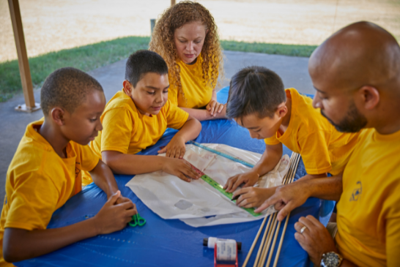
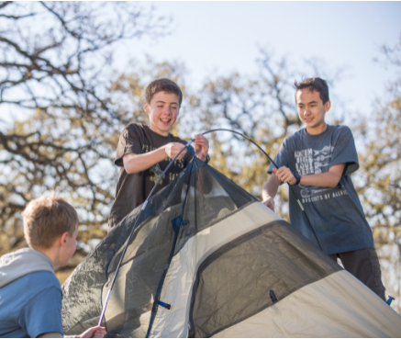
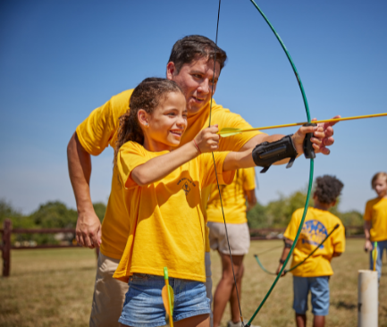
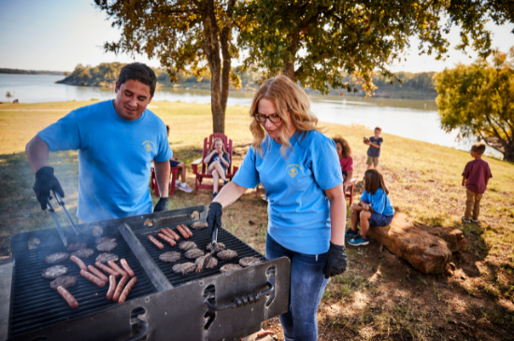
Make it fun!

Slide 20


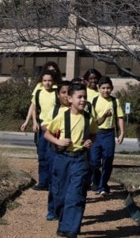

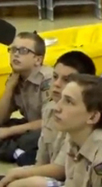


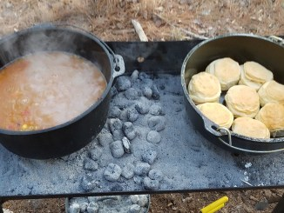
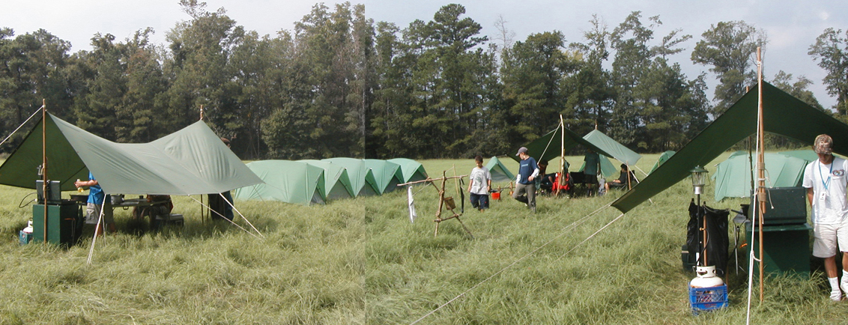
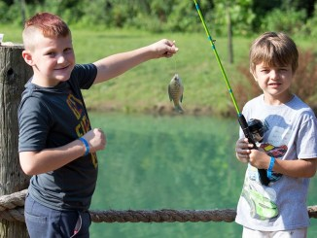
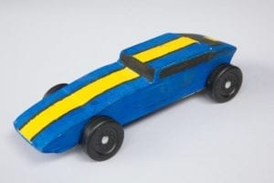
George Mason Program
John Drisco, Vice Chair Program
Matt Burns, Deputy Vice Chair Program
George Mason District

Slide 21

Current 2022 GM Calendar
September 24, 2022 – Life to Eagle Seminar
October 21-23, 2022 – Fall Camporee- Pioneering Theme
November 5, 2022 – Scouting for Food Tag Distribution
November 11,2022- Flags in, National Memorial Park, Falls Church
November 12,2022 Scouting for Food Bag Collection
December 2022- Peace Light of Bethlehem
March 4, 2023 Merit Badge Day at Fairfax Presbyterian Church
March 18 2023 Pinewood Derby at Fairfax Presbyterian
Church
May 5-7, 2023- Spring Camporee TBD

Slide 22


STEM
Scout Day at Nationals Park – 14 August
  Get a special patch!
  https://www.mlb.com/nationals/tickets/specials/scout-days
Explorer Post 1010 Open House – 10 & 14 September
  High school students only
  http://post1010.org/
STEM Expo & Pinewood Derby – (Rescheduled) 15 October @ Camp Snyder
  STEM Expo is open to all! Register by 7 October
  https://scoutingevent.com/082-pwd
Chess Tournaments
  Cubs – 4 February 2023
  SBSA – 11 February 2023

Slide 23
SCOUTS BSA Roundtable

Slide 24
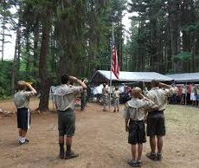
Future Camporees
Save the Dates!!!
George Mason Fall 2022 Camporee – October 28 - 30, 2022
  Pioneering Theme at Blue Ridge Regional Park
George Mason Spring 2023 Camporee – May 5-7, 2023
  Theme and Site TBD
Please factor this into unit calendars/planning.
Scouts are loyal – including loyalty to District activities.

Slide 25

District Life to Eagle Seminar
Saturday, 24 September 2022
1:00 to 4:00 p.m.
Christ Lutheran Church, 3810 Meredith Drive, Fairfax, VA. Check-in starts at 12:30 p.m.
Who should attend:
Life Scouts or advanced Star Scouts who want to pursue the Eagle Rank
Eagle advisors, coaches or unit leaders that haven’t attended a seminar in two years
Parents of Scouts working on Eagle or other adults interested in Scouting
Registration applications must be received by Thursday, 22 September 2022
Fees ($5 per person) will be collected at registration. Registrations ensure adequate handouts and refreshments. To register go to:
https://scoutingevent.com/082-59744
Any questions contact Jack Lundin at 703-938-0369.

Slide 26

Training https://www.ncacbsa.org/george-mason/training
        Cub Leader Position Specific (C40) - 09/24/22 - Herndon, VA
        Cub Scout Den Leader Specific (C42) - 09/24/22 - Herndon, VA
        Basic Adult Leader Outdoor Orientation (BALOO;C32)
        - 10/01/22 – 10/02/22 - Huntingtown, MD
        - 10/15/22 – 10/16/22 - Reston, VA
        Introduction to Outdoor Leadership Skills (IOLS; S11)
        - 10/01/22 - 10/02/22 - Camp Snyder, Haymarket, VA
        Back Country Outdoor Leadership Skills (BCOLS)
        - 09/24/22 (Alexandria, VA) & 10/22/22 - 10/23/22 (Camp Big Mac)
    National Youth Leadership Training (NYLT; S78)
    - 01/20/23 - 01/23/23 & 01/27/23 - 01/29/23 - Camp Snyder, Haymarket, VA
    Outdoor Ethics/Leave No Trace (D78)
    - 09/18/22 - TREAD Lightly! Trainer Course, Bryans Road, MD
    - 09/26/22 (Introduction), Virtual & 10/01/22 (Fieldwork), Germantown, MD
    - 10/17/22 (Introduction), Virtual & 10/22/22 (Fieldwork), Camp Snyder, Haymarket, VA
    Powderhorn (P50) - 08/26/22 - 08/28/22 - Camp St. Charles, Newburg, MD
    Mental Health First Aid https://www.fairfaxcounty.gov/hscode/ereg/Registration.aspx?groupID=47
        - 09/01/22 Adult (Virtual) – 9am – 3:30pm
        - 09/10/22 Youth (Virtual) – 9am – 3:30pm

Slide 27


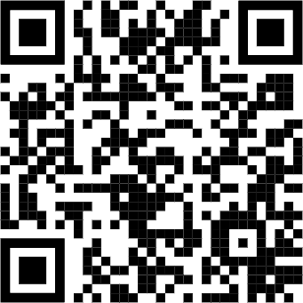
NYLT 2022 Program year is complete
NYLT ran 5 courses in 2022.
George Mason sent 13 Scouts to NYLT this summer and an additional 6 Scouts staffed!
Updated flyer coming soon
2023 Schedule will likely include:
1 winter course run over two weekends in January
4 summer courses
Questions? Email contact@my.NYLT.org

Slide 28
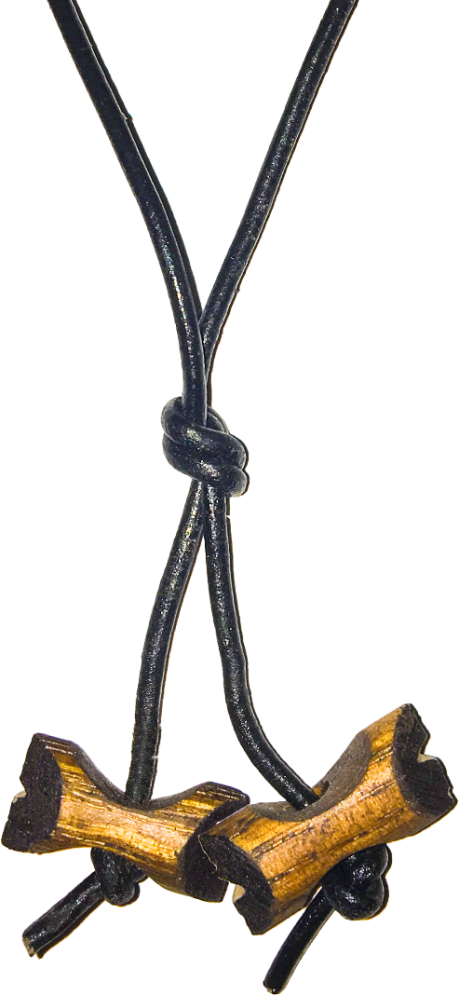
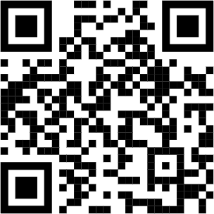
2022 Wood Badge Registration NOW Open
Fall Course
Registration Open at https://www.ncacbsa.org/wood-badge/
Weekend #1: 9 - 11 September
Weekend #2: 8 - 9 October
Course Director: Mr. Rick Rogers
rsrogers4@gmail.com
Wood Badge could be postponed or delayed based on covid restrictions
Wood Badge is the Boy Scouts of America’s ultimate leadership training designed to meet the advanced leadership needs of Scouters in all aspects of the BSA, whether unit, district, or council level – from assistant den leaders to Scoutmasters, from Cubmasters to Venturing Advisors, from committee members to commissioners. It is a fun, energetic and inspiring course guaranteed to infuse your unit with fun and meaning – all designed to fulfill the mission of the BSA, and ensure our youth is getting everything they are promised from the program.
QUESTIONS?
For information about specific courses, contact the Course Director listed above.

Slide 29

GM High Adventure
NCAC High Adventure Committee (HAC) updates and announcements: https://www.ncacbsa.org/high-adventure/
  Summer 2022 lessons learned: How was your unit’s high adventure experience this summer?
    The GMD High Adventure Committee would appreciate any after-action reviews (good, bad, or in between) of your national high adventure base trek or self-supported high adventure activity. Please forward information to knechtjoe@yahoo.com
    Lessons learned will be compiled and shared at a future date.
  HA Sourcebook: https://www.ncacbsa.org/high-adventure-information/
Contact Joe Knecht at knechtjoe@yahoo.com if you have questions regarding high adventure planning or resources.
August 2022

Slide 30
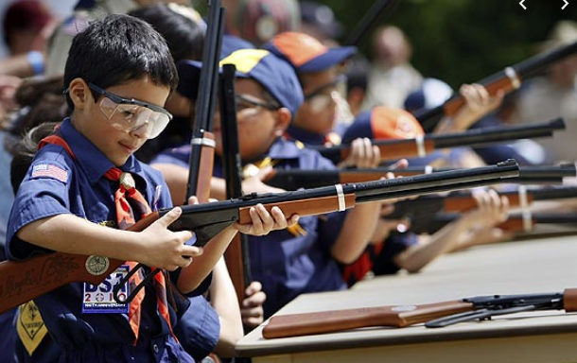
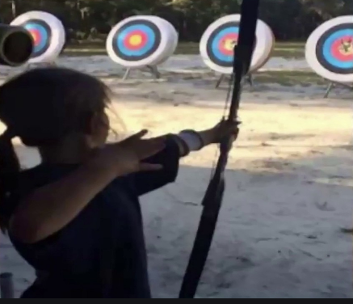
Shooting Sports
Requests for Shooting Events – Lead Time!
  50+ scouts - 6mos
  Less than 50 scouts - 3mos
Shooting on private land:
  Requirements
  Permissions/protocols
Shooting Sports web page
Shooting Sports Instructor Classes:
  Rifle/Shotgun
  Archery (Virtual classes available)

Slide 31


Merit Badges
Every merit badge counselor needs to be on the District charter. The time for action is NOW!
The online Merit Badge Counselor registration works for all Scouters who do not already hold another District position.
New Merit Badge Counselors must complete online merit badge counselor training, in addition to YPT. Existing merit badge counselors have until 12/31/22 to complete training.
Be sure the counselor uses his/her legal name – no nicknames.
Merit Badge Counselors, or the unit Dean/Leader, also need to scan and send Margee the Merit Badge Counselor Information Form listing the badges the counselor is applying to teach and providing a justification of his/her qualifications.
Youth Protection Training is the essential first step. Don’t hit “send” on the application without it!
Contact Margee if you have questions at GM.MB.Dean@hotmail.com.

Slide 32
Other Topics
Order of the Arrow
General Announcements
District Executive Minute
District Chair Minute
District Commissioner Minute
Minutes and slides available on the GMD web site (District Resources, Roundtable). Password is “GMDRT”
Next meeting – September 8, 2022, at 7:30pm (Thoreau MS)

