Slide 1

George Mason District
Roundtable
May 12, 2022

Slide 2


Slide 3
Council Update
Pre-Camp Swim Tests – 6/4 & 6/5, Camp Snyder - https://www.ncacbsa.org/aquatics-committee/
Adding new members – Use on-line processing
Journey to Excellence
  New Scorecards - https://www.scouting.org/awards/journey-to-excellence/unit/
  Scouts Minimal Changes – “Will” & “Scoutbook”
  Cub Significant Changes - Removed Budget, added Lion Den, Retention %, Special Activities.
Restructuring – no update; latest estimate July 2022
Scoutbook uses Internet Advancement database – Check roster in IA first
  Internet Advancement – https://discussions.scouting.org
  Scoutbook – https://help.scoutbook.com

Slide 4
Council Update - Scoutbook
Bug Fixes:
Charter Org - An issue that prevented the Charter Org from automatically being updated in Scoutbook has been fixed.
Connections - An issue that caused parent connections to Scouts to end when the Scout turned 18 has been fixed. Parents will no longer be disconnected from their Scouts that are 18 years of age or older. Units will need to re-establish these connections that were previously removed.
Den/Patrol Admins
  An issue that caused Den Admin positions to be added to Assistant Scoutmasters has been fixed.
  The Den Admin optional role will not longer appear on the Add Position screen for Tiger Den Leader, Den Leader or Webelos Den Leader as the role is automatically created.
Life Rank - An issue that prevented Eagle Required Merit badges earned for Star rank from appearing in the list for Life rank has been fixed.
Pack Membership - An issue that prevented membership in a Pack from ending when Member Update brought in a Troop membership for the Scout has been fixed.
Reports
  Cub Scout History, Scouts BSA History, Venturing History, Sea Scout History, and OA Eligibility Reports
    An issue was corrected in which activity logs/history were not displaying all activities for Scouts and Scouters when individuals previously had two accounts/MIDs that were subsequently merged.
  Scouts BSA History
    An issue that caused a Patrol name to be printed at the top of the Scouts BSA History Report if the Scout was formerly in a patrol but currently is not has been fixed.
New Features:
E-Mail Addresses - E-Mail addresses that are updated in Scoutbook will be pushed to Akela, the BSA Person Database.
Unit Numbers - When a unit’s number changes, Scoutbook will now be automatically updated to display the new number.

Slide 5

Big Rock – Safe Scouting!
Navigating the 'gray areas' to protect yourself and your unit

Slide 6


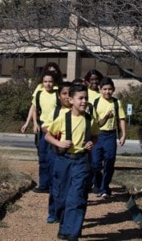

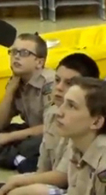


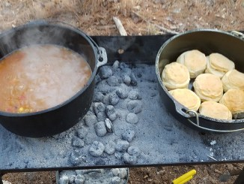
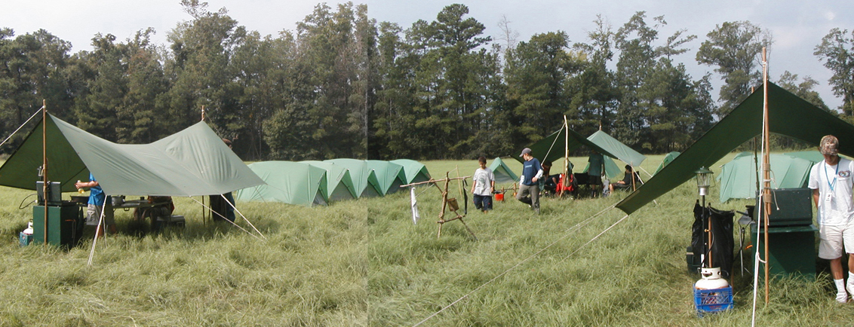
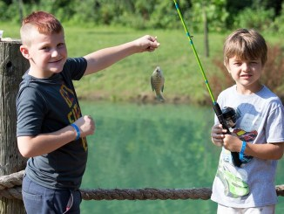
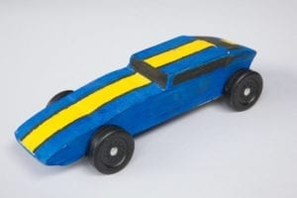
George Mason Program
Matt Burns, Vice Chair Program
George Mason District

Slide 7

Current 2022 GM Calendar
May 1 to May 15, 2022 – GM Hike-O-Ree
May 14, 2022 – Jamboree on the Trail
May 30, 2022 – Flags In
June 2, 2022 – Elks Youth Recognition Dinner
June 4, 2022 – NCAC Stem Expo and Pinewood Derby
June 9, 2022 – Program Launch and Roundtable
June/July 2022 – Cub Summer Camp

Slide 8
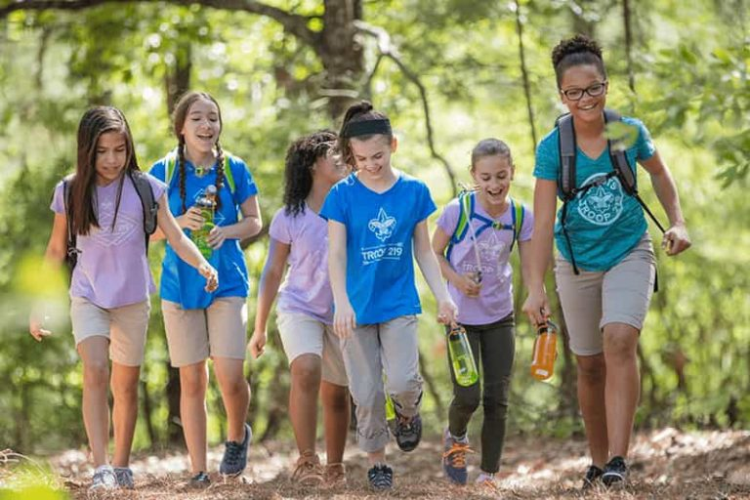
George Mason Hike-O-Ree
2nd Annual GM Hike-O-Ree on weekends of May 7 and May 14 – 5/6 to 5/15/22.
Open to all (Cubs, Scouts BSA and Venturing Scouts), families and friends.
Registration – Coming soon.
Any age, any place and any appropriate grouping – just keep track of how far you hiked.
Register on Council website (registration opening in early 2022). $5.00 for a patch.
Challenge – District Scouts, Scouters and families hike 2,022 miles.
Total the miles for each unit and notify Matt Burns at Burnsmj509@gmail.com. We’ll see how big a total we reach.

Slide 9
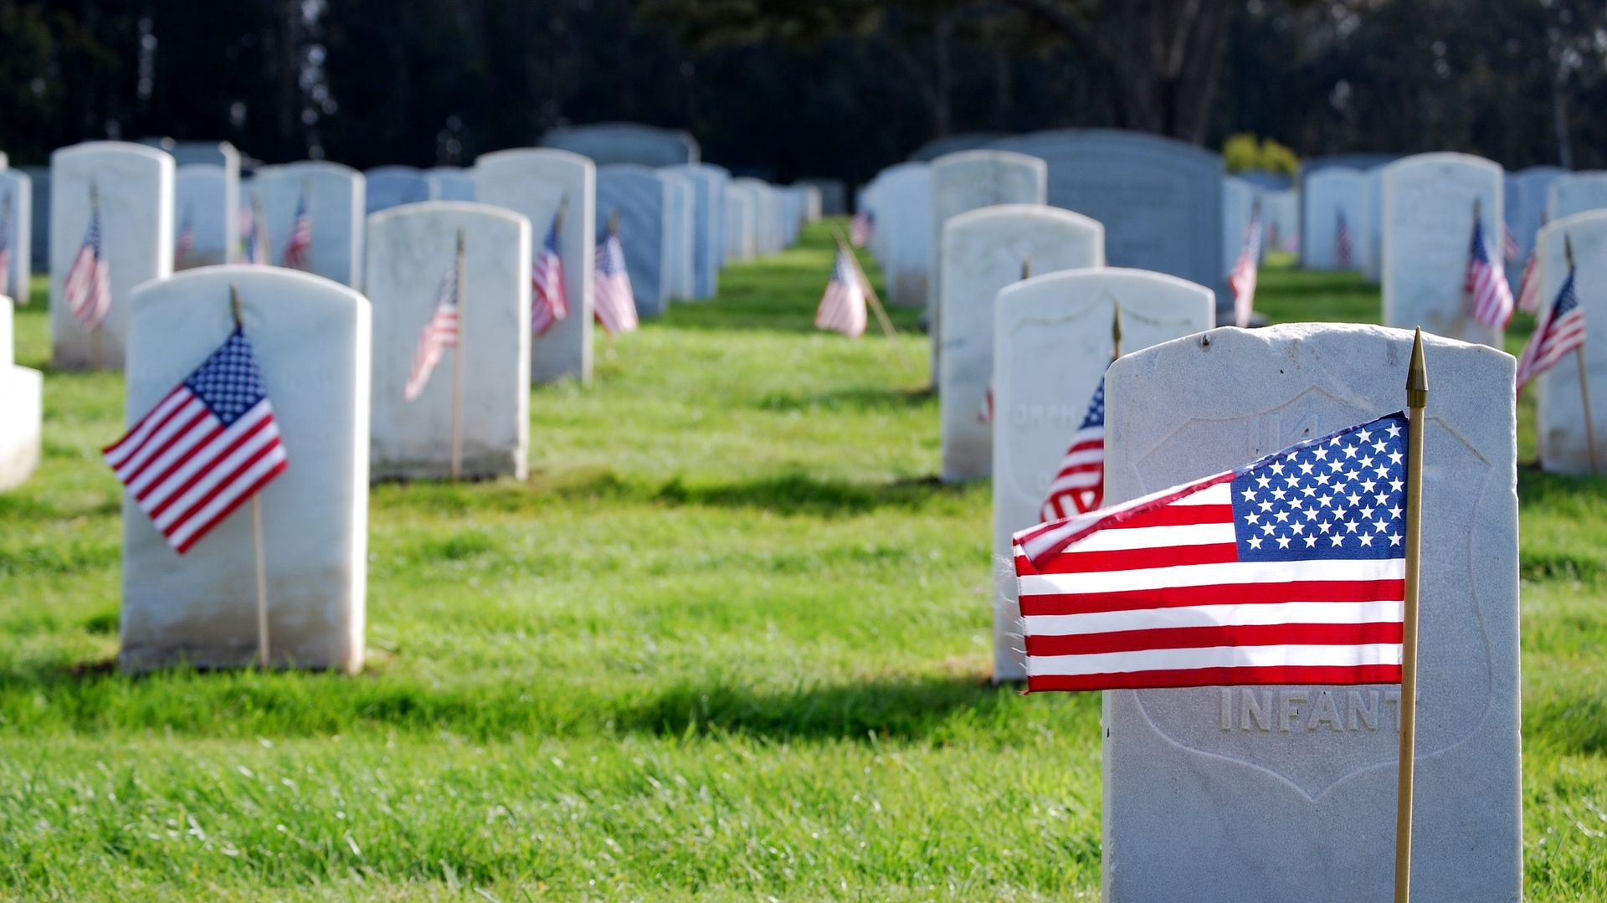
Flags In
May 30, 2022 (Monday)
Flag placement will start at 10:00 am
Social distancing – bring a mask.
National Memorial Park, 7482 Lee Highway, Falls Church
All Scouts, including Girl Scouts, are welcome.
Class A Uniforms
For more info, contact Russell Pittman at ruspittman@gmail.com.

Slide 10
SCOUTS BSA Roundtable

Slide 11
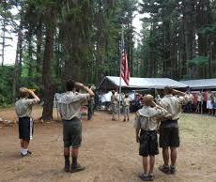
Future Camporees
Save the Dates!!!
George Mason Fall 2022 Camporee – October 21 - 23, 2022
  Theme and Site TBD
George Mason Spring 2023 Camporee – May 5-7, 2023
  Theme and Site TBD
Please factor this into unit calendars/planning.
Scouts are loyal – including loyalty to District activities.

Slide 12

2022 Elks Youth Recognition Dinner
For youth that earned Eagle in 2021 (i.e. their Eagle Board of Review was held in the 2021 calendar year) and their Scoutmasters.
Thursday, June 2, 2022
Elks Lodge 2188, 8421 Arlington Blvd., Fairfax, VA.
Will need unit leader help in contacting Scouts and obtaining an RSVP.

Slide 13

Training
Cub Leader Specific Training in-person 6/4 @ Alexandria https://scoutingevent.com/082-56464
BALOO – 06/18/22, Lorton, VA https://scoutingevent.com/082-56465
Scoutmaster/ASM Specific Training 6/4 in Alexandria
https://scoutingevent.com/082-57862
IOLS – 6/4 -6/5 @ Camp Snyder or 6/18-6/19 in Lorton https://scoutingevent.com/082-PATRIOTSPRING22IOLS
https://scoutingevent.com/082-56465
NYLT summer courses – registration now open
Powderhorn (P50) - 08/26/22 – 08/28/22 – Camp St. Charles, Newburg, MD. https://scoutingevent.com/082-49585

Slide 14

GM High Adventure
NCAC High Adventure Committee (HAC) updates and announcements: https://www.ncacbsa.org/high-adventure/
  Vacancies list updated 11 April: https://public.3.basecamp.com/p/xWpkdrKHKAA9pCzwmHMNdbWb
  NCAC Paddle Craft Safety Class at Camp Snyder - 4/29-5/1. See website.
  Philmont Preparedness Seminars (20 April: Recap and Updates) https://www.philmontscoutranch.org/philmont-prep-seminars/
  NCAC Northern Tier training is available to all interested -- not just those scheduled for a summer trek. Contact Craig Reichow: bsa2xs@gmail.com
  HA Sourcebook update: https://www.ncacbsa.org/high-adventure-information/
  All BSA high adventure treks require Medical forms A, B, and C – both Scouts and adults – certain programs have additional medical screening requirements. (Schedule that physical exam soon!)
Contact Joe Knecht at knechtjoe@yahoo.com if you have questions regarding high adventure planning or resources.
April 2022

Slide 15
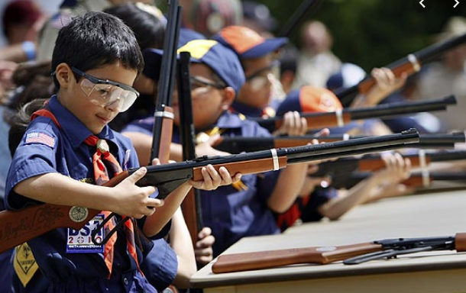
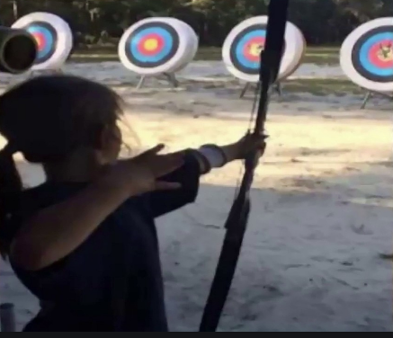
Shooting Sports
Requests for Shooting Events – Lead Time!
  50+ scouts - 6mos
  Less than 50 scouts - 3mos
Shooting on private land:
  Requirements
  Permissions/protocols
Shooting Sports web page
Shooting Sports Instructor Classes:
  Rifle/Shotgun
  Archery (Virtual classes available)

Slide 16


Merit Badges
Every merit badge counselor needs to be on the District charter. The time for action is NOW!
The online Merit Badge Counselor registration works for all Scouters who do not already hold another District position.
New Merit Badge Counselors must complete online merit badge counselor training, in addition to YPT, after November 1, 2021. Existing merit badge counselors have until 12/31/22 to complete training.
Be sure the counselor uses his/her legal name – no nicknames.
Merit Badge Counselors, or the unit Dean/Leader, also need to scan and send Margee the Merit Badge Counselor Information Form listing the badges the counselor is applying to teach and providing a justification of his/her qualifications.
Youth Protection Training is the essential first step. Don’t hit “send” on the application without it!
Contact Margee if you have questions at GM.MB.Dean@hotmail.com.

Slide 17
Other Topics
Order of the Arrow
General Announcements
District Executive Minute
District Chair Minute
District Commissioner Minute
Minutes and slides available on the GMD web site (District Resources, Roundtable). Password is “GMDRT”
Next meeting – Program Launch - June 9, 2022 at 7:00pm (Thoreau MS)

