Slide 1
2023 Charter Renewal

Slide 2
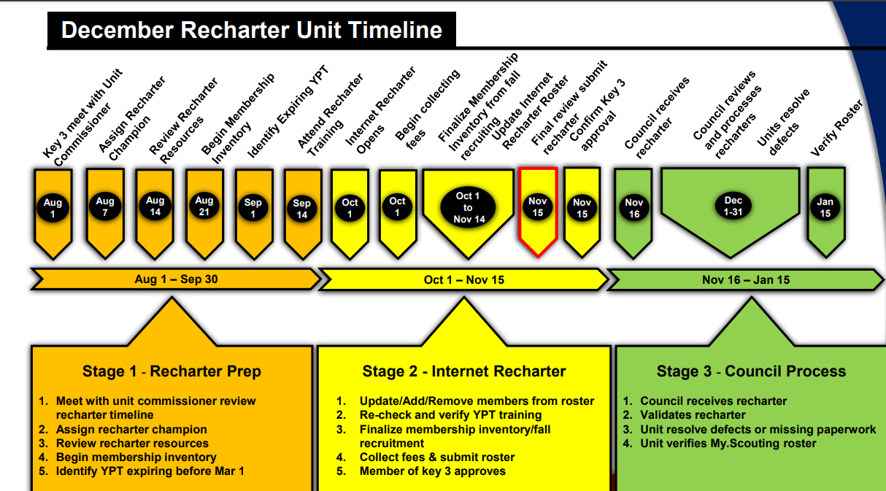

Slide 3
Internet Advancement 2.0 (my.scouting.org)
Only Unit Key 3 and Key 3 Delegates can input to recharter
Log in with my.scouting.org & Scoutbook username & password
Click “Update Unit Roster” to pull in new data/members every time you log in to the recharter portal
Be sure to “Refresh Roster” periodically to add in Youth/Adults that have joined after the roster was generated

Slide 4
Rechartering in Internet Advancement 2.0
Window opens 2 Oct (90 days ahead of expiration)
Delete/Add/Invite members, ID multiples, change positions, upload docs
Please have your Unit Commissioner, District Renewal Processor or District Commissioner to review your roster before “Submitting to Council”
Once reviewed, “Submit to Council”
Any Key 3 member can approve with Adobe digital signature
Print copy of final approved roster, send to UC/DC

Slide 5
2023 National and Council Fees
Youth Fee* $75.00 per paid member
Adults (Lion/Tiger Adult $45.00 per paid member
Partners, EO – No Fee)*
Exploring Youth** $45.00 per paid member
New Scout Fee $25.00 per new Scout
Scout Life $15.00 per subscription
Council Insurance $ 2.04 per paid member
(Tiger/Lion Partners do not pay)
Unit Charter Renewal $100.00 per unit
* - Multiples in traditional units only pay once (Packs, Troops, Crews & Ships).
** - Multiple registrations between Exploring and Traditional units do not exist. Members in both programs, pay both fees.

Slide 6
Payment
Recommend Unit Check paid to Council
  Credit card and E-check payment goes directly to National – Registrar cannot adjust charter until a refund is rec’d (4-6 weeks or longer)
  Unit check to Council goes into Unit account – Registrar can fix charter without waiting for a refund.
  DE can turn in Unit check to Council
Submit to Council – Target is October 24

Slide 7
General Information
An adult Tiger or Lion partner is not a registered position (but they are assigned a BSA ID)
A previous or current Tiger or Lion partner registering in a committee or leader/assistant leader position must fill out an adult paper application with the CBC form & YPT certificate
  Write in the Tiger or Lion Parent BSA ID on the new adult application, so all training is transferred to the new adult profile
Annual Charter Agreement can be done separately
  Recommend completion by EOM September to confirm commitment by sponsor to continue chartering your unit
  https://www.scouting.org/forms
  The form is under the Unit Membership Resources
Submit 2022 JTE to DC by 15 Dec
  https://www.scouting.org/awards/journey-to-excellence/unit/

Slide 8
How to have a successful submission!
Be on the lookout for:
Missing Signed Criminal Background Check Approval Form
Missing or Expired Youth Protection Training
Missing Signatures (Applications, Background Checks)
Missing information on the application (DOB, SSN or false SSN)
Missing Key 3 Approval
Missing Adult Applications
Money Incorrect (in 2021 was software and process issue)
Youth Turned 18 – Needs Youth Protection Training, Criminal Background Check, and Adult Application
Only the unit can fix these issues

Slide 9
Resources to Assist
Recharter Tutorial (video)
Internet Recharter 2.0 User Guide (pptx)
FAQ Sheet (Word)
2023 Charter Renewal Handbook (47 page pdf)
Q & A Sessions

Slide 10
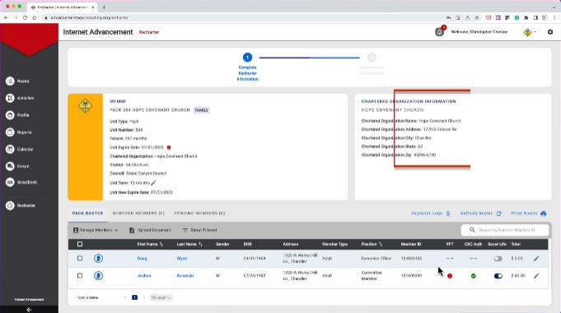
https://public.3.basecamp.com/p/tkR1bgG4BKsZHymQD6hjE9JD
Recharter Tutorial (mp4)

Slide 11
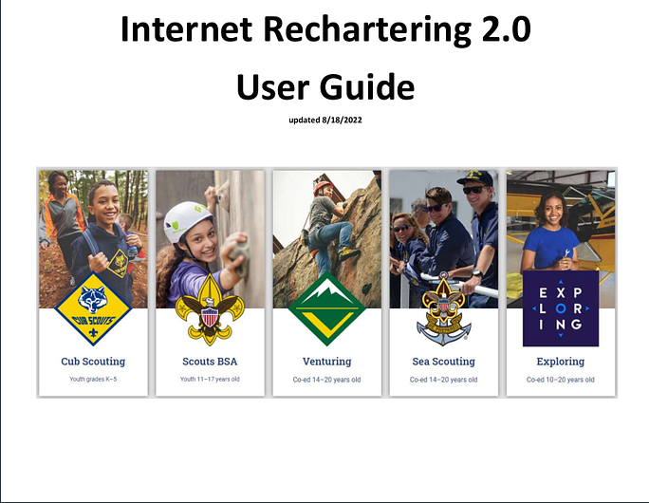
https://public.3.basecamp.com/p/tydzSzQJumotJHtJUtWQPmfp

Slide 12
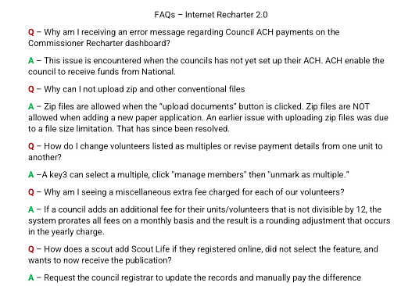
https://public.3.basecamp.com/p/7uxAgTfWQShmbciUL3XfMvfi

Slide 13
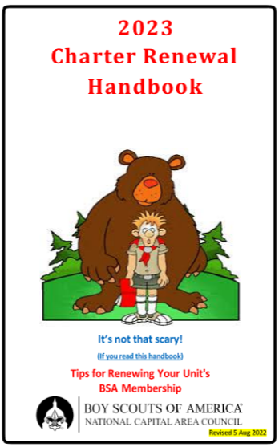
https://public.3.basecamp.com/p/thwJ7Fp9QxnsqDthsJaXfgkW

Slide 14
September Training Sessions (2)
Video Training (12 minutes)
Screen shots of software input (20 minutes)
Question and Answer (as long as needed)
What days would work best?
Please email (ruspittman@gmail.com) with the name and contact information for your Charter Renewal person.

Slide 15
Questions?

