Slide 1

George Mason District
Roundtable
November 10, 2022

Slide 2

Pledge

Slide 3


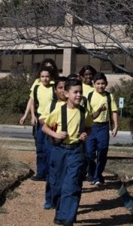

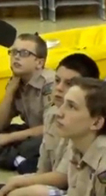


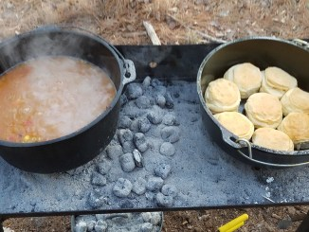
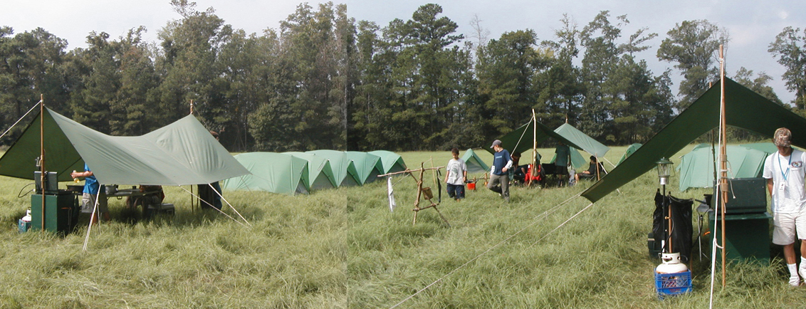
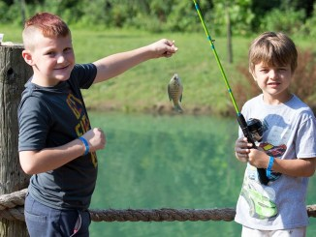
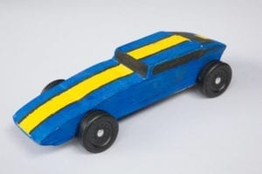
George Mason Program
John Drisco, Vice Chair Program
Matt Burns, Deputy Vice Chair Program
George Mason District

Slide 4

Current 2022 GM Calendar
November 11,2022 –Flags in, National Memorial Park, Falls Church
November 12,2022 – Scouting for Food Bag Collection
December 2022 – Peace Light of Bethlehem
February 4, 2023 - District Life To Eagle Seminar
March 4, 2023 – Merit Badge Day at Fairfax Presbyterian Church
March 25, 2023 – Pinewood Derby at Fairfax Presbyterian
Church
May 5-7, 2023 – Spring Camporee TBD

Slide 5
STEM
Chess Tournaments
  Cubs – 4 February 2023
  SBSA – 11 February 2023
DC STEM Trek- Showcases 24 government agencies, private organizations and monuments related to the tenets upon which STEM is based.
  10.57 miles
  4.75 miles
  https://www.ncacbsa.org/wp-content/uploads/2022/09/DC-STEM-Trek-2.pdf

Slide 6
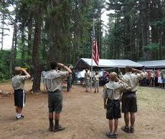
Future Camporees
Save this Date!!!
George Mason Spring 2023 Camporee – May 5-7, 2023
  Theme and Site TBD
Please factor this into unit calendars/planning.
Scouts are loyal – including loyalty to District activities.

Slide 7

District Life to Eagle Seminar
Saturday, 4 February 2023
1:00 to 4:00 p.m.
Virtual
Register at: https://scoutingevent.com/082-64518
Who should attend:
Life Scouts or advanced Star Scouts who want to pursue the Eagle Rank
Eagle advisors, coaches or unit leaders that haven’t attended a seminar in two years
Parents of Scouts working on Eagle or other adults interested in Scouting
Registration will be done online and must be received by 3 February 2023 to get the Zoom link.
Any questions contact Matt Burns at 703-938-9550.

Slide 8
2023 District Merit Badge Event
March 4th, 2023 at Fairfax Presbyterian Church in Fairfax.
Registration will open on December 23rd, 2022
Need Unit Merit Badge Day Coordinator names and contact details by November 30 to John Drisco at gmasonmeritbadgeday@gmail.com
Encourage Scouts to get merit badge books by December 31. Read requirements and start tackling “pre-work” by early January 2023.
Note: The “pre-work” is not the same as a “prerequisite.” The “pre-work” consists of tasks/activities that the Scout is advised to do in advance of the Merit Badge Day. A Scout can still participate in the Merit Badge Day class if he hasn’t completed the pre-work but failure to complete the pre-work may mean the Scout leaves the Merit Badge Day with a partial badge. A prerequisite is something that must be done in order to qualify to take the class. The only prerequisite we are aware of for the George Mason Merit Badge Day is that the Scout must be a registered member of the Boy Scouts in a participating unit.
Feedback to John Drisco at gmasonmeritbadgeday@gmail.com

Slide 9


Merit Badges
Every merit badge counselor needs to be on the District Charter. The time for action is NOW!
The online Merit Badge Counselor registration works for all Scouters who do not already hold another District position.
New Merit Badge Counselors must complete online merit badge counselor training, in addition to YPT. Existing merit badge counselors have until 12/31/22 to complete training.
Be sure the counselor uses his/her legal name – no nicknames.
Merit Badge Counselors, or the unit Dean/Leader, also need to scan and send Margee the Merit Badge application form listing the badges the counselor is applying to teach and providing a justification of his/her qualifications.
Youth Protection Training is the essential first step. Don’t hit “send” on the application without it!
Contact Margee if you have questions at GM.MB.Dean@hotmail.com.

Slide 10

SCHOLARSHIPS
Deadlines Approaching!!!
BSA Scholarship page - https://www.scouting.org/awards/scholarships/
Elks Most Valuable Scholar – Deadline Nov 14, 2022 https://www.elks.org/scholars/scholarships/MVS.cfm
Sons of American Revolution – Deadline Dec 15, 2022 Arthur M. & Berdena King Eagle Scout Contest – National Society Sons of the American Revolution (sar.org)
For more info/questions, contact Bill Denk at thinkdenk3@msn.com.
National Eagle Scout Association – Deadline January 31, 2023 Scholarships - The National Eagle Scout Association (nesa.org)
American Legion Eagle Scout of the Year – Deadline is February 15, 2023 – Apply to local Legion Post. Open to Scouts in units sponsored by an American Legion Post or who have a parent or grandparent that is a member of the Legion. Applications at: https://www.legion.org/scouting/nominate

Slide 11

Glenn A. and Melinda W. Adams Award
Recognizes a noteworthy Eagle Scout Service Project.
Deadline is January 21, 2023
Anyone can make a nomination. ADAMS-NATIONAL-EAGLE-SCOUT-SERVICE-PROJECT-OF-THE-YEAR-NOMINATION-FORM.pdf (nesa.org)
Scout must sign application to document their “consent.”
Also needs an electronic copy of the project workbook.
Some nominations include video.
Winners can receive:
  $500 at the Council level.
  $500 at the Regional (Northeast) level.
  $2,500 for National winner.

Slide 12

Training https://www.ncacbsa.org/george-mason/training
        Akela’s Trail (formerly Pow-Wow)
        – 11/19/22 – Zoom https://scoutingevent.com/082-63597
        Cub Leader Position Specific (C40) / Cub Scout Den Leader Specific (C42)
        - 11/19/22 – Alexandria, VA
        - 12/17/22 – Alexandria, VA
        Basic Adult Leader Outdoor Orientation (BALOO;C32)
        - 11/12/22 – 11/13/22 – Gaithersburg, MD
        Introduction to Outdoor Leadership Skills (IOLS; S11)
        - 12/03/22 – 12/04/22 – Camp Snyder, Haymarket, VA
    National Youth Leadership Training (NYLT; S78)
    - 01/20/23 - 01/23/23 & 01/27/23 - 01/29/23 - Camp Snyder, Haymarket, VA (Waitlist)
    Outdoor Ethics/Leave No Trace (D78)
    - 11/13/22 For Guides and their Advisors, Camp Snyder, Haymarket, VA
    Mental Health First Aid https://www.fairfaxcounty.gov/hscode/ereg/Registration.aspx?groupID=47
        - Two classes in November; Two Classes in December (Thursdays 9am – 3:30pm)
        University of Scouting - 02/25/23 – Alexandria, VA
        Wood Badge (A90)
        - 03/31/23 – 04/02/23 & 04/22/23 – 04/23/23
        - 05/05/23 – 05/07/23 & 06/03/23 – 06/04/23

Slide 13

GM High Adventure
NCAC High Adventure Committee (HAC) updates and announcements: https://www.ncacbsa.org/high-adventure/
High Adventure Bases
  - Northern Tier
  - Winter 2022-2023 and summer 2023 – first come/first serve
  - 2024 reservations should open January 2023
  - Philmont - Lottery open 10/1/22 – 12/1/22
  - Seabase
  - Some 2022 & 2023 availability https://www.bsaseabase.org/scouts/register/
  - 2024 Reservations should open January 2023
Training
              - Northern Tier Classroom Training (email: BSA2XS@gmail.com)
    03/04/23; 03/25/23; 04/15/23 – Holy Cross Lutheran, Herndon, VA
    - Philmont
    11/20/22 – Orientation for Crew Members and Parents (Zoom)
    01/08/23 – Advisors & Crew Leader Training
    03/12/23 & 03/18/23 – Philmont Advisor Hikes (email: wcdubi@gmail.com)
    03/25/23 – Skills Training (Zoom)
    04/01/23 – Skills Training (In-Person, TBD)
November 2022

Slide 14
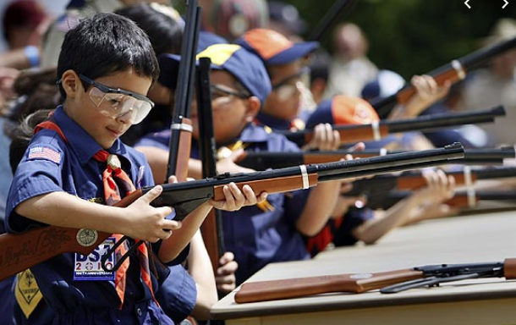
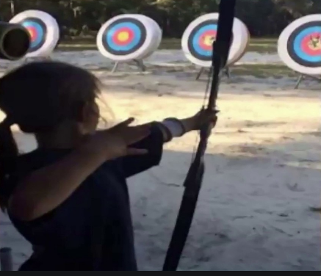
Shooting Sports
Requests for Shooting Events – Lead Time!
  50+ scouts - 6mos
  Less than 50 scouts - 3mos
Shooting on private land:
  Requirements
  Permissions/protocols
Shooting Sports web page
Shooting Sports Instructor Classes:
  Rifle/Shotgun
  Archery (Virtual classes available)

Slide 15
Council Update
Charter Renewal – 11 of 40 units have logged into the Charter Renewal system.
Fall Family Camping (Snyder; $35/person) – BB, Archery, Scouterhorn, Crafts, Leatherwork, Woodshop.
  11/18-20/2022 - https://www.gotosnyder.org/year-round-events/cub-scout-expo/
Goshen 2023 Registration is open – https://www.gotogoshen.org
Paper Adult Applications – Use 3-page form https://filestore.scouting.org/filestore/pdf/524-501.pdf
Changing IH/EO or CR – Paper applications; but at Charter Renewal can use Internet Advancement
My.Scouting.org
  Update Adult email/address/phone
  Organizational Manager
    COR/ COR Delegate can change positions
    New Position - Unit Treasurer

Slide 16
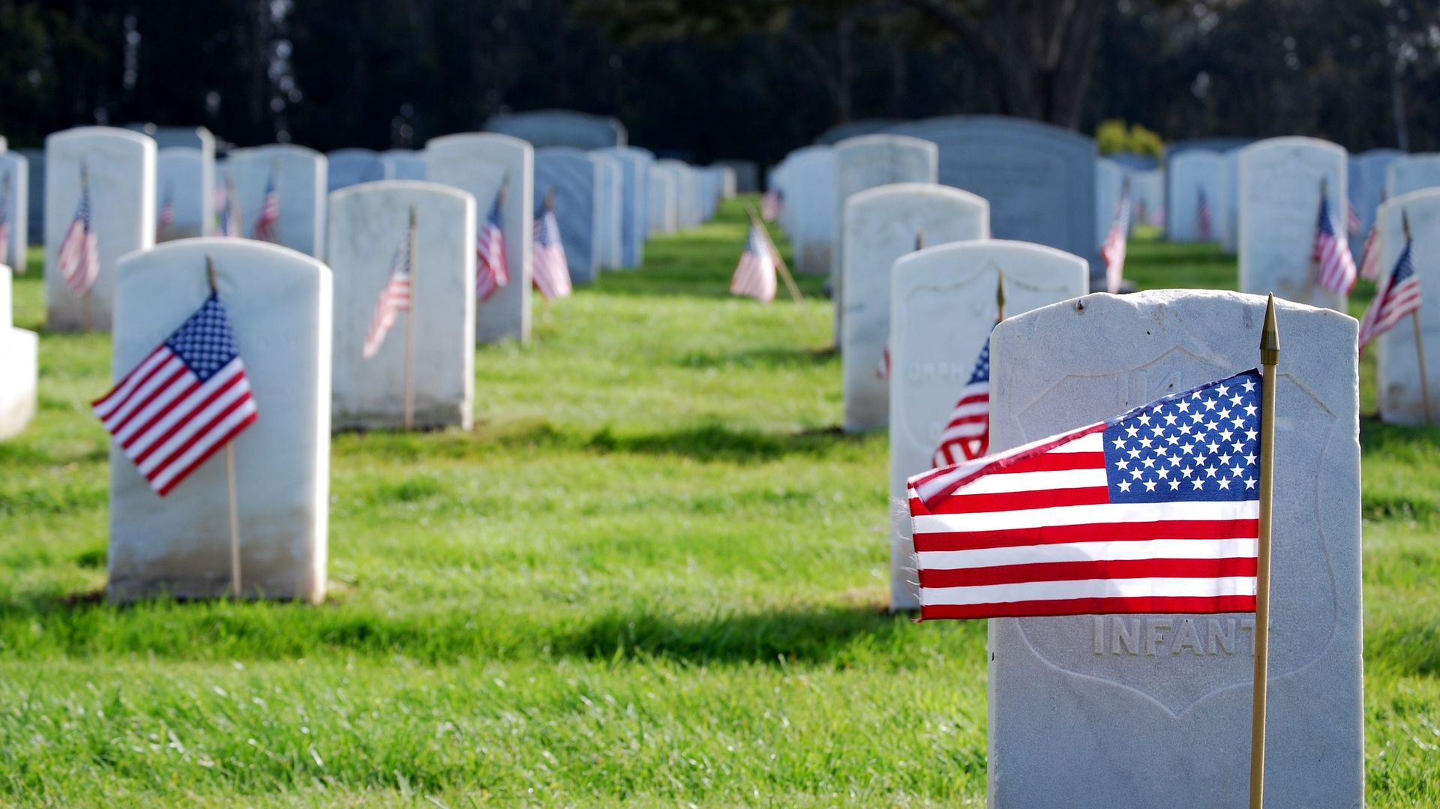
Flags In
November 11, 2022 (Veterans Day)
Start at 12:00 noon – Pizza is available!
Social distancing – bring a mask.
National Memorial Park,
7482 Lee Highway, Falls Church
All Scouts, including Girl Scouts, are welcome.
Class A Uniforms
For more info, contact Russell Pittman at ruspittman@gmail.com.

Slide 17
Other Topics
Order of the Arrow
General Announcements
District Executive Minute
District Chair Minute
District Commissioner Minute
Minutes and slides available on the GMD web site (District Resources, Roundtable). Password is “GMDRT”
Next meeting – December 8, 2022, at 7:30pm (Thoreau MS)

