Slide 1

George Mason District
Roundtable
January 12, 2023

Slide 2

Pledge

Slide 3
Council Update
Unit Charter Renewal – 39 of 40 units have submitted their rosters and 35 have posted. Once your unit posts, please review
  Scoutbook (missing and should have dropped)
  https://my.scouting.org
    Roster (any missing; names misspelled; update any contact information needed)
    Key-3 Delegates and COR Delegate
    Unit PIN information
  Email lists
  Note: Online registration should work within 24 hours. If not, check PIN.
Non-Unit Charter Renewal (MBC)
  Scoutbook – Check MBC list
Council Virtual Roundtable - January 17, 2023, at 7:30pm, the NCAC will have a virtual Roundtable. The topic for the evening is "Scouting is Outing" - information about Day Camps, Summer Camps, and Fishing Programs. Zoom info: here.
Fund Raising - Learn more about the Right-Response First Aid Kits! Zoom call on 01/23/2023 - register here.

Slide 4
Scoutbook
Updates to Scoutbook – Scoutbook uses the my.scouting.org database. Within 24 hours of a change to my.scouting.org, the changes should be visible in Scoutbook.
Common issue – Units will add an adult or youth to Scoutbook before the adult/youth has been added to their roster. This can result in two copies of their Scoutbook and/or one copy still online after they leave the unit.
Removing an adult leader – Enter an end date for their position. You can delete the adult’s unit account, but this can impact them if they are tracking their own Scout or have other positions (e.g., MBC).
Scoutbook Forum - https://discussions.scouting.org/
Scoutbook Demo Environment - https://scoutbookpp.scouting.org/

Slide 5

Big Rock – What the District Can Do For You!

Slide 6
What the District Can Do For You!
How Do I Make My Job Easier?

Slide 7
George Mason District Organization
District Committee
District Commissioner
District Executive
Program
Membership
Unit Commissioners
Roundtables
Rechartering
Marketing & Communications
Finance
Nominating Committee

Slide 8
Program Committee
Program Launch
Activities
Advancement
Camping
Civic Service
Training

Slide 9
Activities – Things to do! Making Scouting Fun
Cub Scout
Pi Day
Hike O Ree
District Pinewood Derby
JOTI/JOTA/JOTT
Scouts BSA
Pi Day
Hike O Ree
Spring & Fall Camporees
JOTI/JOTA/JOTT

Slide 10
Advancement – Moving Along the Scouting Trail
Merit Badge Counselor approval & listings
Merit Badge Day
Life to Eagle Seminars
Eagle Class Recognition Dinner

Slide 11
Camping – Where to go/What to Do
Promoting Cub Day & Summer Camps
Promoting Scouts BSA Summer Camp
Promoting Scouts BSA High Adventure Camps
Promoting Year-Round Camping
Listing and reviewing camp locations for approval

Slide 12
Civic Service and Awards – To Help Other People at All Times
Scouting for Food
Flags In on Memorial Day & Veterans Day
Promoting & Sharing Service Opportunities in the Region
District Court of Honor

Slide 13
Training – Preparing Adults & Youth to Lead
Providing Training Opportunities in the District for
Cub Scout Leader Specific Training
Basic Adult Leader Outdoor Orientation - BALOO
Introduction to Outdoor Leadership Skills – IOLS
Wood Badge
National Youth Leadership Training – NYLT
Promoting Above Training in Other Districts and Councils

Slide 14
Membership – Making Scouting Available
Helping Form New Units Where Needed
Helping Existing Units Grow
Supplying Materials for Membership Drives

Slide 15
Marketing & Communications – Telling Our Story
Bi-Monthly District Newsletter
District Facebook Page
District section on NCAC website
Roundtable live, by Zoom, minutes sent to all on RT list

Slide 16
Finance – Paying for Scouting
Approving Unit Money Earning Applications
Providing Unit Money Earning Opportunities
Popcorn Sales
Right Response Sales
Friends of Scouting Unit Presentations

Slide 17
Nominating Committee – Developing District Leadership
Recruit District Level Volunteers
Present Annual Slate of Members & Officers for Election

Slide 18
Last Words
The District exists to serve units
The District attempts to deliver response to needs (Tell us what you want)
The District is You! We need your help. If something we covered interests you, let us know.
Talk to your Unit Commissioner. They know stuff and what they don’t know they can find out.

Slide 19


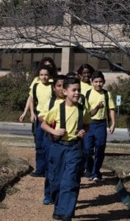

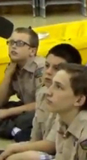


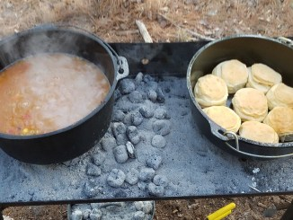
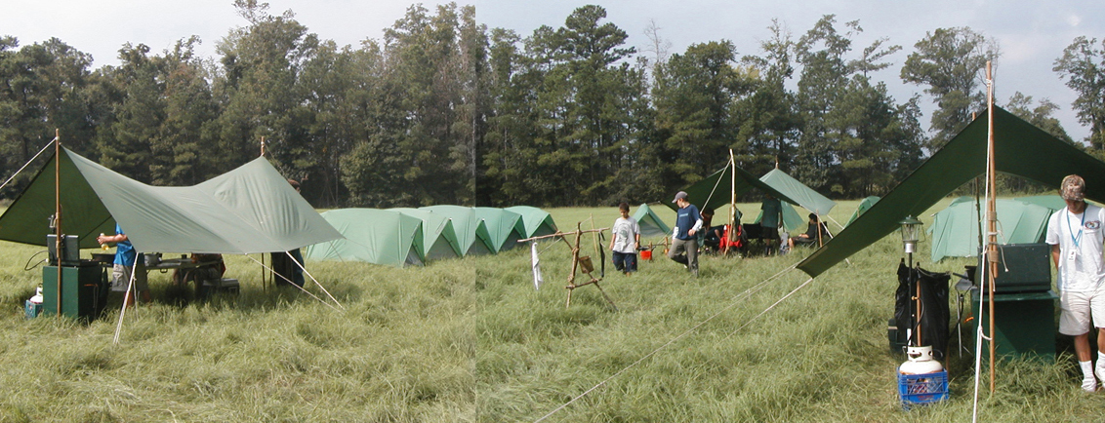
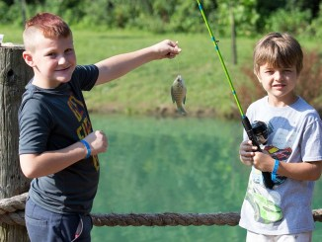
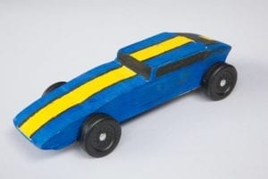
George Mason Program
John Drisco, Vice Chair Program
Matt Burns, Deputy Vice Chair Program
George Mason District

Slide 20

Current 2022 GM Calendar
February 4, 2023 – District Life To Eagle Seminar
February 25, 2023 – University of Scouting
March 4, 2023 – Merit Badge Day at Fairfax Presbyterian Church
March 25, 2023 – Pinewood Derby at Fairfax Presbyterian Church
April 13, 2023 - District COH (before April Roundtable)
May 5-7, 2023 – Spring Camporee Theme: Canoeing at Antietam
May 13-20, 2023 – Jamboree on the Trail
May 13, 2023 – District Hike-O-Ree
May 25, 2023 – Elks Youth Recognition Dinner for 2021 GM Eagles
May 29, 2023 – Flags In

Slide 21
STEM
Chess Tournaments
  Cubs – 4 February 2023
  SBSA – 11 February 2023
DC STEM Trek- Showcases 24 government agencies, private organizations and monuments related to the tenets upon which STEM is based.
  10.57 miles
  4.75 miles
  https://www.ncacbsa.org/wp-content/uploads/2022/09/DC-STEM-Trek-2.pdf

Slide 22
Advancement
Changes to Scout rank requirements effective January 1, 2023.
All Scouts must complete all 2023 requirements for any rank earned after January 1, 2023. Most significant change involves Outdoor Code and Leave No Trace
New merit badge requirements also took effect on January 1, 2023.
Impacts involved 30 merit badges – most significant impacts on Archery, Cooking, Cycling, Hiking and Snow Sports
For a comprehensive description of changes in a single place, please see http://usscouts.org/advance/changes/advchanges23.asp

Slide 23

District Life to Eagle Seminar
Saturday, 4 February 2023
1:00 to 4:00 p.m.
Virtual
Register at: https://scoutingevent.com/082-64518
Who should attend:
Life Scouts or advanced Star Scouts who want to pursue the Eagle Rank
Eagle advisors, coaches or unit leaders that haven’t attended a seminar in two years
Parents of Scouts working on Eagle or other adults interested in Scouting
Registration is live now and must be registered by 3 February 2023 to get the Zoom link.
Any questions contact Matt Burns at 703-938-9550.

Slide 24
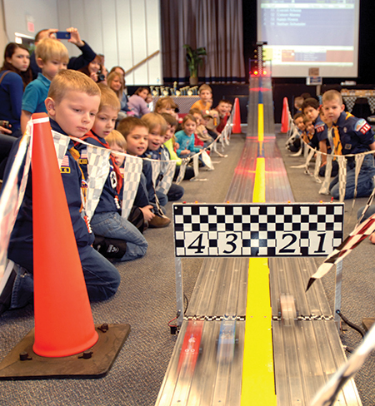
2023 George Mason Pinewood Derby
Race Day is March 25, 2023
All Packs wanting to participate in the 2023 Pinewood Derby MUST hold their Pack Pinewood Derbies by March 9, 2023.
One unit winner from each age bracket (Lions, Tigers, Wolves, etc.) regardless of gender.
Pack winners must register (and pay) on Council website. $15.00 per entry. No money collected at door on day of race. Must register by 3/16/23.
Register coming soon.
Race will be held at Fairfax Presbyterian in Fairfax.
For questions, contact Pat Berney.

Slide 25
2023 District Merit Badge Event
March 4th, 2023 at Fairfax Presbyterian Church in Fairfax.
All units participating at this event needs to provide volunteers for the Friday Preparation, Saturday opening, and Adult Assistant to MBC in their class rooms. This list is needed by February 14th, 2023
Need Unit Merit Badge Day Coordinator names and contact details now to John Drisco at gmasonmeritbadgeday@gmail.com
Note: The “pre-work” is not the same as a “prerequisite.” The “pre-work” consists of tasks/activities that the Scout is advised to do in advance of the Merit Badge Day event. A Scout can still participate in the Merit Badge Day class if he hasn’t completed the pre-work but failure to complete the pre-work may mean the Scout will leave Merit Badge Day with a partial merit badge. A prerequisite is something that must be done in order to qualify to take the class. Feedback to John Drisco at gmasonmeritbadgeday@gmail.com

Slide 26
Merit Badges being offer this year:
American Heritage
Citizenship of the Community
Citizenship of the Nation
Citizenship of the World
Communications
Disabilities Awareness
Emergency Preparedness
Engineering
Family Life
Fire Safety
Genealogy
Geology
Law
Journalism
Personal Management

Slide 27

District Court of Honor
To recognize adults who served/are serving at the unit level.
Two awards:
  Unit Commissioner’s Unit Scouter Award – 1 per unit
  Unit Appreciation Award – Maximum 8 per unit.
Please provide a sentence or two describing the individual’s service.
Submit Unit Commissioner’s Unit Scouter Award to Unit Commissioner.
Unit Appreciate Award to gm.adultrecognition@gmail.com
Must have all submissions by no later than March 22, 2023.
Will confer awards at District COH/April Roundtable.

Slide 28


2023 Spring Camporee
George Mason District
May 5 to May 7, 2023

Slide 29
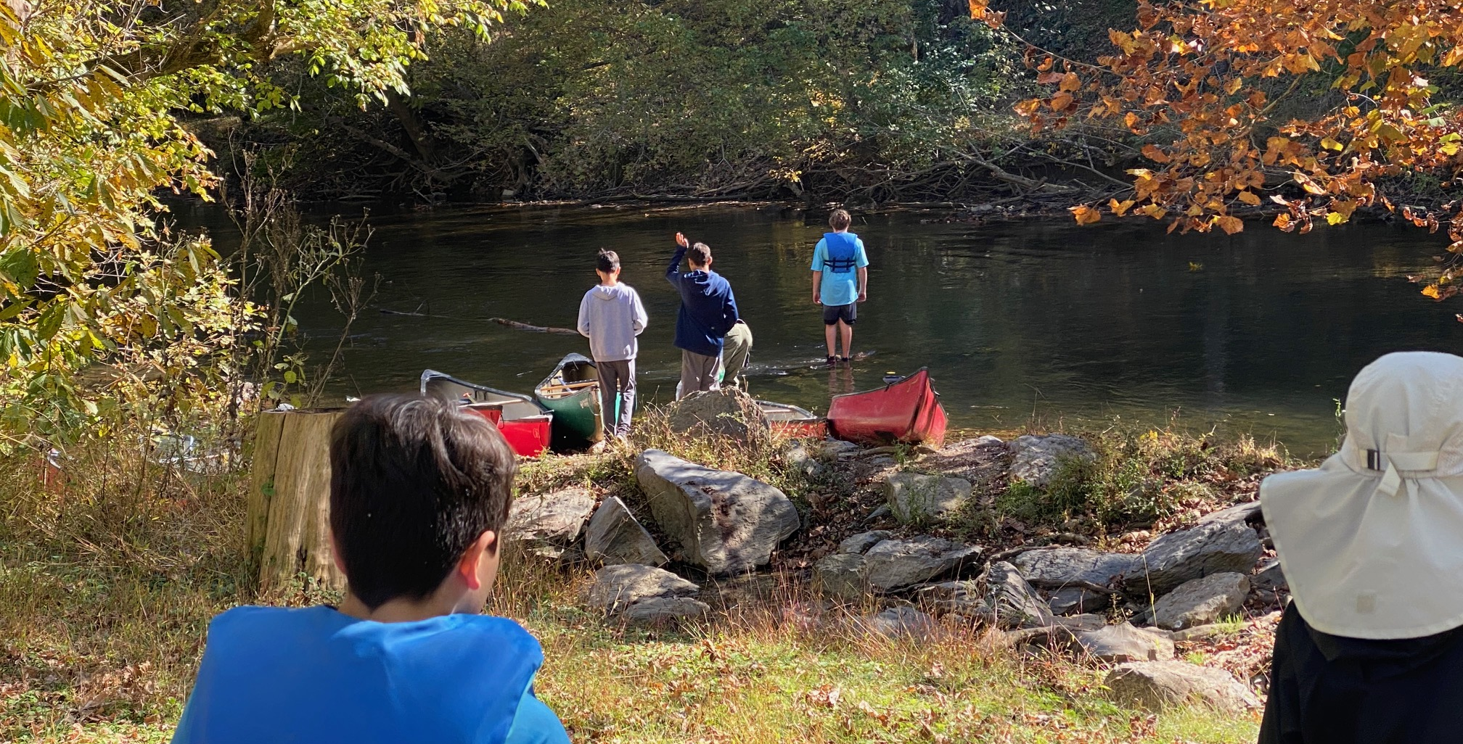
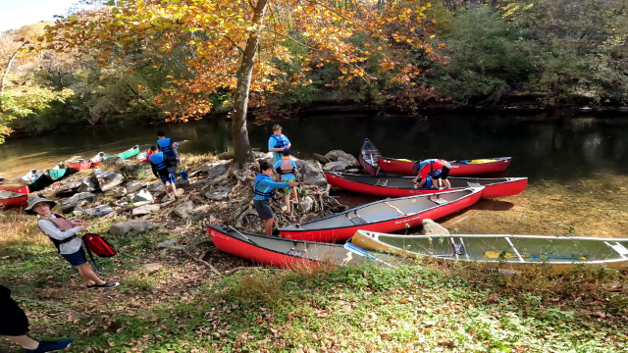
Spring Camporee 2023: Antietam creek canoeing

Slide 30
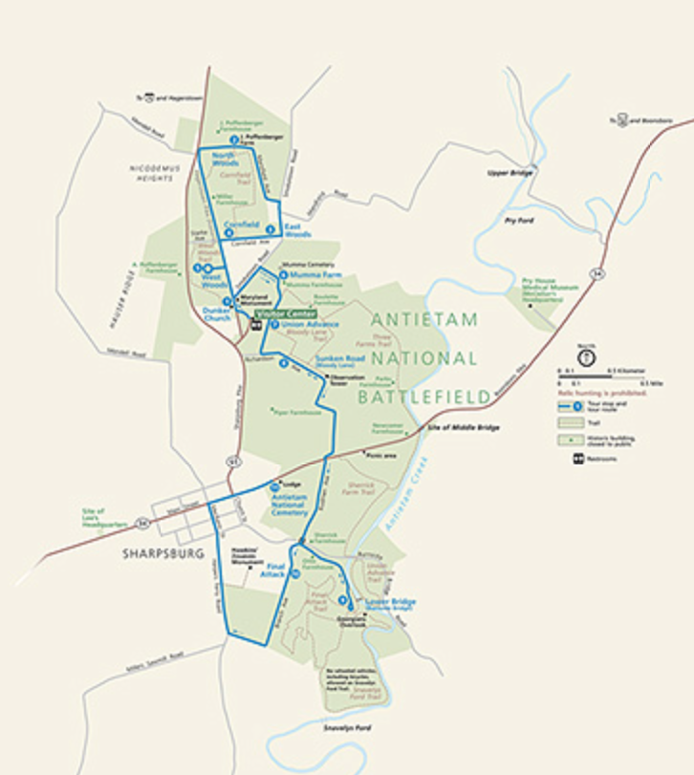
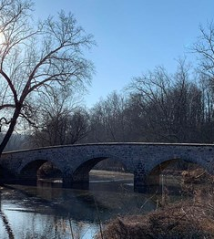
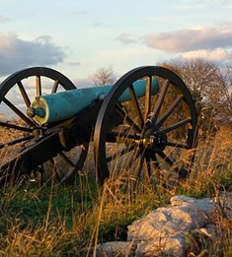
Spring Camporee 2023: Antietam Park
Hiking Through History

Slide 31

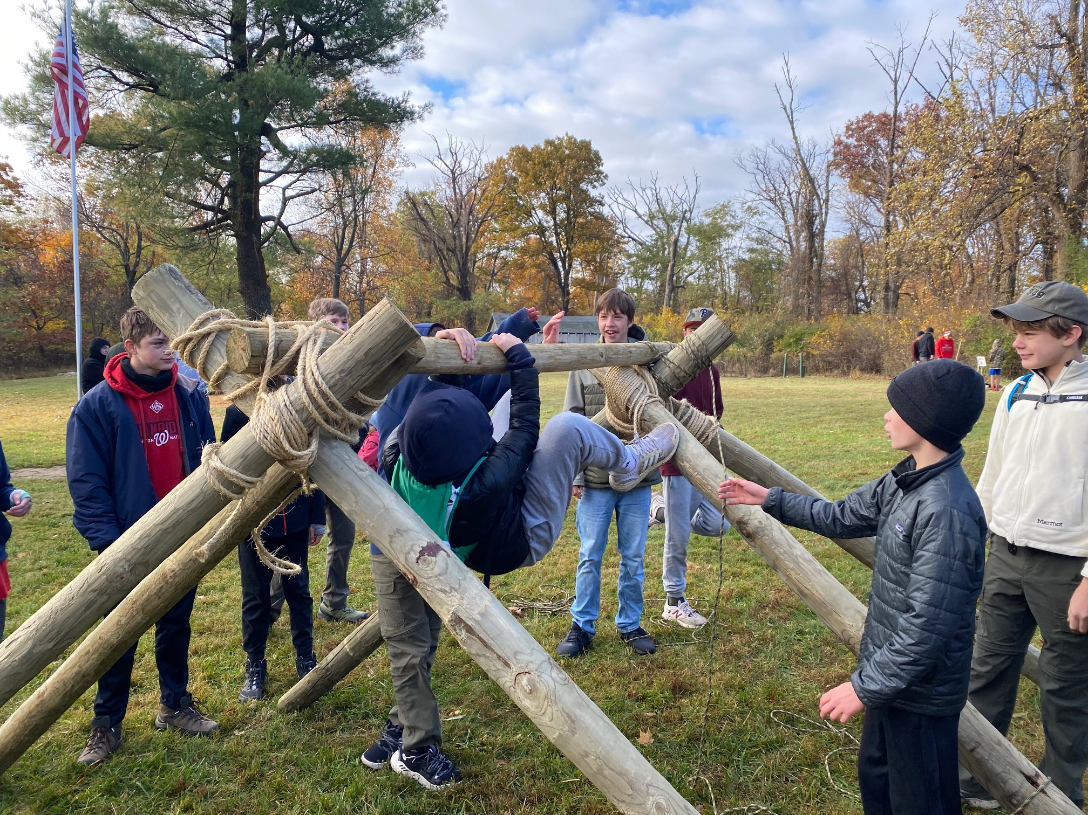
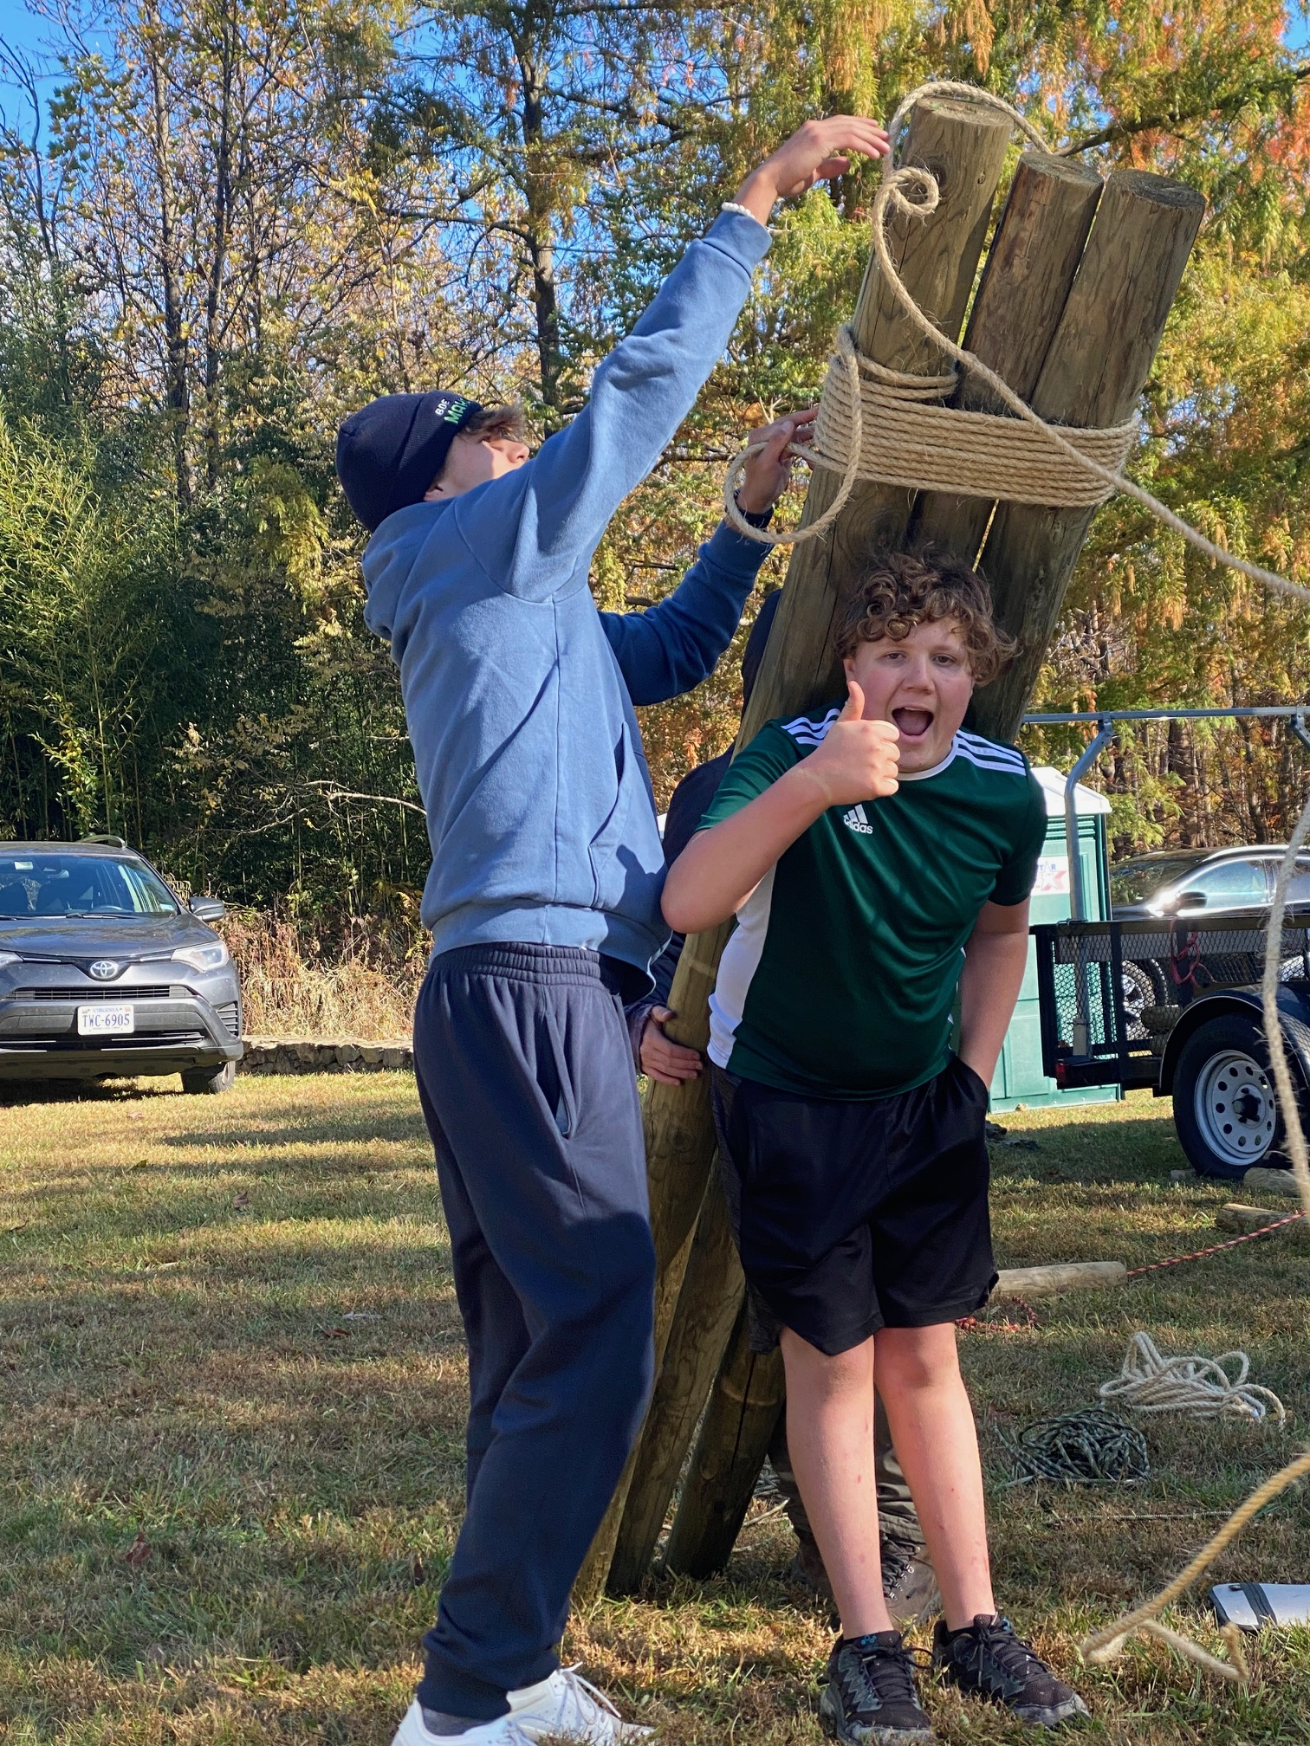
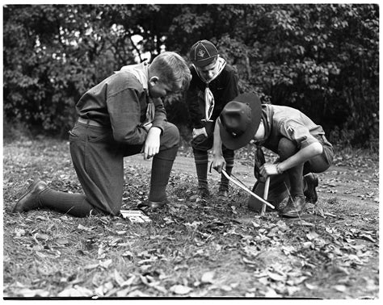
Spring 2023 Camporee: Scoutcraft
Trustworthy
Helpful

Slide 32
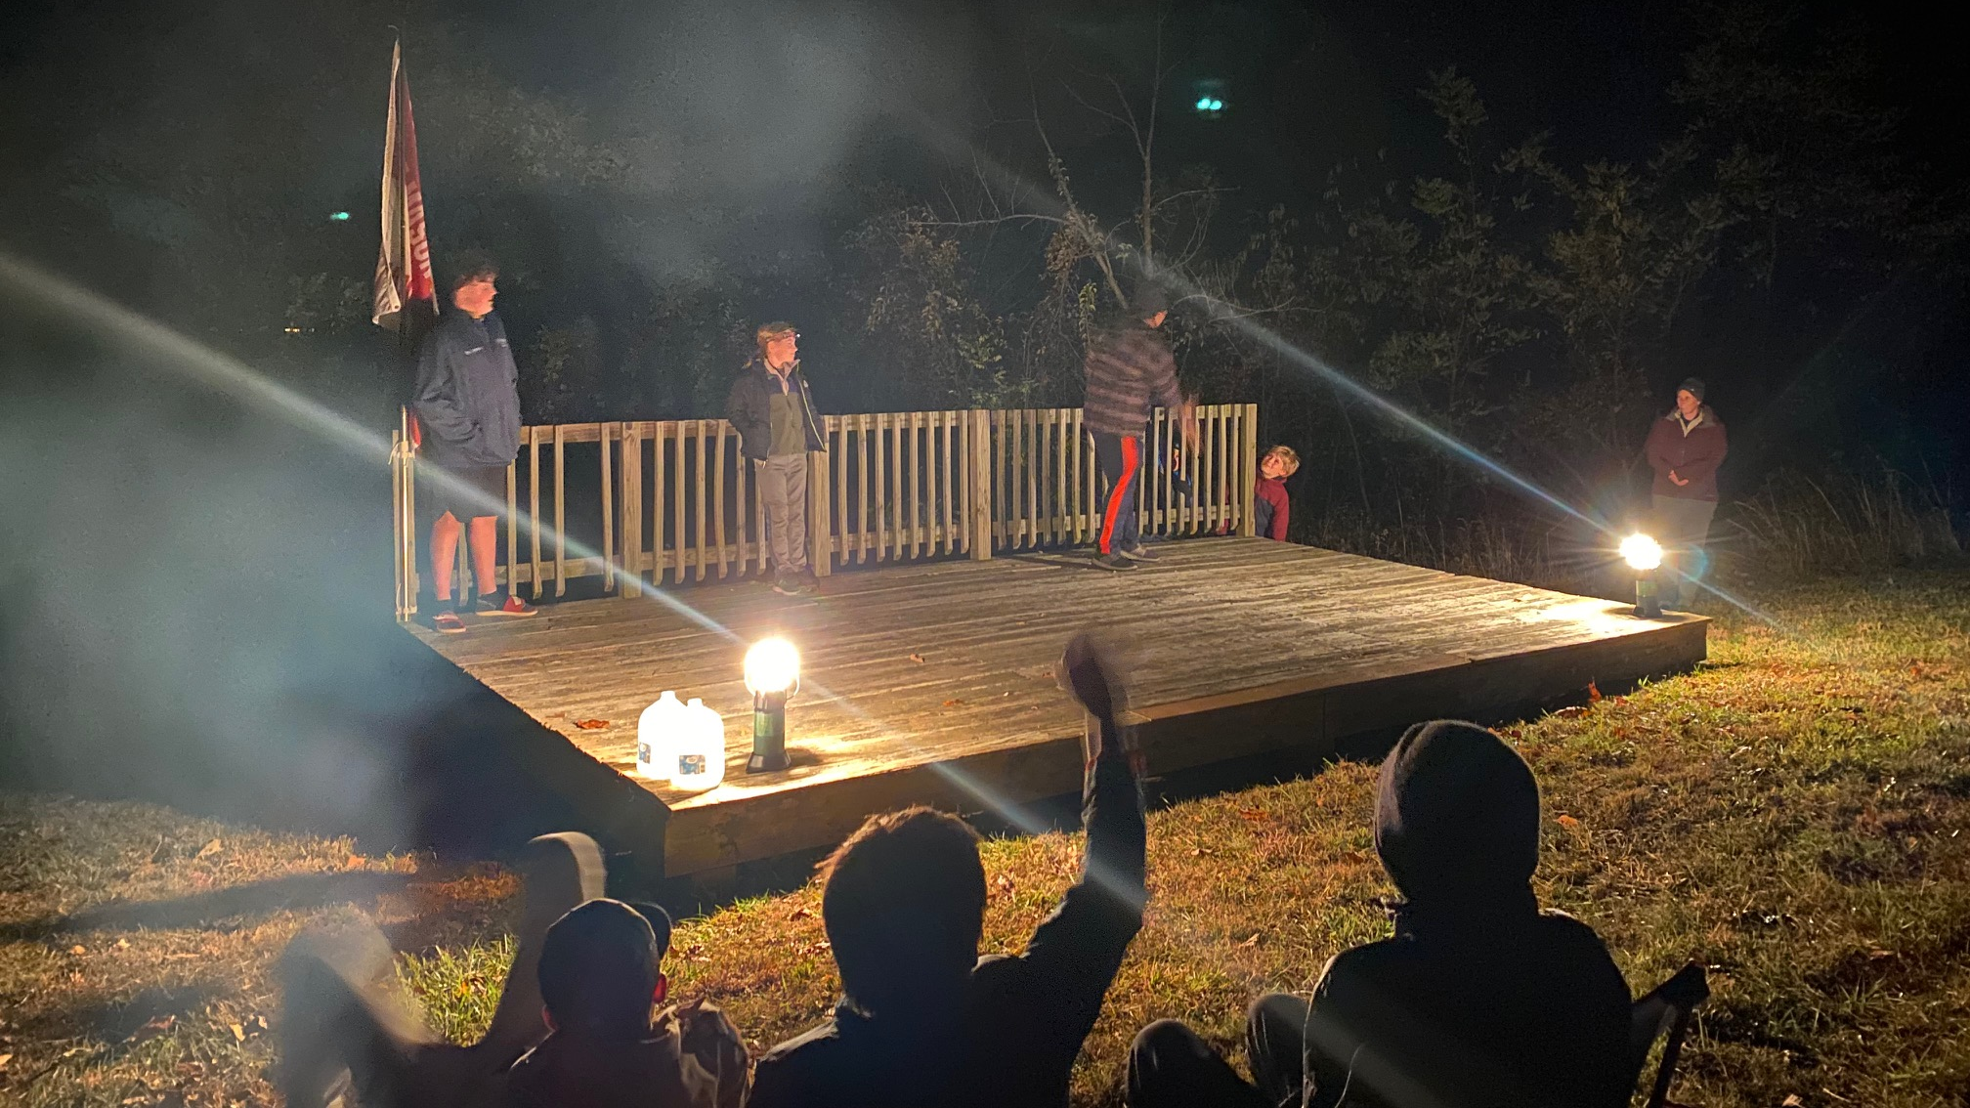
Spring 2023 Camporee: Campfire

Slide 33
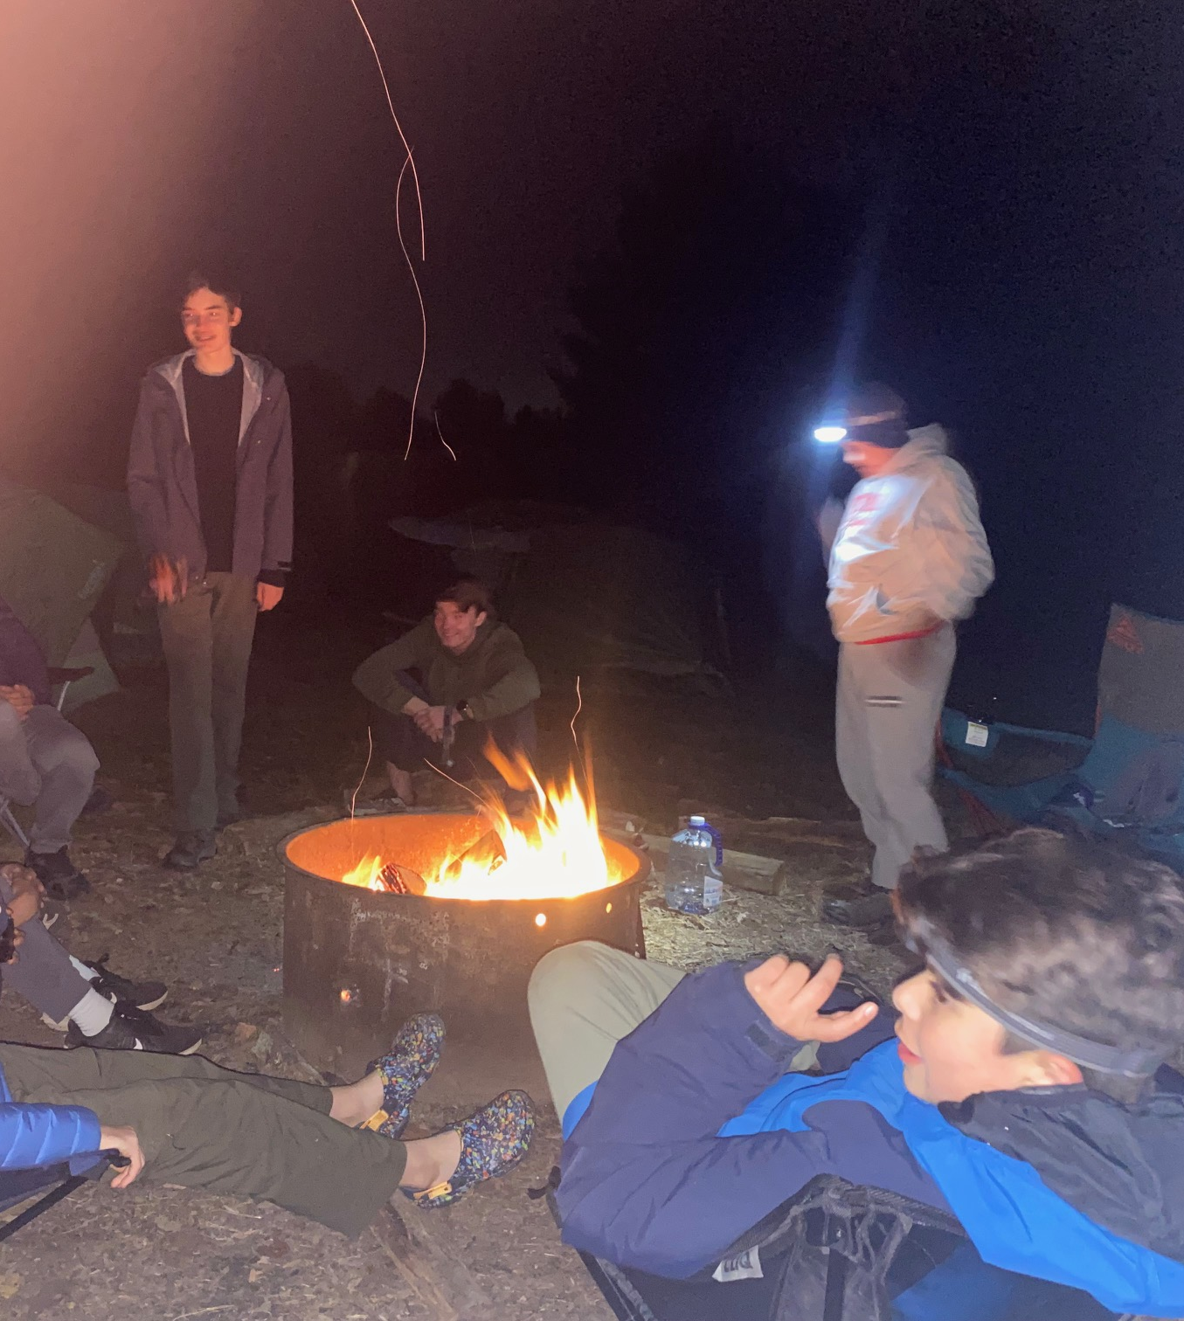
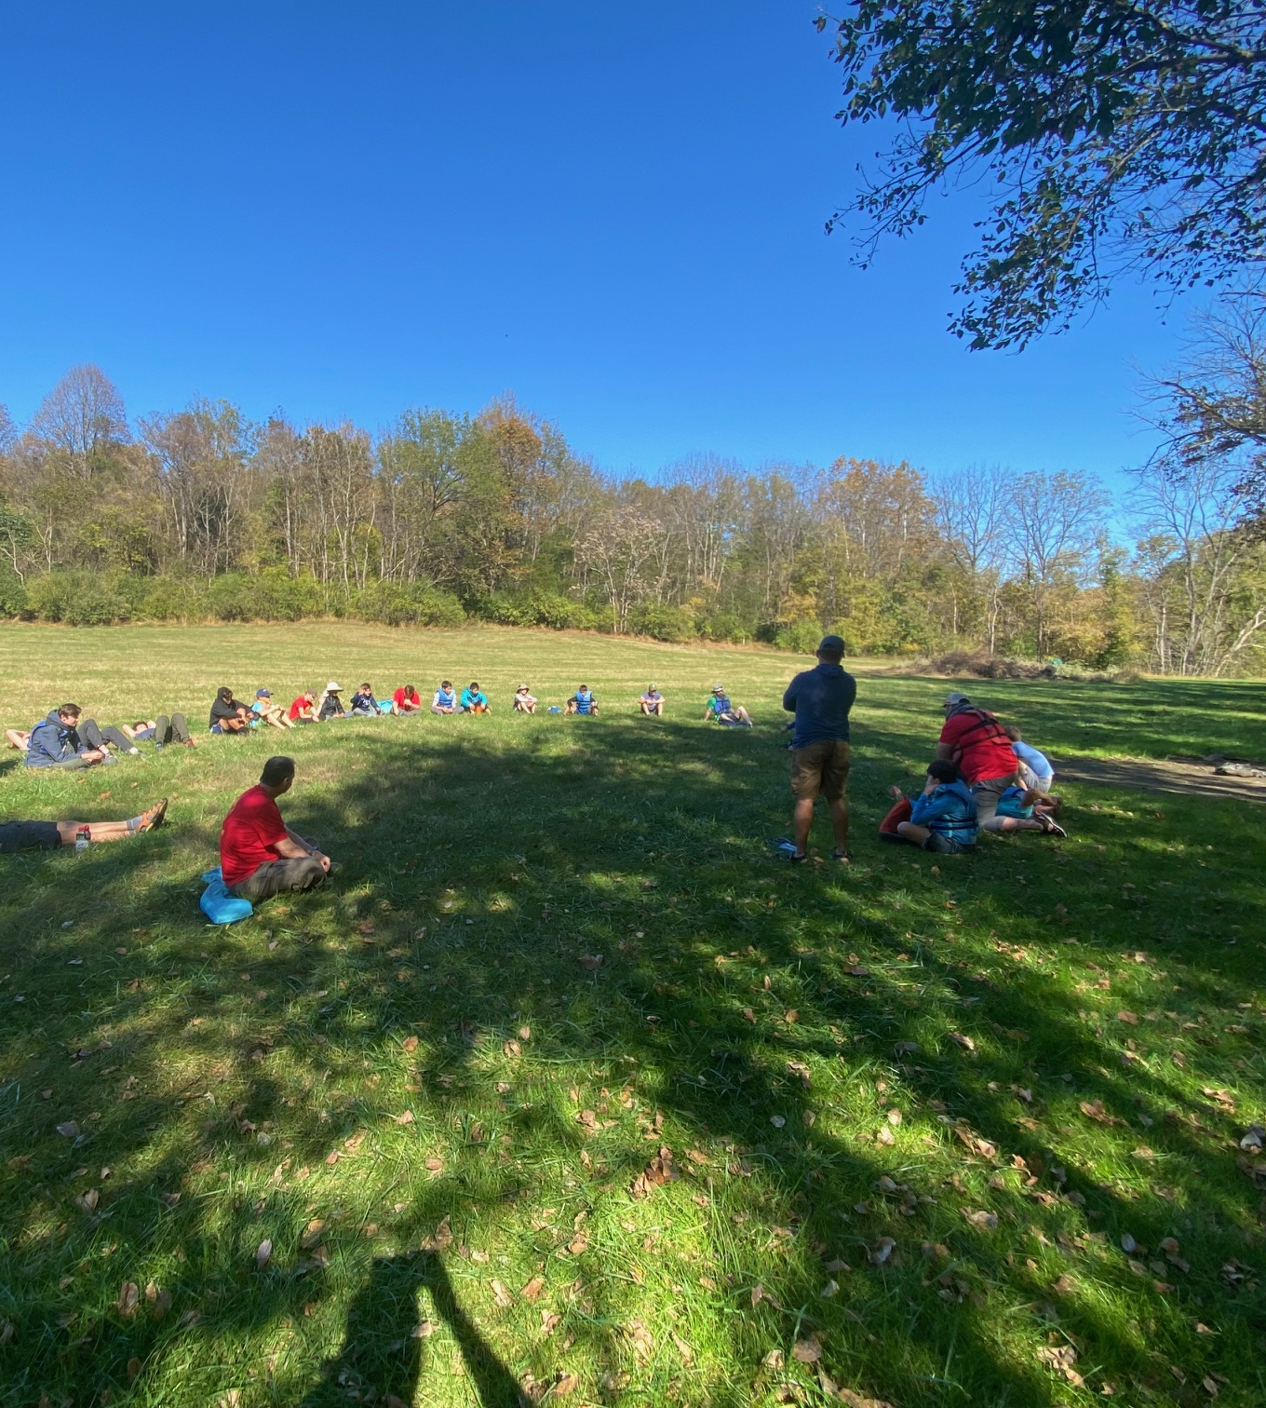
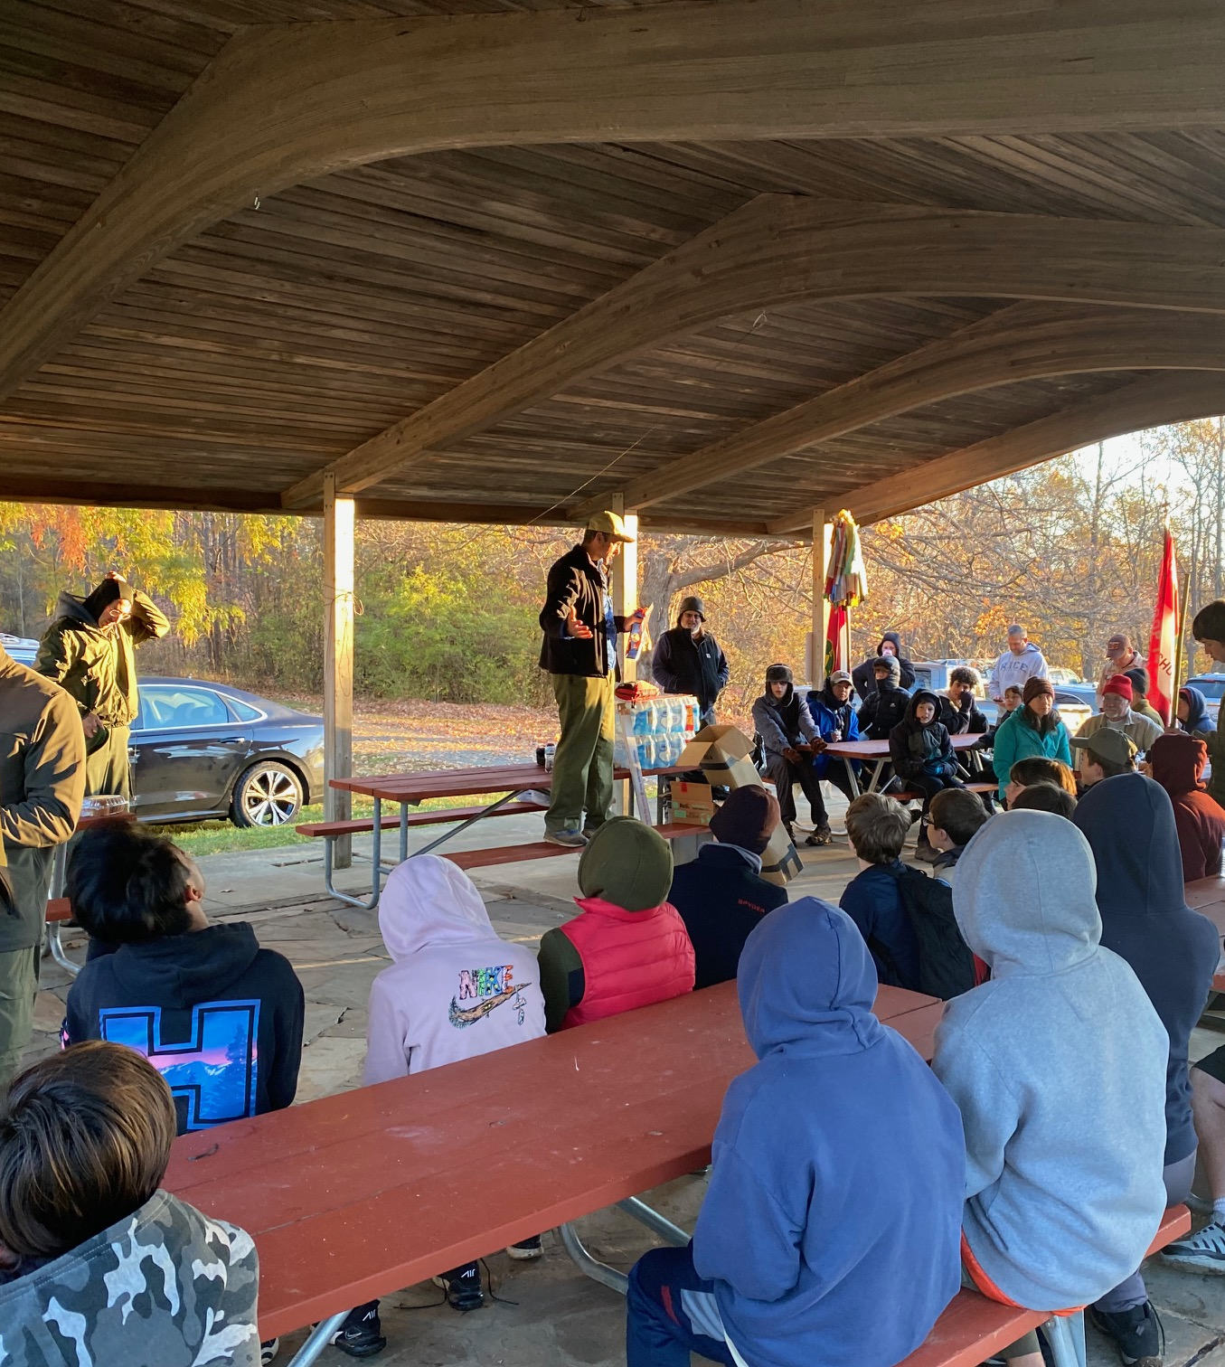
Spring 2023 Camporee:
Friendship & Fellowship

Slide 34

NCAC George Mason District
Spring 2023 Camporee: May 5-7

Slide 35

2023 Spring Camporee
George Mason Spring Camporee – May 5-7, 2023
  Theme : Canoeing at Antietam
Come join us as we step back into history and explore the Antietam Battlefield by canoe or foot. The battle of Antietam was a result of the Confederate Army’s attempt to invade the north and win control of the Civil War.
First 75 Scouts can canoe. Limit is based on canoe and adult availability.
Scouts that canoe MUST have a swim test before arriving at Camporee. Units must bring documentation showing date Scout passed swim test.
Other Scouts, adults and Webelos can hike the battlefield and participate in other on-land activities.
Each unit needs to volunteer at least one adult to help with staffing the activities on Saturday.
To register, go to https://scoutingevent.com/082-66660.

Slide 36

George Mason Hike-O-Ree
^{3rd} Annual GM Hike-O-Ree
Open to all (Cubs, Scouts BSA and Venturing Scouts), families and friends.
Can hike at ANY time between May 12 and May 21.
Registration – Coming soon.
Any age, any place and any appropriate grouping – just keep track of how far you hiked.
Register on Council website (registration opening in early 2023).
Challenge – District Scouts, Scouters and families hike 2,023 miles.
Total the miles for each unit and notify Matt Burns at Burnsmj509@gmail.com. We’ll see how big a total we reach.

Slide 37

Jamboree on the Trail
May 13, 2023
An international event
The only requirement is to get out and hike.
Inaugural hike was in 1998.
Scouts of all ages can hike.
Register by March 31 to be certain of getting patches by May 13.
Register at: https://jamboreeonthetrail.org/registration/

Slide 38

2023 Elks Youth Recognition Dinner
For youth that earned Eagle in 2022 (i.e. their Eagle Board of Review was held in the 2022 calendar year) and their Scoutmasters.
Thursday, May 25, 2023
Elks Lodge 2188, 8421 Arlington Blvd., Fairfax, VA.
Will need unit leader help in contacting Scouts and obtaining an RSVP.
Scoutmaster are invited at no cost to them.

Slide 39
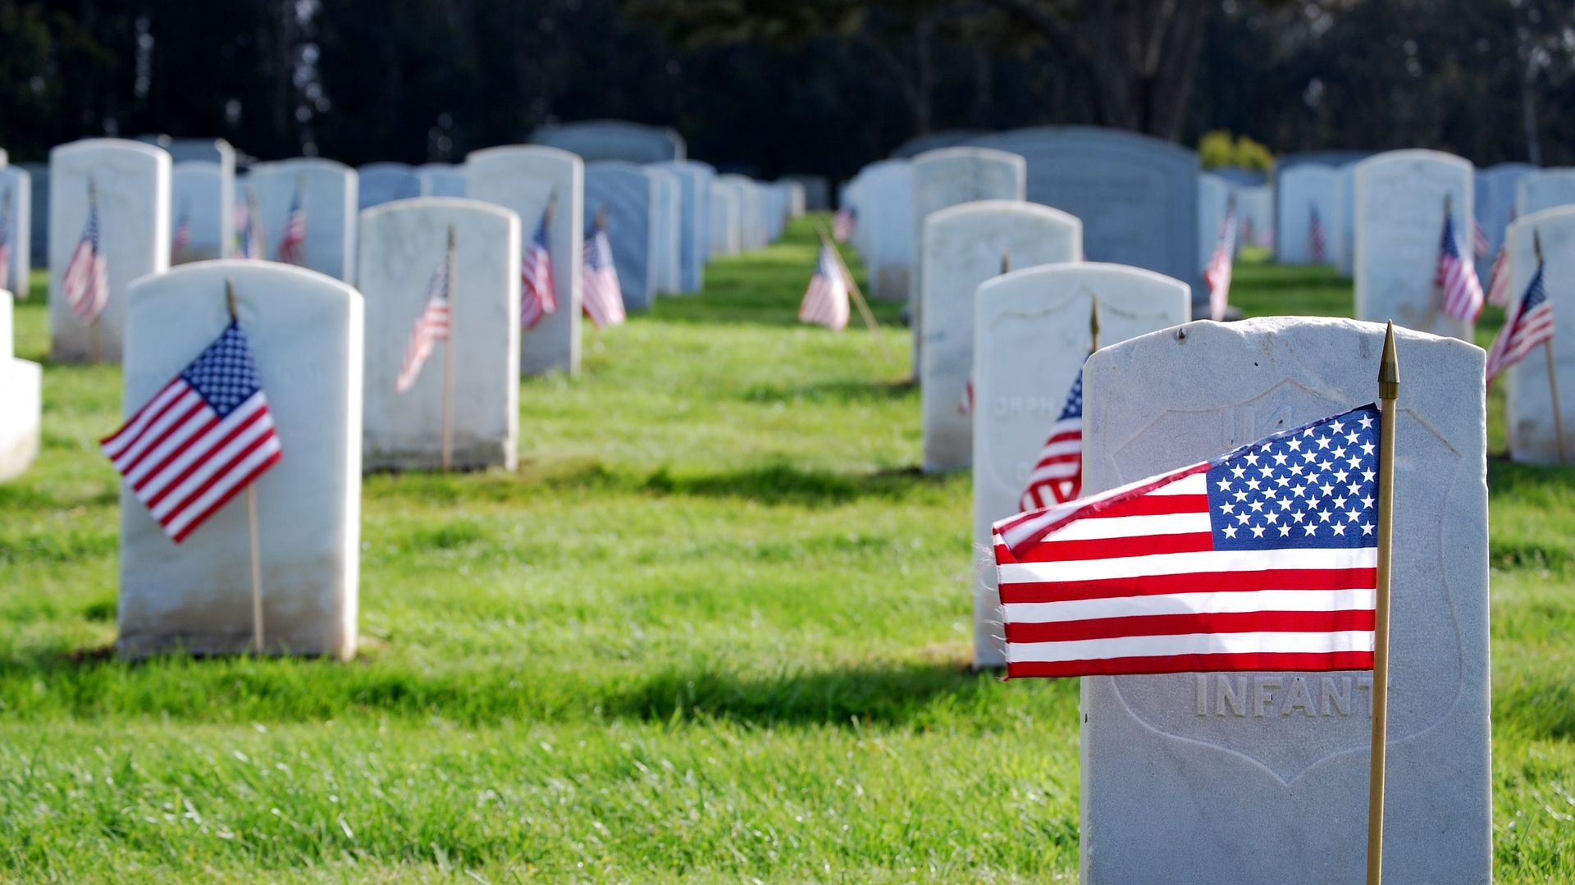
Flags In
May 29, 2022 (Memorial Day Monday)
Start at 10:00am – Pizza is available!
Social distancing – bring a mask.
National Memorial Park,
7482 Lee Highway, Falls Church
All Scouts, including Girl Scouts, are welcome.
Class A Uniforms
For more info, contact Russell Pittman at ruspittman@gmail.com.

Slide 40


Merit Badges
Every merit badge counselor needs to be on the District Charter. The time for action is NOW!
The online Merit Badge Counselor registration works for all Scouters who do not already hold another District position.
New Merit Badge Counselors must complete online merit badge counselor training, in addition to YPT. Existing merit badge counselors have until 12/31/22 to complete training.
Be sure the counselor uses his/her legal name – no nicknames.
Merit Badge Counselors, or the unit Dean/Leader, also need to scan and send Margee the Merit Badge application form listing the badges the counselor is applying to teach and providing a justification of his/her qualifications.
Youth Protection Training is the essential first step. Don’t hit “send” on the application without it!
Contact Margee if you have questions at GM.MB.Dean@hotmail.com.

Slide 41

Training https://www.ncacbsa.org/george-mason/training/
Basic Adult Leader Outdoor Orientation (BALOO;C32)
- 03/03/23 – 03/04/23 – Stafford, VA
- 04/15/23 – 04/16/23 – Camp Snyder, Haymarket, VA (Reg. Opens 01/16)
Back Country Outdoor Leadership Skills (BCOLS) - 03/04/23 – Huntingtown, MD
    National Youth Leadership Training (NYLT; S78)
    - 01/20/23 - 01/23/23 & 01/27/23 - 01/29/23 - Camp Snyder, Haymarket, VA (Waitlist)
- 06/18/23 – 06/23/23 – Session 23-2 – Camp Snyder, Haymarket, VA (registration open)
- 06/25/23 – 06/30/23 – Session 23-3 – Camp Snyder, Haymarket, VA (registration open)
- 07/23/23 – 07/28/23 – Session 23-4 – Camp Snyder, Haymarket, VA (registration open)
- 07/23/23 – 07/28/23 – Session 23-5 – Camp Snyder, Haymarket, VA (registration open)
    University of Scouting - 02/25/23 – Alexandria, VA (registration open)
        Wilderness First Aid (N02)
- 01/28/23 – Camp Snyder, Haymarket, VA
- 02/25/23 – Camp Snyder, Haymarket, VA
        Wood Badge (A90)
        - 03/31/23 – 04/02/23 & 04/22/23 – 04/23/23 (registration open)
        - 05/05/23 – 05/07/23 & 06/03/23 – 06/04/23 (registration open)
        - Fall Wood Badge (registration will open Feb 1, 2023)

Slide 42

SCHOLARSHIPS
Deadlines Approaching!!!
BSA Scholarship page - https://www.scouting.org/awards/scholarships/
National Eagle Scout Association – Deadline January 31, 2023 Scholarships - The National Eagle Scout Association (nesa.org)
American Legion Eagle Scout of the Year – Deadline is February 15, 2023 – Apply to local Legion Post. Open to Scouts in units sponsored by an American Legion Post or who have a parent or grandparent that is a member of the Legion. Applications at: https://www.legion.org/scouting/nominate

Slide 43

Glenn A. and Melinda W. Adams Award
Recognizes a noteworthy Eagle Scout Service Project.
Deadline is February 17, 2023
Anyone can make a nomination. ADAMS-NATIONAL-EAGLE-SCOUT-SERVICE-PROJECT-OF-THE-YEAR-NOMINATION-FORM.pdf (nesa.org)
Scout must sign application to document their “consent.”
Also needs an electronic copy of the project workbook.
Some nominations include video.
Winners can receive:
  $500 at the Council level.
  $500 at the Regional (Northeast) level.
  $2,500 for National winner.

Slide 44

GM High Adventure
NCAC High Adventure Committee (HAC) updates and announcements: https://www.ncacbsa.org/high-adventure/
High Adventure Bases
  - Northern Tier
  - Winter 2022-2023 and summer 2023 – first come/first serve
  - 2024 reservations should open January 2023
  - Philmont - Lottery
  - Seabase
  - Some 2022 & 2023 availability https://www.bsaseabase.org/scouts/register/
  - 2024 Reservations will open January 18, 2023
Training
              - Northern Tier Classroom Training (email: BSA2XS@gmail.com)
    04/01/23 – VFW, Occoquan, VA
    04/22/23 - Virtual
    - Philmont (email: wcdubi@gmail.com)
    01/08/23 – Advisors & Crew Leader Training
    03/12/23 & 03/18/23 – Philmont Advisor Hikes
    03/25/23 – Skills Training (Zoom)
    04/01/23 – Skills Training (In-Person, TBD)
January 2023

Slide 45
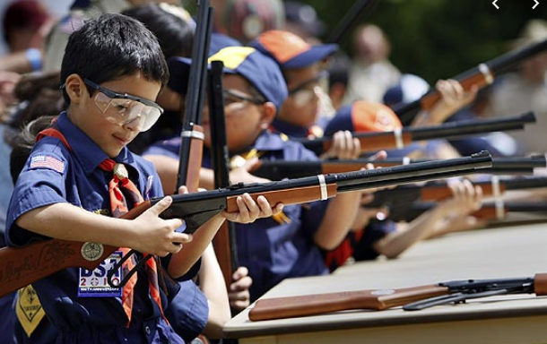
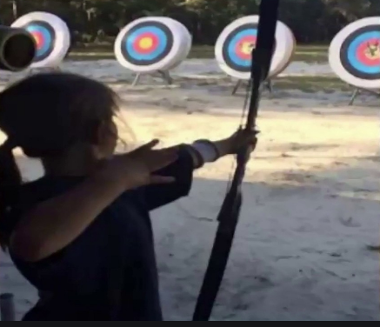
Shooting Sports
Requests for Shooting Events – Lead Time!
  50+ scouts - 6mos
  Less than 50 scouts - 3mos
Shooting on private land:
  Requirements
  Permissions/protocols
Shooting Sports web page
Shooting Sports Instructor Classes:
  Rifle/Shotgun
  Archery

Slide 46
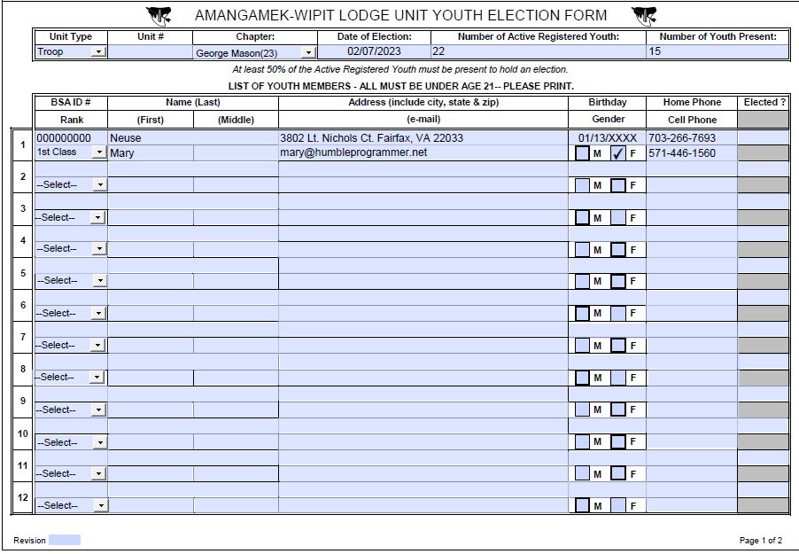
Order of the Arrow – Election Form

Slide 47
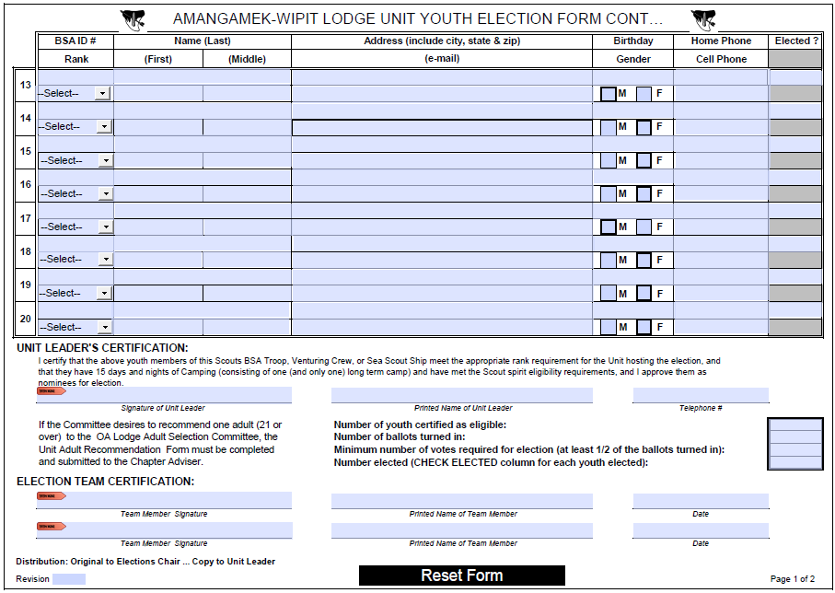
Order of the Arrow – Election Form(cont)

Slide 48
Other Topics
General Announcements
Troop 1539 will have a winter Join Scouting Night event on Tuesday, January 31 starting at 7:30pm, on the second floor of the Vienna Community Center. In addition to a chuck box demonstration, troop tent setup, and knot-tying, we will have displays of our recent activities and exciting videos of our summer 2022 adventures. We will also go over some of the requirements needed for the AOL Scouting Adventure.
Troop 1978B will be holding Duct Tape Night at the St Mark activity center in Vienna, VA on Tuesday, January 17th starting at 7:30pm. AOL and Webelo are welcome to attend. Scouts will be working in patrols to work through a challenge that has to be accomplished using Duct Tape.
District Executive Minute
District Chair Minute

Slide 49
GM Finance Committee
Right Response Fundraiser

Slide 53
Other Topics (cont)
District Commissioner Minute
Minutes and slides available on the GMD web site (District Resources, Roundtable). Password is “GMDRT”
Next meeting – February 9, 2023, at 7:30pm (Thoreau MS)

