Slide 1

George Mason District
Roundtable
February 8, 2024

Slide 2

Pledge

Slide 3
Agenda
Welcome and Pledge
Questions about Read-ahead
Award(s)
General Announcements
Program Announcements
Joint Session: AOL Bridging and Transitioning to Scouts
Cracker Barrel/Networking (Optional; NLT 9pm)
Next Meeting: March 14, 2024 (7:30pm)

Slide 4
Welcome
New to Roundtable?
Please introduce yourself!

Slide 5
Questions/Clarification about Read-ahead?

Slide 6
Award(s)

Slide 7
General Announcements

Slide 8

Current 2023 George Mason Calendar
February 24, 2024 – University of Scouting, Alexandria, VA
March 09, 2024 – GMD Merit Badge Day, Fairfax, VA
April 11, 2024 – GM District Court of Honor
April 13, 2024 – GMD Pinewood Derby, Fairfax, VA
May 3-5, 2024 – Spring Camporee, 4H
May 27, 2024 – Memorial Day Flags In, Falls Church, VA
May 29, 2024 – Elks Youth Recognition Dinner for 2023 Eagle Scouts

Slide 9
STEM
02/10/24 - Akela Chess Classic Scouts BSA Tournament, MSSC, Bethesda, MD
03/23/24 – Maryland Science Center Camp-In, Baltimore, MD
Ancient Earth: Birth of the Sky (on PBS) - link
Anytime – DC STEM Trek- Showcases 24 government agencies, private organizations and monuments related to the tenets upon which STEM is based. Two hikes - 10.57 miles, or 4.75 miles

Slide 10

2024 GM District Merit Badge Day
March 9th, 2024, at Fairfax Presbyterian Church in Fairfax.
There are currently 125 Scouts registered today. There are still openings (Chess, Disabilities Awareness, Geology, Citizenship of the Nation) but they are going fast. Please check out at the Registration site to see what is open:
https://site.corsizio.com/a/5bf2f8e8e6dfc6f1ca7cbd64
Will be needing Unit Adult Volunteers for Merit Badge Day (Setup, Clean up and Assistant to the Merit Badge Counselors. Send info to : gmasonmeritbadgeday@gmail.com
Scouts should be utilizing the merit badge books and read requirements and start tackling the “pre-work” now.
Note: The “pre-work” is not the same as a “prerequisite.” The “pre-work” consists of tasks/activities that the Scout is advised to do in advance of the Merit Badge Day. A Scout can still participate in the Merit Badge Day class if he hasn’t completed the pre-work but failure to complete the pre-work may mean the Scout leaves the Merit Badge Day with a partial badge. A prerequisite is something that must be done in order to qualify to take the class. The only prerequisite we are aware of for the George Mason Merit Badge Day is that the Scout must be a registered member of the Boy Scouts in a participating unit.
Feedback to John Drisco at gmasonmeritbadgeday@gmail.com

Slide 11
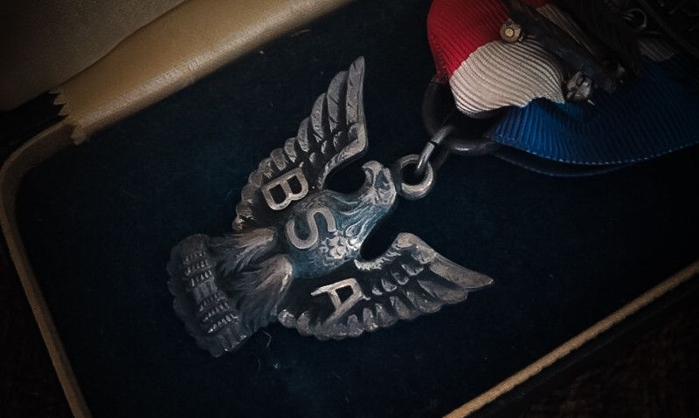
American Legion Eagle Scout of the Year Award
15 years old and in high school
Relationship w/ American Legion (as CO, or parent/grandparent in AL)
Eagle scout, project and community participation
Submit by March 1, 2024
Winner will be announced in May.
The recipient will receive a $10,000 scholarship.
Three runner-up scholarship awards will be granted in the amount of $2,500 each.
https://www.legion.org/scouting/261001/apply-2024-american-legion-eagle-scout-year-award

Slide 12

Elks Youth
Recognition Dinner
For youth that earned Eagle in 2023 (i.e. their Eagle Board of Review was held in the 2023 calendar year) and their Scoutmasters.
Thursday, May 29, 2024
Elks Lodge - 2188, 8421 Arlington Blvd., Fairfax, VA.
Will need unit leader help in contacting Scouts and obtaining an RSVP.
Scoutmaster are invited at no cost to them.

Slide 13
Big Rock
AOL Bridging and Transitioning to Scouts

Slide 14
Time for Cracker Barrell
Minutes and slides available on the GMD web site (District Resources, Roundtable). Password is “GMDRT”
Next meeting – March 14, 2024, at Thoreau MS

Slide 15
Backup Slides

Slide 16


Merit Badges
The online Merit Badge Counselor registration works for all Scouters who do not already hold another District position.
New Merit Badge Counselors must complete online merit badge counselor training, in addition to YPT. Be sure the counselor uses his/her legal name – no nicknames.
Merit Badge Counselors, or the unit Dean/Leader, also need to scan and send Margee the Merit Badge application form listing the badges the counselor is applying to teach and providing a justification of his/her qualifications.
Youth Protection Training is the essential first step. Don’t hit “send” on the application without it!
Contact Margee if you have questions at GM.MB.Dean@hotmail.com.
Did you know:
The National Council does not limit the number of merit badges a youth may earn from one counselor, though a unit leader is permitted to do so, as long as the same limit applies to all Scouts in the unit. Ideally, Scouts should work with a variety of adults. (GTA 7.0.0.3)
Partial Merit Badges have no expiration except the Scout’s 18th birthday. (GTA 7.0.3.3)
Due to the BSA policies related to Youth Protection and two-deep leadership, a merit badge counselor must have another adult present during all merit badge counseling sessions. However, the parent or legal guardian of the Scout may serve as the second adult. This parent or legal guardian does not have to be a registered leader.
If the requirements for a merit badge differ between the merit badge pamphlet and the current edition of Scouts BSA Requirements, the requirements in the Scouts BSA Requirements book supersede all others.

Slide 17

Training (https://www.ncacbsa.org/george-mason/training/)
Back Country Outdoor Leadership Skills (BCOLS)
03/23/24 & 04/27/24-04/28/24
10/05/24 & 11/02/24-11/03/24
Climbing Level 1 Instructor
April 20-21 at Great Falls Park, 7:30 AM to 5:00 PM. Logistics memo
April 27-28 at Carderock Rec Area, 8:00 AM to 5:00 PM. Logistics memo
June 15-16 at Great Falls Park, 7:30 AM to 5:00 PM. Logistics memo
Sept 7-8 at Great Falls Park, 7:30 AM to 5:00 PM. Logistics memo
Sept 21-22 at Sugarloaf Mountain, 8:15 AM to 5:00 PM. Logistics memo
Mental Health First Aid https://www.fairfaxcounty.gov/hscode/ereg/Registration.aspx?groupID=47
NYLT https://www.ncacbsa.org/national-youth-leadership-training/
24.2: 06/16/24-06/21/24
24.3: 06/23/24-06/28/24
24.4: 07/28/24-08/02/24
24.5: 07/28/24-08/02/24
Registration is open. Some seats are still available. There may be a wait list.
Trainer’s Edge
09/10/24
12/07/24
Wilderness First Aid (N02) https://scoutingevent.com/082-WFASpring2024
02/24/24 – 02/25/24 – Camp Snyder
03/23/24 – 03/24/24 – Camp Snyder
04/27/24 – 04/28/24 – Camp Snyder
Wood Badge (A90) https://www.ncacbsa.org/wood-badge/
04/12/24 – 04/14/24 & 05/04/24 – 05/05/24
10/14/24 – 10/15/24 & 10/05/24 – 10/06/24

Slide 18

GM High
Adventure
GM High Adventure / Brian H
Members of the High Adventure Committee are available to assist units in planning and training for their upcoming high adventure trips – Contact Brian Heath for more information
Important notes for this month
  Registration for BSA’s high adventure bases - https://www.scouting.org/outdooradventures/open4adventure/
    2024 treks – Most BSA High Adventure bases still have availability
    2025 treks – Registration for all high adventure bases are now open
  2024 National High Adventure Base Scholarships
    SUMMIT: Submit by 3/31/24. Go here for the application.
    The deadlines for all other bases have already passed.
NCAC-Organized High Adventure Trips - 2024
  Lenhok’sin – James River Canoeing Trek - July 7-13, 2024
    Crew of 6-12 - $475 per participant – 5 slots remaining
    Registration: https://scoutingevent.com/082-75664
    For more information, e-mail highadventure@ncacbsa.org
  Wind River Range, WY: 06/22 to 06/30/24 – Registration is Full
  NCAC-sponsored trips for Philmont, Northern Tier & Sea Base are already full
High Adventure Preparation Training - Open to all NCAC Scouts & adults that are participating in HA trips in the next few years
  Philmont 2024 Sessions: IIIa – 03/24/24 (virtual); IIIb – 04/06/24 (in-person)
  Philmont Advisor Hikes: Sat 3/09/24 & Sun 3/17/24, 8:00am – Catoctin Mt Park, Thurmont, MD
  Northern Tier: Sat, 04/06/24 (in-person); Sat, 04/20/24 (virtual)
  Sea Base Session: TBD
Feb 2024
Notes:
Sea Base Trip on Jul 29-Aug 3, 2024 - FULL

Slide 19
GM High
Adventure
Other Training
  Back Country Outdoor Leadership Skills
    Maryland session, Spring 2024: 03/02/24 (classroom), 04/27-28 (overnight), https://scoutingevent.com/082-79025-191979
    Virginia session, Fall 2024: 9/21/2024 (classroom), 10/19-20 (overnight)
  Paddle Craft Safety Training Sessions (2024): May 18-19, June 1-2, August 24-25, September 7-8
Council Plans for More Big High Adventure Trips
  Summer 2024 - Backpacking in Wind River Range, WY - FULL
  Summer 2025 - Backpacking in Sawtooth Mountains, ID
    June 21-29, 2025 - $1,165 per person – Ask for details
  Looking for more ideas and volunteers to plan the trips
National High Adventure Base Quick Links
  Philmont: https://www.philmontscoutranch.org/register/
  Northern Tier: https://www.ntier.org/provisional-scout-connections/
  Sea Base: https://www.bsaseabase.org/scouts/scout-connections/
  Summit: https://www.summitbsa.org/registration/scoutconnections/
Other High Adventure Bases
  Adirondack High Adventure Area: https://public.3.basecamp.com/p/hLgsVbk7Suju6cuDzQQJaEn4
  Maine High Adventure Area: https://www.mainehighadventure.org/
  Montana Outdoor High Adventure Base: https://montanabsa.org/camps/high-adventure/
Other useful links for high adventure information and opportunities
  NCAC High Adventure website - https://www.ncacbsa.org/high-adventure/
  List of units with available slots in their upcoming high adventure trips - https://public.3.basecamp.com/p/xWpkdrKHKAA9pCzwmHMNdbWb
Feb 2024 (cont.)

Slide 20
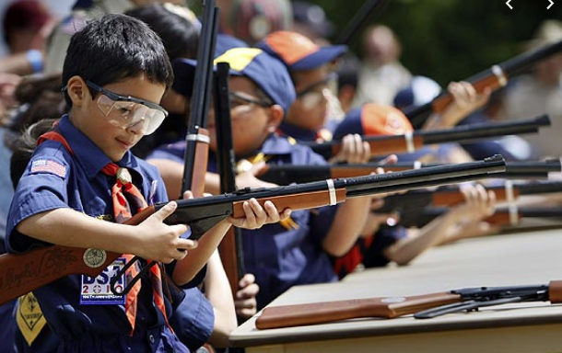
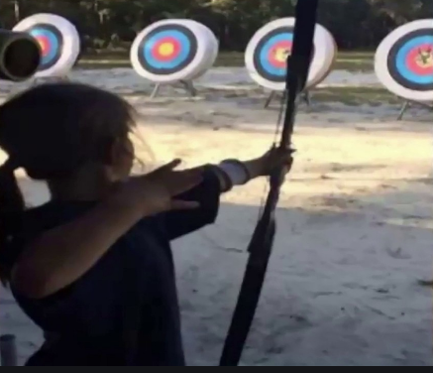
Shooting Sports
Requests for Shooting Events – Lead Time!
  50+ scouts - 6mos
  Less than 50 scouts - 3mos
Shooting on private land:
  Requirements
  Permissions/protocols
Shooting Sports web page
Shooting Sports Instructor Classes:
  Rifle/Shotgun - 02/24/24, 04/27/24, 07/20/24, 08/24/24
  Archery – 02/24/24, 03/18/24

Slide 21
Order of the Arrow
  Brian Fleck is Chapter Advisor.
  2024 Dues can be paid online: https://wipit470.org/dues.html
  The Amangamek-Wipit Lodge will be sending a contingent to the one-and-only National Order of the Arrow Conference (NOAC) next summer and we want you to join us! Registration is now open! Follow the directions below to register for the one and only 2024 National Order of the Arrow Conference (NOAC) at the University of Colorado at Boulder. Here are the steps to register for this once-in-a-lifetime opportunity!
Step 1: Click the registration link here!
Step 2: Fill out all information for the registration form.
Step 3: Congrats! You have reserved your spot for the 2024 NOAC! Look out for other emails in regard to both national registration AND further payments you may need to make! Can’t wait to see you there!!
If you have any questions regarding the National Order of the Arrow Conference email noac2024@wipit470.org
  Registrations open online https://wipit470.org/index.html under “Events”

Slide 22
OA – Lodge Master
Instructions for setting up a Troop in Lodge Master for upcoming O/A elections. They should have their election dates confirmed prior to setting this up.
  Log into Lodge Master (https://lodgemaster.oa-bsa.org/)
  Select “Inductions”
  Select “Visit & Election Management” (right side of the screen)
  Filter on “George Mason”
  Find your Troop and select “Edit”
  Scroll to the bottom of the page and enter your eligible Scouts information.
  Please include e-mail addresses for both the Scout and Parent. If no Scout e-mail is available, add the parents.
  Please add phone numbers.
  SAVE
You should be back at the 2024 Inductions page. If you are not, go back and repeat steps 1-4. At the top in the red banner, click on “Reports”
Print 2 copies of the Unit Election Report. The Election Team will sign both and give one to you at the conclusion of the election.
Print 1 copy of the Candidate Information Form. This is for the Election Team to use to verify the election results.
Click on the Unit Election Ballots and print that as many times as you need for all the Scouts in the Troop.

